Slide 1
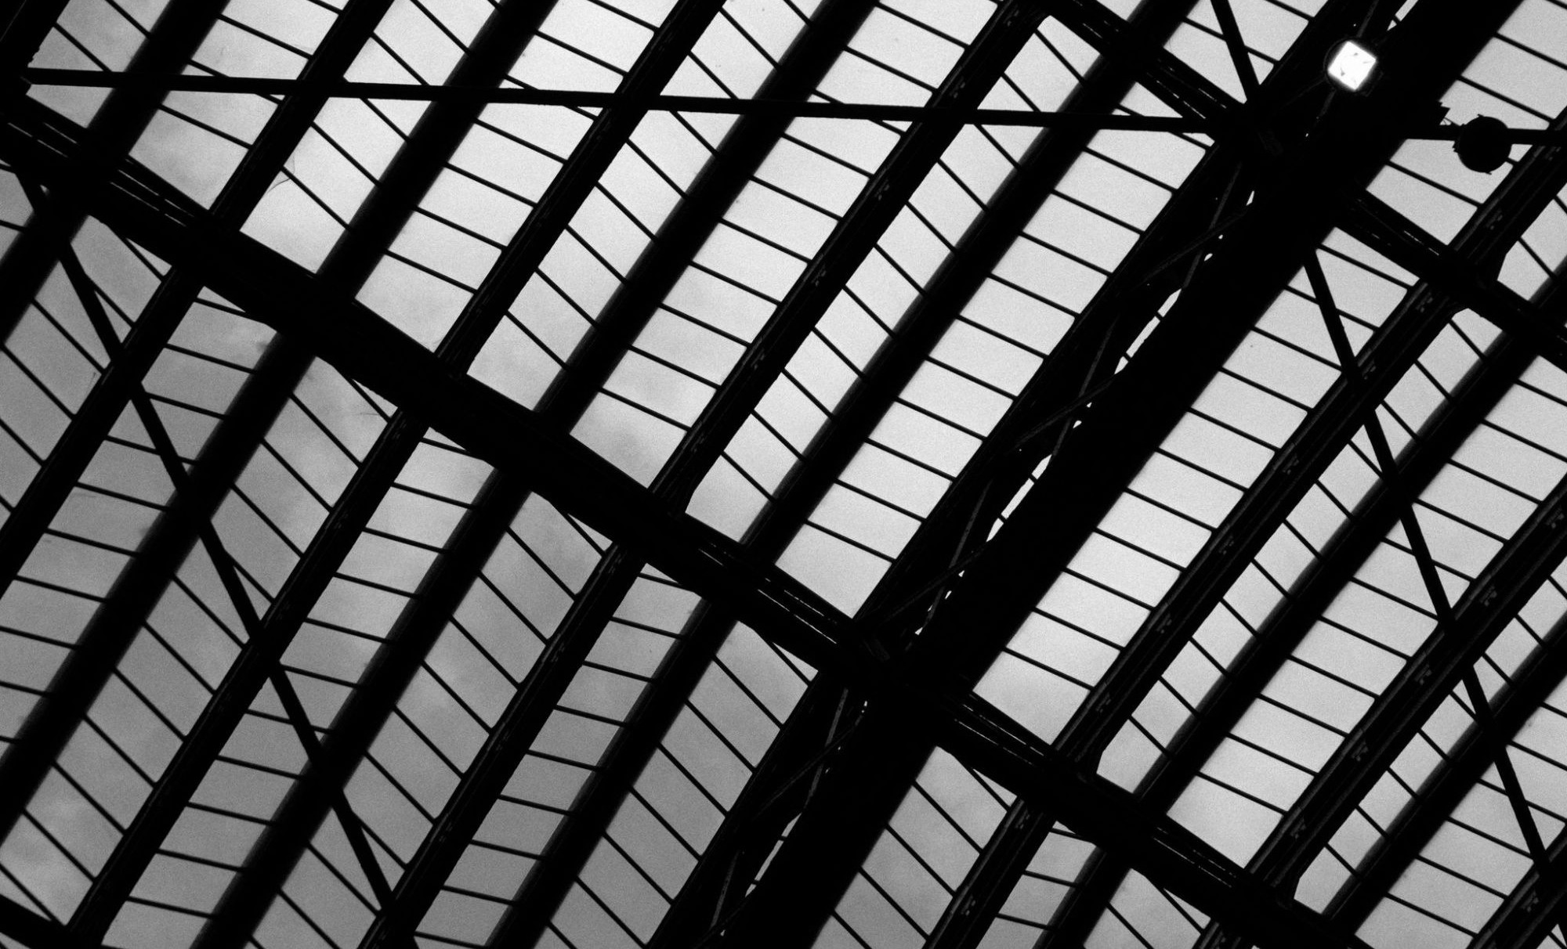
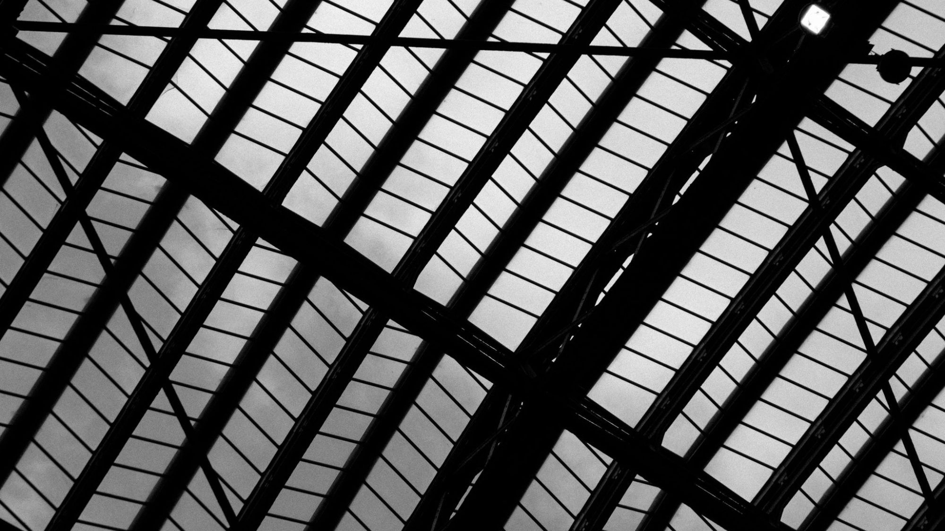
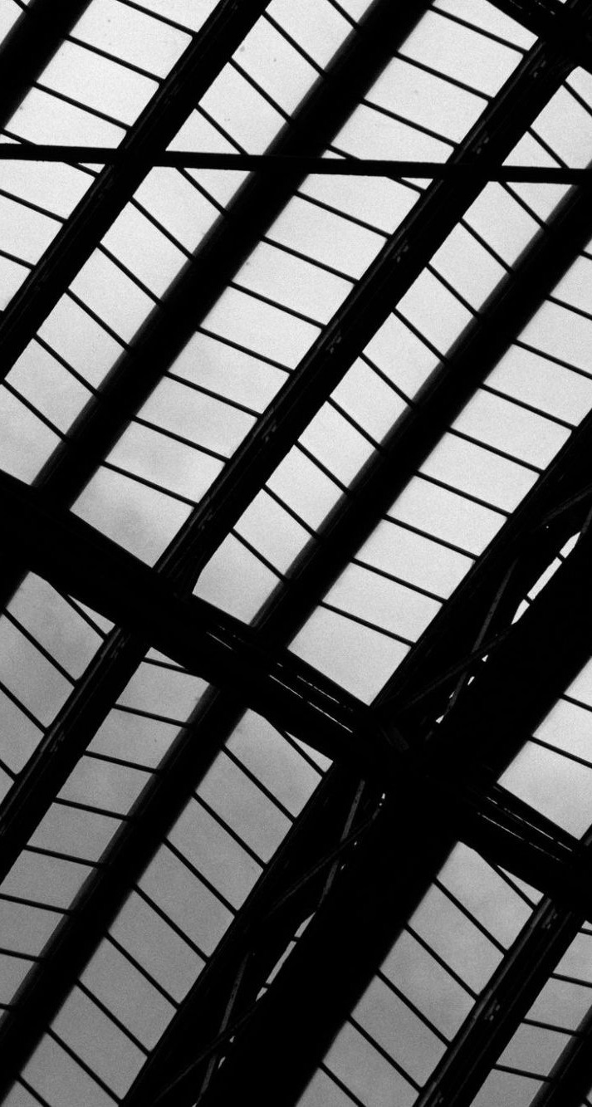
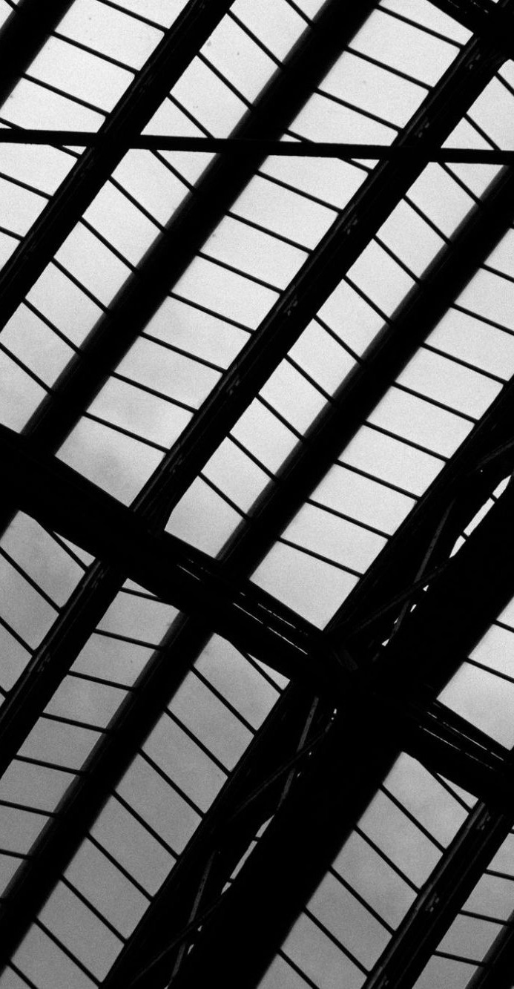







Images: Accountability Framework
HIDDEN SLIDE · IMAGES FOR THIS PRIORITY
One image for this priority. Use it on every slide of the priority: the divider, the header band, the update panel, and any split image or banner in a detail slide. This slide is hidden: it does not show when presenting.
Source image
Divider
Split image
Update panel
Header band
Banner (flow with banner)
Split image (full height): used by Split with points, Image and two phases, Six blocks and a takeaway, and Goal and three pillars. Banner: used by Flow with banner. Divider, header band and update panel: used on every slide in this priority.

