Slide 1
LOGIC PUZZLES!
Rachel Lawrence, Una Boyle, and
Genevieve Fowler
Yale Splash – April 6, 2013

Slide 2
Warm-up Puzzle
You meet two brothers. One of the brothers is named John
One brother always tells the truth, and one brother always lies.
You have only one chance to ask a single, 3-word question to one of the brothers.
Can you figure out whether John is a liar?

Slide 3
Strategy
1. Make a list of key information
2. Start out with an assumption
3. Go through all the possible outcomes (make a chart!)

Slide 4
Solution: “Are you John?”
 | John | Not-John
Liar | No | Yes
Truth teller | Yes | No
So, John is a liar if the answer to the question is No
If John is the one who tells the truth, the answer is Yes
Bonus question: Also using just one, 3-word question, can you figure out which of the two brothers is John?

Slide 5
100 Prisoners
There are 100 Martian prisoners in 100 separate locked cells. During the night, 100 prison officers visit the cells.
The first officer visits every cell.
The second officer visits cells 2,4,6,... etc (every 2nd cell)
The third officer visits cells 3,6,9,..etc (every third cell)
The fourth officer visits every fourth cell,
and so on until the 100th officer visits the 100th cell.
On a visit each officer unlocks the door if it is locked or locks the door if it is unlocked.
If the cell remains unlocked after all officers have completed their rounds, the prisoner can escape. In the morning, how many prisoners have escaped and why?

Slide 6
Lets look at the first 6 cells...
Cell Number:
1
2
3
4
5
6
Guard 1
Guard 1
Guard 1
Guard 1
Guard 1
Guard 1
Guard 2
Guard 3
Guard 2
Guard 5
Guard 2
Guard 4
Guard 3
Guard 6
Notes:
Write good points they make about these things on the board as they answer
-Did anyone notice the relationship between the cell numbers and the guard numbers which visit these cells?
- If they get stuck write out some more on the board with them up until nine
-next ask the 1st question again
-if they are still stuck ask them how many guards visit each cell and make a chart like thing on the board
-If still stuck: Has anyone heard of a factor tree? do factor tree for 6
-first thing to give away would be that the guard numbers who visit the cell are the factors of the cell numbers
-Does anyone have any ideas as to which prisoners escape now?
-If not: lets think about the number of guards that visit each cell again now that we know the guard numbers are factors
-So how many perfect squares are there between 1 and 100?

Slide 7
Lets look at the first 6 cells...
Cell Number:
1
2
3
4
5
6
Guard 1
Guard 1
Guard 1
Guard 1
Guard 1
Guard 1
Guard 2
Guard 3
Guard 2
Guard 5
Guard 2
Guard 4
Guard 3
...So the Martians in cells 1 and 4 escape.
What do those two cells have in common?
Guard 6
Notes:
Write good points they make about these things on the board as they answer
-Did anyone notice the relationship between the cell numbers and the guard numbers which visit these cells?
- If they get stuck write out some more on the board with them up until nine
-next ask the 1st question again
-if they are still stuck ask them how many guards visit each cell and make a chart like thing on the board
-If still stuck: Has anyone heard of a factor tree? do factor tree for 6
-first thing to give away would be that the guard numbers who visit the cell are the factors of the cell numbers
-Does anyone have any ideas as to which prisoners escape now?
-If not: lets think about the number of guards that visit each cell again now that we know the guard numbers are factors
-So how many perfect squares are there between 1 and 100?

Slide 8
Solution
So we know that the Martians who escape have an odd number of jailers visit and that the number of the visiting jailer is a factor of the cell number
The only Martians who escape have an odd number of visits, so they have an odd number of factors
Which numbers have an odd number of factors???
PERFECT SQUARES!!!!
How many perfect squares less than or equal to 100?
10

Slide 9
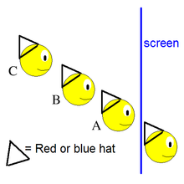
A Full Jail
There are four prisoners in the Yale Maximum Security Prison.
Three prisoners are placed in a line so that they can only see the people in front of them.
The fourth prisoner is put behind a screen and can see no one.
Two prisoners are given red hats, and two are given blue hats.
If one can correctly guess the color of his own hat, they all go free.
But, if a single person guesses incorrectly, they are all executed

Slide 10
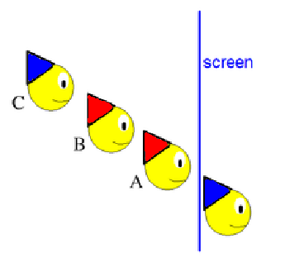
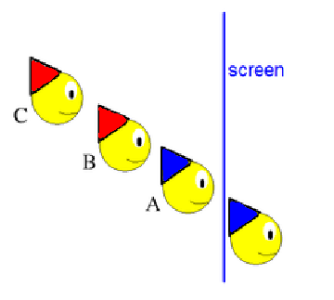
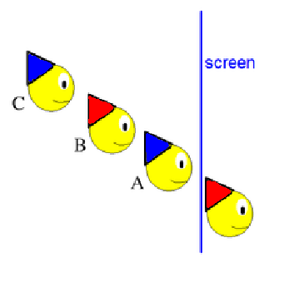
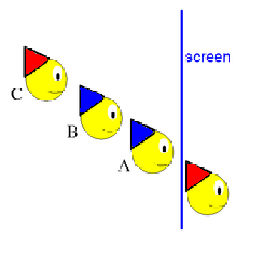
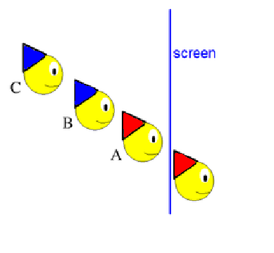
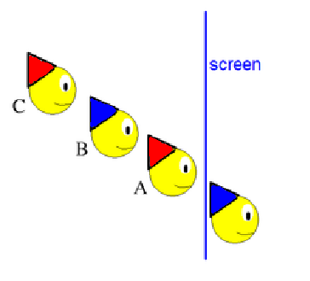
Strategy: Look at Two Cases
1
1
2

Slide 11
Case 1
A and B have the same color hat.
C sees them both and knows his/her hat can't be that color.

Slide 12
Case 2
A and B have different colored hats.
C cannot tell the color of his hat.
When B realizes that C is not answering, he/ she knows that A and B have different color hats.
B's hat is whatever color A's is not.

Slide 13
Black and White Hats
There is a group of people standing in line. Each is wearing a black or white hat, but can only see the color of the hats in front of them.
An interrogator will ask them the color of their own hat. If they answer incorrectly they will be eliminated. Each person hears the previous answers, but nothing else (not even the correctness of the previous answer).
The people are given time to decide on a strategy which will lead to as few eliminations as possible.
Interogator starts here

Slide 14
Solution
The first person said black, so he saw an odd number of black hats.
I see an odd number of black hats too, so my hat must be white.
If my hat had been black, he would have seen an even number of black hats, since I see an odd number.
The first person is essentially a sacrifice and answers black if the number of black hats he or she sees is odd.
Black

Slide 15
The Campers Problem
A counselor and a group of eight campers are lost in the woods.
They come to an intersection with four roads leading away (not including the one they came down)
Their camp is 20 minutes down one of the roads, but they do not know which one.

Slide 16
The Campers Problem
There is just one hour of daylight left, so there’s just enough time to split up, venture down a path, see if the campsite is there, come back, and then bring everyone back down the right road.
The problem is that two of the campers are not always truthful…and you don’t know which two they are! How do you divide the campers into groups so that you can tell for sure what road leads to the camp? Remember: The untruthful campers don’t always lie—sometimes they may tell the truth.
Liars???

Slide 17
Solution
Let's number the
campers 1 through 8
Sending the counselor down one road eliminates that path
Group the campers in two groups of three and one group of two
The counselor will ask the campers if they found the campsite.
4, 5, 6
1, 2, 3
7, 8
Counselor
Notes:
Class-room discussions about the problem usually lead to a solution similar to Dr. Ecco’s
(page 151 of Ecco). Here is the same solution, but with a diﬀerent slant, and it serves as a
good introduction to the notion of a Hamming distance.
Send campers number 1, 2, and 3 down road A, numbers 4, 5, and 6 down road B, and
numbers 7 and 8 down road C. (The counselor goes down road D and we may assume that
the camp is not down road D, otherwise there is no problem.)
The counselor asks each camper the following question:
Is the camp on the road that you went down?
The campers will answer 0 (= no) or 1 (= yes).
Suppose that all of the campers told the truth. Then the only possible answers would be

Slide 18
Solution
Let's number the
campers 1 through 8
4, 5, 6
We always know the counselor will tell the truth so we can essentially eliminate one path.
Path 2
1, 2, 3
Path 1
Path 3
7, 8
Counselor
Notes:
Class-room discussions about the problem usually lead to a solution similar to Dr. Ecco’s
(page 151 of Ecco). Here is the same solution, but with a diﬀerent slant, and it serves as a
good introduction to the notion of a Hamming distance.
Send campers number 1, 2, and 3 down road A, numbers 4, 5, and 6 down road B, and
numbers 7 and 8 down road C. (The counselor goes down road D and we may assume that
the camp is not down road D, otherwise there is no problem.)
The counselor asks each camper the following question:
Is the camp on the road that you went down?
The campers will answer 0 (= no) or 1 (= yes).
Suppose that all of the campers told the truth. Then the only possible answers would be

Slide 19
Solution
4, 5, 6
Path 2
In the case that the liars are telling the truth, the solution is straightforward.
1, 2, 3
Path 1
Path 3
7, 8
Camp Location | Answers: 1, 2, 3 | Answers: 4,5, 6 | Answers: 7, 8
Path 1 | Yes, Yes, Yes | No, No, No | No, No
Path 2 | No, No, No | Yes, Yes, Yes | No, No
Path 3 | No, No, No | No, No, No | Yes, Yes
Notes:
Class-room discussions about the problem usually lead to a solution similar to Dr. Ecco’s
(page 151 of Ecco). Here is the same solution, but with a diﬀerent slant, and it serves as a
good introduction to the notion of a Hamming distance.
Send campers number 1, 2, and 3 down road A, numbers 4, 5, and 6 down road B, and
numbers 7 and 8 down road C. (The counselor goes down road D and we may assume that
the camp is not down road D, otherwise there is no problem.)
The counselor asks each camper the following question:
Is the camp on the road that you went down?
The campers will answer 0 (= no) or 1 (= yes).
Suppose that all of the campers told the truth. Then the only possible answers would be

Slide 20
Solution
4, 5, 6
CAMP!
Path 2
Lets consider the case where one liar lies and the other tells the truth:
1, 2, 3
Path 1
Path 3
7, 8
Camp Location | Answers: 1, 2, 3 | Answers: 4,5, 6 | Answers: 7, 8
Path 1 | Yes, Yes, Yes | No, No, No | No, Yes
Path 1 | Yes, Yes, Yes | No, No, Yes | No, No
Path 1 | Yes, Yes, No | No, No, No | No, No
Notes:
Class-room discussions about the problem usually lead to a solution similar to Dr. Ecco’s
(page 151 of Ecco). Here is the same solution, but with a diﬀerent slant, and it serves as a
good introduction to the notion of a Hamming distance.
Send campers number 1, 2, and 3 down road A, numbers 4, 5, and 6 down road B, and
numbers 7 and 8 down road C. (The counselor goes down road D and we may assume that
the camp is not down road D, otherwise there is no problem.)
The counselor asks each camper the following question:
Is the camp on the road that you went down?
The campers will answer 0 (= no) or 1 (= yes).
Suppose that all of the campers told the truth. Then the only possible answers would be

Slide 21
Solution
4, 5, 6
CAMP!
Path 2
Now let's look at when both liars lie:
1, 2, 3
Path 1
Path 3
7, 8
Camp Location | Answers: 1, 2, 3 | Answers: 4,5, 6 | Answers: 7, 8
Path 1 | Yes, Yes, Yes | No, No, No | Yes, Yes
Path 1 | Yes, Yes, Yes | No, No, Yes | No, Yes
Path 1 | Yes, Yes, Yes | No, Yes, Yes | No, No
Path 1 | Yes, Yes, No | No, No, Yes | No, No
Notes:
Class-room discussions about the problem usually lead to a solution similar to Dr. Ecco’s
(page 151 of Ecco). Here is the same solution, but with a diﬀerent slant, and it serves as a
good introduction to the notion of a Hamming distance.
Send campers number 1, 2, and 3 down road A, numbers 4, 5, and 6 down road B, and
numbers 7 and 8 down road C. (The counselor goes down road D and we may assume that
the camp is not down road D, otherwise there is no problem.)
The counselor asks each camper the following question:
Is the camp on the road that you went down?
The campers will answer 0 (= no) or 1 (= yes).
Suppose that all of the campers told the truth. Then the only possible answers would be

Slide 22
Prisoners & Light bulbs
There are 100 prisoners who also happen to be Martians are in solitary confinement in Yale Maximum Security Prison.
The guard, at random intervals, randomly selects one of them and takes him out of his cell to a room with a single lightbulb, that starts OFF. The prisoner can then choose to toggle the state of the lightbulb (or he can do nothing).
If a person tells the guard when everyone has been to the cell everyone is freed.

Slide 23
Prisoners & Light bulbs
They are allowed one evening together to decide on a strategy.
What strategy should they follow to ensure that they all get released?

Slide 24
Solution!
Assign one person as the counter.
Each other person will go into the room and if he finds the light off, he will turn it on. Each person will only ever turn the light on once. Otherwise, he leaves it off.
Then each time the counter comes in, if he finds the light on, he will add one to his count and turn the light back off.
When he reaches 99, he can declare all 100 prisoners have been to the room.
Something extra to think about: on average, how long will this take? (There’s some cool math/statistics behind this!)

Slide 25

Thanks for coming!

