Slide 1

Controlling a Device Using Twitter
A Lamp

Slide 2
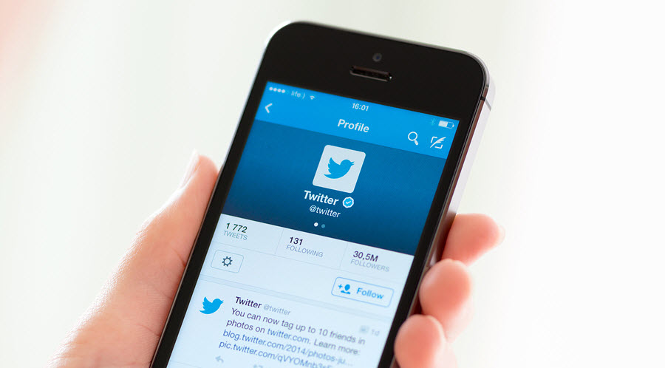
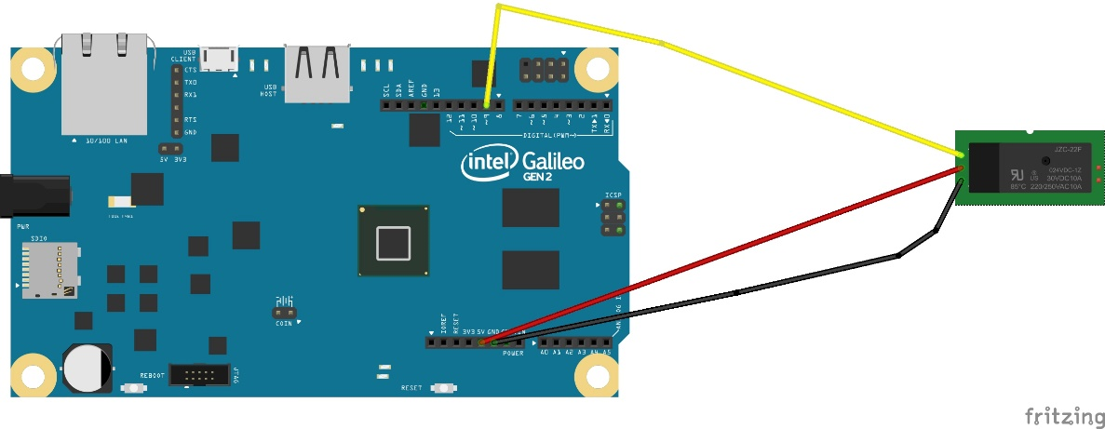
Design

Slide 3




Technology

Slide 4
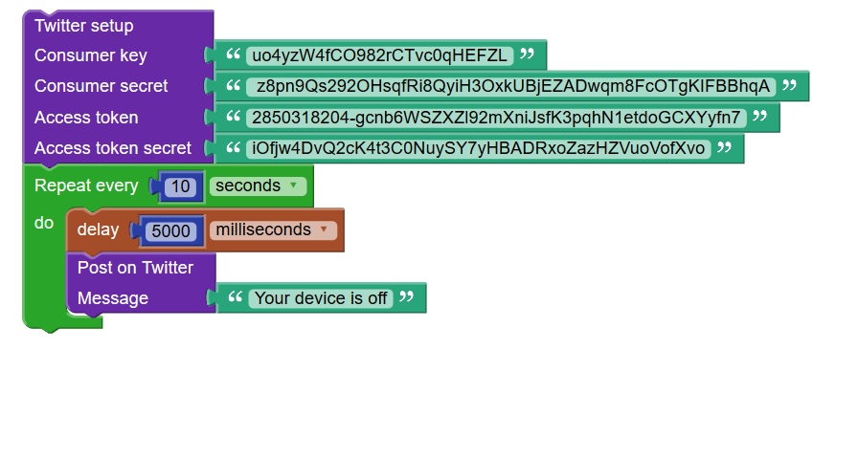
Skills
Programming
Computer Systems
Web Development
Physics
Project
YouTube

Slide 5
Progress
Completed
Goals
Relay controlling
Registered the application with twitter
Github Repository
Control the app from Twitter
Develop the web application

