Slide 1
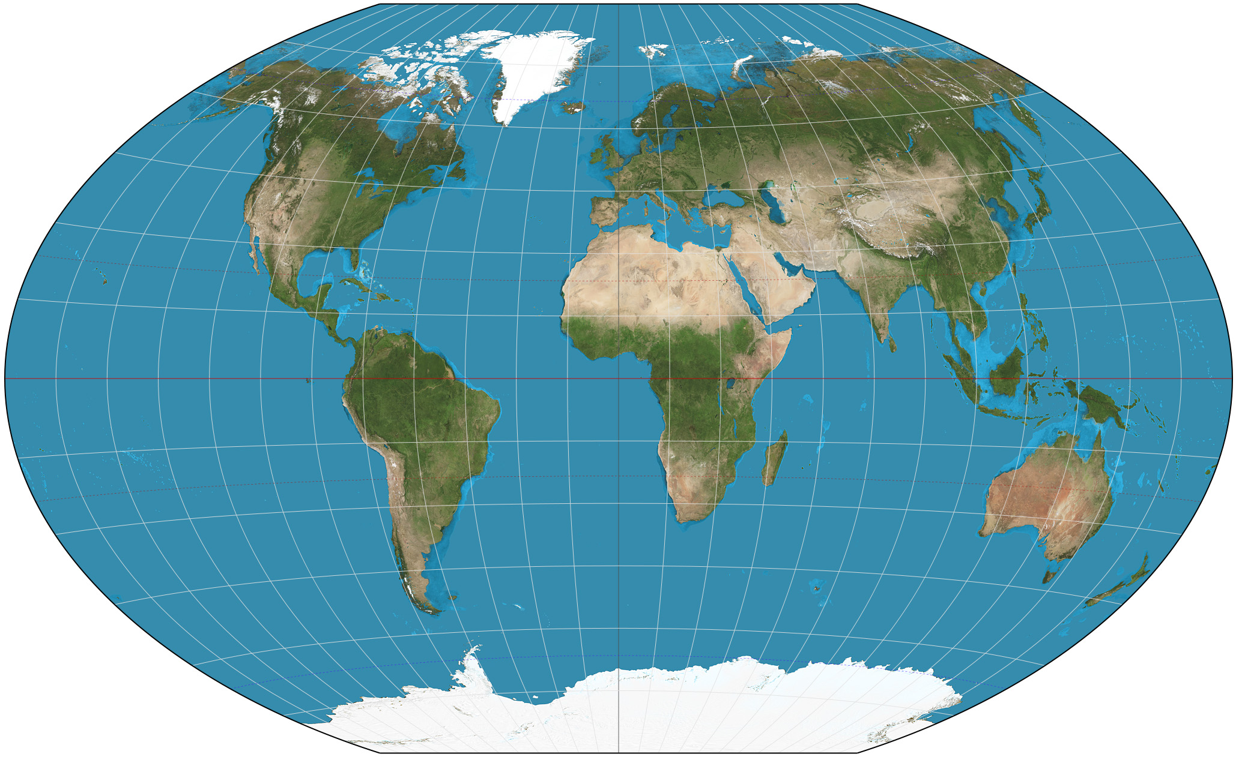
Spatiotemporal Epidemiology Methods
All pictures stolen from Google search. Tell no one.

Slide 2
What is Spatiotemporal Epidemiology?
Studies how disease patterns vary across space and time
Useful for identifying clusters, trends, and risk factors
Involves tools like mapping, statistics, and time-series models

Slide 3
Core Spatiotemporal Methods
1. Cluster Detection (SaTScan)
2. GIS Mapping & Interpolation
3. Regression Modeling
4. Time-Series and Lag Models
5. Multi-Method Comparisons

Slide 4
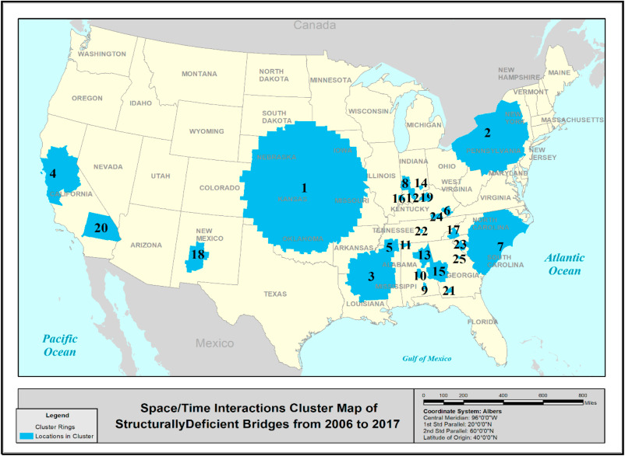
Cluster Detection with Spatial Scan Statistics (SaTScan)
Finds clusters of high disease rates using moving windows
Tests each zone for unusually high case counts
Uses Poisson or Bernoulli models

Slide 5
Multi-Method Comparison & Flexible Cluster Tools
Uses multiple scan methods for better cluster detection
PreCoG combines circular, elliptical, and flexible shapes
Flexible methods find realistic, irregular clusters

Slide 6
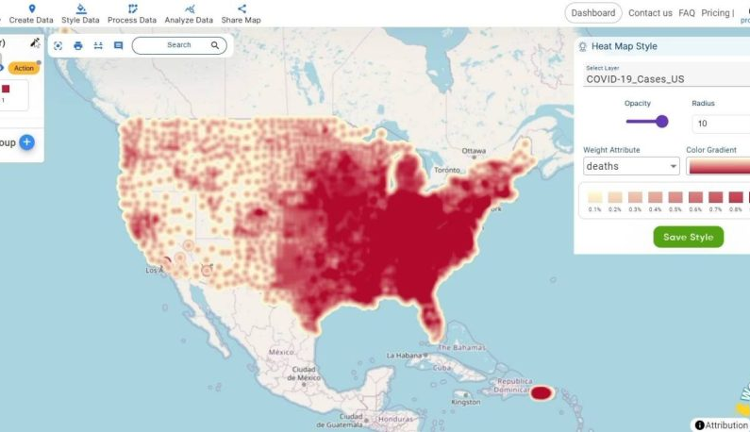
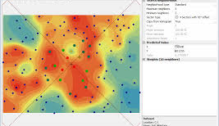
GIS Mapping & Spatial Interpolation (Kriging)
Maps environmental variables across space
Estimates exposure at unsampled locations
Assumes nearby values are more alike

Slide 7
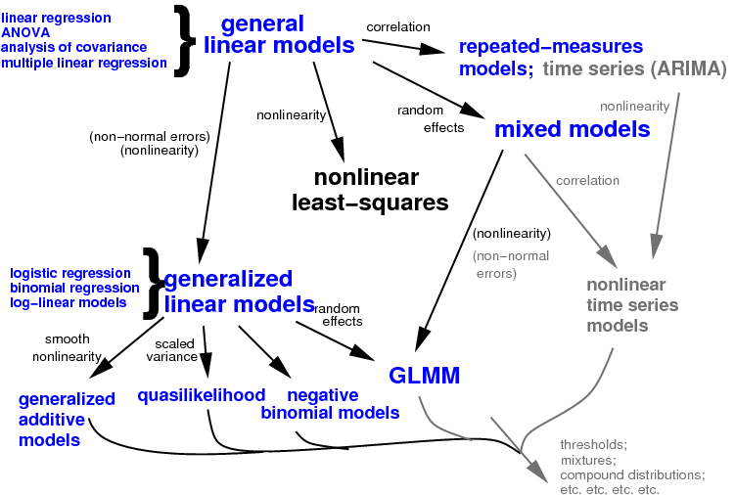
Regression Modeling (Logistic, Poisson, GLMM)
Explores associations between environment and disease
Logistic: yes/no outcomes; Poisson: counts
GLMM: includes random effects for clustering

Slide 8
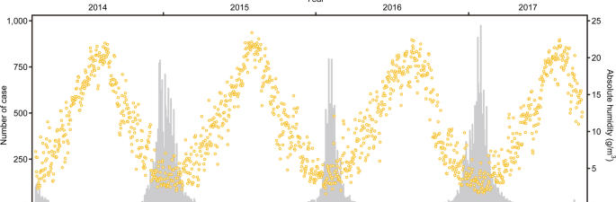
Time-Series & Lagged Climate Models
Studies delayed effects of climate on infections
Includes lagged predictors like rainfall months before
Uses GAMs and distributed lag models

Slide 9
Considerations for NTM
Dealing with both environmental and host effects
Time lag between environmental exposure and disease unknown.
Variable selection: we have so many climate variables…which are important?

Slide 10
Next time
Monday:
Review of today’s material
Review exercise: it will be nicer than today
Spatiotemporal variable selection
Three methods
Options for final models (such as GAM, GLM, or deterministic)
Tuesday:
Review and Q & A

