Slide 1
Understanding Regression
An Introduction

Slide 2
What is Regression?
Regression is the process of estimating the relationship between variables. In linear regression, we model the response as a linear combination of predictors.

Slide 3
Why Use Regression?
Regression helps us:
- Predict future values
- Understand relationships
- Identify important predictors
- Control for confounders

Slide 4
What is a Linear Model?
A linear model is a mathematical equation that describes the relationship between a response variable (Y) and one or more predictor variables (X). The form is:
Y = β₀ + β₁X₁ + β₂X₂ + ... + ε
Where:
- β₀ is the intercept
- β₁, β₂,... are the slopes (effects of each X)
- ε is the error term
A really fancy way of saying y = mx + b

Slide 5
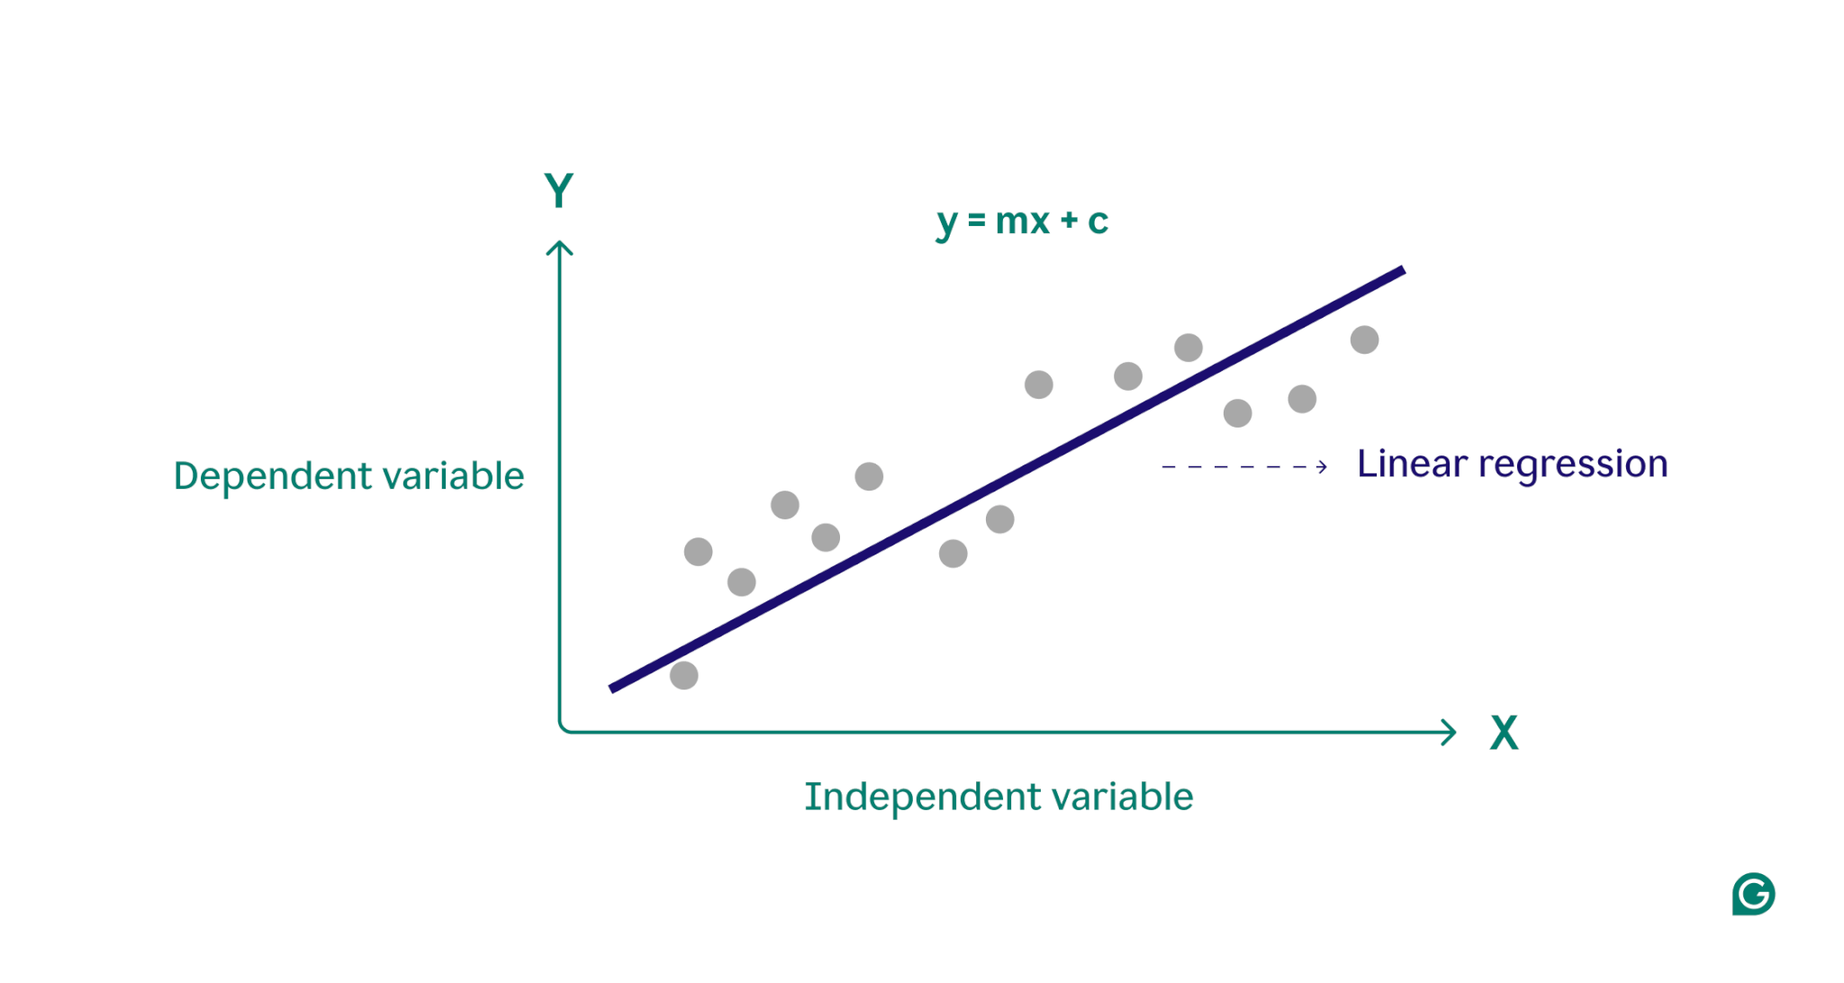
Visual Example of a Linear Model
Imagine plotting house prices (Y) against square footage (X). A linear model draws a best-fit line through these points.
Imagine plotting our NTM case rate against temperature, then drawing a line through the points

Slide 6
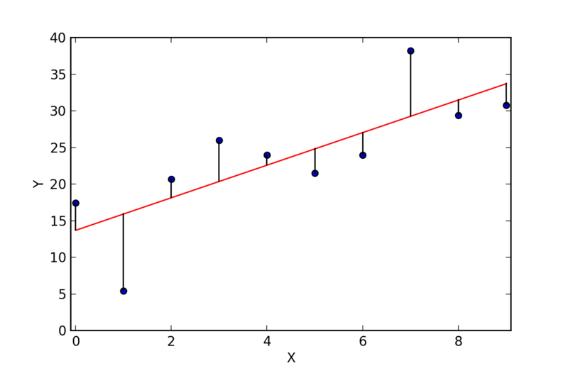
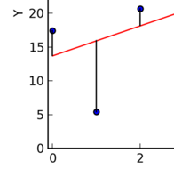
Here, the dot marks the actual data. At x = 1, y = 5. But the line is closer to 15.
The difference between 5 ( the real value) and 15 (the line value) is -10. Therefore, -10 is the error for this point. This is also called a residual value.
Errors can be positive or negative, depending on which direction you subtract in. We calculate error² , which is always positive. This is the squared error.
The best fitting line is the one that results in the smallest sum of all the squared errors. Also known as “least squares.”

Slide 7
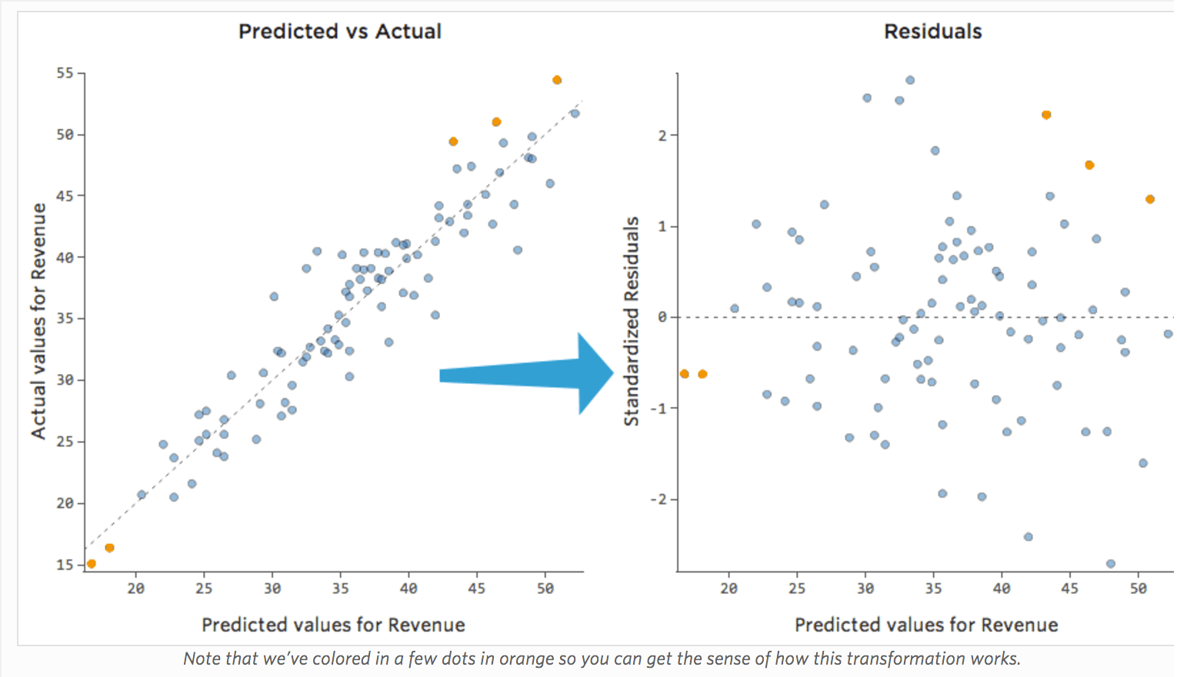
Plotting residuals can show patterns or violations of model assumptions.
A good residual plot has points scattered randomly around 0. Patterns indicate model issues.

Slide 8
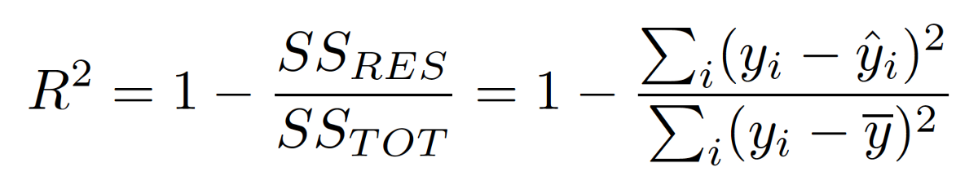
R-squared
R² tells us how much of the variance in the outcome is explained by the model.

Slide 9
Limitations of R-squared
R² always increases with more predictors. Adjusted R² accounts for the number of variables and can decrease if irrelevant variables are added.
This is related to the issue of bias/variance. The more variables you add, the closer the model gets to predicting your exact data set perfectly. We do not want too much of this bias… the final model will work well with your own data, but will not be generalizable.

Slide 10
AIC and BIC: Penalizing Complexity
Key takeaway:
AIC and BIC help us select the most parsimonious model.
Parsimonious means the model does well to describe our data with the least complex model (fewer variables).
AIC and BIC are only valuable relative to other AIC and BIC values. Meaning, if you run several linear models with the same outcome, you can compare the AICs or BICs of those models.
Lower AIC or BIC values indicate a more parsimonious model
AIC = 2k - 2ln(L)
BIC = ln(n)k - 2ln(L)
Where:
- k = number of parameters
- L = likelihood
- n = sample size

Slide 11
What Are Interaction Terms?
Interaction terms test whether the effect of one predictor depends on another.
In R: X1 * X2 = X1 + X2 + X1:X2

Slide 12
How Linear Models Handle Interactions
The model adds an extra term for the product of the interacting variables:
Y = β₀ + β₁X₁ + β₂X₂ + β₃X₁X₂ + ε

Slide 13
Log-Linear Models
We talked a lot about linear models. We won’t always be able to use them. In fact, we should only use linear models if we have a continuous outcome (rates work for this).
If we have count data (e.g., number of cases) we can use a log-linear model.
They model the log of the expected count:
log(Y) = β₀ + β₁X₁ + ...
A Poisson model is a log-linear model.

Slide 14
Logistic Regression
Similarly, we can’t use a linear model if we have a binary outcome (e.g., disease: yes/no).
Logistic regression is used when the outcome is binary.
They model the log-odds:
log(p/(1-p)) = β₀ + β₁X₁ + ...

Slide 15
Comparing Model Types
- Linear: continuous outcomes
- Log-linear: count outcomes
- Logistic: binary outcomes
Choose the model that matches the outcome type.

Slide 16
Example R Code: Linear Model
model1 <- lm(case_rate_100k ~ temperature + precipitation, data = data)
Interpreting a linear model is simple: We can use the coefficient values directly. If the coefficient for precipitation is 1.7, that means the case_rate increases by 1.7 for each additional inch of precipitation.

Slide 17
Example R Code: With Interaction
model2 <- lm(case_rate_100k ~ temperature + precipitation + (temperature * precipitation), data = data)
Interpreting an interaction is complex. A significant interaction term (p-value < 0.05) means the relationship between the predictors and the outcome is not uniform across all levels of the predictors. The effect of one predictor variable on the outcome is different depending on the level of the other predictor variable.

Slide 18
Example R Code: Log-Linear Model
model3 <- glm(case_rate_100k ~ temperature + precipitation, family = poisson, data = data)
Interpreting coefficients: Because log-linear regression models the log of the case count, we need to exponentiate the model coefficients.
For example, if the coefficient for precipitation is 0.025, we use exp(0.025), or 1.0253, to describe the effect of precipitation on case counts.

Slide 19
Example R Code: Logistic Regression
model4 <- glm(case_rate_100k ~ temperature + precipitation, family = binomial, data = data)
Interpreting coefficients: Because logistic regression models the log-odds, we need to exponentiate the coefficients for our variables. This gives us an odds ratio.
For example, if the coefficient for temperature is 0.003, the odds ratio for temperature is exp(0.003), or 1.003

Slide 20
Model Selection Strategy
- Start simple
- Add complexity (interactions, nonlinear terms)
- Compare using AIC/BIC
- Try building models on a subset of the data, and validating the model on the remaining data (this is called a train/test data split)
Do not try to compare models with different underlying assumptions.
Example: do not use AIC to compare a linear model to a Poisson model

