Slide 1

Orderly
Fast, flexible ordering for any business
Team 7 | Programming Capstone Project | CSC 289.0001 | April 30th, 2026
Kim Mayo · Kenny Bacdayan · Rachel Mizer · Tristin Gatt · Caleb Fowlkes · Serina Rodriguez (PM/SCRUM Master)
Notes:
🟡 SERINA
Hello, and welcome.
Today is a big milestone for our team — and we are truly excited to share what we've built.
My name is Serina
And I am the Project Manager and Scrum Master for Team 7: a group of six student developers formed together at Wake Tech Community College.
As “PM”, I was the main facilitator for our entire development process
— keeping us aligned, moving, and accountable from the our first planning meeting.. all the way to shipping: version 1.0.0 this week.
But before I talk about how we built it — let me tell you what we built…
🎬 NEXT SLIDE.. 😌 ⏭️

Slide 2
INTRODUCTION
What is Orderly?
Serina Rodriguez
PM | SCRUM Master
A centralized web application designed to streamline operations for small to mid-sized businesses.
5
Agile Sprints
The Problem
Small and mid-sized businesses lack affordable, efficient, and unified tools for managing orders, inventory, and customer-facing menus.
The result: manual processes, spreadsheet chaos, and no real-time visibility.
6
Team Members
Our Solution
15+
A flexible, full-stack self-service ordering and business management platform – built for real businesses, by a team of student developers.
User Features Done 🎉
Notes:
🟡 SERINA (continues..)
| 👀 READ the room:
| “Wait, so before I continue…
| let’s welcome Professor Tabbal and our spectators 😊
| We’re glad to have you here, thank you.”
So — what exactly is… “Orderly”?
At the start of this semester…
our class was surveyed, grouped, and handed..
a Software Requirements Specification developed by a separate group in previous semester.
…Our challenge was simple: make it happen.
What we were handed was a vision for a centralized web application —
one designed to solve a very real problem for small to mid-sized businesses.
Business owners were managing orders on paper, tracking inventory in spreadsheets, juggling tools that were NEVER meant to work together..
.. This meant manual processes.. missed orders.. and no real-time visibility.
Our job was to take that vision off the page… and then build it.
The final result?
Our software that stands today.. Orderly.
A flexible, self-service.. ordering and business management platform —
With ✨ a customer-facing storefront and a full business admin portal… built.. from the ground up..
Across Five sprints.
Six team members.
And over fifteen user features delivered.
Now, Let me walk you through exactly how we got there. -🌿 -- Breathe -- 🍃
🎬 NEXT SLIDE.. 😌 ⏭️

Slide 3
DEVELOPMENT PROCESS
Agile Workflow & Sprint Structure
Serina Rodriguez
PM | SCRUM Master
Iteratively built from the ground up.
S1
S2
S3
S4
S5
Foundation
Infrastructure & Data Layer
Engineering Backbone
Customer Experience
Business Admin
Architecture, Planning, Standards, Development Environment
Authentication, Database Management, UI shell
APIs, Authentication, Process Improvements & CI Pipeline
Storefront Page, Customer Order Flow, RBAC
Dashboard, Admin Settings, Product & Inventory Operations, Order Management & Sales Analytics
S1
S2
S3
S4
S5
Phase 4
Jan 31
Feb 14
Feb 28
Break
Mar 21
Apr 4
Apr 18
Apr 24 Code Freeze
Apr 25 Deployed
April 30 Presentation & Demo
5
14
5
30+
2
1
Sprints
Weeks
Sprint Reviews & Retrospectives
Team Meetings ~60 Daily Standups
Trello Boards
Product Development Plan
Notes:
🟡 SERINA (continues..)
Script:
Alright. So..
We followed an Agile Scrum methodology across five “two-week sprints”.. running from January through April.
Each sprint had a clear focus —
we started with Foundation: laying out our software architecture, team standards, and development environment.
From there, we built up our data layer… then our engineering backbone.. then the full customer experience… and then finally the business admin tools.
The timeline on this slide tells that exact story.
You can see.. the sprint milestones, our spring break, and then.. the final push —
Which Included a hard code freeze on April 24th, deployment on the 25th, and then… here.. where we stand today.
This was all built across Fourteen weeks where our team held Five sprint reviews and five more retrospectives,
Where I as PM facilitated over thirty team meetings using two “Kanban Trello boards” that served as our Team’s “process organization”.
Iteratively built, from the ground up.. All under one product development plan.
I'll now hand it over to Kim, our Product Owner,
to walk you through what we delivered and how we scoped it all out!
Kim, if you could please 🙂‍↔️
⏭️ UP NEXT: KIM
🎬 NEXT SLIDE.. 😌 ⏭️

Slide 4






KEY FEATURES
What Orderly Delivers
Kim Mayo
Product Owner
Customer Ordering
Admin Dashboard
Product & Inventory
Orders placed in seconds
One hub for everything
Full control, no guesswork
Self-service menu browsing · Customize, Place & cancel orders · Real-time Order Status
Unified overview · Quick access navigation · Role-based Views
Full CRUD management · Stock alerts · Category Organization
Sales Summary
Admin Order Management
Settings
Revenue clarity & Best Sellers at a glance
Nothing falls through the cracks
Your business, your settings
Revenue Trends · Order volume analytics · Date range filtering
Full order history · Status management · Customer detail view
Customer & Business Profile Config · Preference Management · Secure Updates
Notes:
Hi…! I’m Kim Mayo. ✨
Product Owner and Full Stack Developer for Orderly.
.. Let’s take a look at some of the key features that make up its system..
Orderly is designed around two main types of users:
customers and business users.
Orderly allows customers to browse products, customize items, and place orders with real-time updates.
For business users, we built an admin dashboard that provides a centralized view of the system, with role-based access and quick navigation.
Admins can manage products, inventory, and.. orders, including updating stock levels and tracking order activity.
We also included a sales dashboard
… to provide insights like revenue and order trends, helping to support better business decisions ✨
🎬 NEXT SLIDE.. 😌 ⏭️

Slide 5
PROJECT OVERVIEW
Epics & Delivered Features
Kim Mayo
Product Owner
What we set out to build — and what we delivered
Epic 1 & 2
Epic 3
Epic 4 · Part 1
Epic 4 · Part 2
Sprints 1–2
Sprint 3
Sprint 4
Sprint 5
Foundation & Auth
Customer Ordering
Business Admin — Access & Orders
Admin — Products & Reporting
Development environment & toolchain
Product browsing — categories & variants
Role-based access control (RBAC)
Product & variant mgmt — full CRUD
Database schema, seed data & migrations
Shopping cart — add, adjust, remove
Admin layout — sidebar & protected routing
Inventory — stock view, adjust, alerts
JWT auth — register, login, reset
Checkout — guest email & auth submit
Order management — history & status
Sales dashboard — revenue & best sellers
App shell, routing & nav structure
Order confirmation & status tracking
Mark Complete workflow
CI/CD pipeline — GitHub Actions Updated
4
25+
800+
50+
1,000+
1
Epics
User Stories
Code Commits
Backend APIs
Automated Tests
Living Backlog
Notes:
Now that we’ve looked at what Orderly does from a user perspective, let’s take a step back and look at the overall scope of the project.
Orderly is a full-stack system designed to be flexible and scalable.
We worked across four major epics and delivered over 25 user stories supporting both customers and business users.
As a team, we made over 800 code commits, reflecting strong collaboration throughout the project.
We also developed over 50 API endpoints and supported them with automated testing to ensure system reliability.
Finally, we maintained a living backlog to keep development aligned and up to date.
🎬 NEXT SLIDE.. 😌 ⏭️

Slide 6
PROJECT OVERVIEW
Scope & Product Decisions
Kim Mayo
Product Owner
How we kept the product focused, deliverable, and built right
🗂
MoSCoW Prioritization
🌊
Wave-Based Delivery
🔍
Scope Gap Ownership
Backlog discipline
Dependency-first planning
Product Owner catch
Product backlog maintained with MoSCoW priorities from Sprint 1.
Must-have features were protected every sprint; stretch items required an explicit greenlight before work could begin.
Sprint work split into waves with hard deadlines — Wave 1 backend APIs had to land before frontend work began.
Eliminated cascade failures seen in Sprint 3, from Sprint 4 forward.
Kim flagged critical scope gaps before they became blockers — most notably that Product Management had no variant interface.
Resolutions were drafted and merged into the sprint plan same day.
🔄
Carry-Over Triage
✅
Acceptance Criteria First
📋
Living Backlog
Sprint integrity
Definition of Done
Continuous refinement
Every sprint opened with explicit carry-over triage.
Sprint 4 was the first to close with zero carry-overs — a milestone reflecting both planning improvements and strong team execution.
Every user story included explicit acceptance criteria before development began.
No card moved to Done without a PR open, peer review complete, and all testing passed.
Product backlog treated as a living document throughout all five sprints.
User stories were refined, split, and re-scoped as the team learned — every change logged in the sprint plan.
Notes:
To make all of that possible, we had to be very intentional about how we managed scope and made product decisions.
We kept the project focused and deliverable throughout development.
We used Moscow to ensure critical features were completed first.
We also followed a wave-based approach, completing backend APIs before frontend integration to reduce blockers.
We made sure every feature had clear requirements before development began.
These decisions helped us stay organized and deliver a complete system.
🎬 NEXT SLIDE.. 😌 ⏭️

Slide 7




DEVELOPMENT HIGHLIGHTS
What We're Proud Of
Kim Mayo
Product Owner | Full Stack Developer
"I'm most proud of seeing all the components come together into a polished final product." – Kenny B.
API Contract discipline
Contribution Standards
Tristin owned and maintained a living API contract throughout the project. Every endpoint was documented and kept both frontend and backend in sync across all five sprints.
From Sprint 1, the team operated with a defined branching strategy, PR checklist, and code review standards. No code merged to main without a completed review and testing, every sprint.
Team Support
Testing and CI Integration
When team members needed to step back, support was advanced without hesitation. Ownership shifted seamlessly and the team finished stronger than it started.
Kenny delivered 1,000+ automated tests and maintained 90%+ coverage across both backend and frontend, with a GitHub Actions CI/CD pipeline validating every pull request.
Kim Mayo – Product Owner
A Product That Actually Feels Like One
Submitted team’s 1st PR! Stepped up as active PM when Serina was sick. Most active contributor by PR volume in Sprint 4. Flagged scope gaps before they became blockers. Delivered backend APIs, frontend pages, and code reviews every sprint.
Getting here took redesigns, dependency chains, a lot of iteration. The result is a two-side SPA – customer storefront + admin portal – where every screen is consistent, responsive, and role aware. The UI didn’t just get built; it got finished.
Notes:
Beyond how we built the system, we also want to highlight how we worked as a team.
One of our biggest strengths was maintaining a clear API contract, which kept the frontend and backend aligned.
We also followed strong development practices, including code reviews and testing before merging changes.
Our team collaborated closely, supporting each other and adapting quickly when needed.
From a personal standpoint, I worked across both the backend and frontend, contributing to API development and frontend integration. I also helped ensure that features worked together end-to-end, focusing on connecting components and maintaining consistency across the system.
Overall, what we’re most proud of is that this idea became a reality—a complete platform with both a customer interface and an admin portal that work together seamlessly.
Now, I’ll hand off to Rachel.
🎬 NEXT SLIDE.. 😌 ⏭️

Slide 8
FRONTEND & USER EXPERIENCE
User Experience
Rachel Mizer
Frontend & UI/UX Lead
🛍 Customer Experience
⚙ Admin Experience
Product Browsing
Admin Dashboard & Navigation
Category filtering · variant selection · availability display · image support · add-to-cart from list view
Role-restricted SPA routing · persistent sidebar nav · active link states · responsive layout wrapper · unauthorized redirect
Shopping Cart
Product Management
Persistent draft order · quantity adjustment · item removal · order total with tax · guest & authenticated checkout
Full CRUD for products & variants · inline validation · delete confirmation · image upload · modifier display (read-only)
Checkout & Ordering
Inventory Management
Guest email flow · authenticated one-tap submit · order confirmation · order status tracking
Stock level view · quantity adjustment · low-stock indicators · item detail editing · empty & error state handling
Customer Profile
Sales Dashboard & Orders
Account registration · login & logout · password reset · profile management · order history view
Revenue summary · best sellers · order list with status · Mark Complete workflow · date-filterable reporting view
🎨 Consistent Branding
📱 Responsive Design
🔒 Role-Based UI
⚡ State Management
Colors, typography & components unified across all views
Layouts adapt across desktop and mobile breakpoints
Admin views restricted; customers see only their flows
Loading, empty, error & success states on every view
Notes:
🟡 RACHEL:
As the UI/UX and frontend lead for Orderly, my work spanned the full customer-facing experience as well as the admin side of the application.
On the customer side, I built the storefront from the ground up — that's the page customers actually use to browse and order.
It features a product grid with category filtering, so customers can quickly find what they're looking for.
Each product has its own dedicated page where customers can customize their order — choosing modifiers like size, add-ons, or preparation options — before adding it to their cart.
I built the shopping cart with full modifier and pricing support, followed by checkout and order confirmation. Customers can also view their order history and cancel orders directly from the storefront.
On the admin side, I built a full suite of management tools.
The product catalog lets business owners add and edit products, manage variants, and set up modifier groups and options — all through a clean, guided form interface.
The supplier management pages let admins add and edit their supplier records with similar ease.
------------
🎬 NEXT SLIDE.. 😌 ⏭️

Slide 9
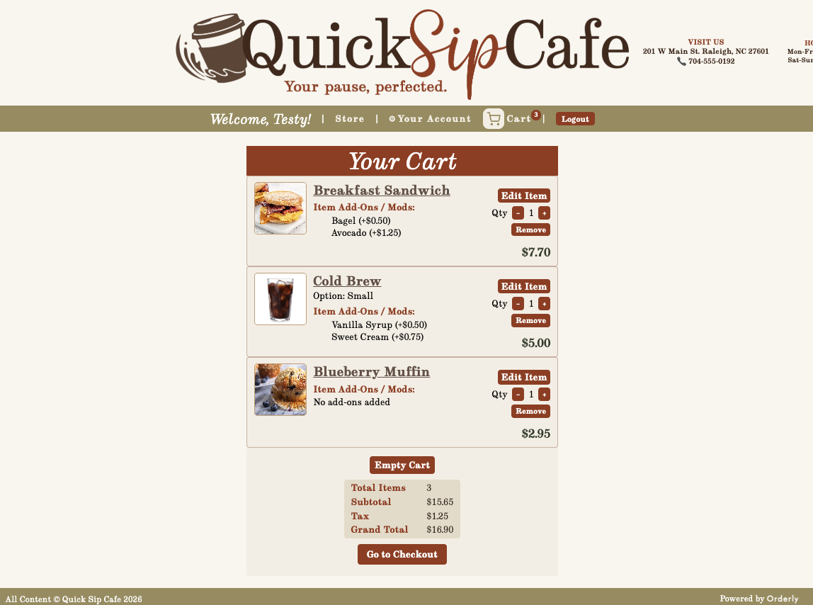
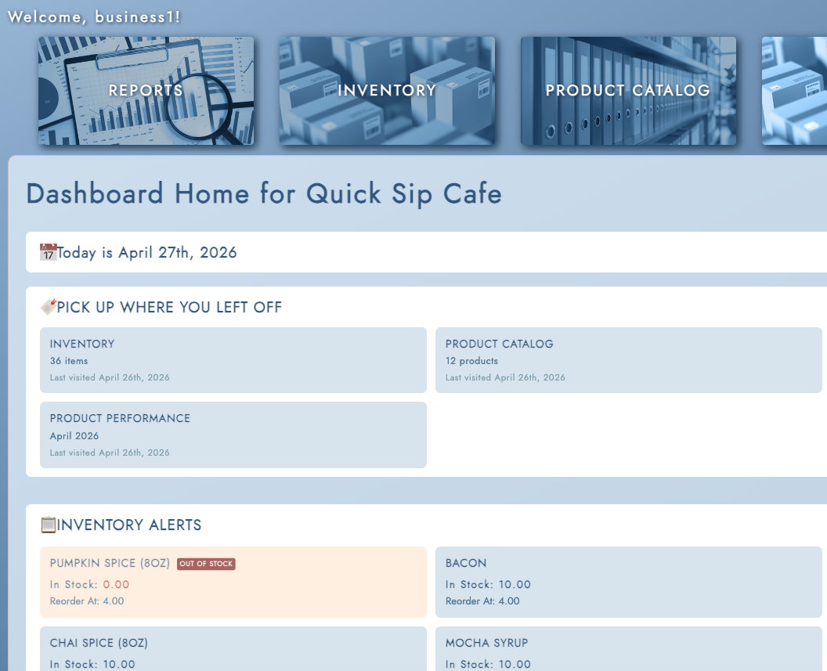
FRONTEND & USER EXPERIENCE
In Action
Rachel Mizer
Frontend & UI/UX Lead
Customer Storefront
Admin Dashboard
Product browsing · Cart · Checkout flow
Navigation · Role-restricted Views · Admin Layout
UI
UI
[ Replace with storefront screenshot ]
React SPA · SimpleJWT authentication · Role-enforced routing · Component-based architecture
Notes:
🟡 RACHEL
The inventory management page gives admins visibility into stock levels, handles ingredient dependencies, and surfaces low-stock alerts both inline and on the dashboard.
When items are running low, the admin dashboard flags them immediately, so nothing slips through.
I also built the sales and reporting features — including a sales summary dashboard with bar chart visualizations, month and year filtering, and a sortable product performance table.
Admins can export data and print reports directly from these pages.
------------------------------
🎬 NEXT SLIDE.. 😌 ⏭️

Slide 10
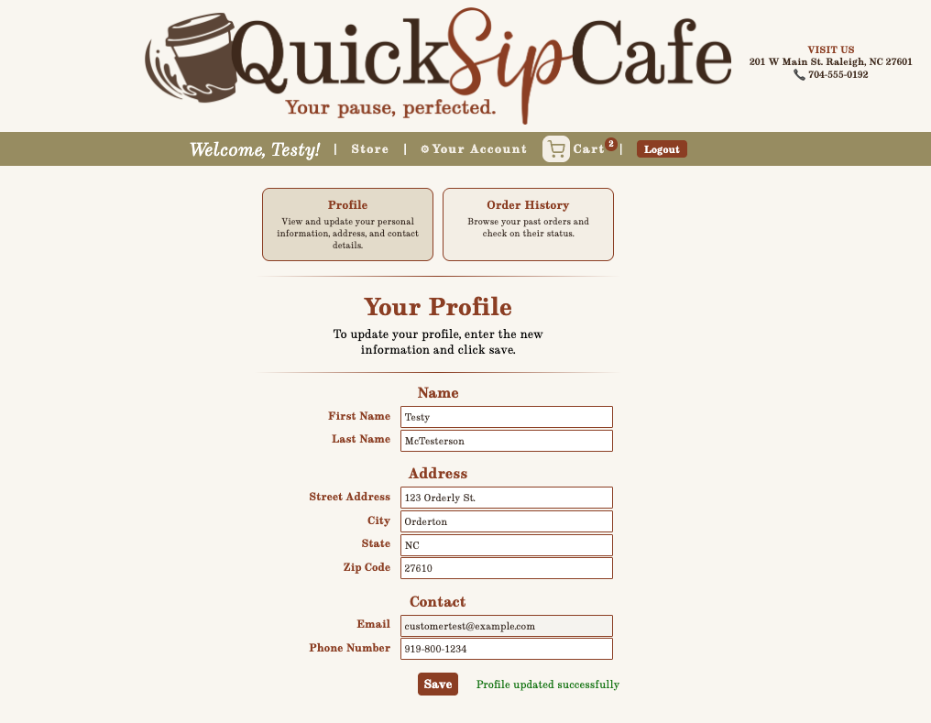
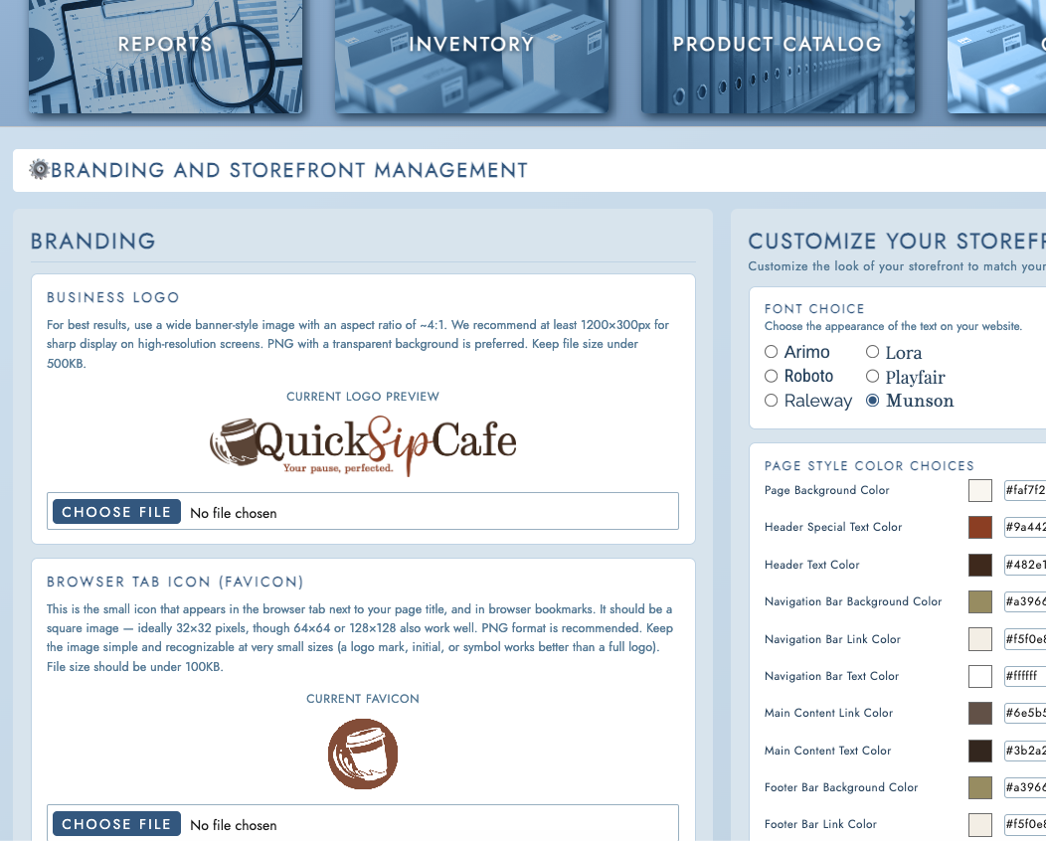
FRONTEND & USER EXPERIENCE
In Action
Rachel Mizer
Frontend & UI/UX Lead
Customer Profile
Business Tools
Account Management · Order History · Profile Editing
Product & Inventory Management · Sales Dashboard · Settings
UI
UI
[ Replace with customer profile screenshot ]
Branding consistent across all views · Loading, error & empty states on every page · 77+ automated tests passing
Notes:
🟡 RACHEL:
Beyond the feature pages, I handled the settings hub — business information, storefront branding and appearance, and account management
— all of which feed into the live storefront experience.
Finally, I built out a full in-app user manual accessible from the admin dashboard, covering every major section of the application with annotated screenshots and step-by-step guidance.
Throughout, I wrote and maintained frontend unit tests and automated UI tests using Robot Framework to make sure all of this held up as the application grew.
Thank you.
Frontend had to start somewhere, in the backend! Let’s hear from Tristin about how it all worked behind the scenes of UI..
----------
🎬 ⏭️ Up Next: Tristin Takes Control

Slide 11



ARCHITECTURE & DESIGN
Software Architecture
Tristin Gatt
Software Architecture & Backend Lead
Frontend
Backend
Database
React
Django + DRF
MySQL 8.0
SPA – Component Based – SimpleJWT auth
REST API – JWT auth – Business Logic
Relational Schema – Seed Data – Migrations
Tools & Stack
React
Django + DRF
MySQL 8.0
SimpleJWT
Robot Framework
GitHub Actions
APIs
REST · versioned at /api/v1/ · JWT-authenticated · role-enforced (Customer / Business / Guest)
POST
/api/v1/auth/login/
Issues JWT access + refresh tokens
JWT
GET
POST
PATCH
DELETE
/api/v1/products
Product catalog CRUD
Business
POST
PATCH
/api/v1/orders / orders/{id}/submit
Create & submit customer orders
Customer
GET
/api/v1/reports/sales · /low-stock
Sales summary & low-stock report
Business
GET
PATCH
/api/v1/inventory
Stock view & update
Business
Consistent error format across all endpoints: { "error": "ERROR_TYPE", "message": "Human readable message" }
Notes:
🟡 TRISTIN:
Thanks Rachel and good afternoon, everybody. I'm Tristin and I am the software architect for Orderly.
My responsibilities included articulating the software architecture to the team, designing APIs, and full stack development skewing towards the backend.
Orderly uses a RESTful, decoupled architecture with JSON token authentication.
The front and back ends communicate entirely through API calls.
This puts Orderly in a good position for future integration with other systems, namely point-of-sale systems
The backend receives API calls, runs business logic, accesses the database, and returns data in JSON format.
The frontend accepts user input, makes API calls, receives data, and constructs the UI to display that data.
Throughout development I designed about 50 APIs and implemented about one third of those in the backend. Those APIs drive all of Orderly's functionality from user registration to inventory management.
While most of the data model for Orderly was designed prior, I did make a second pass to ensure it could support user roles, product customization, and inventory tracking for products and product components.
🎬 NEXT SLIDE.. 😌 ⏭️

Slide 12
DEPLOYMENT
Deployment – Docker & AWS
Tristin Gatt
Software Architecture & Backend Lead
Containerize
Push to GitHub
CI Passes
Deploy to EC2
Connect RDS
Live on AWS
Docker bundles frontend & backend
GitHub Actions triggers on push to main
PyTest, NPM, Robot Framework all green
Docker containers run on AWS EC2 Instance
MySQL 8.0 database on AWS RDS
App live at: http://54.145.84.28:3000
Run It Yourself:
Deployment Target
git clone + docker-compose up
AWS EC2 (app) + AWS RDS (MySQL)
Dockerized frontend & backend
Environment Variables for secrets
The full application runs locally in minutes. Clone the repo, run Docker Compose, and the stack is live.
Link to Orderly: http://54.145.84.28:3000/
Deployed April 25, 2026. AWS deployment is live and functional. Image rendering requires a final polish pass -- the local build is the recommended demo environment and reflects the full, complete experience.
Notes:
For deployment and distribution, we opted to use Docker for its ability to replicate our development environment.
Currently, our distribution model includes the source code and Docker files. Installation is as simple as downloading the code, running a few docker commands, and configuring environment variables.
Towards the end of development, I deployed Orderly to AWS cloud infrastructure utilizing an EC2 Instance, a managed RDS, and two ECRs.
This deployment was not as refined as we'd like and misses some features, such as product images.
Orderly is live at the URL on screen and you're welcome to visit and explore Orderly's customer functionality.
With that, I'll pass it off to Kenny for quality assurance.
🎬 ⏭️Up Next: QA Practice (Kenny)

Slide 13




TESTING & QUALITY ASSURANCE
Our QA Strategy
Kenny Bacdayan
Quality Assurance & Testing Lead
Frontend Component Testing
Backend/API Testing
End-to-End Testing
Tool: Jest + React
Tool: PyTest + DRF
Tool: Robot Framework
626 Automated test passed
54 Test Suites passing
90%+ Test Coverage
UI, Routing, Validation, Admin pages tested
301 Automated tests passed
90%+ Backend Test Coverage
API Validation, RBAC, Inventory tested
Contract and Edge-Case coverage
166 Automated Tests passed
Critical Customer Workflows validated
Admin Workflows and Regression coverage
100% pass rate
QA Lead: Kenny Bacdayan
Lead the quality assurance strategy and test suite across all five sprints. Authored test plans, test cases, acceptance coverage reports, automated test coverage, and CI regression validation. Owned end-to-end QA coordination and helped drive release readiness with no critical defects open.
Thorough and consistent throughout. Results: 90% test coverage achieved.
Notes:
🟡 KENNY:
Thanks, Tristan — and thanks everyone.
Hi, I’m Kenny, and I served as the QA Lead for our project.
My role focused on developing and executing our testing and quality assurance strategy across all sprints to help ensure the system was stable, functional, and release ready.
Our testing approach used three layers of validation: frontend testing, backend/API testing, and end-to-end regression testing.
On the frontend, I built automated component and integration tests using Jest and React Testing Library, where we executed over 600 automated tests, maintaining over 90% test coverage while validating UI behavior, routing, and admin functionality.
For backend and API testing, I developed over 300 automated tests, also with 90%+ coverage, covering validation, role-based access control, inventory logic, reporting endpoints, and edge-case scenarios.
For end-to-end testing, I built and ran 166 Robot Framework tests, validating critical customer workflows, admin regression scenarios, and full system interactions, with a 100 percent pass rate.
In addition to automation, I led QA coordination by creating test plans, test cases, testing matrices, acceptance coverage reports, and supporting CI regression validation to help drive release readiness with no critical defects open.
🎬 NEXT SLIDE.. 😌 ⏭️

Slide 14



TESTING & QUALITY ASSURANCE
QA in Practice
Kenny Bacdayan
Quality Assurance & Testing Lead
Issue Discovered
Detection & Validation
Resolution & Impact
Defect Summary
During Admin RBAC testing, QA found logged-out users could access /admin/products instead of being redirected to login.
A high-severity bug report was created with reproduction steps, expected vs actual behavior, and security impact.
Validation Approach
The issue was traced to route protection and access control logic.
After the fix was implemented, it was validated through manual retesting and automated regression testing across unauthorized access scenarios.
Outcome & Coverage
Unauthorized access was blocked and RBAC behavior was corrected.
Regression coverage and related test cases were added to prevent recurrence and strengthen admin security validation.
Key QA Highlight: Security and Regression Validation
“Quality assurance is not just about testing expected behavior — it’s also about validating failure paths and catching risks before users do.”
Discover → Report → Fix → Retest → Document & Expand Test Coverage
Notes:
To show how that worked in practice, here’s one example from our Role Based Access Control testing.
During admin access validation, I identified a defect where logged-out users could directly access an admin route instead of being redirected to login, which introduced a security risk.
I documented the issue through a bug report with reproduction steps and impact. The issue was traced to route protection logic and a fix was implemented. Afterward, I validated the solution through manual retesting and automated regression testing. Then, just as importantly, we added test cases and expanded coverage so the issue wouldn’t reappear.
That reflects our QA workflow: Discover, Report, Fix, Retest, and Expand Test Coverage.
For me, that captures how QA supported the project — not just identifying issues, but improving long-term reliability throughout development.
And with that, I’ll hand it over to Caleb, who will walk through User Feedback. Thank you.
🎬 ⏭️Up Next: Caleb

Slide 15
USER FEEDBACK
How Feedback Shaped the Product
Caleb Fowlkes
Code Review Lead & Database Specialist
Our feedback loops came from within: sprint reviews, retrospectives, code reviews, and Trello.
Sprint 3 Review
Sprint 3 Retrospective
Customer ordering flow — testers completed orders without instruction. UX approach confirmed on track.
Cards mixing frontend and backend tasks caused confusion. Kenny flagged that features arriving late created a QA crunch.
Process Change
Cards split into explicit Frontend/Backend tracks from Sprint 4. Wave deadlines enforced to protect QA time.
Sprint 4 Review
Sprint 4 Review → Sprint 5 Action
Product CRUD performed consistently across create, edit, and delete. Confirmed production-ready with no iteration needed.
Admin dashboard navigation needed clearer labeling. Rachel flagged visibility gaps; Tristin suggested Trello labels for bug-found-in-review states.
Sprint 5 Action
Feedback logged as Sprint 5 UX cards (UX5.1). Resolved before code freeze.
Sprint 5 Review
Code Review Process
Sales dashboard charts and date filtering were praised as genuinely practical for non-technical business owners. No changes requested.
24-hour review turn around with structured GitHub PR feedback — approve or request changes — enforced from Sprint 1. No code merged to main without a completed review.
Consistent Result
Every sprint closed with full PR coverage. Sprint 5: 16 PRs reviewed, 0 unreviewed merges.
Notes:
🟡 CALEB: two slides total! One more after this one.
“””
“””
NOTE: Transition to your next slide please
🎬 NEXT SLIDE.. 😌 ⏭️

Slide 16
FUTURE PLANS
What’s Next: Orderly v1.1
Caleb Fowlkes
Code Review Lead & Database Specialist
Deferred scope, known gaps, and natural next steps identified during development
📋 Deferred Features
🔧 Quality & Stability
🚀 Longer-Term Vision
Cut to protect delivery
Gaps identified during testing & review
Natural growth from the current foundation
Modifier Management
Payment Integration
AWS Production Deployment
Admin UI for creating and editing product modifiers — data model is ready, UI was deferred.
Replace the payment simulation with a real processor — Stripe or equivalent.
Docker images and ECR pipeline are built — EC2 + RDS deployment is fully documented.
Update!
Deployment is LIVE. Requires minor image support
Supplier Management
GitHub Issues for Bugs
Mobile App
Full supplier CRUD was out of scope for v1.0. Backend model exists and is integration-ready.
Formal defect tracking was missing — link bug reports directly to PRs and branches.
The SRS scoped a mobile-first design — the modular API makes a React Native frontend straightforward.
Email Notifications
Integration Docs
Multi-Business Support
Order confirmation and status emails — backend hooks are in place; delivery layer is next.
A frontend/backend architecture walkthrough would accelerate onboarding for any new contributor.
A tenant model would let Orderly serve multiple businesses from a single deployment.
Notes:
🟡 CALEB: last slide!
“””
“””
”Now back to our PM as she guides us through our final messages ”…
🎬⏭️ Up Next: Wrap UP (Serina)

Slide 17
Conclusion
What We Built. What We Learned.
What We Built
What We Learned
A full-stack ordering platform — React SPA, Django/DRF backend, MySQL 8.0, deployed on AWS via Docker
Dependency-first planning eliminates cascade failures — wave-based delivery transformed our Sprint 4 and 5 execution
Two distinct user experiences: a customer storefront and a role-restricted business admin portal
Vocabulary matters: understanding APIs, endpoints, and contracts earlier would have accelerated cross-functional work
50+ REST API endpoints at /api/v1/, JWT-secured, with a living API contract maintained across all 5 sprints
Collaborative development is a skill — communication, PR habits, and daily check-ins improved meaningfully sprint over sprint
1,000+ automated tests: 301 backend (Pytest), 626 frontend (Jest), 166 end-to-end (Robot Framework) — 90%+ coverage
Agile works when the team owns it — retrospective actions were documented and acted on, not just noted
Orderly Version 1.0.0 — released April 25, 2026
We built something real. A platform that looks, works, and ships like professional software.
Thank you for your time and attention. We welcome any questions.
Team 7 · CSC 289.001 · WTCC · April 30, 2026
Notes:
🟡 SERINA: This slide, then demo, then questions!
Thank you so much Caleb, and to my entire Orderly team for bringing us to this closing moment.
Now, before we present a live demo of our software and then.. open the floor for questions…
I want to close out with what this experience actually taught us.
To start our list..
Dependency-first planning changed how we worked.
..early in the project, we learned the hard way that when one piece arrives late… everything downstream stalls.
.. Wave-based delivery fixed exactly that — and it's something I’ll remember in every project I manage moving forward,
or at the very least… having a contingency plan and map for dependencies.
..Another moment showed us that..
Vocabulary matters a lot more than we expected. Understanding the language of APIs, endpoints, and contracts much earlier would have saved us real time across the team.
It is understood that communication only works when everyone is speaking the same language.
Next, a lesson I found crucial:
Collaborative development is a skill — and it's one that we built sprint over sprint.
This surfaced in better PR habits, better communication, and.. better problem-solving and it didn't happen overnight…. but it happened.
And lastly…
Agile works when the team owns it.
We didn't just note our retrospective actions. We acted on them. Every sprint closed better than the one before it.
Together, we built something real. A platform that looks, works, and ships like professional software.
And we built it together — as academic software developers. 👏
built and delivered by your team of dedicated Project Capstone students.
Thank you.
Before we open the floor for questions, We'll now bring everything together with a demo, brought to you by our frontend lead, Rachel Mizer—
… Please let it be known that at this point, after our demo, we should have about ~_____ minutes for questions. (add 5 minutes to current time!)
Rachel, when you’re ready…
🎬⏭️ Up Next: Rachel with our demo!

Slide 18

Questions?
We'd love to walk you through a demo or answer any questions.
Serina Rodriguez
Scrum Master / Project Manager — Team 7
CSC 289.0001 · Wake Technical Community College
Orderly is proudly brought to you by Team 7 | Kim Mayo · Kenny Bacdayan · Rachel Mizer · Tristin Gatt · Caleb Fowlkes
Notes:
All team members should be prepared to step forward to answer any questions respectively
🟢 SERINA: [Take control — advance to Questions slide]
Thank you, Rachel — for not only putting that together, but for running it live in front of everyone today.
That demo represents what this whole project has been about. Real software, built by a real team, working exactly as intended.
And with that, Team 7 is ready for your questions.
I'll be directing questions to whoever is best positioned to answer — so don't hesitate to ask about any part of what you've seen today, whether that's the product, our process, or how we got here.
We have approximately _____ minutes. The floor is yours Professor.

