Slide 1
Decision Trees for Hospital Capacity Meeting
18th August 2023

Slide 2
Recap
Have three broad categories of classifiers covering three time periods
“Naïve” classifier: only uses whether current hospital capacity exceeds 15/100k
“Optimized CDC” classifier: uses new weekly COVID-19 cases, hospital admissions, and the percent of inpatient beds used by COVID-19 patients
+ “Enhanced” classifier which uses whether current hospital capacity exceeds 15/100k
“Full” classifier with cases, deaths, admissions, beds, ICU beds, % of beds, change in these metrics, and whether current capacity exceeds threshold
Three possible time periods:
Period
Exact
Shifted

Slide 3
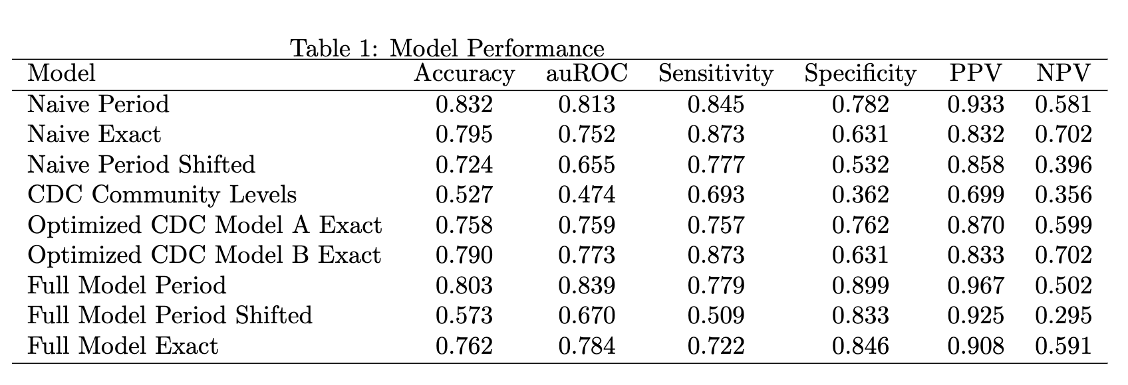
Decision tree performance

Slide 4
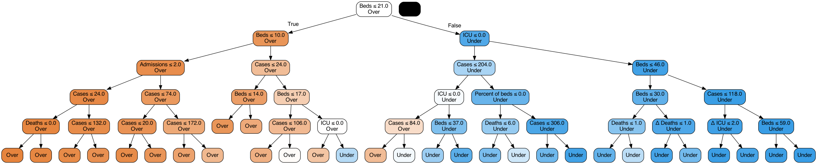
Complexity vs performance
“Full” classifier, 3-week period
Cost complexity pruning using 10-fold cross validation
Harder to interpret…

Slide 5
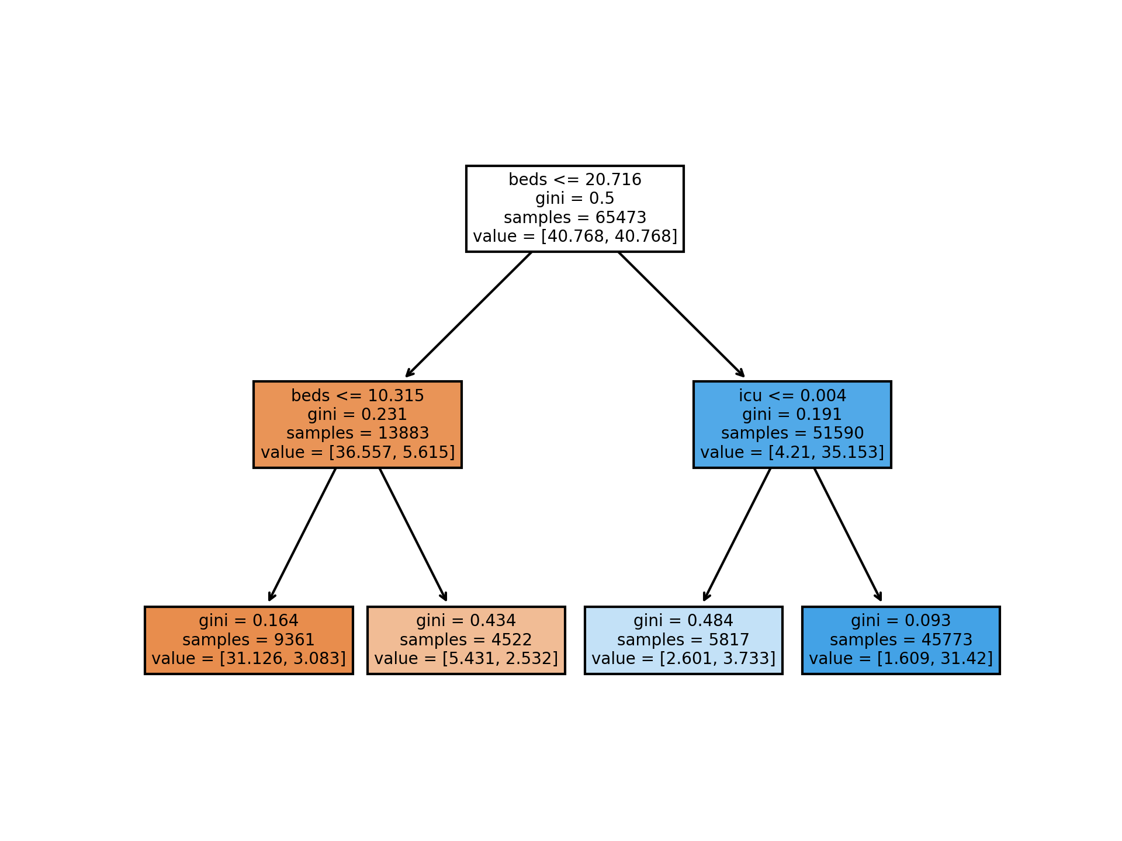
Complexity vs performance
“Full” classifier, 3-week period
Overfitting minimized by setting max. depth of tree to 4
Easier to interpret…

Slide 6
“Restricted” classifier – max. depth of 4
 | auROC | Accuracy | Sensitivity | Specificity | PPV | NPV
Pruned | 0.839 | 0.803 | 0.779 | 0.899 | 0.967 | 0.502
Max. depth | 0.83 | 0.80 | 0.77 | 0.89 | 0.97 | 0.49
Trade-off between interpretability and predictive power?

Slide 7
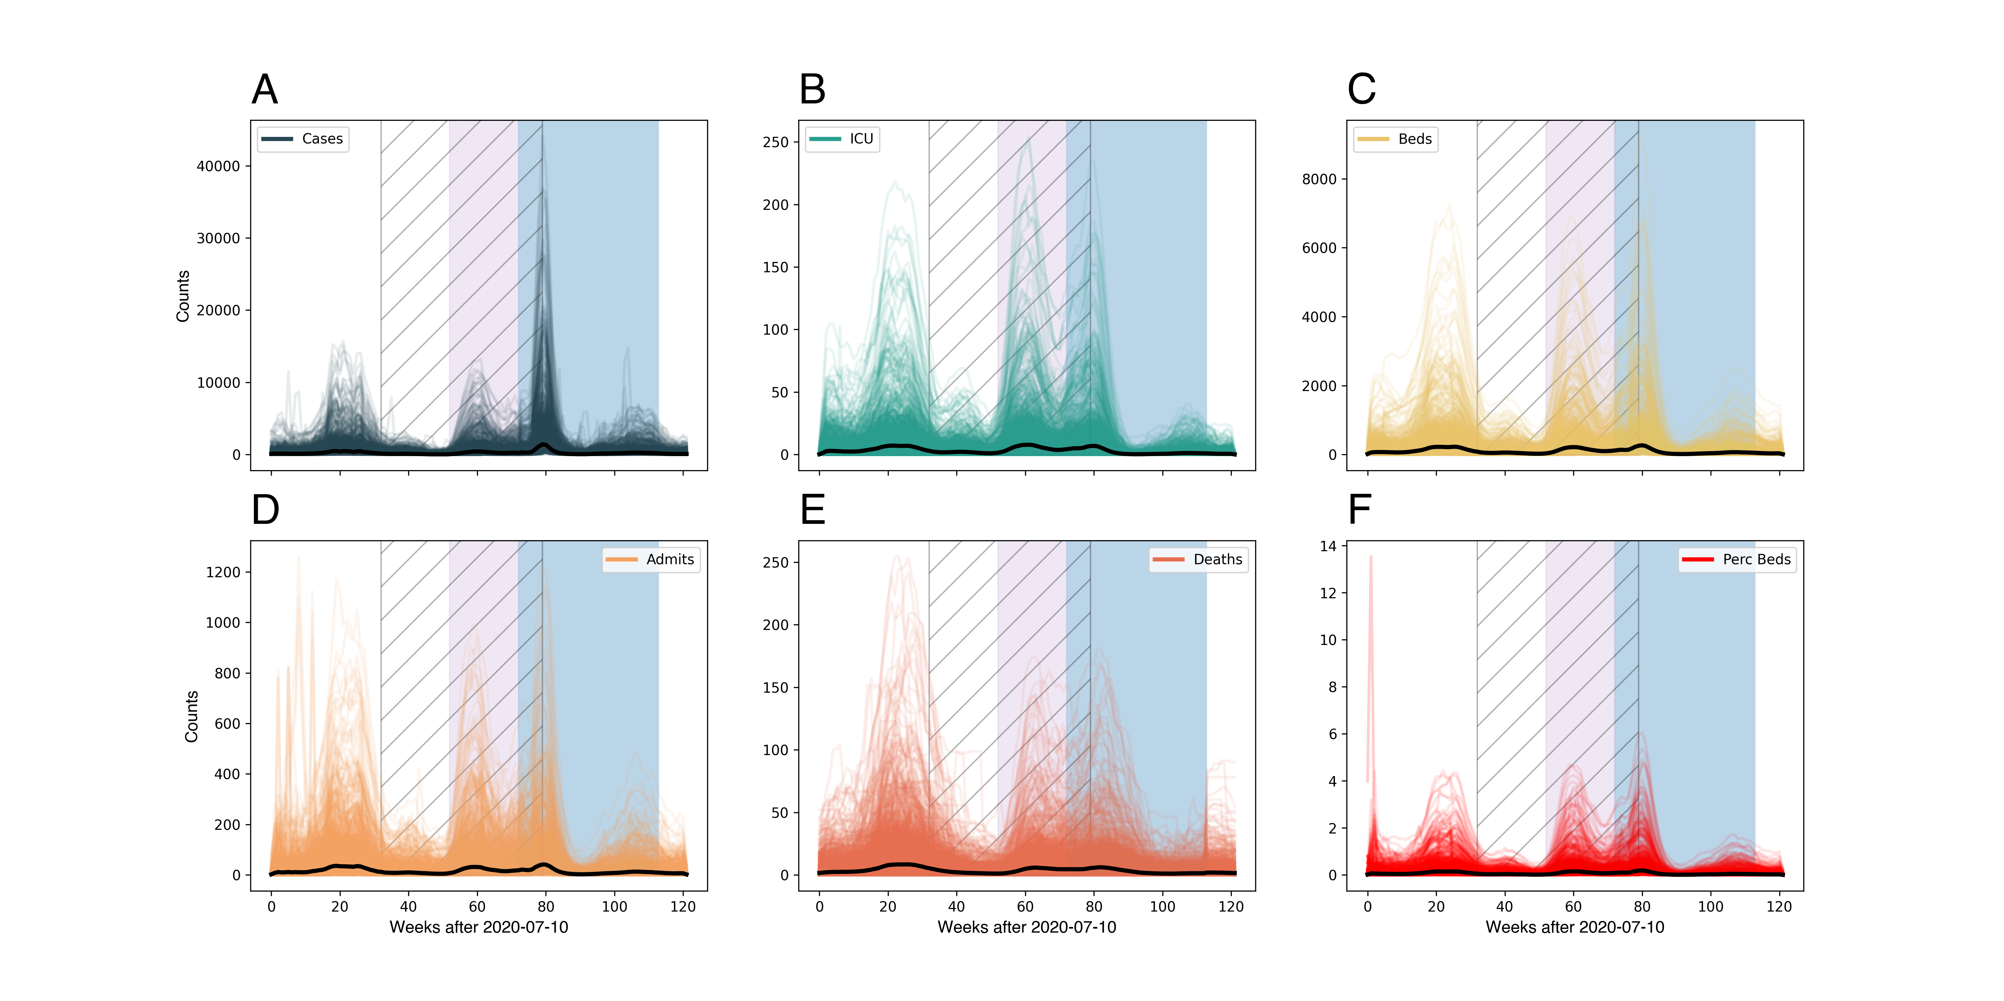
CDC Classifier Time Period
 | CDC Time Period (% exceeded) | Entire 123-period (% exceeded)
High | 81.1 | 69.7
Medium | 85.5 | 66.0
Low | 71.0 | 63.8
Using only the CDC period improves predictions for “High”, but also increases the false negatives (low + high)
Community Levels stopped surge in omicron cases

Slide 8
Strain-specific train/test periods
Used all data up to two weeks before it became “dominant” strain

Slide 9
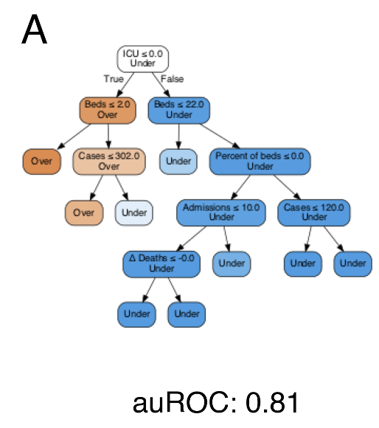
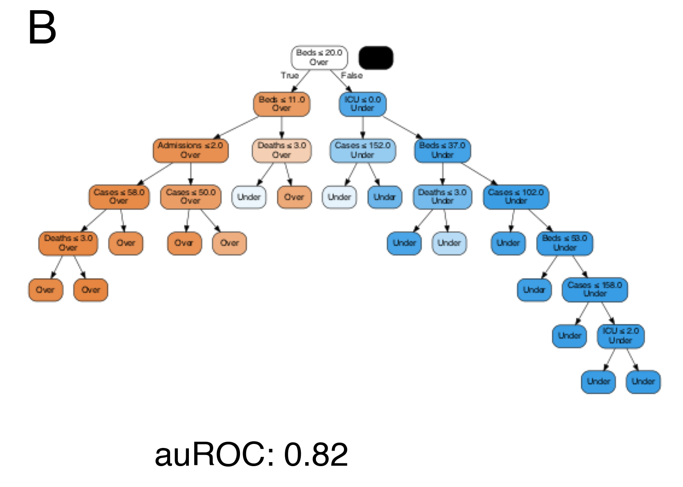
Strain-specific train/test periods
Used all data up to two weeks before it became “dominant” strain
Does a model built w/o data on a strain still predict well?
Robust even to new strains

Slide 10
Current work
Bootstrapping for CI
Writing manuscript
Balance of tp/fp etc

