Slide 1
Decision Tree Classifiers
4th August 2023

Slide 2
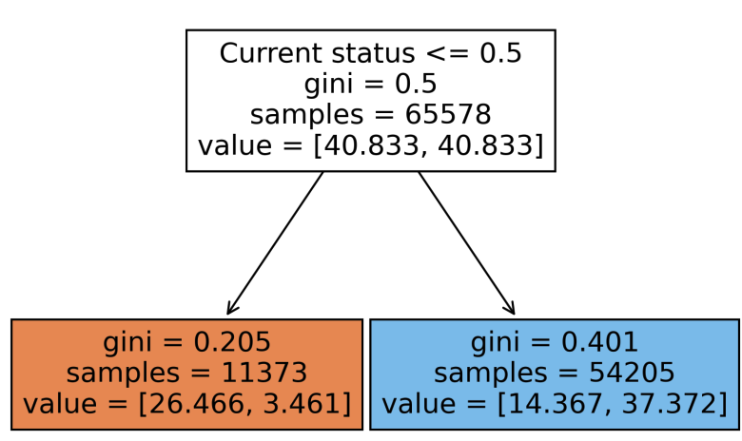
Naïve Classifier
Only has current hospital threshold status
auROC: 0.813

Slide 3
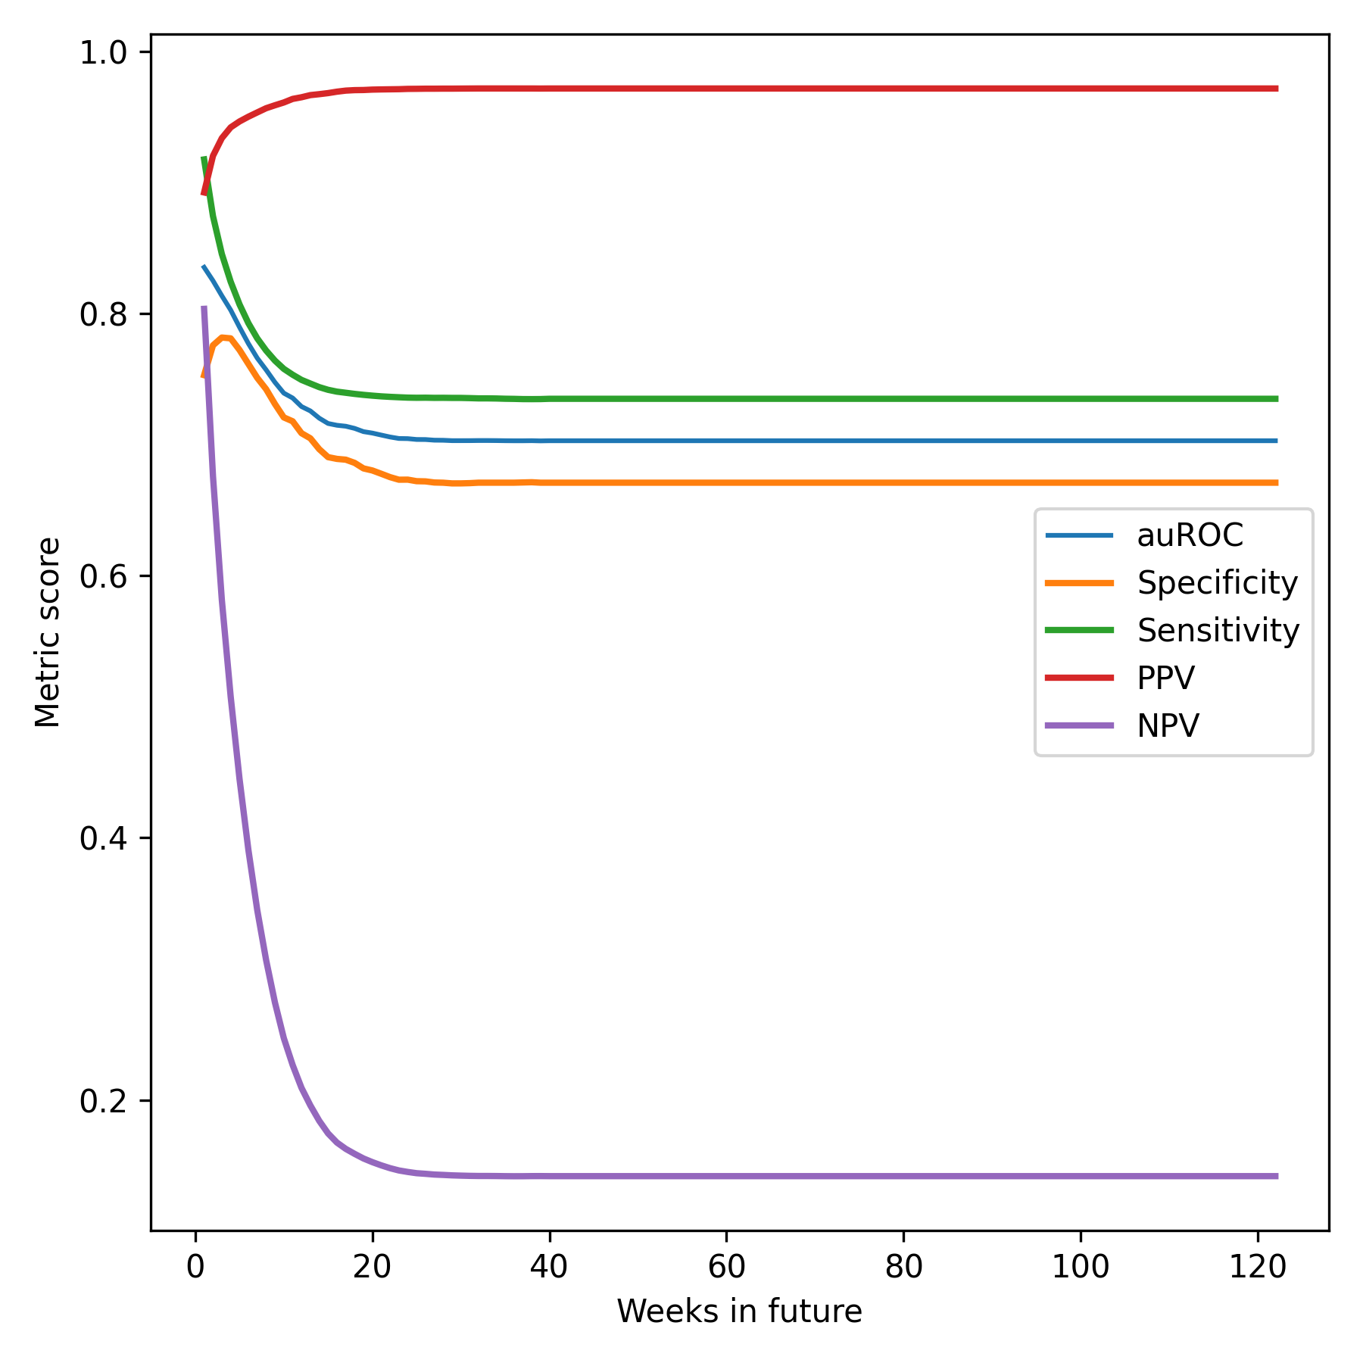

Slide 4
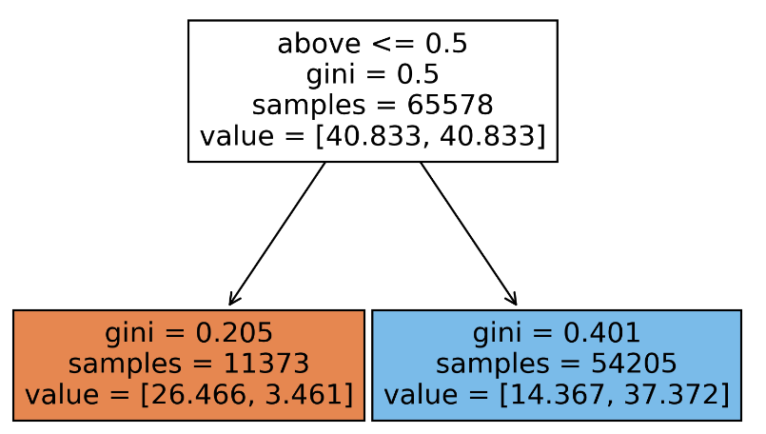
Naïve Classifier – predicting exactly 3 weeks
auROC = 0.751

Slide 5
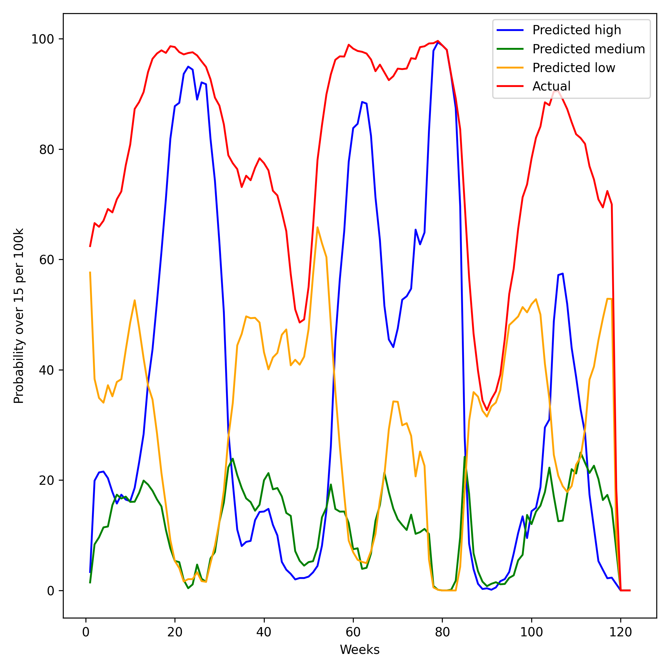
CDC Community Levels
35% of``high risk'' actually exceeded the hospital capacity
only 11% of those that were designated ``medium'' did
30% of those designated ``low risk'' exceeded capacity.

Slide 6
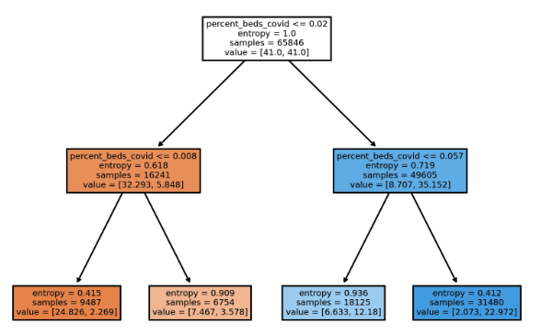
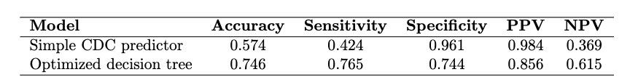
“Optimized” CDC Classifier

Slide 7
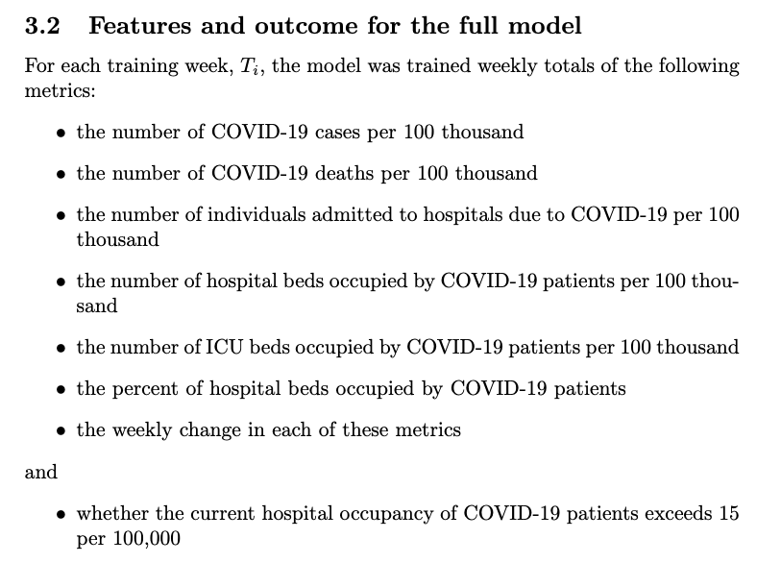
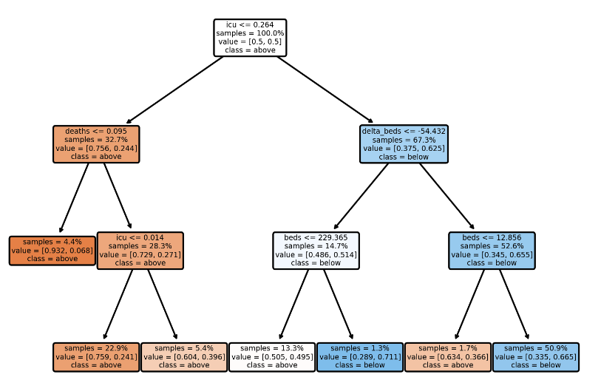
“Full” Classifier – 3 week period
auROC = 0.825
- Driven by week 1, but performance still good (>0.79) for weeks two and three

Slide 8
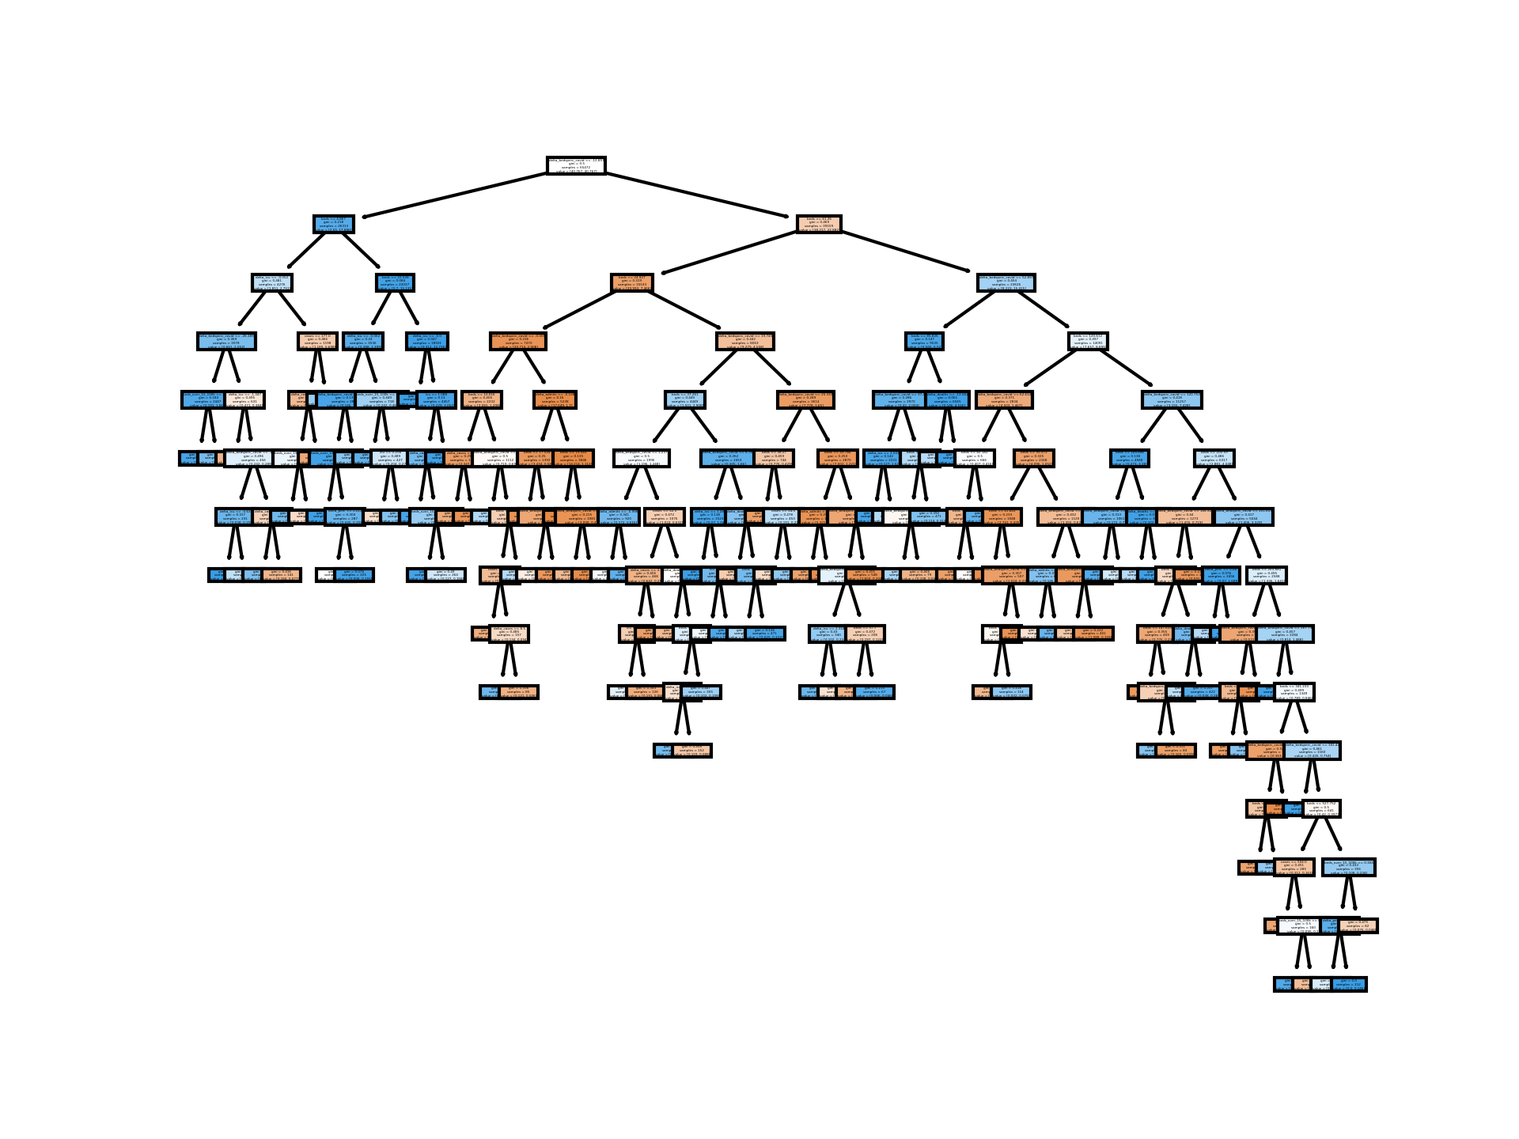
“Full” Classifier – 3 week period “shifted”
auROC = 0.8

Slide 9
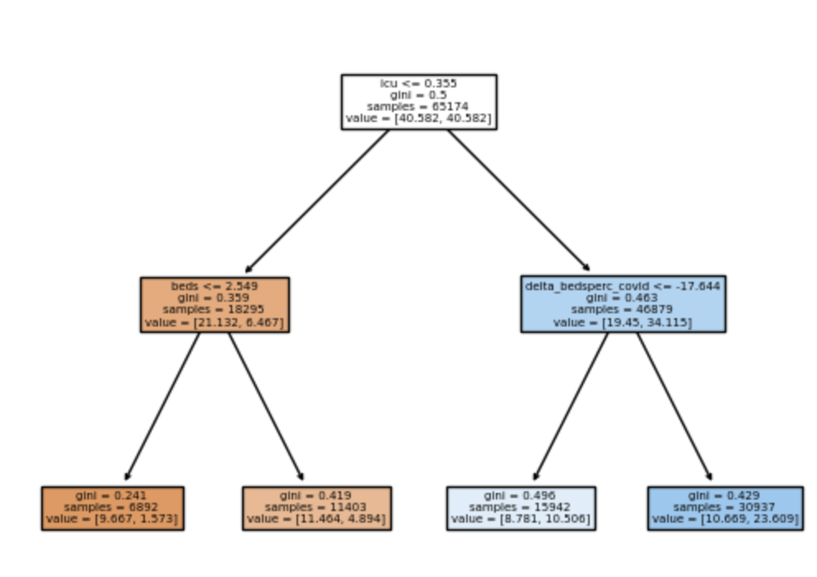
“Full” Classifier – exactly 3 weeks
auROC: 0.745

Slide 10
