Slide 1

Project One | Million Song Data Set
John Choo, Daniel Fischer, Gregory Lang, Rachel Popp

Slide 2
Million Song Data Set | Introduction
What to Expect
Background & Setup
Motivation and Hypothesis
Variables
Process
Code Screenshots
Output Tables and Charts
Analysis
Linear Regression
Multiple Linear Regression
Conclusions

Slide 3
Background & Setup

Slide 4
Million Song Data Set | Motivation and Hypothesis
What Makes a Song a Hit?
Questions of Interest
Are there commonalities among hit songs?
If so, what do hit songs have in common?
Can we generate actionable recommendations to new artists and producers based on analysis of previous “hit” songs?
Hypothesis
There is a measurable similarity in the composition of hit songs with relation to any number of variables and “hotness”
More specifically given the variables present in our data set -
There is a measurable similarity in the composition of hit songs with relation to “duration” and “hotness”
There is a measurable similarity in the composition of hit songs with relation to “tempo” and “hotness”
There is a measurable similarity in the composition of hit songs with relation to “year” and “hotness”
There is a measurable similarity in the composition of hit songs with relation to “loudness” and “hotness”

Slide 5
Million Song Data Set | Variables
Variables Chosen from Our Data Source for this Study
Key Success Metric
“Hotness” is the measure of how much buzz each artist/song is generating online and on social networks
For the purposes of our testing, hotness will be used to evaluate how successful songs from this data set are
Additional Metrics
Artist Name
Duration
Title
Release
Year
Danceability
Energy
Tempo
Loudness

Slide 6
Process

Slide 7
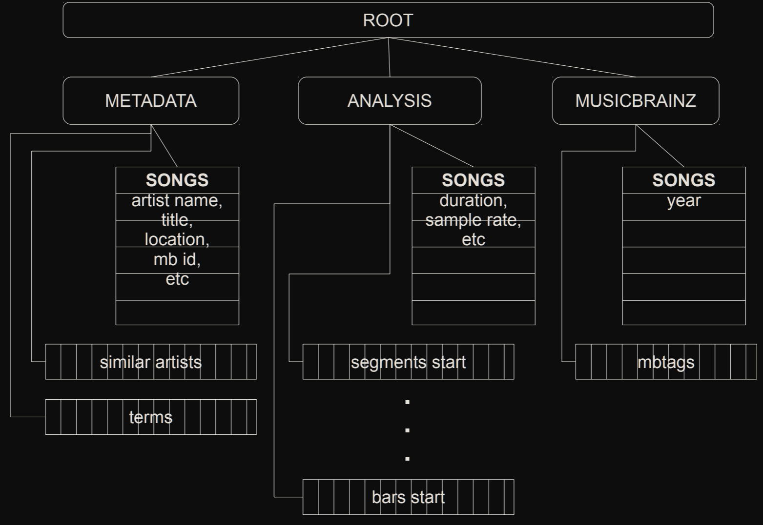
Million Song Data Set | Process
H5 Format

Slide 8
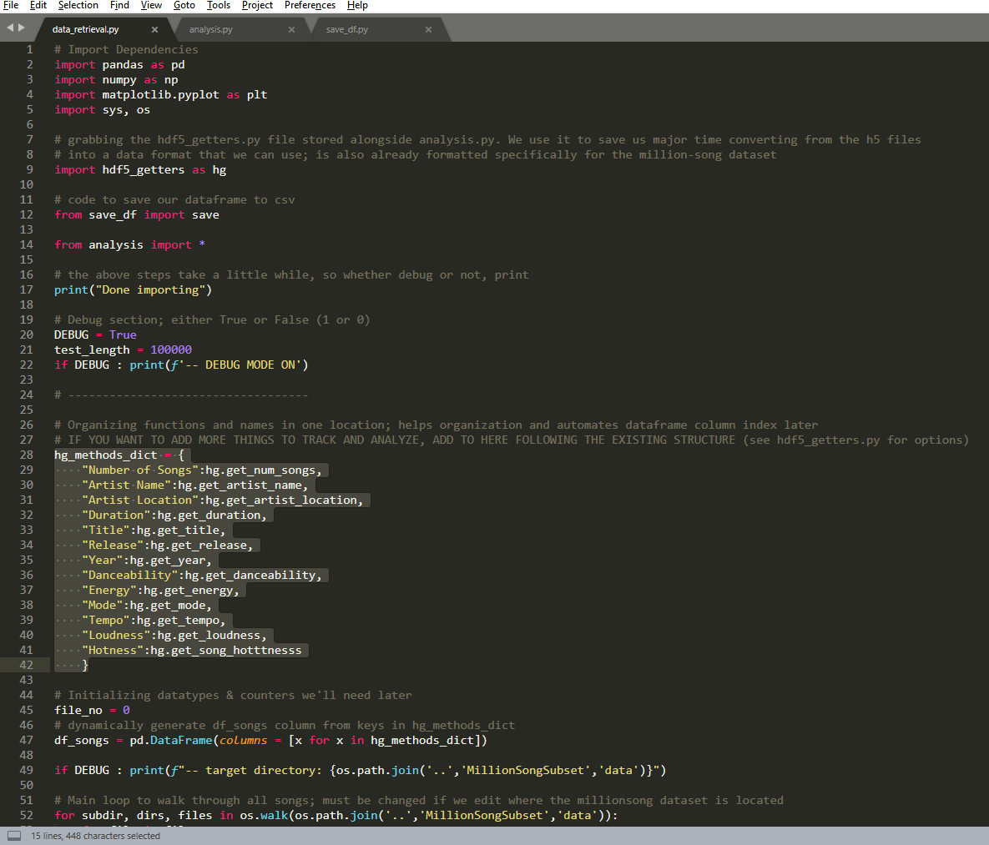
Million Song Data Set | Process
From H5 files to CSV
Using Existing Methods

Slide 9
Million Song Data Set | Process
From H5 files to CSV
Selecting Data

Slide 10
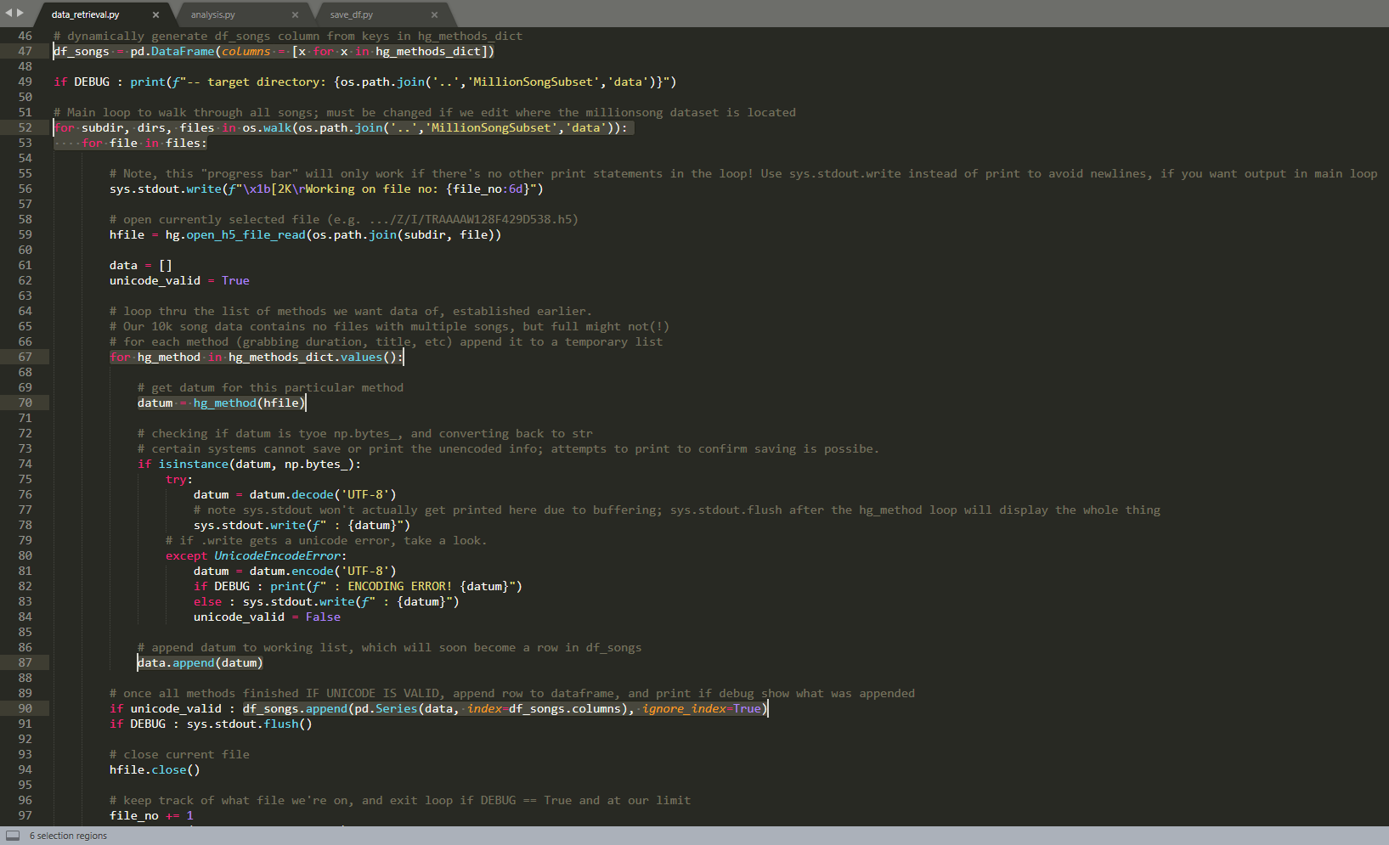
Million Song Data Set | Process
Additional Code
From Tree
Only selected traits from file
Into DataFrame

Slide 11
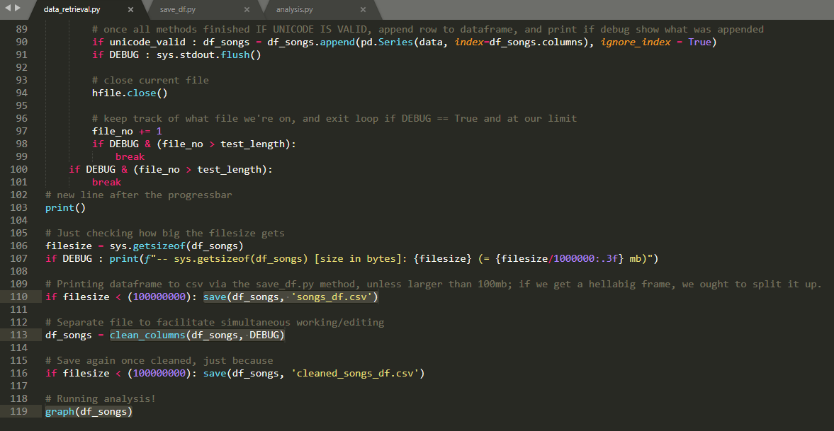
Million Song Data Set | Process
Cleaning and Analyzing

Slide 12
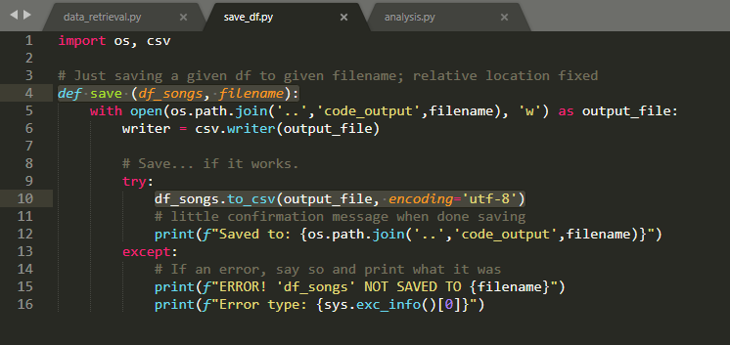
Million Song Data Set | Process
Cleaning and Analyzing

Slide 13
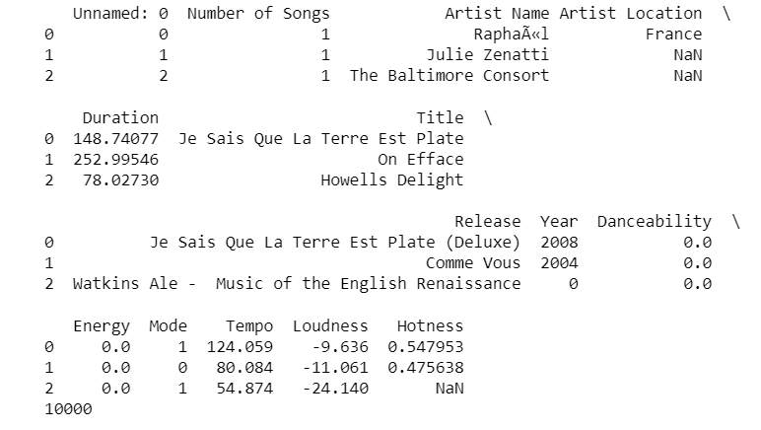
Million Song Data Set | Process
Data Produced
Output
10,000 songs total
12 traits:
Artist Name
Artist Location
Duration
Title
Release Year
Danceability
Energy
Mode
Tempo
Loudness
Hotness

Slide 14
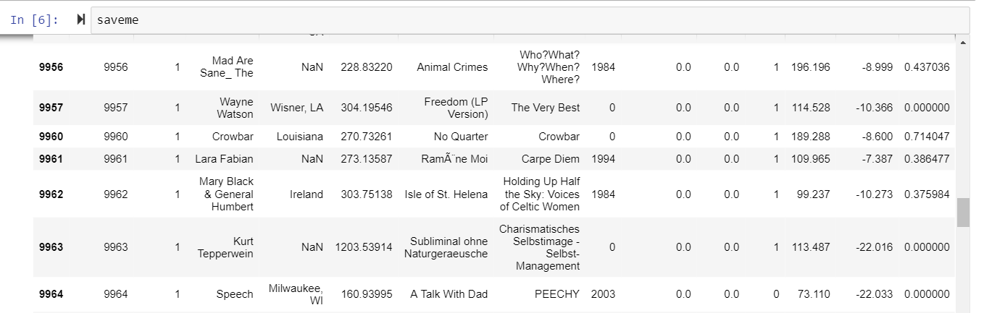
Million Song Data Set | Process
Data Outputs Highlight the Need for Cleaning
Things to Clean
“Danceability”, “Energy” = 0
NaN under “Hotness”
How about the 0’s for “Hotness”? Those were kept in because some songs may actually have 0 “Hotness”
0 under “Year”

Slide 15
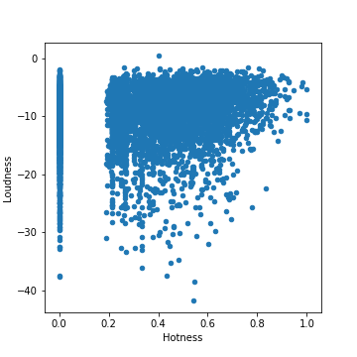
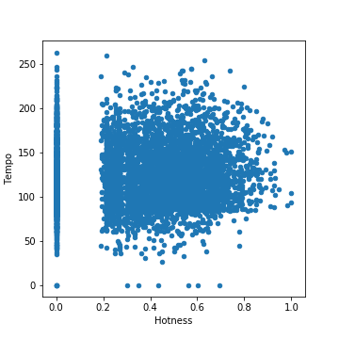
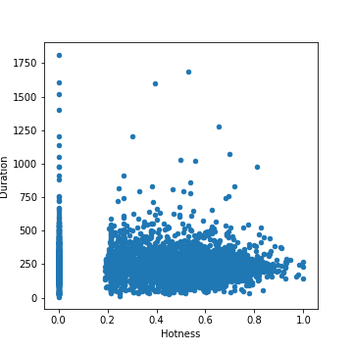
Million Song Data Set | Process
Scatterplots Support Need to Eliminate “0” Values from Data Set
Scatterplots

Slide 16
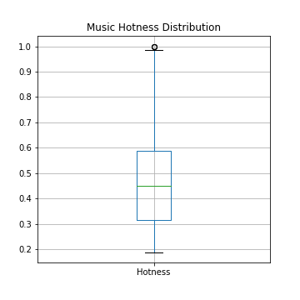
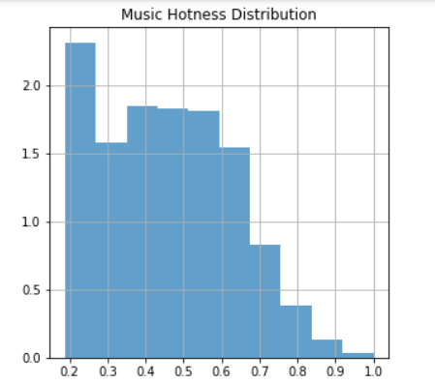
Million Song Data Set | Process
Additional Outputs
Hotness Distribution

Slide 17
Analysis

Slide 18
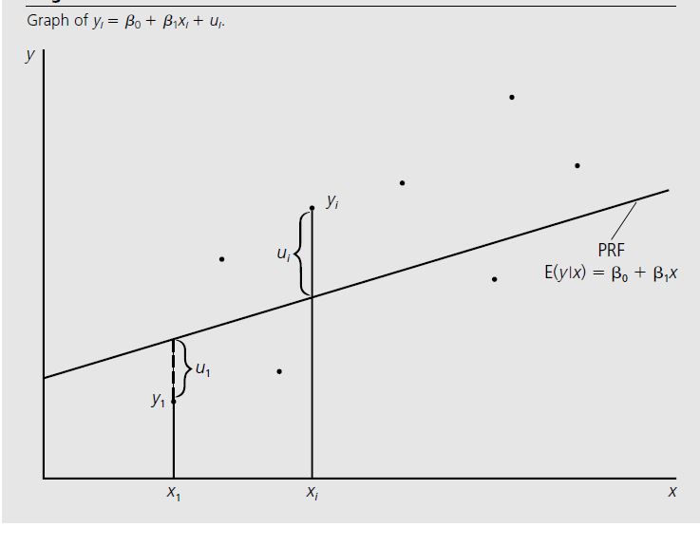
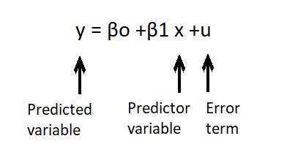
Million Song Data Set | Analysis
The Regression Model
Linear Regression
Linear Regression gives a function to explain y in terms of x. We use the Ordinary Least Squares Method to solve for β_{o} and β₁ , which minimizes the distance of the line to the sample population.
Example: y = “hotness” and x = “tempo”
Citation: Jeffery M. Wooldridge, Introductory to Econometrics

Slide 19
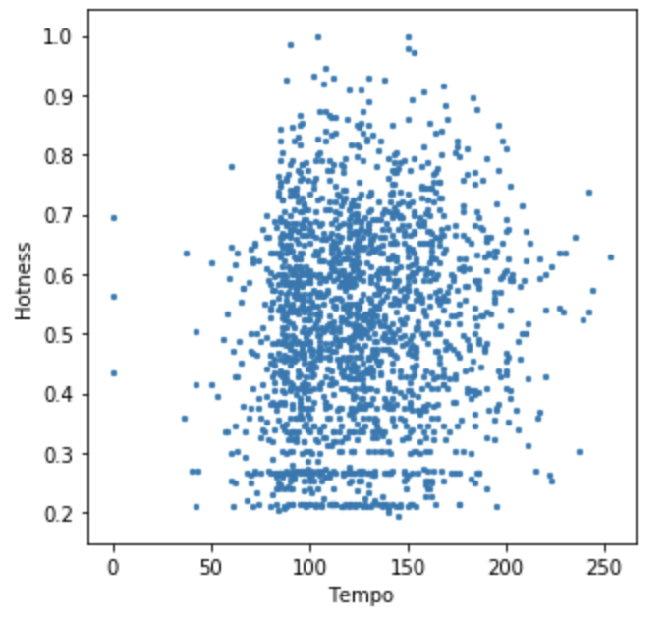
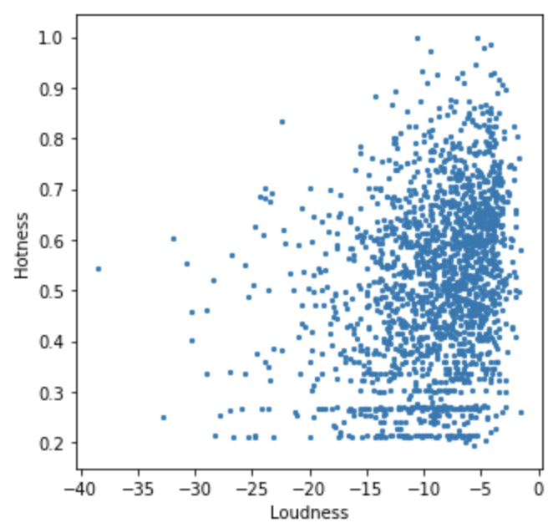
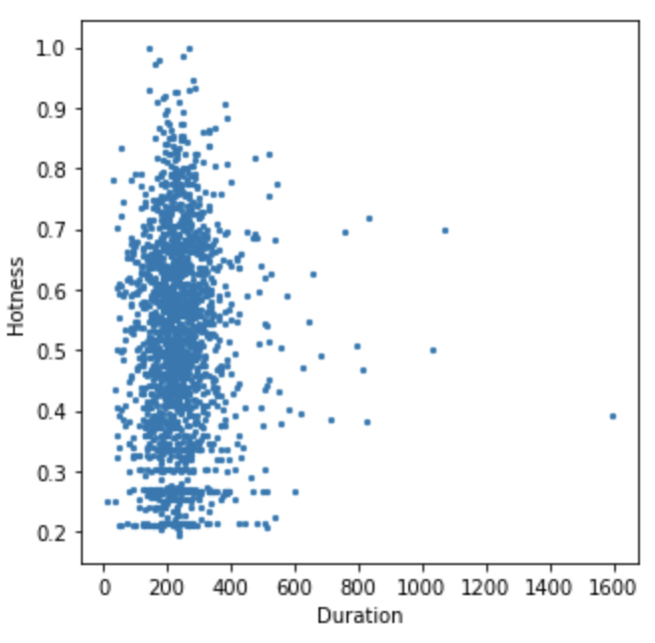
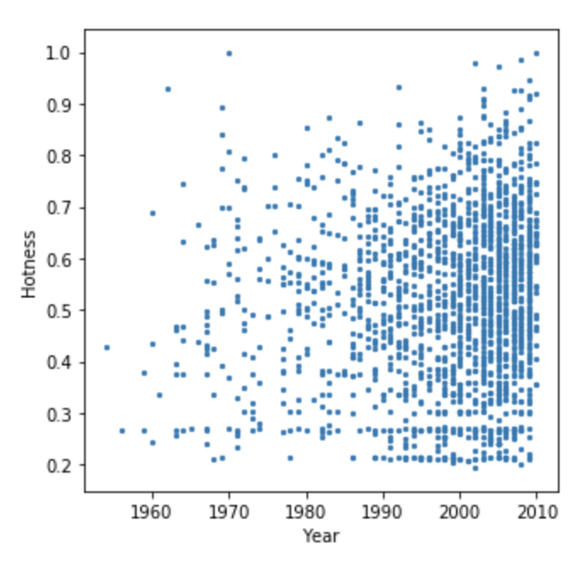
Million Song Data Set | Analysis
Linear Regression
Our Regression
There were no strong linear relationships between Hotness and our other variables in our tested data

Slide 20
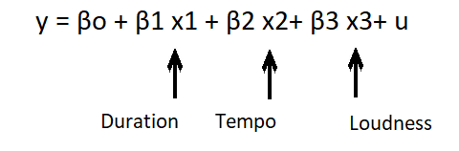
Million Song Data Set | Analysis
The Regression Model
Multiple Linear Regression
Citation: Jeffery M. Wooldridge, Introductory to Econometrics

Slide 21
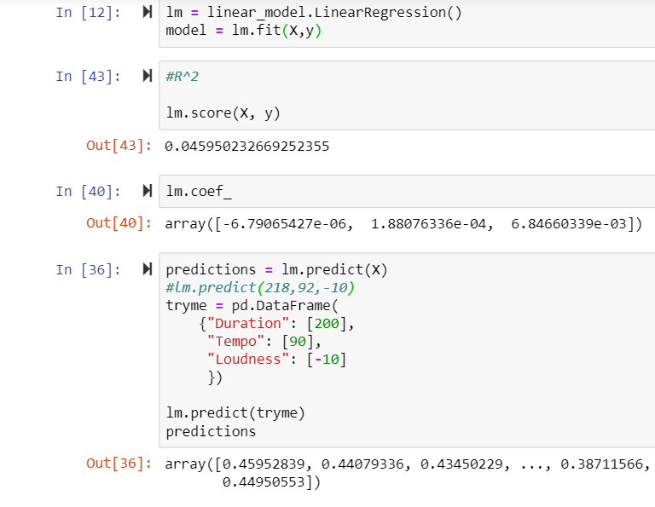
Million Song Data Set | Analysis
Multiple Linear Regression
Our Regression
We used sklearn to perform multiple linear regression
R² = .046 indicating that this is not a good model

Slide 22
Conclusion

Slide 23
Million Song Data Set | Conclusion
What Makes a Song a Hit?
Hypothesis #1
There is a measurable similarity in the composition of hit songs with relation to “duration” and “hotness”
Conclusion
There is no measurable similarity in the composition of hit songs with relation to
duration and hotness among hit songs
R² = 0.746

Slide 24
Million Song Data Set | Conclusion
What Makes a Song a Hit?
Hypothesis #2
There is a measurable similarity in the composition of hit songs with relation to “tempo” and “hotness”
Conclusion
There is no measurable similarity in the composition of hit songs with relation to
tempo and hotness among hit songs
R² = 0.830

Slide 25
Million Song Data Set | Conclusion
What Makes a Song a Hit?
Hypothesis #3
There is a measurable similarity in the composition of hit songs with relation to “year” and “hotness”
Conclusion
There is no measurable similarity in the composition of hit songs with relation to
year and hotness among hit songs
R² = 0.678

Slide 26
Million Song Data Set | Conclusion
What Makes a Song a Hit?
Hypothesis #4
There is a measurable similarity in the composition of hit songs with relation to “loudness” and “hotness”
Conclusion
There is no measurable similarity in the composition of hit songs with relation to
loudness and hotness among hit songs
R² = 0.635

Slide 27
Million Song Data Set | Conclusion
What Makes a Song a Hit?
Hypothesis Disproved
There is no measurable similarity in the composition of hit songs with relation to any number of variables and “hotness”
Final Thoughts
There was likely no linear relationship between “hotness” and our other variables in the sample likely due to the range of music genres international makeup of the sample given than “hit” songs are likely reflective of specific cultures in which it is popular
For future projects of this kind, it might be more effective to conduct linear regression analysis on samples of hit songs that are reflective of more specific regions (e.g. by country) and by music genre
Additionally, we believe that there are likely better ways to analyze these types of random data sets than with linear regression
Random Forest
Machine Learning
Genetic Algorithms

Slide 28
Appendix

Slide 29
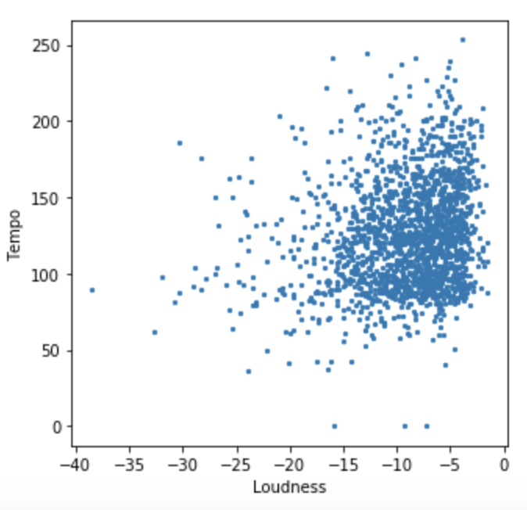
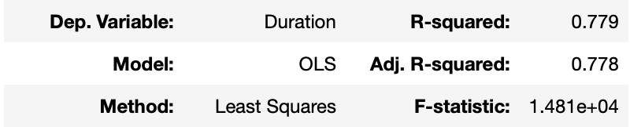
Million Song Data Set | Appendix
Other Charts and Analysis
Tempo v. Loudness

Slide 30
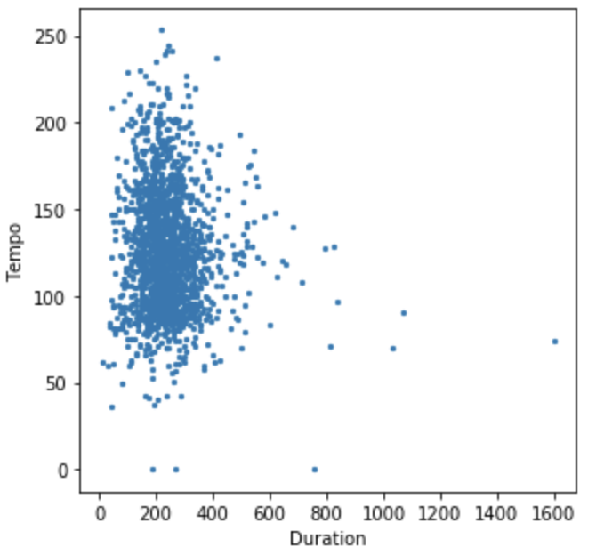
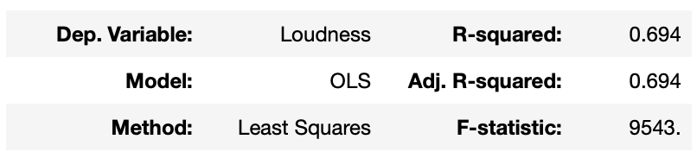
Million Song Data Set | Appendix
Other Charts and Analysis
Tempo v. Duration

Slide 31
Million Song Data Set | Style Guide
Color Codes
#002F87 - Navy Blue
#002f8725 - Navy Blue with 25% opacity
#9BDDFF - Columbia Blue
#9BDDFF25 - Columbia Blue with 25% opacity
Use Black and shades of Grey for additional color variety

Slide 32

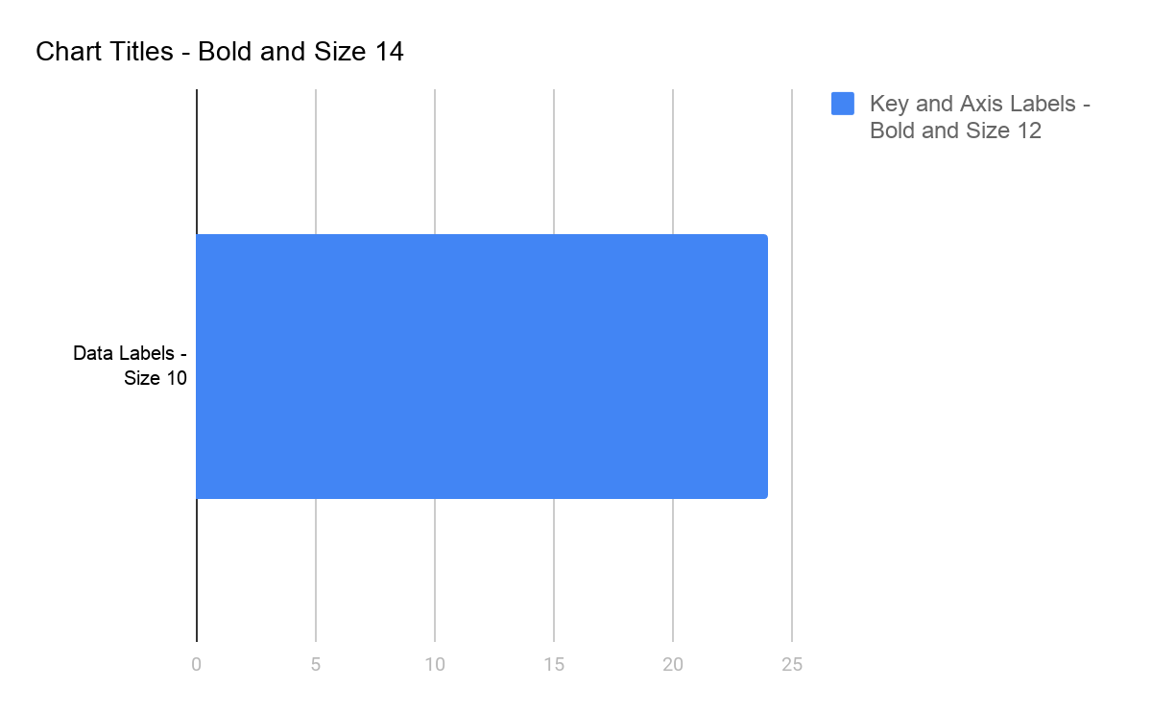
Million Song Data Set | Style Guide
Fonts
Header - Bold and Size 24
Subheader - Size 20
Text Box Titles - Bold and Size 12
Insights - Size 10

