Slide 1

Welcome!
DEPT XXX
COURSE TITLE
Instructor Name, Instructor
Teaching Assistant Name, TA
ULA Names

Slide 2
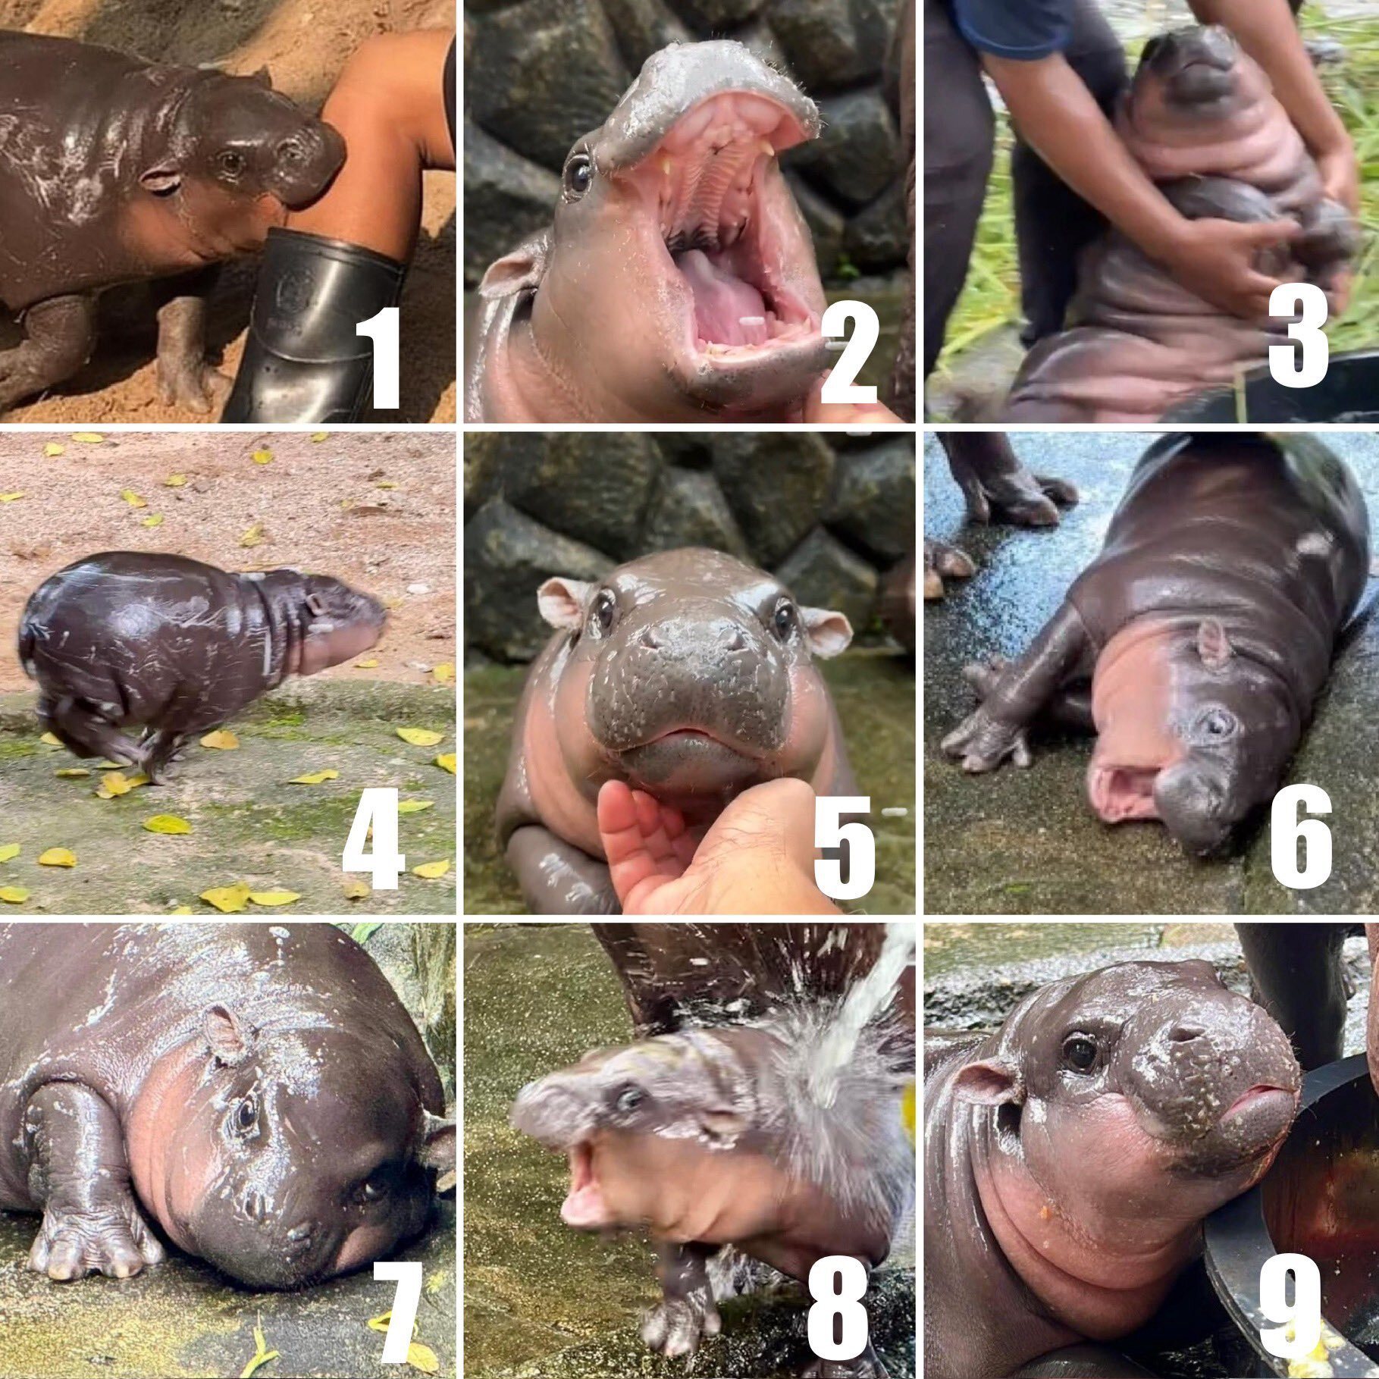
Which Moo Deng are you today?

Slide 3
Reminders!
It's the last week! I am rapidly posting grades, please check feedback and reach out ASAP if you have any questions. Final grades are due Monday at 4pm so we’re both on crunches.
Your project is due TONIGHT!!!!
If you haven't submitted assignments, do so ASAP.
Lowest quiz will still be dropped (highest 3 grades)
Watch out for my post-semester survey!
The Student Perceptions of Learning Survey (SPLS) survey opened last Friday- please fill it out! You’ll get an email notification with the link.

Slide 4
This Week
Monday, August, 12 | 24 | Agent-based modeling 2
Tuesday, August, 13 | 25 | In-class project workday
Wednesday, August, 14 | 26 | Algorithmic Bias Activity
Thursday, August, 15 | 27 | In-class project presentations (last day)

Slide 5
Norms
Make space, take space: share the air
Listen to understand, not to judge
Speak for yourself, not for others
Avoid generalizations
Respect others’ experiences
Consider whose viewpoints are not included in our conversations
Use both/and rather than either/or thinking
“Yes, and” language
Be aware of, and work to deconstruct, the existing power dynamics in the room

Slide 6

PCA Day 25
Survival of the Best Fit
Algorithmic Bias

Slide 7
Plan for Today!
First, you’re going to spend time discussing Survival of the Best Fit with your group
We’ll come back together to discuss in about 10 minutes!
Each group should have one idea or reflection they want to share with the rest of the class
After, you’ll look at code in the wild - how was data for the simulation generated?
This is in a separate notebook than the ICA - you will turn in both
Dive further into algorithmic bias - real world example of bias!
We’ll come back together at the end!

Slide 8
Let’s Chat About the Game!
What were some thoughts you had in your groups?
How did the game make you feel? How did this change when you started getting timed?
What was the intent of using an algorithm to help hire candidates? Was it malicious?
What was the impact of using an algorithm to help hire candidates? Was it positive? How did it go wrong?
What do you expect to find in the data file?
Notes:
For after the first 10 minutes of class when groups are discussing

Slide 9
Final Discussions
Did anything surprise you about the data generation code?
How much code were you able to understand or recognize?
Even if it is not all of it give yourself a pat on the back!
What connections can you make between the simulation and the real-world example we explored?
How may this affect how you engage with algorithms? What might we do differently?
Any last thoughts or insights?
Notes:
Last 15 min of class

Slide 10
Final Takewaways
Pros:
Algorithms can help reduce workload and synthesize large amounts of data.
When implemented appropriately and thoughtfully, algorithms may help uncover patterns in candidates.
Cons:
Algorithms reflect the data they are given. Bias in the data implies there is bias in the model.
As we learned in Day 4, all data contains bias!
Bias goes beyond gender, as we talked about in this case. It can also portray ageism, ableism, racism, socioeconomic status, etc. Similarly, algorithms can favor key words in resumes that might not be present in resumes of candidates that are highly qualified.
Not using data that explicitly contains race, sex, or other identities does not mean that our algorithms will not negatively impact certain groups. These groups tend to be the most marginalized and underrepresented.

