Slide 1
HOUSING AFFORDABILITY IN THE U.S.
Isabelle Kallenberg
Ozcan Ozturk
Andrea Rubio
Zheran Wang
STAT7000 Dr. Peng Zeng
Group Project

Slide 2
CONTENT
Introduction
Goals
Data
Methods
Models
Results
Conclusion
SAS Code

Slide 3

Introduction
The U.S. Census Bureau reported in September 2014 that: U.S. real median household income was $51,939 in 2013 versus $51,759 in 2012, statistically unchanged. In 2013, real median household income was 8.0 percent lower than in 2007, the year before the latest recession.

Slide 4
Introduction
American Housing Survey (AHS) national files 1985 – 2009 and the metropolitan files 2002 – 2009
The Housing Affordability Data System (HADS)
Affordability of housing units and the housing cost burdens of households relative to:
Area median incomes
Poverty level incomes
Fair Market Rents
https://www.huduser.gov/portal/datasets/hads/hads.html

Slide 5
Data
VALUE = the price of the house (numeric, continuous)
YEAR = the year in which the unit was constructed (numeric, continuous)
NROOM = number of rooms in the house (numeric, continuous)
studio(0 bedrooms), 1 bedroom, 2 bedrooms, 3 bedrooms, 4 or more bedrooms
LOCA = closeness to the city (characteristic)
Central City, Suburb, Nonmetropolitan.
Changed into 0,1,2 in SAS analysis
CONDI = condition of the house (characteristic)
Adequate, Moderately Inadequate, Severely Inadequate, Vacant–no information
Changed into 0,1,2,3 in SAS analysis
INS = Insurance, condo, land rent, other mobile home fees (numeric, continuous)
INC = income of the household (numeric, continuous)

Slide 6
Goal
Analyzing the relationship between the house prices with the year of construction, number of rooms, closeness to the city, condition of the houses, insurance and total income of the households.

Slide 7
Methods
Used matrix plot to look at the data
QQ-plot and Residual plot to check model assumption
Used multiple linear regression to test the model (model 1)
Used backwards elimination to eliminate the insignificant variables
Variable interactions by looking at the correlation
Tested the new model (model 2)
Used backward elimination to eliminate the insignificant variables in new model

Slide 8

Models
Model 1:
Value $=β_{0}+β_{1}year+β_{2}nroom+β_{3}loca+β_{4}condi+β_{5}ins+β_{6}inc+ε$

Slide 9
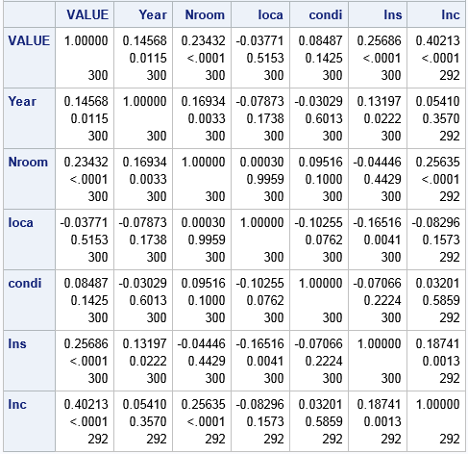
Models
Interact variables:
Yearo = Year * Nroom
Yearis = Year * Ins
Roinc = Nroom * Inc
Locins = Loca * Ins
Insinc = Ins * Inc

Slide 10

Models
Model 2:
Value $=β_{0}+β_{1}year+β_{2}nroom+β_{3}loca+β_{4}condi+β_{5}ins+β_{6}inc+β_{7}{yearo+β}_{8}yearis+β_{9}roinc+β_{10}locins+β_{11}insinc+ε$

Slide 11
Results

Slide 12
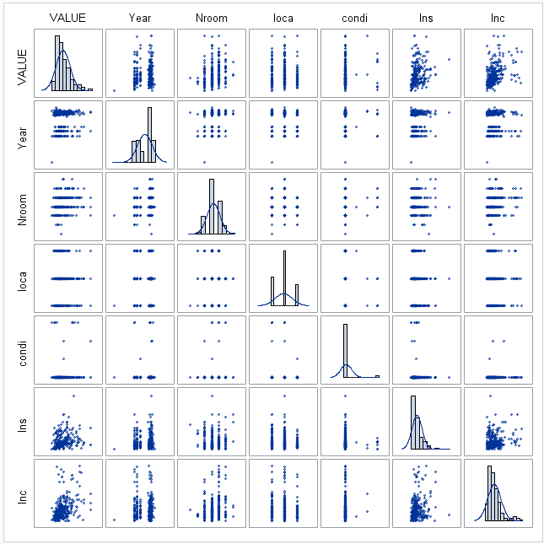
Matrix Plot

Slide 13
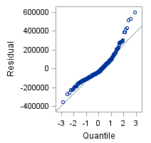
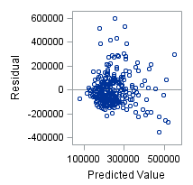
QQ-plot & Residual Plot - Model 1

Slide 14
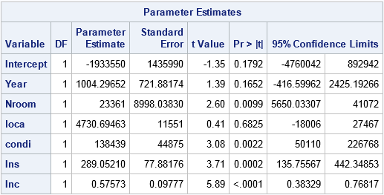

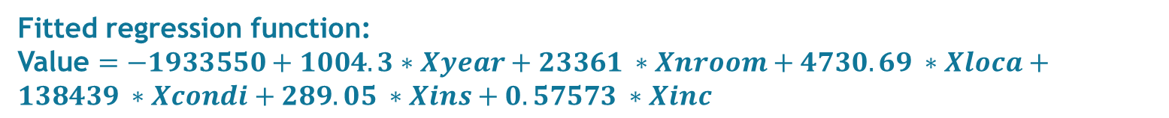
Regression – Model 1
Fitted regression function:
Value $=−1933550+1004.3∗Xyear+23361 ∗Xnroom+4730.69 ∗Xloca+138439 ∗Xcondi+289.05 ∗Xins+0.57573 ∗Xinc$

Slide 15
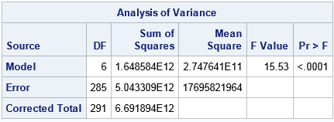
Linear Association of Model 1
H0: There is no linear relationship between value and other 6 variables.
Ha: There exists linear relationship between value and other 6 variables.
P-value less than 0.05, reject H0.
There exist a linear relationship between the responses and predictor.

Slide 16
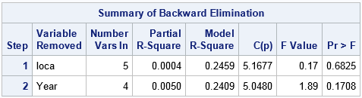
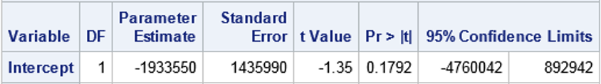
Backward Elimination

Slide 17
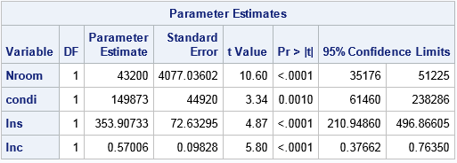

Model 1 After Backward Elimination
Fitted regression function:
Value $=43200 ∗Xnroom+149873 ∗Xcondi+353.91 ∗Xins+0.5701∗Xinc$

Slide 18
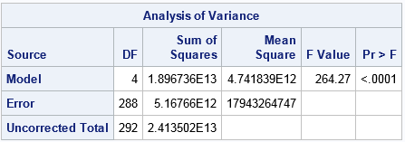
Linear Association of Model 1 After Backward Elimination
H0: There is no linear relationship between value and other 4 variables.
Ha: There exists linear relationship between value and other 4 variables.
P-value less than 0.05, reject H0.
There exist a linear relationship between the responses and predictor.

Slide 19
Models
Interact variables:
Yearo = Year * Nroom
Yearis = Year * Ins
Roinc = Nroom * Inc
Locins = Loca * Ins
Insinc = Inc * Inc

Slide 20
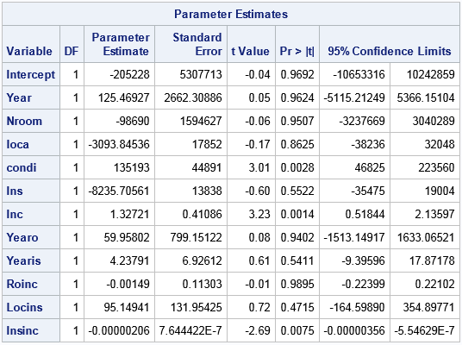

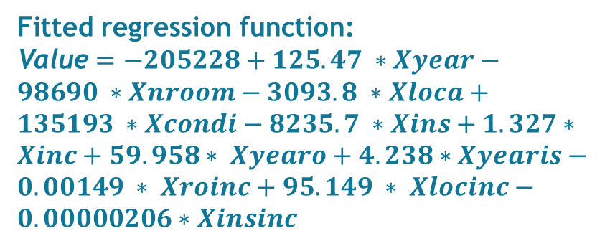
Regression – Model 2
Fitted regression function:
Value $=−205228+125.47 ∗Xyear−98690 ∗Xnroom−3093.8 ∗Xloca+135193 ∗Xcondi−8235.7 ∗Xins+1.327∗Xinc+59.958∗ Xyearo+4.238∗Xyearis−0.00149 ∗ Xroinc+95.149 ∗ Xlocinc−0.00000206∗Xinsinc$

Slide 21
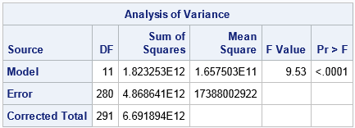
Linear Association of Model 2
H0: There is no linear relationship between value and other 11 variables.
Ha: There exists linear relationship between value and other 11 variables.
P-value less than 0.05, reject H0.
There exist a linear relationship between the responses and predictor.

Slide 22
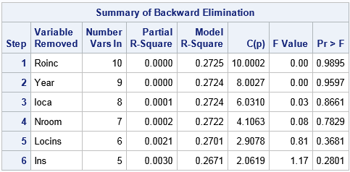
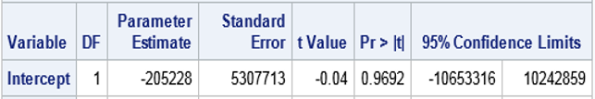
Backward Elimination

Slide 23
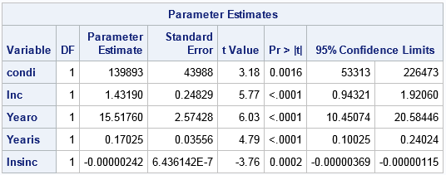

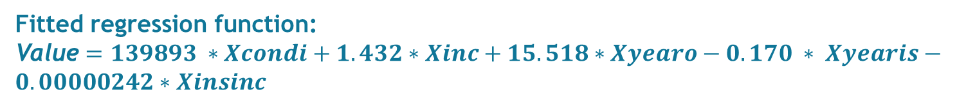
Model 2 After Backward Elimination
Fitted regression function:
Value $=139893 ∗Xcondi+1.432∗Xinc+15.518∗Xyearo−0.170 ∗ Xyearis−0.00000242∗Xinsinc$

Slide 24
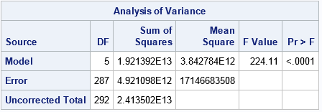
Linear Association of Model 2 After Backward Elimination
H0: There is no linear relationship between value and other 5 variables.
Ha: There exists linear relationship between value and other 5 variables.
P-value less than 0.05, reject H0.
There exist a linear relationship between the responses and predictor.

Slide 25
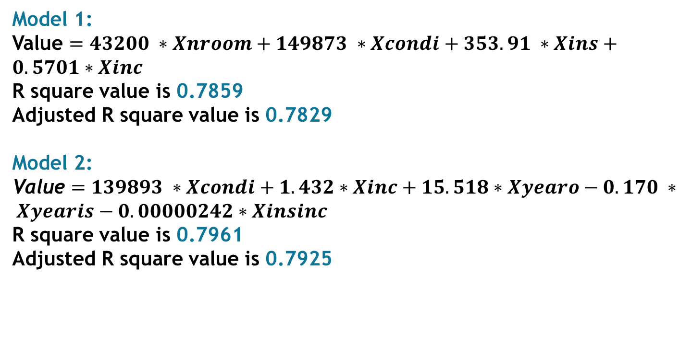
Results Summary
Model 1:
Value $=43200 ∗Xnroom+149873 ∗Xcondi+353.91 ∗Xins+0.5701∗Xinc$
R square value is 0.7859
Adjusted R square value is 0.7829
Model 2:
Value $=139893 ∗Xcondi+1.432∗Xinc+15.518∗Xyearo−0.170 ∗ Xyearis−0.00000242∗Xinsinc$
R square value is 0.7961
Adjusted R square value is 0.7925

Slide 26
Conclusions
There exists a linear relationship between the house price and the number of rooms, condition of the house, insurance and total income of the household.
The model improved after the interaction of the variables.

Slide 27
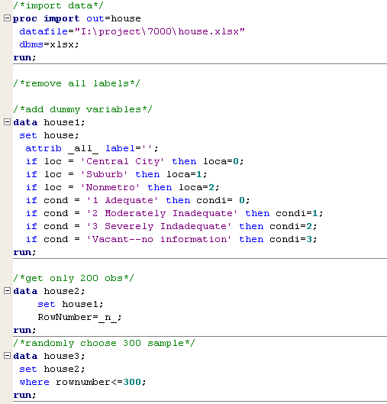
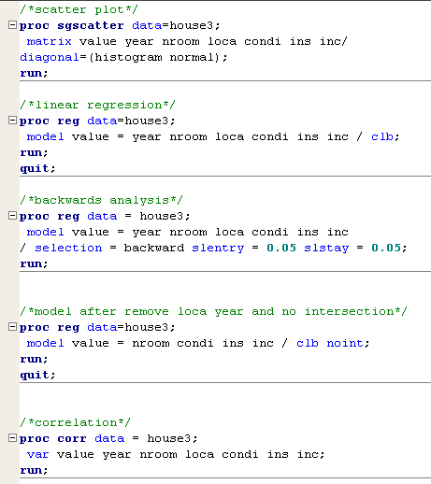
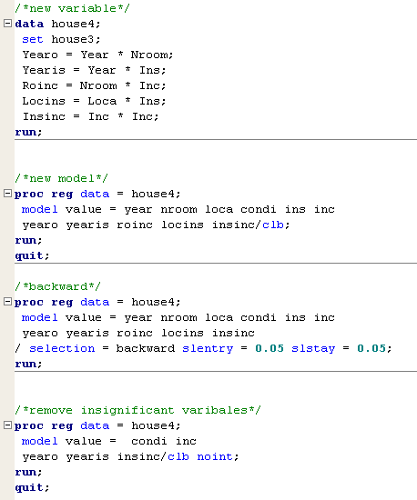
SAS Code

Slide 28


