Slide 1


NHL: What makes the best the best?
DSC 530 Final Project by Rachel Wantuch

Slide 2
Overview
The dataset and the Question at hand
Exploratory Data Analysis (EDA)
Testing the Hypothesis

Slide 3
The Dataset
Description: This dataset comes from Kaggle. It is a combination of multiple csv files to form data frames of relevant data. The specific files used were the ‘Scoring.csv’ file and the ‘Master.csv’ file. All files contain season by season data for all players that have played in a professional hockey league since 1909.
Notes:
Data was filtered to 1967 and on so that it was when there were more than 6 teams in the league and only the NHL players were selected.
From the original datasets values were summed by uniqueID to get career values.
An addition column called ‘Origina_bool’ was created to assign a value of 1 to Canadians and 0 to other nationalities.
Source: https://www.kaggle.com/datasets/open-source-sports/professional-hockey-database

Slide 4

What’s My Goal here?
What does it take to last in the NHL? What aspects of the game serve as good indicators that a player will have a long, productive career?

Slide 5
Variables Used
Variable Name | Value Type | Description
playerID | String | This is a string containing the first 5 letters of the players last name, then the first two letter of the players first name, then a two digit number sequence that increased if the alphabetical combo was already used before in identifying a different player.
GP | Float | Career games played by the player.
G | Float | Career goals for that player.
A | Float | Career assists for that player.
Pts | Float | Career points for that player.
SOG | Float | Career shots on goal (SOG) for that player.
PIM | Float | Career penalty minutes (PIM) for that player.
Origin | string | Nationality of that player.
Origin_bool | Boolean | If the player is Canadian they get a value of 1 otherwise the player gets a value of 0.

Slide 6
Histogram Note
All outliers in all histograms are valid. They are players that played for 800+ games.
Bins were done because there are 5000ish values we are looking at, and that made for an unreadable graph. The other solution would be to do just a sample of the population.

Slide 7
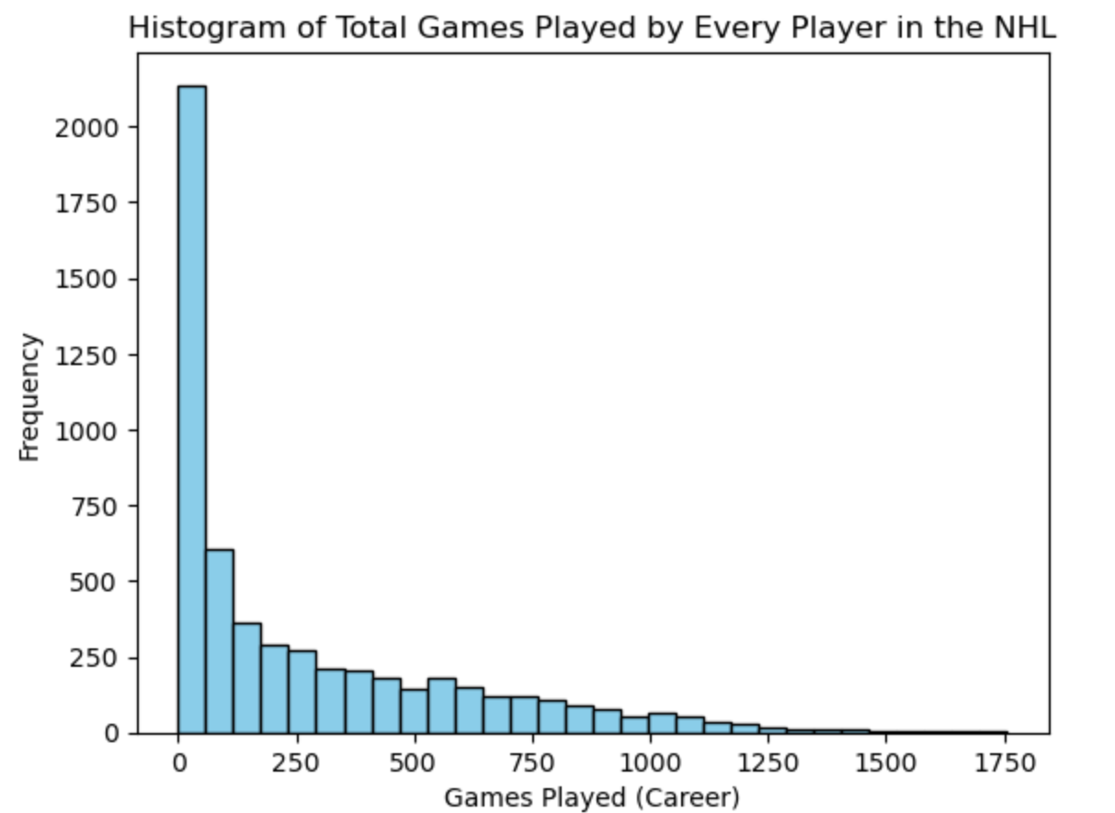
Games Played Histogram
Insight
Bins=30
Right-skewed and exponential in shape
Mean: 269.06
Var: 103428.76
Std: 321.60
After the first bin (60-70 goals roughly) of numbers the games played really gets limited to a much smaller range of players. The difference in frequencies from the first bin to the second is at least 1500.

Slide 8
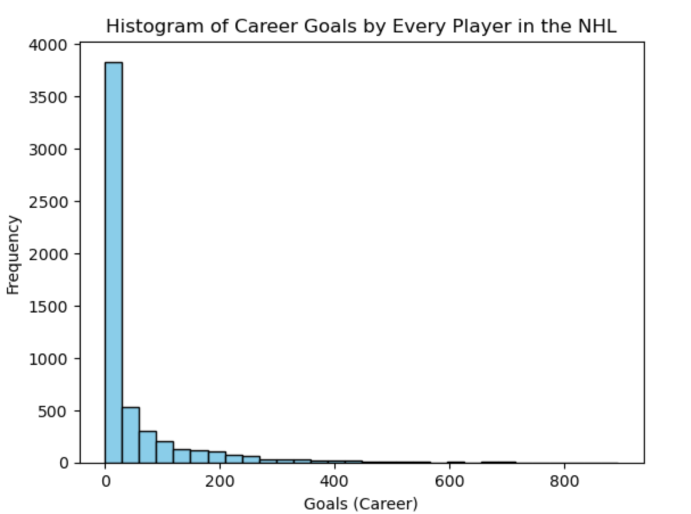
Goals Histogram
Insights
Bins=30
Right-skewed and exponential in shape
Mean: 45.45
Var: 7969.09
Std: 89.27
Same pattern as the other histograms with a sudden drop off after the first bin. Most players can be accounted for because of that first bin meaning a lot of players only score a handful of goals over their careers.

Slide 9
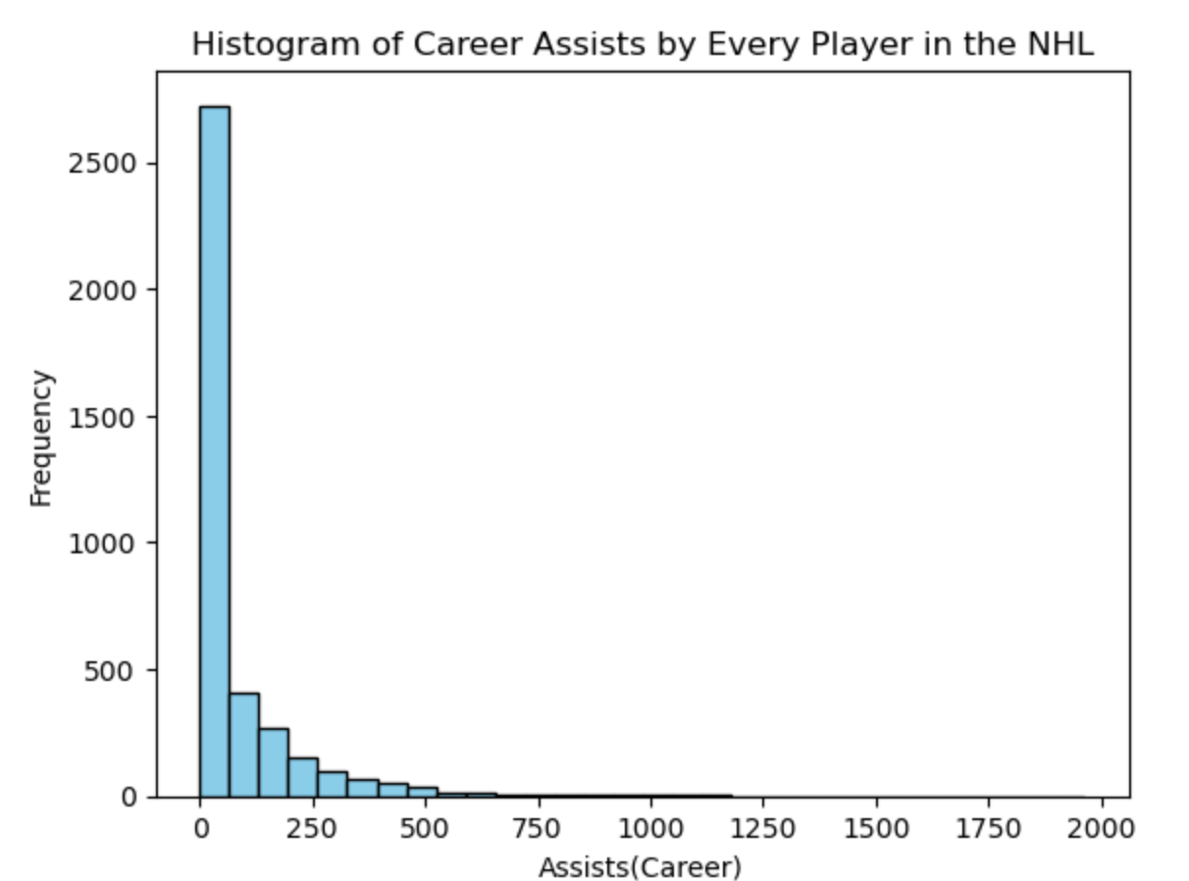
Assists Histogram
Insight
Bins=30
Right-skewed and exponential in shape
Mean: 76.06
Var: 18840.93
Std: 137.26
The first seems to be, again, where the average player falls into. The first bin is for the values (roughly) 60-70 assists in their career. This is more than the goals histogram which makes sense because 2 players can be accounted for an assist but only 1 player can score a goal.

Slide 10
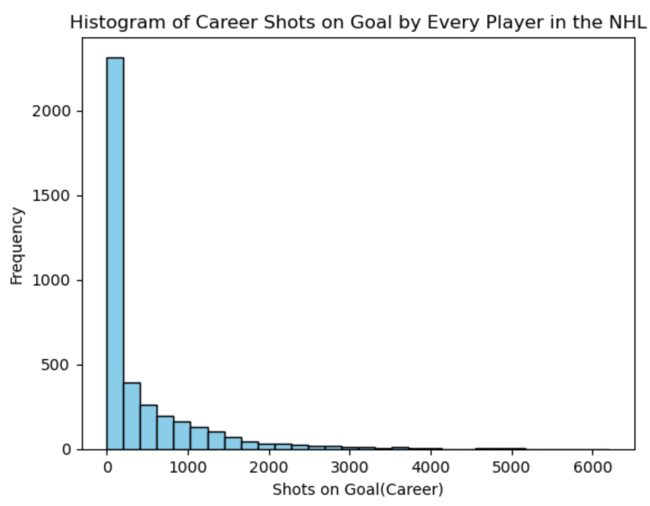
Shots on Goal Histogram
Insight
Bins=30
Right-skewed and exponential in shape
Mean: 428.66
Var: 491869.04
Std: 701.33
A lot of players fall in that first bin that accounts for up to 250 shots roughly in a career.

Slide 11
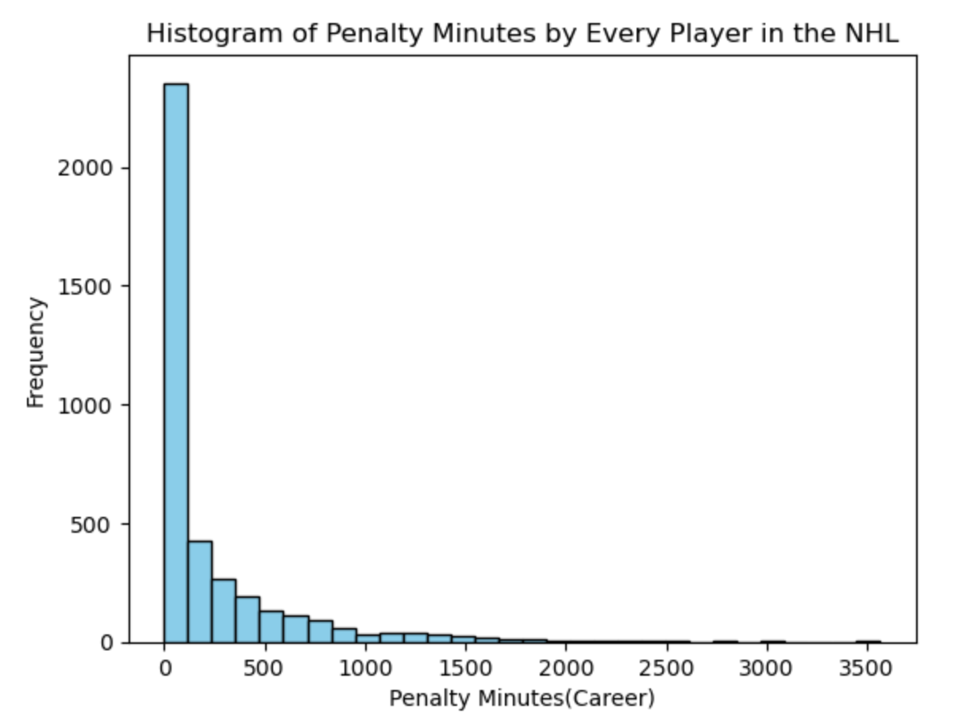
Penalty Minutes Histogram
Insight
Bins=30
Right-skewed and exponential in shape
Mean: 239.45
Var: 169501.49
Std:411.71
This is the one I would be interested for a different study to look at. A lot of players fall in the bin of up to 250 PIM in their career but are the players in the other values ‘goons’ or is it because they played so long?

Slide 12
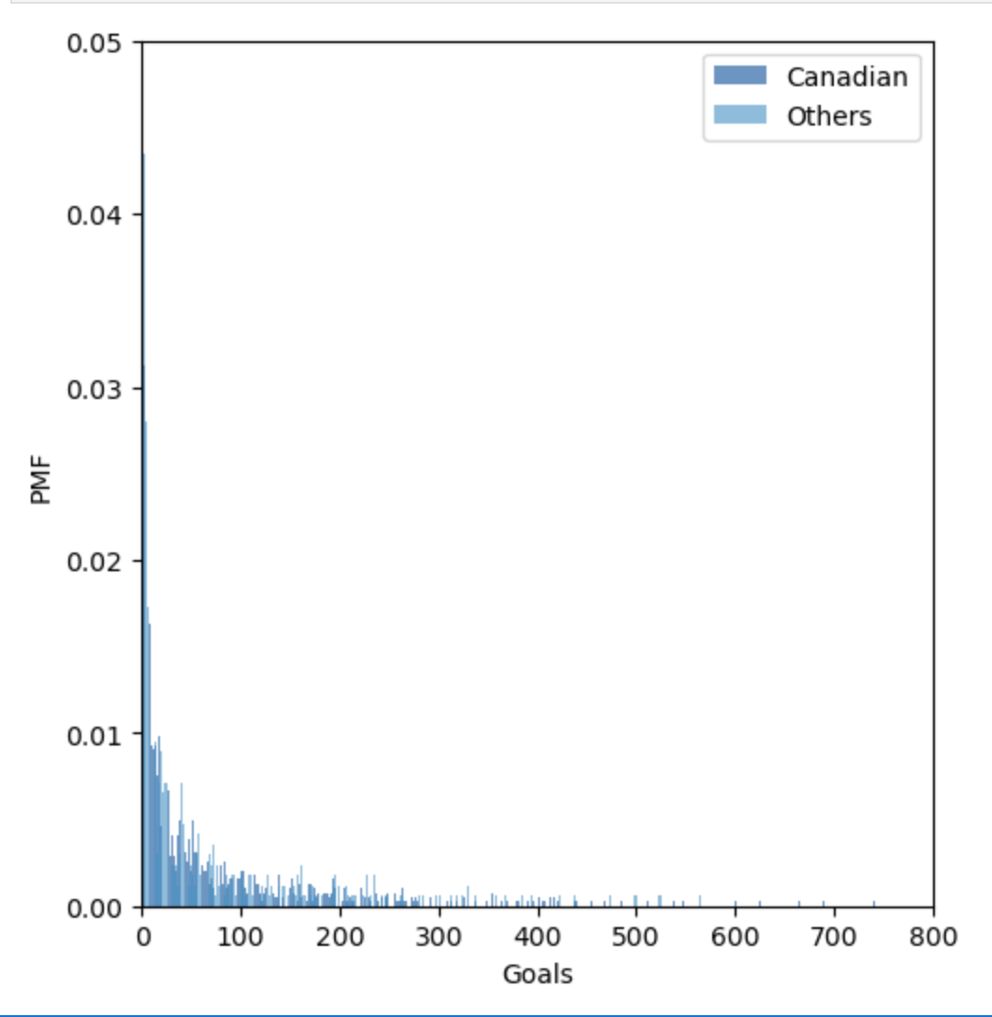
Probability Mass Function (PMF)
This graph is hard to read but of note:
Canadian goal scorers dominate the first column by a lot.
Anything after 275 career goals has a minimal probability of being the chosen number because so few players get that far in their career.

Slide 13
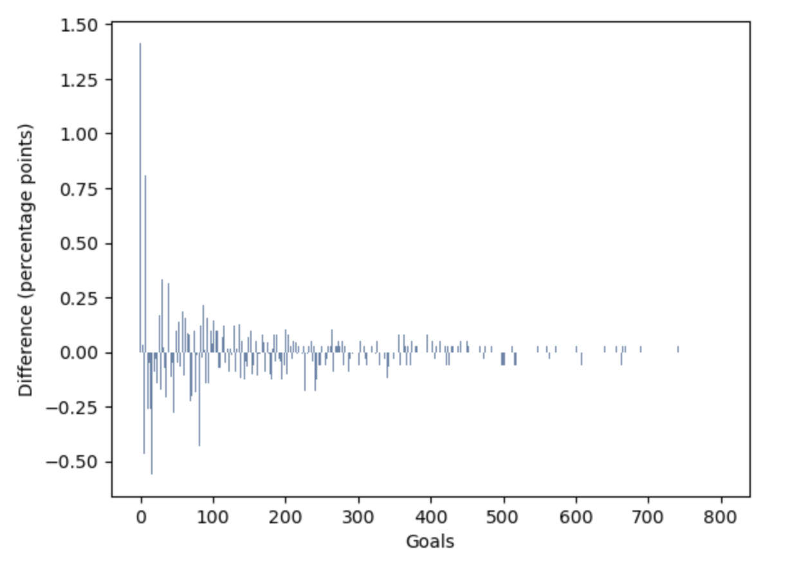
Difference Between Groups (PMF)
This graph is a better way to see the differences for each group at each point. Another area of note is that small section close to the start that non-Canadian goal scorers dominate.

Slide 14
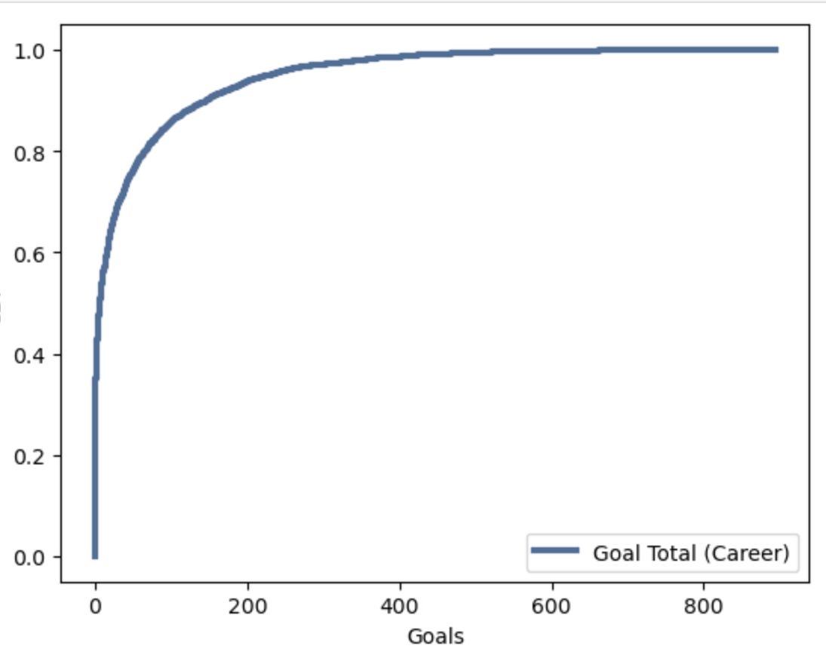
Cumulative Distribution Function
It is like we flipped our histograms vertically! The CDF tell us the probability that a value will be less than or equal to a given value. It supports the histograms though that at around 60-70 goals we see a change. Everything about to those values is covered by about a 60% probability of that value.

Slide 15
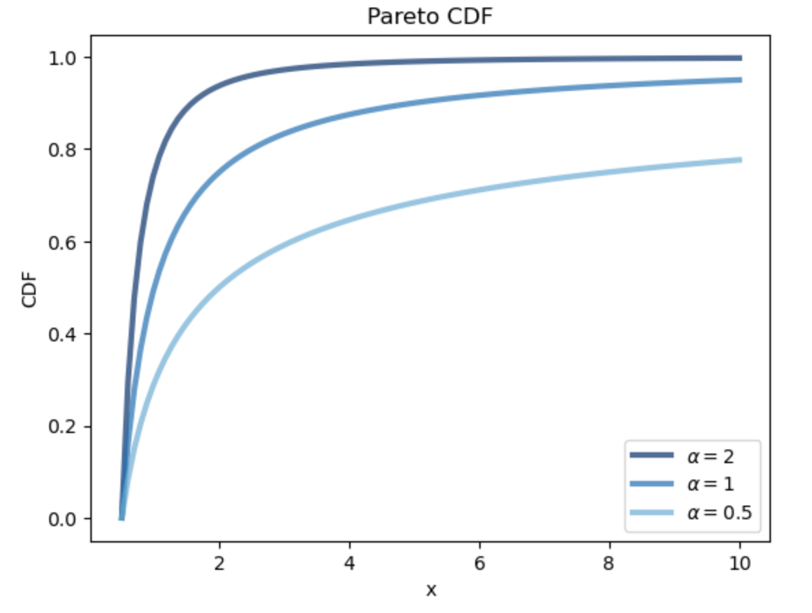
Pareto Distribution
Idea: 80% of the output is done by 20% of the population.
To the right is an example pareto with different parameters.

Slide 16
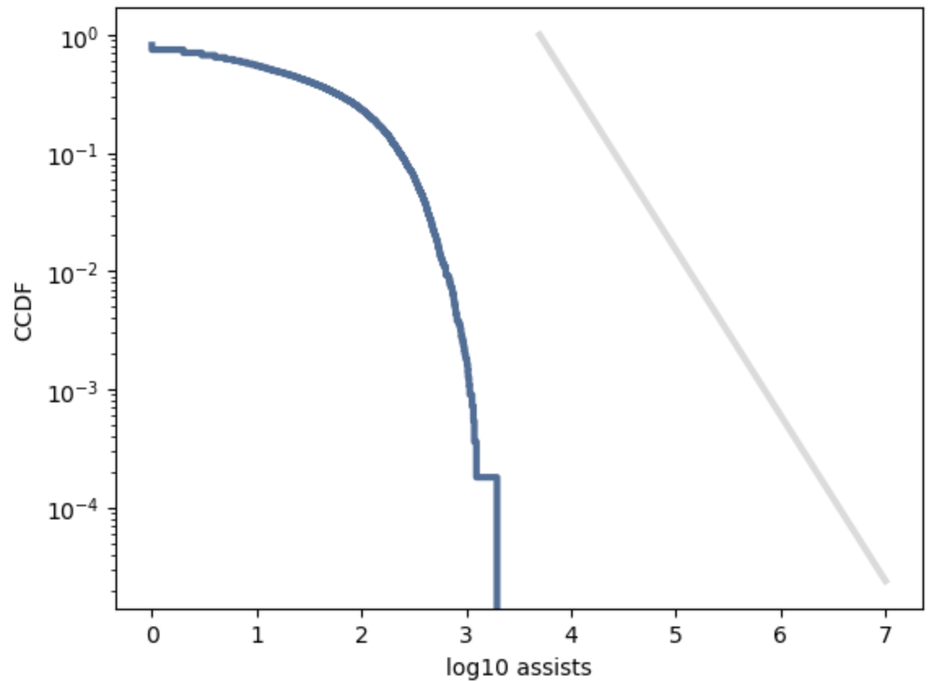
Applied Pareto Distribution
This model did not do well with my data. The data didn’t get anywhere close to the model’s expected results. In hindsight I probably should have tried and exponential distribution.

Slide 17
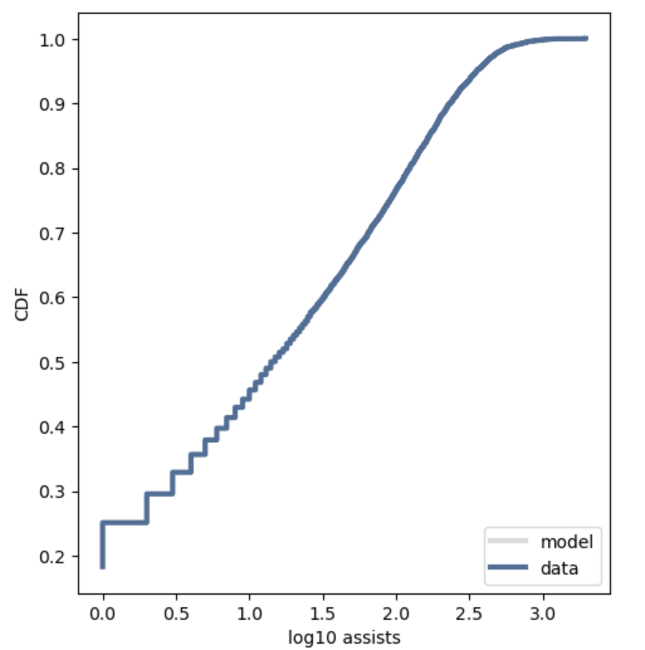
Log Normal Distribution
This model appears to be either an exact fit or the model line is not within the realm of the chart. My hunch is that exponential distribution is better.

Slide 18
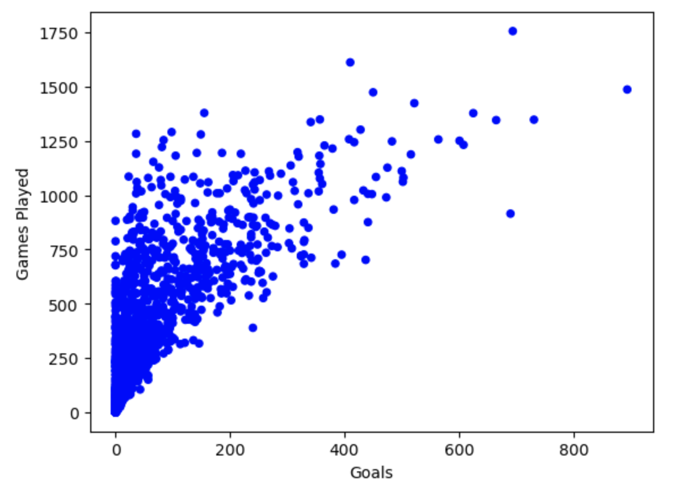
Scatterplots – Goals vs Games Played
Exponential style trend. The data is very clustered at the beginning. We only start to see individual player show up either past about 180 goals or above 750 games. The outlier players tend to be in the top 10 list for the respective variable.

Slide 19
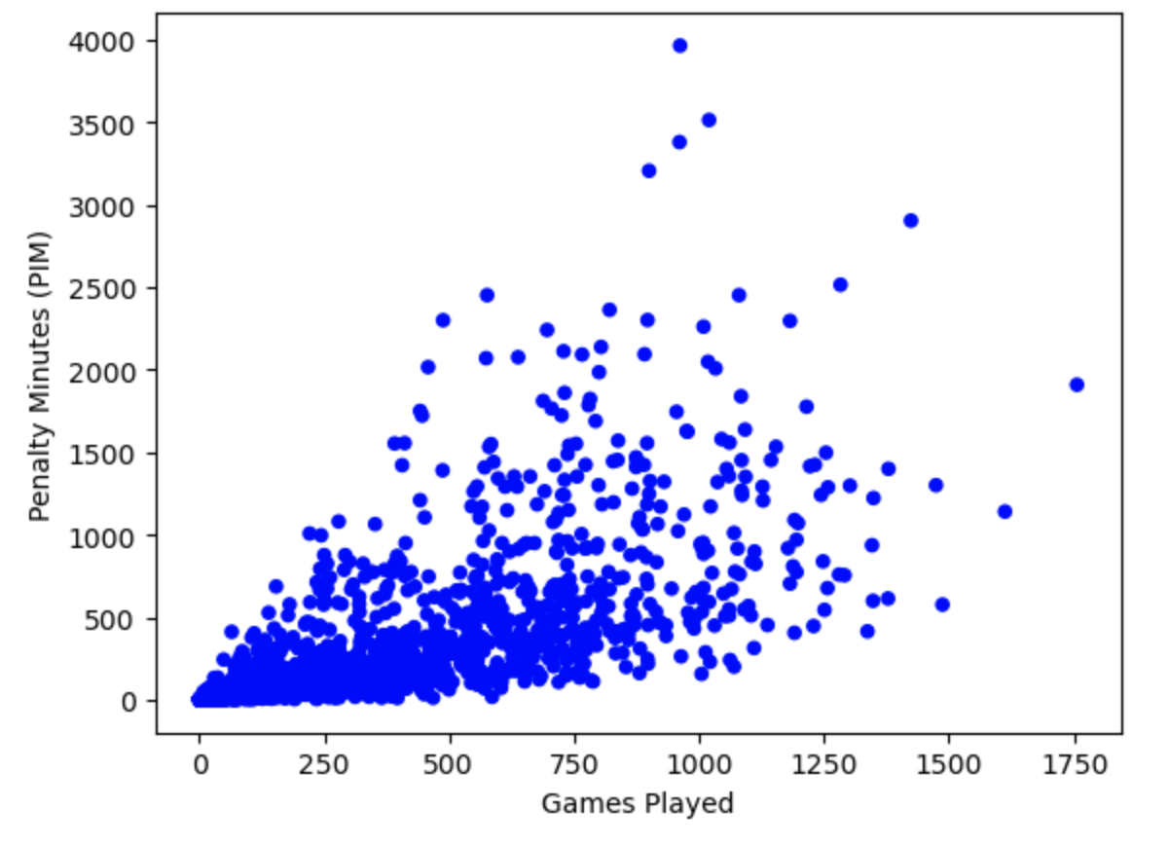
Scatterplot- Games Played vs Penalty Minutes
Relatively shallow relationship. We can see a handful of players though that excelled in penalty minutes in lower than average amount of games at around the 1000 game mark!

Slide 20
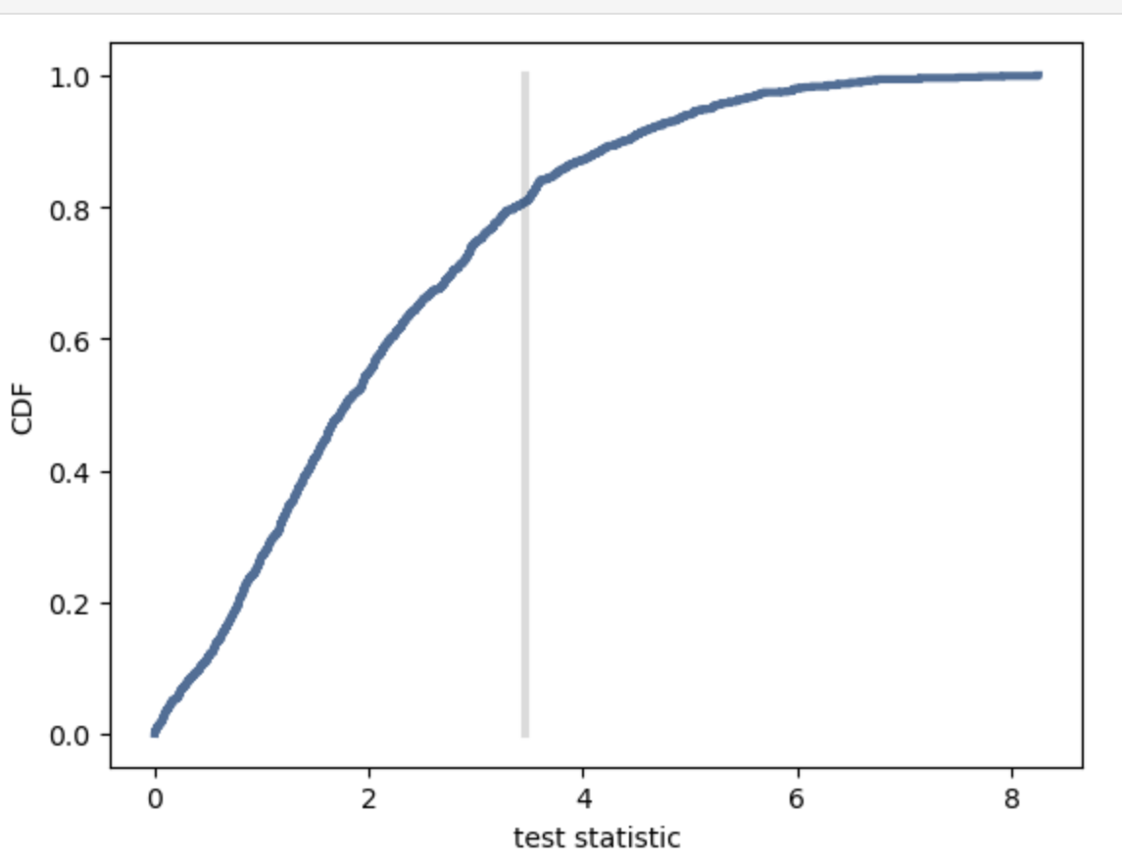
Hypothesis Tests
The graph shows that we expect to see a difference of about 3.5 goals between Canadians vs non-Canadians about 80%-ish of the time which is the compliment of the p-value (0.192). That doesn’t appear to be a big enough difference to say Canadians are better at scoring goals than non-Canadians over the course of a career.

Slide 21
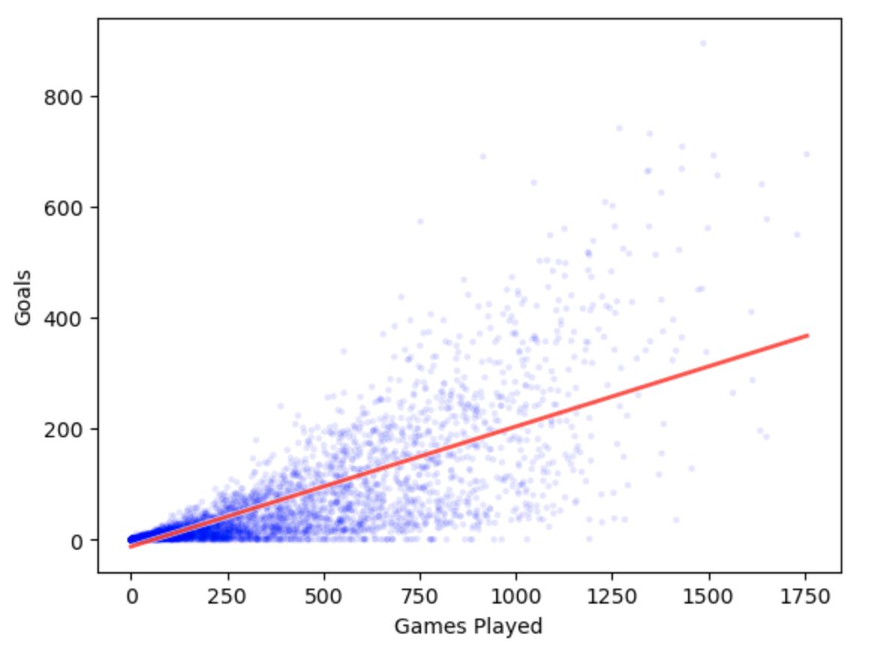
Regression Analysis
Intercept: -12.74
Slope: 0.22
The intercept makes sense because there are probably a few players who never got a goal in their career. The slope is gentle as seen in the scatterplots. At the 0,0 mark a lot of players fall under the regression line but as you get further along you see the outliers pulling the regression line up.

Slide 22
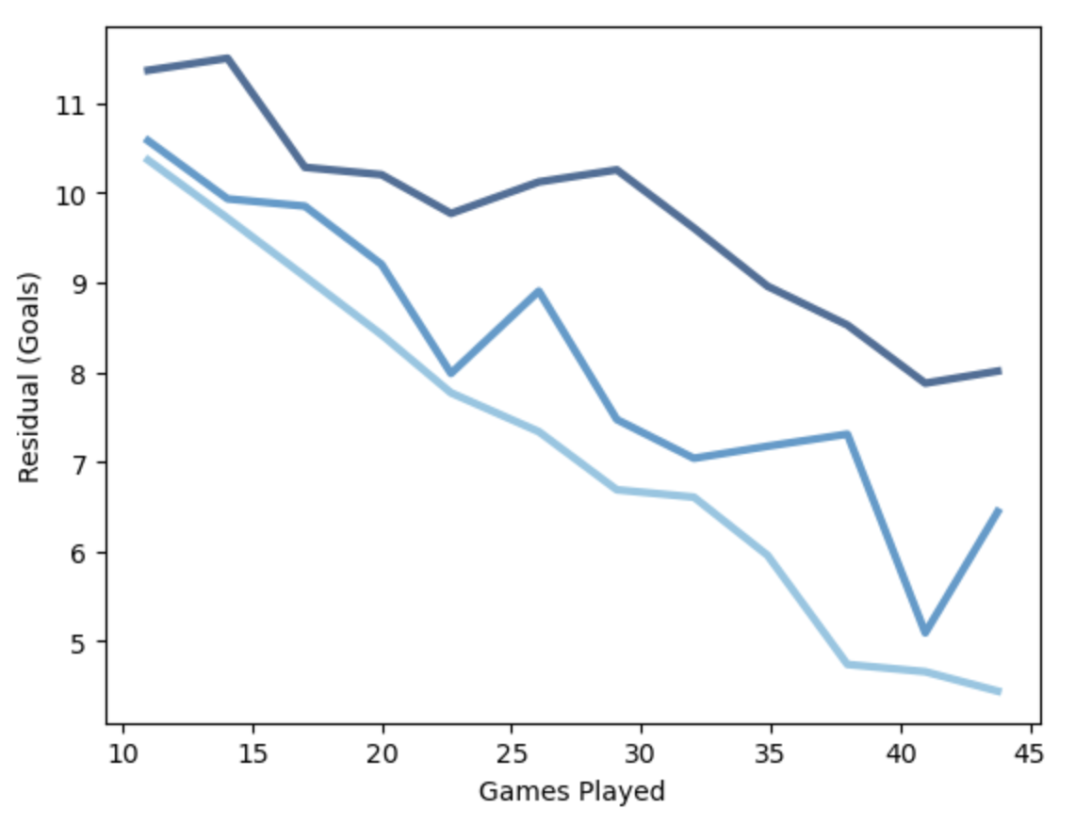
Regression - Residuals
This is the residual plots for the 25th, 50th, and 75th percentile starting from light blue to dark blue.
The 50th percentile is erratic with the interquartile range being anywhere from less than 1 goal to 3 goals depending on how many games they have played.

