Slide 1

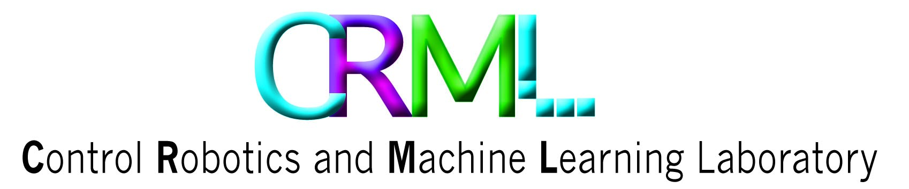

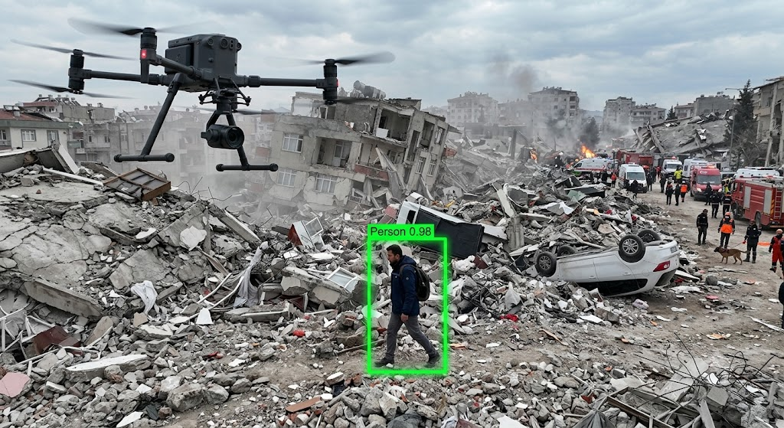
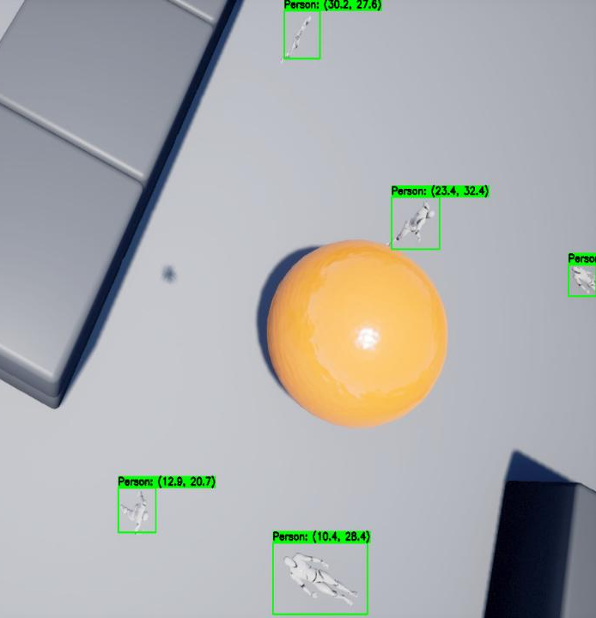
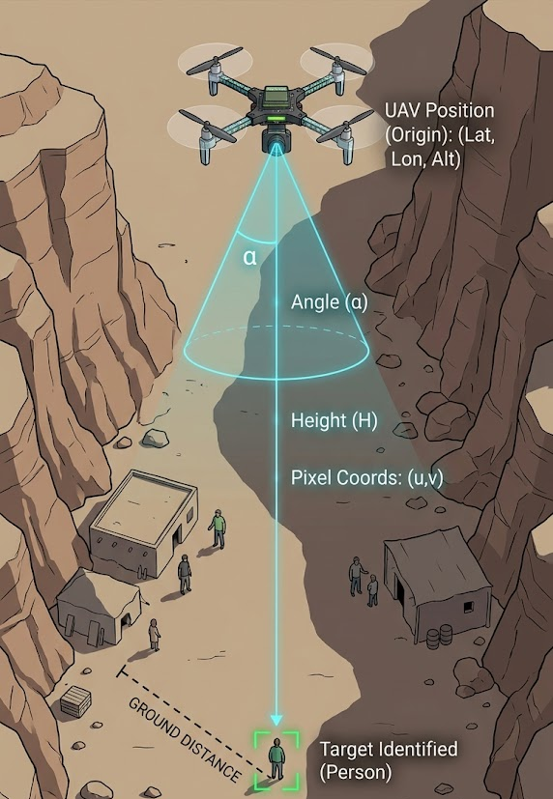
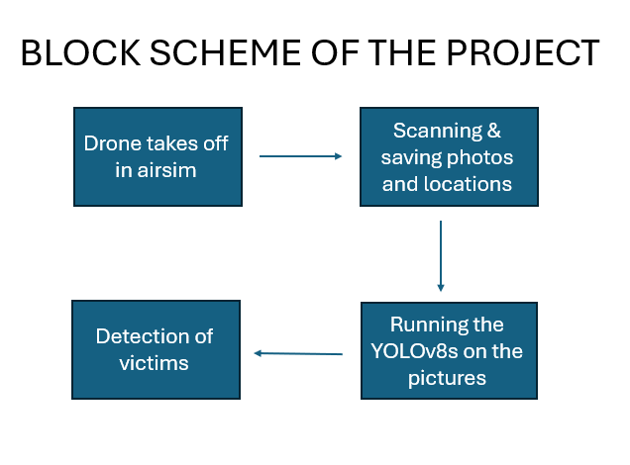
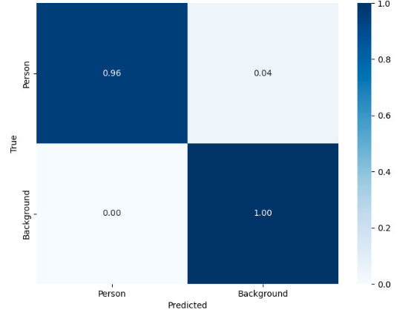
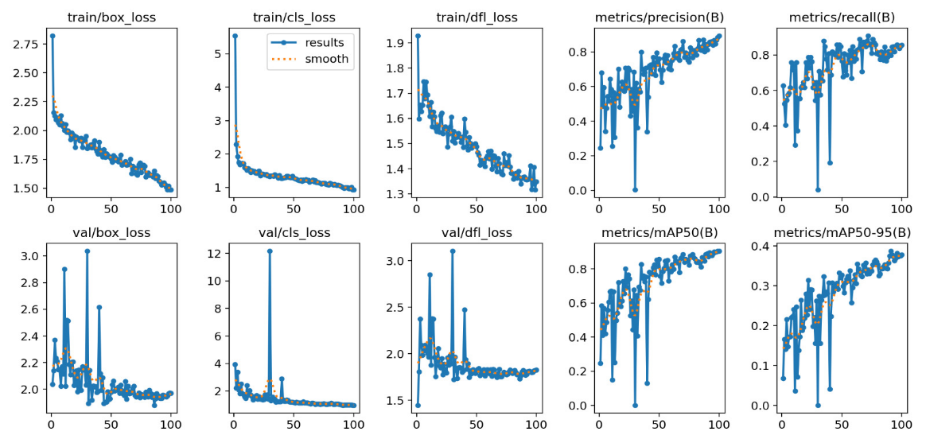
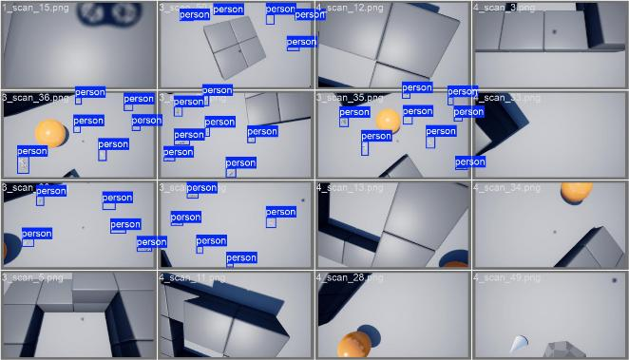
Search & Rescue Drone Assistant
Raz Pizan and Racheli Dor, Supervised by Oren Rosen
Introduction
Geolocation Algorithm
System Architecture
Identifying a survivor visually is insufficient; rescue teams require precise geographic coordinates. We developed a proprietary geolocation algorithm that translates 2D pixel locations from the image into 3D real-world coordinates. Utilizing the drone's altitude, spatial position, and camera FOV, the algorithm applies the following scale factor logic:
Offset (m) = (Pixel Center - Image Center) × Scale Factor
This calculation provides an exact relative position, which is then converted into absolute global coordinates for rapid team deployment.
Search and Rescue (SAR) operations in disaster zones are time-critical and extremely hazardous for human responders. Traditional aerial scanning relies heavily on manual analysis of live video feeds, which is resource-intensive, slow, and highly prone to human error due to cognitive overload.
This project aims to develop a rapid, autonomous system designed to systematically scan complex, unstructured terrains and identify human survivors automatically, thereby minimizing risks to rescue teams and maximizing search efficiency during the critical "Golden Hour."
Pixel-to-GPS Geolocation
Due to the computational limits of the Crazyflie 2.0 drones, we implemented an end-to-end "Store-and-Process" architecture. The workflow consists of three pillars:
Scan: The drone autonomously navigates a predefined search grid using a Python control script.
Acquire: High-resolution images and telemetry data are captured at calculated intervals and stored locally.
Detect: Advanced offline processing is performed using the YOLOv8s algorithm to rapidly identify survivors within the acquired dataset.
We selected the YOLOv8s architecture for its optimal balance between exceptional processing speed and high detection accuracy, tailored for identifying targets in complex terrains.
To adapt the model to the virtual environment, we generated a custom synthetic dataset, manually labeled the images to establish ground truth, and fine-tuned the network to accurately detect survivors within the simulation.
Goals
Autonomous Grid Scan
YOLOv8s Human Detection
Precise Geolocation
Hardware limitations: restricted battery life and a lack of high-resolution camera APIs, makes the Crazyflie 2.0 drone unsuitable for complex, long-range autonomous missions.
Change of Dataset: While the NOMAD dataset provides real-world aerial data, the model failed to generalize to the simulator due to the "Domain Gap“ - the visual difference between real and synthetic textures.
Simulation Selection: Selecting a platform required balancing photorealistic graphics with accurate flight physics to ensure the AI's training would be meaningful and transferable.
Results & Performance
YOLOv8s Model
The transition to synthetic data training yielded exceptional results, proving the viability of our offline processing pipeline.
Detection Accuracy: The fine-tuned YOLOv8s model achieved a 94% overall detection accuracy within the simulated disaster zone.
True Positives: Achieved a 96% success rate in correctly identifying human figures (Precision).
Background Filtering: Demonstrated near-perfect reliability with 100% accuracy in filtering out background noise, effectively eliminating false positives and ensuring rescue resources are only deployed to verified targets.
Challenges
Conclusions
Achieving robust and accurate real-time object detection requires a large, diverse and precisely annotated dataset that matches the target environment, thereby preventing overfitting and minimizing false positives.
The project successfully validated a fully autonomous SAR workflow. By pivoting to Microsoft AirSim, we demonstrated that high-fidelity simulations and synthetic datasets can bridge critical hardware limitations, providing a platform for developing lifesaving algorithms.
Navigation & Data Acquisition
To ensure complete terrain coverage without blind spots, the drone executes an autonomous Lawnmower (Zigzag) Pattern.
The control algorithm calculates the optimal altitude and camera Field of View to determine the exact distance between flight lines.
As the drone traverses the grid, it triggers periodic snapshots. Each image is automatically logged alongside precise GPS and telemetry metadata, creating a highly structured dataset ready for post-flight evaluation.
Confusion Matrix
Model Training Results
Detection of survivors in Airsim
June 2026

