Slide 1
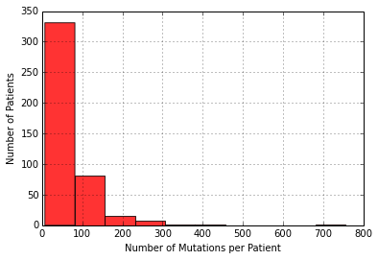
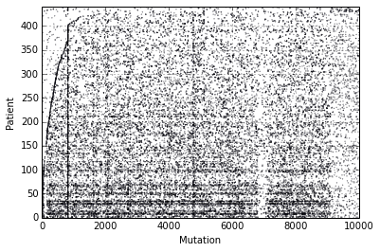
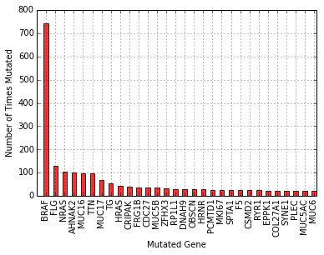
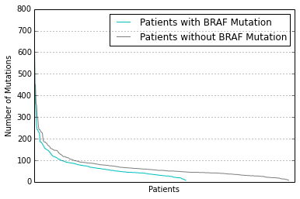
a
b
c
d
Figure 1. (a) There is wide variety in the number of somatic mutations each cancer patient obtains. (b) The somatic mutation landscape does not have apparent trends. (c) BRAF mutations occur frequently; all others are relatively rare. (d) Patients with BRAF mutations have similar numbers of mutations as compared to patients without BRAF mutations.

Slide 2
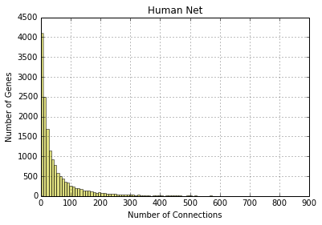
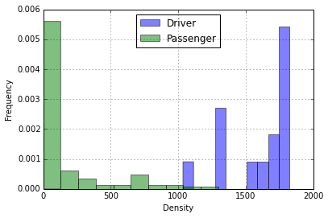
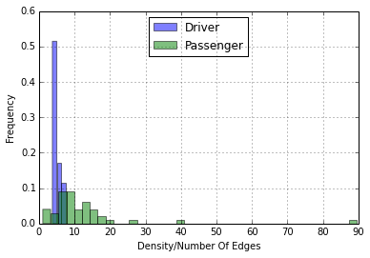
a
b
c
Figure 2. (a) The genes in Human Net have widely varying numbers of connections to other genes. (b) The density scores for driver mutations tend to be much higher than passenger mutations. (c) Driver mutations tend to have more connections; once density is normalized by number of edges, the separation disappears.

Slide 3
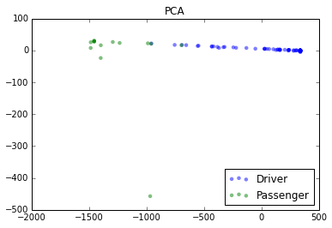
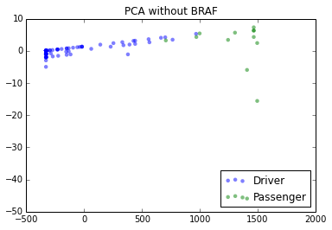
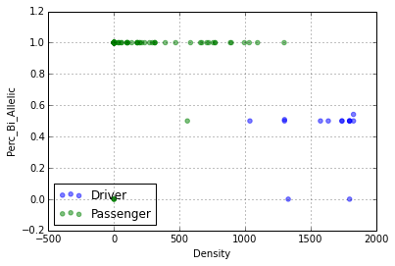
a
b
c
Figure 3. (a) Principle Component Analysis on the Training and Validation data sets. (b) BRAF is a significant outlier; once removed from the analysis, the principle component graph changes. (c) While they do not represent the principle components, the density score and percent bi-allelic score successfully separate the driver and passenger mutations.

