Slide 1
Classifying Thyroid Cancer SNPs
Rachel Marty and Shelly Trigg
BENG 203 Final Project 06/04/15

Slide 2
Background: Thyroid Cancer?
Prevalence:
1.1% of men and women will be diagnosed with thyroid cancer during their lifetime
(http://seer.cancer.gov/statfacts/html/thyro.html)
5th most common female cancer
(Wang, Y. et al. J Med Genet 2013)
Interesting characteristics:
(http://www.endocrineweb.com/conditions/thyroid-cancer/thyroid-cancer)
Thyroid cancer can occur in any age group, although it is most common after age 30
Aggressiveness increases significantly in older patient
Lee et al. Genomics and Informatics, 2013

Slide 3
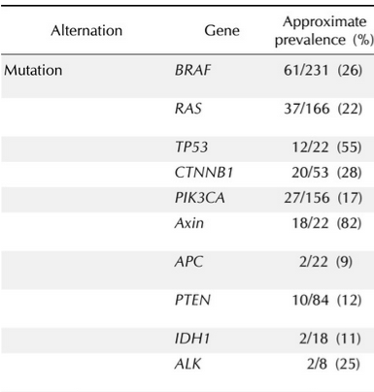
Background: Recent Classification
Logistic regression odds ratio ID’d 5 SNPs :
NRG1
DIRC3
1 lncRNA
2 intergenic regions
(Gudmundsson et al Nat genetics 2009 and Takahashi et al Hum Mol Genet 2010)
Subtype | Common Genes with enriched SNPs
Papillary | RET, BRAF, NTRK1, MET
Follicular | RAS
Medullary | RET
Anaplastic | →
(Lee et al Genomics and Informatics 2013)
http://www.cancer.org/cancer/thyroidcancer/detailedguide/thyroid-cancer-what-causes
Notes:
GWAS: looking across a population to find SNP enrichments in disease case above control case, calculating OR

Slide 4
Background: Recent Classification
Logistic regression odds ratio ID’d 5 SNPs :
NRG1
DIRC3
1 lncRNA
2 intergenic regions
(Gudmundsson et al Nat genetics 2009 and Takahashi et al Hum Mol Genet 2010)
“…need more detailed, multidimensional genomic characterization of thyroid cancer genomes” (Lee et al Genomics Inform. 2013)
More info needs to be incorporated (i.e. more SNPs, CNV, nongenetic factors)
Subtype | Common Genes with enriched SNPs
Papillary | RET, BRAF, NTRK1, MET
Follicular | RAS
Medullary | RET
Anaplastic | →
“…genotyped 5 SNPs…with 9 machine learning methods…found 4 SNPs associated…limited power to predict thyroid cancer.” (Guo, et al Cancer Med. 2014)
(Lee et al Genomics and Informatics 2013)
http://www.cancer.org/cancer/thyroidcancer/detailedguide/thyroid-cancer-what-causes

Slide 5
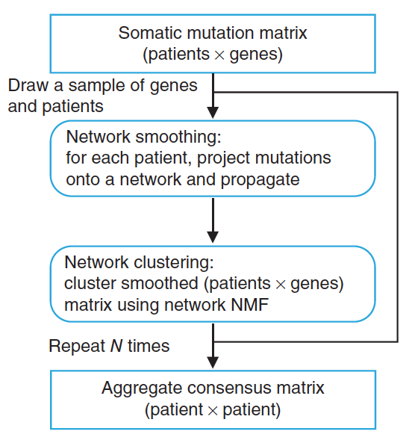
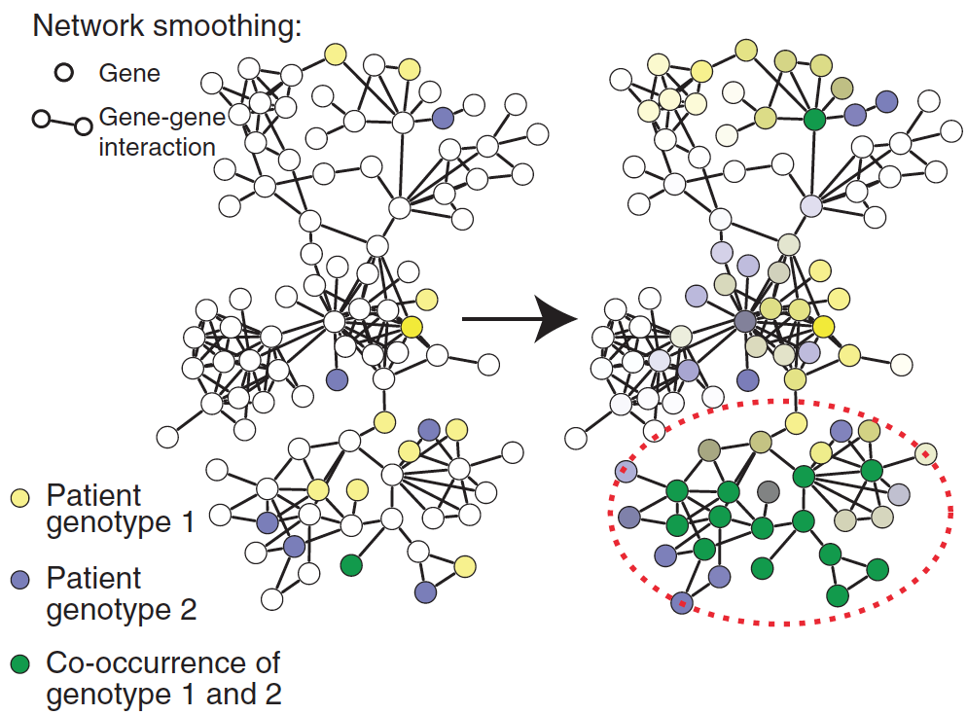
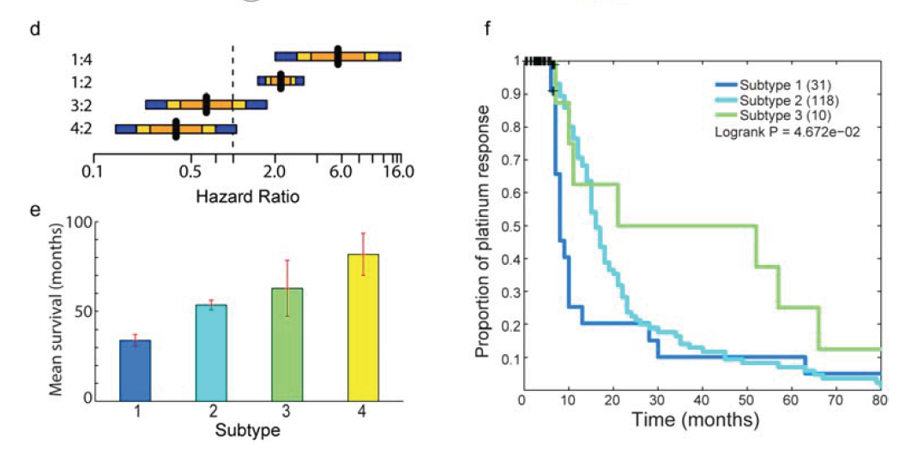
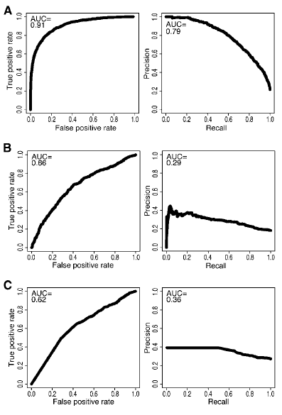
Background: Improving Classification
Network-Based Stratification
Hofree et al Nat Methods 2013
CHASM: Cancer-Specific High-Throughput Annotation of Somatic Mutations
Carter et al Cancer Res. 2009
Classifies somatic driver mutations:
uses 49 features
machine learning: SVMs and Random Forests
Top-ranked Features:
Exon nucleotide conservation
SNP density (# SNPs in exon/exon length)
frequency of missense change type
CHASM outperforms missense mutation predictors
CHASM
PolyPhen PSIC
SIFT
Notes:
incorporating PPI can better predict treatment response and survival rate

Slide 6
Background: Improving Classification
Network-Based Stratification
Hofree et al Nat Methods 2013
Still outliers and not completely comprehensive
CHASM: Cancer-Specific High-Throughput Annotation of Somatic Mutations
Carter et al Cancer Res. 2009
Classifies somatic driver mutations:
uses 49 features
machine learning: SVMs and Random Forests
Top-ranked Features:
Exon nucleotide conservation
SNP density (# SNPs in exon/exon length)
frequency of missense change type
CHASM outperforms missense mutation predictors
CHASM
PolyPhen PSIC
SIFT
Notes:
incorporating PPI can better predict treatment response and survival rate

Slide 7
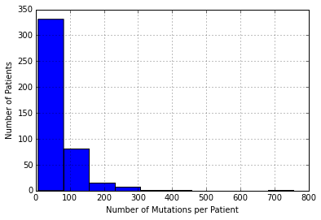
TCGA Thyroid Cancer Data

Slide 8
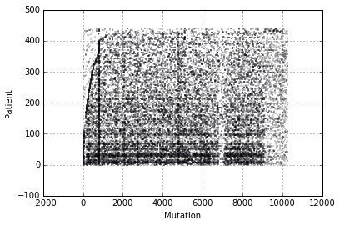
TCGA Thyroid Cancer Data

Slide 9
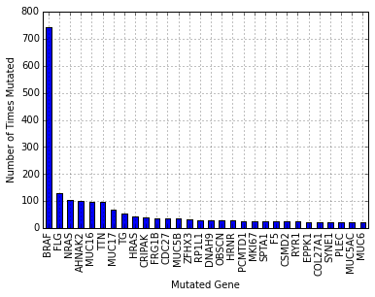
TCGA Thyroid Cancer Data

Slide 10
Classifier: Random Forest

Slide 11
Features
Variant Classification
Variant Zygosity
Variant Occurrence
Density of variants in neighboring proteins
Notes:
Using some of chasm’s best features and then adding density as novel feature

Slide 12
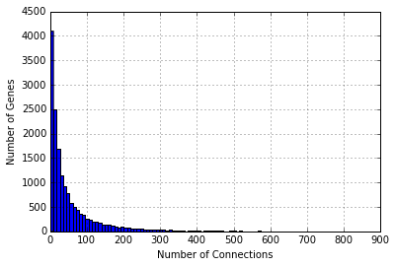
HumanNet – 16,243 Total Genes

Slide 13
Density
Density(gene) = 0.2*(mutations/kb of neighbor) + 0.1*(mutations/kb of neighbor’s neighbors)

Slide 14
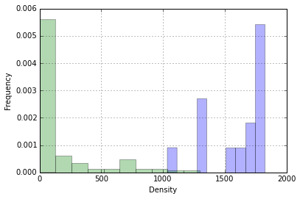
Density
Density(gene) = 0.2*(mutations/kb of neighbor) + 0.1*(mutations/kb of neighbor’s neighbors)

Slide 15
Cosmic Data
Training
10 validated cancer causing mutations
10 predicted neutral (FATHMM and appearance in normal data sets)

Slide 16
Cosmic Data
Training
10 validated cancer causing mutations
10 predicted neutral (FATHMM and appearance in normal data sets)
Validation
4/4 cancer causing mutations classified correctly
103/103 neutral mutations classified correctly

Slide 17
TCGA Mutation Predictions
972 Mutations Predicted Deleterious
19,012 Mutations Predicted Neutral
Feature Importance:
Density
Zygosity
Occurrence
Classification

Slide 18
Necessary Validation
Increase sample sizes of training and validation sets
Add protein functionality features
Functional annotation of predicted cancerous mutation results

Slide 19
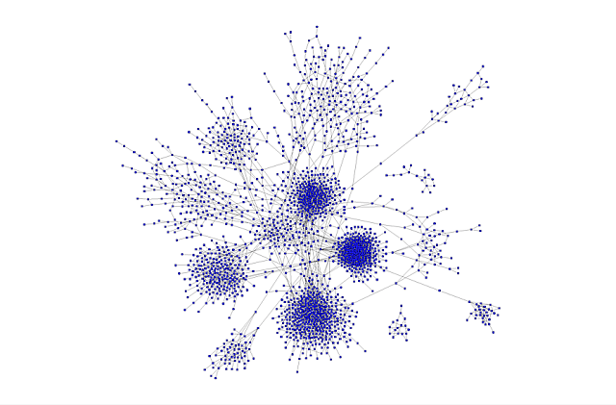
Next Steps
Cluster Mutations
Rank Perturbation of Clusters per Patient
Stratify Patients
Patient | Cluster 1 | Cluster 2 | Cluster 3 | Cluster4
A | 0.5 | 0.1 | 0.2 | 0.2
B | 0.1 | 0.3 | 0.6 | 0.0
http://www.thenetworkthinkers.com

Slide 20



Acknowledgements

