Slide 1
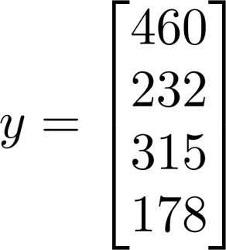
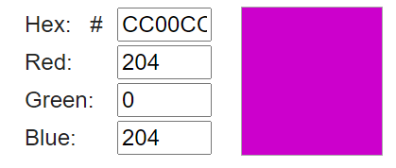
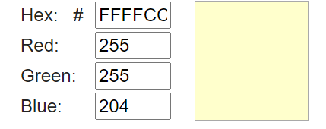
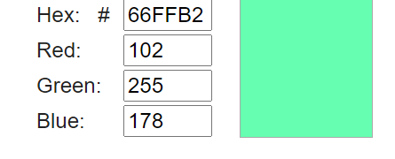
Quiz 1 (5 points): What is the value of vector at location i=3
Math vector representation
Python representation
Quiz 2 (10 points): Which 2 colors of the following are more similar and what is the Euclidian distance between them:
Vector quiz
Quiz 3 (10 points):
a) Calculate cosine similarity between 2 documents bellow:
Document 1 : We are learning machine learning course
Document 2 : We are learning computer vision course
b) What is the dimension of vectors you are working with?
Quiz 4 (10 points): Compute Euclidian distance and Cosine similarity between following 2 vectors:
A = [1,3,5], B= [-3,6,2]

Slide 2
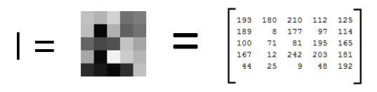
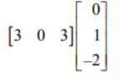




Quiz 5 (10 points): What is the value of matrix
at location x=2, y=3
Math vector representation
Python representation
Quiz 6 (10 points): Multiply the matrices:
Matrix quiz
Quiz 7 (5 points): Indicate whether the statement: “If A is a 4x3 matrix and Bis 3x1 matrix, then the product BA is a 3x3 matrix.” is true or false
Quiz 8: Find A^{T}A if
(10 points)
Quiz 9 (10 points): Rotate vector [1,1] by 30 degrees counter-clockwise
Quiz 10 (10 points): Find inverse matrix if one exists of:
Bonus Quiz 12: (10 points) Suggest an algorithm to get valid rotated image? You can check also that it works in Python
Quiz 11 (10 points): Find eigenvalues of the following matrix: a) b)

