Slide 1
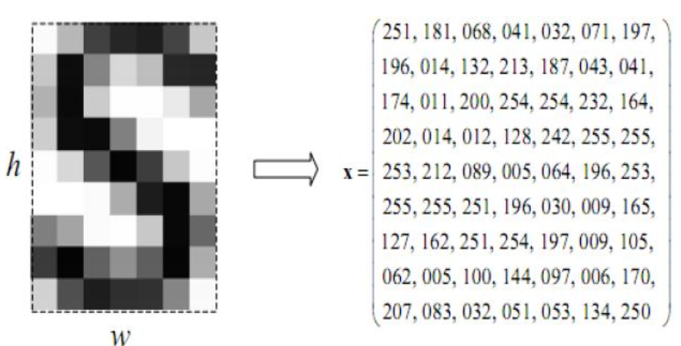

Slide 2

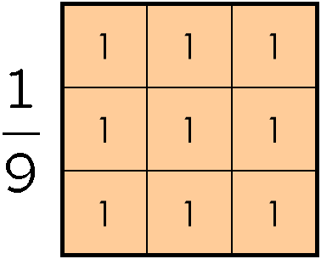
Quiz1: (25 points) Down-sample image I to the image J of size 3x5 still to have the shape which looks like “S”
Quiz2: (25 points) Up-sample (the small down-sampled image J of size 3x5) to the image H of size 6x10 using nearest neighbor interpolation.
Quiz3: (25 points) Smooth original image I using box filter 3x3
Quiz4: (25 points) Smooth original image I using median filter 3x3
Note : All the exercises could be done either in Python (but not using dedicated functions as e.g. smoothing , or manually )

