Slide 1



Water Quality Prediction
Name: Rachi Rajpal
AICTE Internship Student Registration ID :
STU65abaac7158e11705749191
Email : rachirajpal13@gmail.com Contact Info : +917898776913 Gender :FEMALE

Slide 2

Learning Objectives
Build a model to predict multiple pollutant levels
Deploy a user-friendly interface for easy input and results.
Make predictions accessible to non-technical stakeholders.
GOAL
Source :
www.freepik.com/

Slide 3
Tools and Technology used
🔹 Programming Language
Python – core language for data handling, modeling, and logic.
🔹 Libraries & Frameworks
Pandas / NumPy – data manipulation and numerical computations.
Scikit-learn – model training and evaluation.
Pickle – saving and loading trained models.
🔹 Deployment
Streamlit – used to build an interactive web app.
Jupyter Notebook – for exploratory analysis and testing.
🔹 Other Tools
GitHub – version control and code sharing.

Slide 4
Methodology
🔹 1. Data Collection
Gathered historical water quality data.
Each record includes year, station ID, and pollutant levels.
🔹 2. Data Preprocessing
Handled missing values.
Encoded categorical features like station ID using one-hot encoding.
Ensured input format matches the model’s structure.
🔹 3. Model Training
Trained a regression model to predict six pollutants :O₂, NO₃, NO₂, SO₄, PO₄, CL
Used scikit-learn and saved the model using joblib.
🔹 4. Model Deployment
Developed an interactive interface using Streamlit.
Users input Year and Station ID.
App predicts and displays pollutant levels.
🔹 5. Testing & Validation
Tested predictions using known samples.
Verified accuracy and interface functionality.

Slide 5
Problem Statement:
Predict water pollutants based on station ID and year.
Helps in early detection and prevention of water contamination.
Supports environmental and public health planning

Slide 6
Dataset Overview
• Collected data of water quality indicators from multiple stations over several years.
• Key features include: Year, Station ID, and pollutant levels such as O2, NO3, NO2, etc.

Slide 7
Solution:
solution aims to help predict the concentration of six major water pollutants (O₂, NO₃, NO₂, SO₄, PO₄, and CL) based on just two inputs:
Year
Station ID
This helps environmental departments or researchers monitor water quality trends over time for different locations.
How It Works
User inputs data in the web app
Data is encoded and formatted
Model makes predictions
Results are displayed in real-time
Output Pollutants
O₂, NO₃, NO₂, SO₄, PO₄, CL
Streamlit Web App
Simple, interactive UI
Accessible via browser

Slide 8
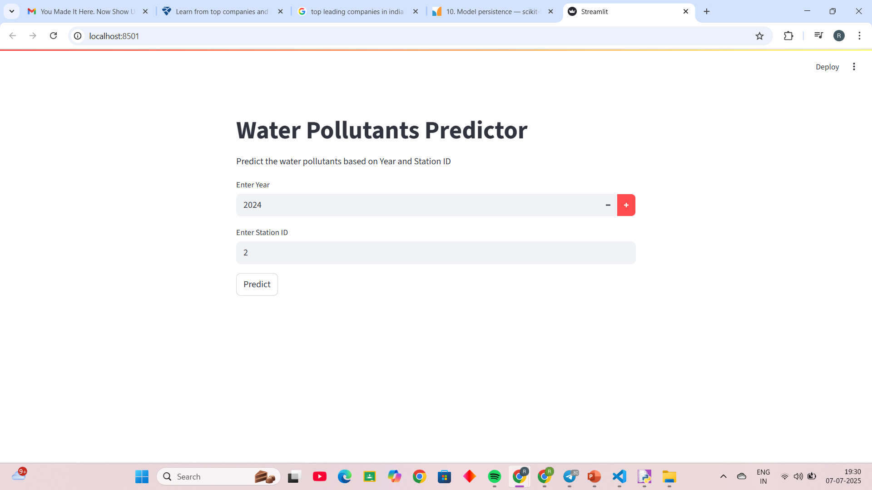
Screenshot of Output:

Slide 9
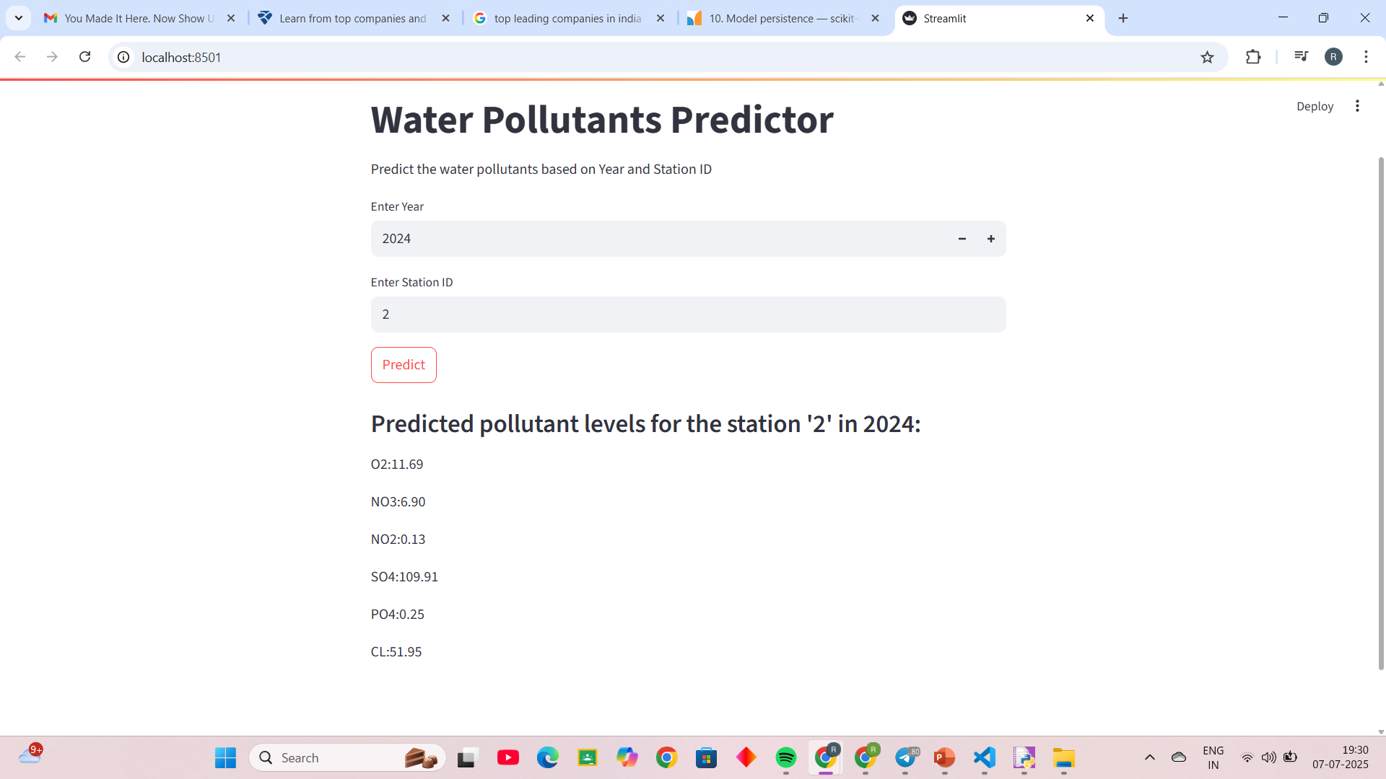

Slide 10
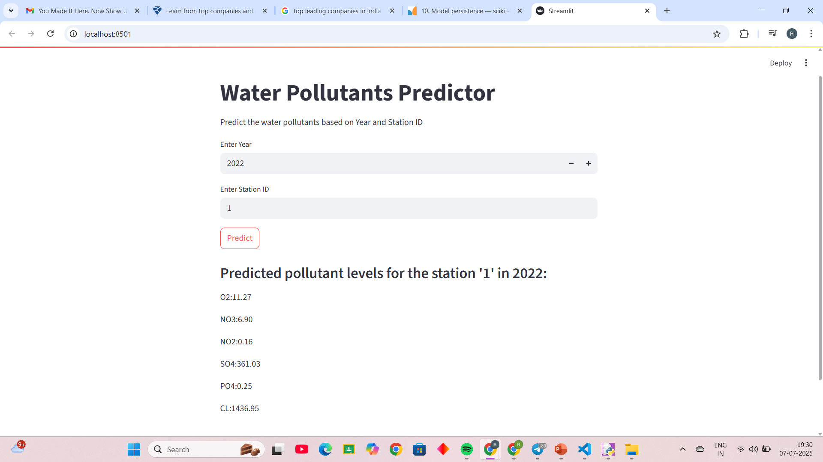

Slide 11
Results & Predictions
• The model successfully predicts pollutant levels like O2, NO3, NO2, SO4, PO4, and CL.
• Predictions vary by station and year, aiding environmental monitoring.
GitHub Repository Link: https://github.com/Rachi-collab/AICTE_Internship_Week2.git

Slide 12
Conclusion:
This project helped understand end-to-end ML workflow.
Demonstrated how ML can assist in environmental protection.
Ready for integration with monitoring systems.

