Slide 1
Automatic Referencing Tool for Thesis and Research
https://www.mendeley.com/

Slide 2
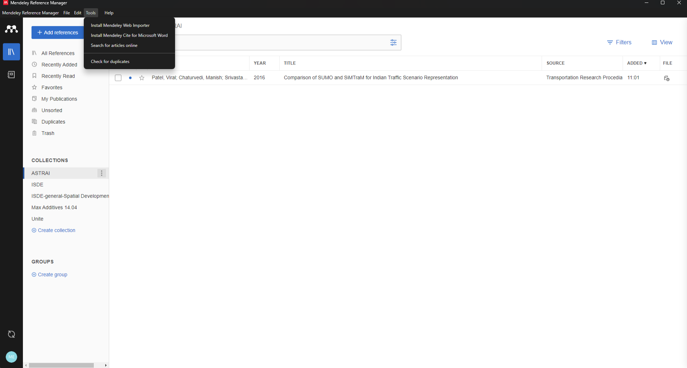

Slide 3
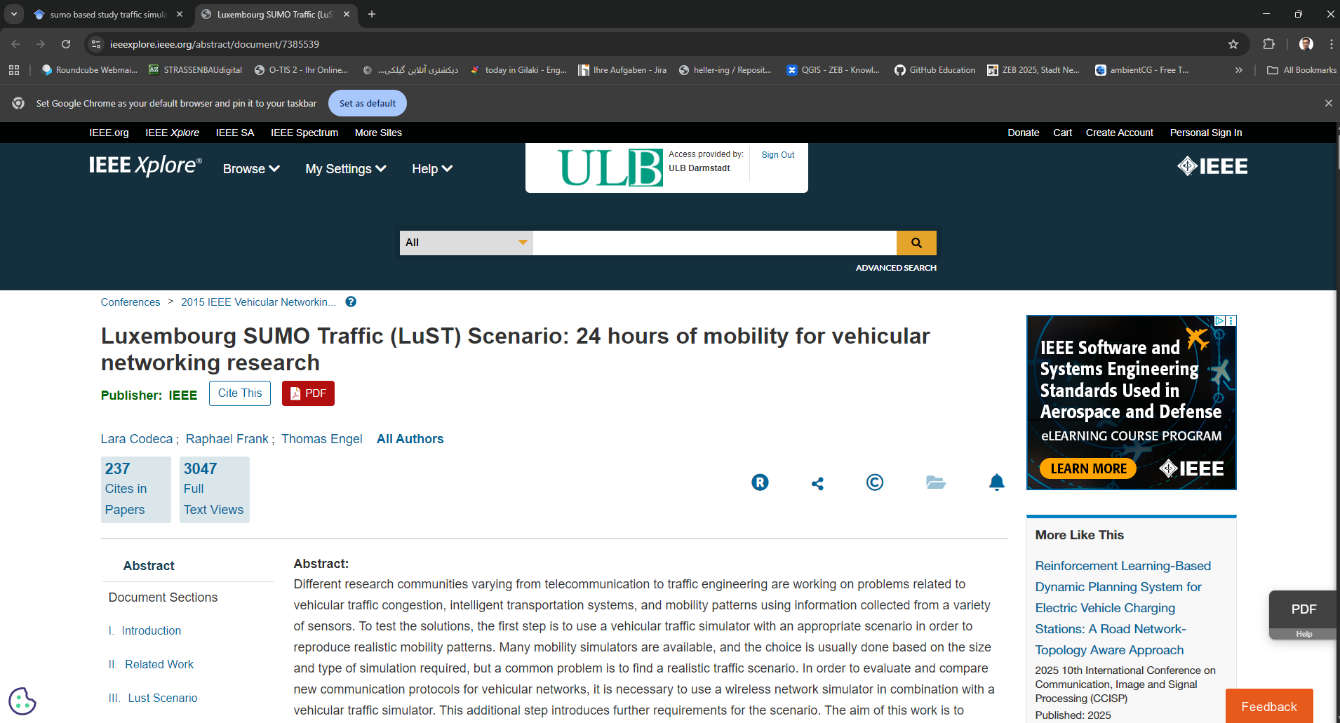

Slide 6
