Slide 1
Texas School District Analysis: Classifying Districts on Their Ability to Prepare Students for College
Capstone 1 Project

Slide 2
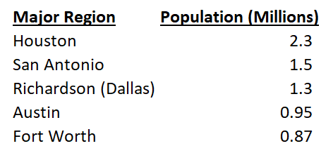
Data Collection: Texas’ Major Regions -The Focus of This Study
In this study, 2011 - 2017 data was collected from the following resources:
-Texas Education Agency (“TEA”):
https://tea.texas.gov/
-Texas Education Reports (“TER”):
https://www.texaseducationinfo.org/
The data was then filtered to focus public school districts within the major regions of Texas. The major regions represent areas with the most economic opportunity, making them prime locations for families and talented educators.

Slide 3
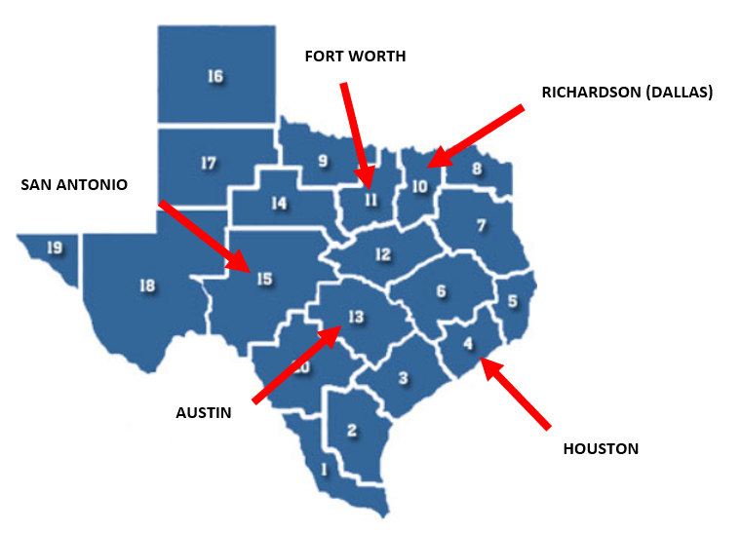
Texas’ Major Regions
Here’s how the Texas Education Agency splits up its educational regions for reporting data
The school districts utilized in this study exist within the highlighted regions

Slide 4

“We Would Like Our Child to Attend College. Do You Know Which School Districts Improve the Likelihood of this Happening?”
This is a very popular question among parents looking to provide their child with a quality education
With a solid high school career, students can go to college prepared to earn their degree and live a more comfortable life.
This is what all concerned parents want for their child transitioning into adulthood.

Slide 5


Asking the Right Questions (Part 1)
The better question for parents to ask is “which school districts improve the likelihood that my child will be able to earn their degree in college?”
The honest truth is that there are many colleges willing to accept your child even if they had poor college admission test results.
Colleges will gladly collect expensive tuition checks until the student fails out (not prepared) or earns a degree (prepared student).

Slide 6
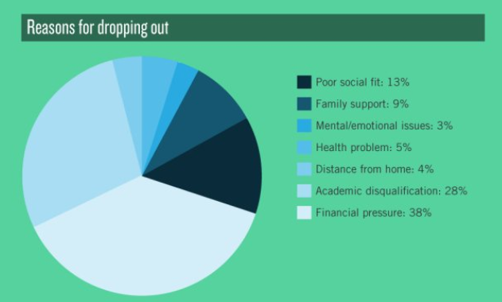
Asking the Right Questions (Part 2)
In a 2011 Harvard study “Pathways to Prosperity”, the U.S. contained the highest college dropout rate among industrialized nations.
Among four-year colleges, just 56% of students graduated within six years (not four. Remember… more time spent means more money spent).
Financial pressure and academic disqualification are the top two reasons why a student drops out.

Slide 7
Aim of the Project:
Through this project, I aimed to reasonably predict the likelihood of a student earning a college degree four years after graduating high school from a certain school district.
In order to do this, historical district features were collected in addition to college graduation data to train a predictive model.
This model can help answer parents’ question about what districts increase their child’s likelihood of earning their degree within four years.

Slide 8

College Admissions Tests
SAT
Highest Possible Score is a 1600
SAT(Total) = Math (800) + Reading/Writing (800)
ACT
Highest Possible Score is a 36
ACT (Composite) =
(Math (36) + Reading (36) + English (36) + Science (36))
/ 4

Slide 9

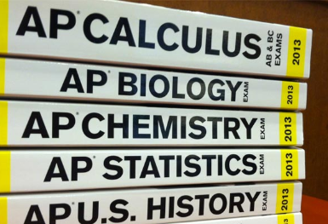
AP Exams
At the end of the school year, students enrolled in AP classes have the chance to earn college credit through AP Exams!
Most colleges nationwide offer college credit for qualifying AP exam scores. College courses can cost thousands of dollars, but if you take and pass an AP test, you’re only spending roughly $93.
AP exams are scored from one to five, with five being the highest score. Colleges will accept a minimum exam score for it to transfer to college credit.
For the purpose of this data analysis, we will use the benchmark score of a 3 (most colleges accept this score) as an indicator of how well students in a district test.

