Slide 1
(Predicting the Percentage of Students Who Will Graduate College Within Four Years, Based on the Features of the School District They Attended High School in)
Texas Education
Capstone 1 Project

Slide 2
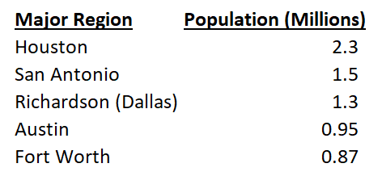
Data Collection: Texas’ Major Regions -The Focus of This Study
In this study, 2011 - 2017 data was collected from the following two resources:
-Texas Education Agency (“TEA”):
https://tea.texas.gov/
-Texas Education Reports (“TER”):
https://www.texaseducationinfo.org/
The data was then filtered to focus public school districts within the major regions of Texas.
The college enrollment and graduation data only considers Texas colleges.

Slide 3
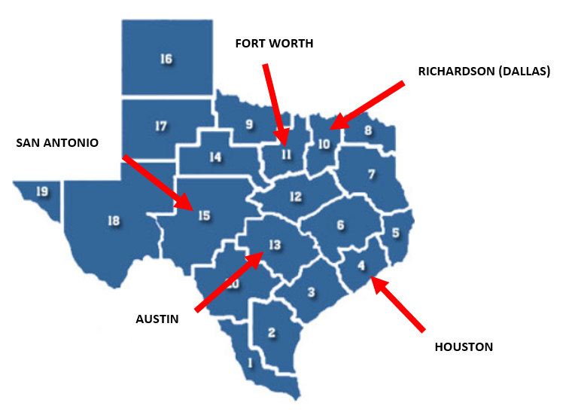
Texas’ Major Regions
Here’s how the Texas Education Agency splits up its educational regions for reporting data
The major regions represent areas with the most economic opportunity, making them prime locations for families and talented educators.

Slide 4

“Which School Districts are Proven to Contain a Higher Percentage of its Graduates Earn a College Degree Within Four Years?”
The above question was presented by clients (parents) considering a move to or within the major regions of Texas. The clients would like their child to one day attend a college in Texas.
They are looking to avoid a situation in which their child takes more time to earn their degree (more tuition money spent) or even fails out (worst case scenario with no return on investment).
In strictly focusing on Texas colleges, the clients are also looking to avoid expensive out-of-state tuition.

Slide 5
Importance Behind the Question & Providing a Solution:
The clients have expressed that they simply want their child to live a more comfortable life after earning a college degree and receiving a quality education.
I approached the problem presented to me by collecting historical data on the percentage of students who earned a college degree within four years’ time after graduating high school from a particular school district. For each school district, their historical features were also collected to measure their influence on the resulting college graduation percentage.
Utilizing this historical data, I aimed to build a predictive model to estimate the percentage of students going to college (from a specific school district) that will graduate within four years.

Slide 6

College Admissions Tests
SAT
Highest Possible Score is a 1600
SAT(Total) = Math (800) + Reading/Writing (800)
ACT
Highest Possible Score is a 36
ACT (Composite) =
(Math (36) + Reading (36) + English (36) + Science (36))
/ 4

Slide 7

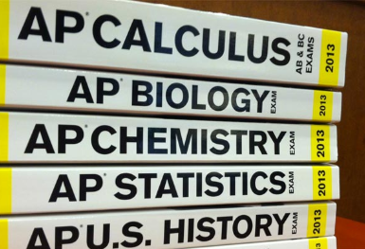
AP Exams
At the end of the school year, students enrolled in AP classes have the chance to earn college credit through AP Exams!
Most colleges nationwide offer college credit for qualifying AP exam scores. College courses can cost thousands of dollars, but if you take and pass an AP test, you’re only spending roughly $93.
AP exams are scored from one to five, with five being the highest score. Colleges will accept a minimum exam score for it to transfer to college credit.
For the purpose of this data analysis, we will use the benchmark score of a 3 (most colleges accept this score) as an indicator of how well students in a district test.

Slide 8
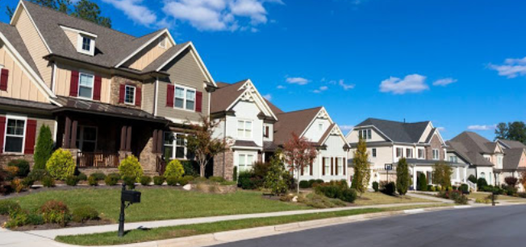
Wealth Per Average Daily Attendance (“Wealth/ADA”)
Wealth/ADA is simply the property value of each school district divided by its average daily attendance.
The property value comes from the Texas state comptroller and is the basis for each school district’s local property tax collections.

Slide 9
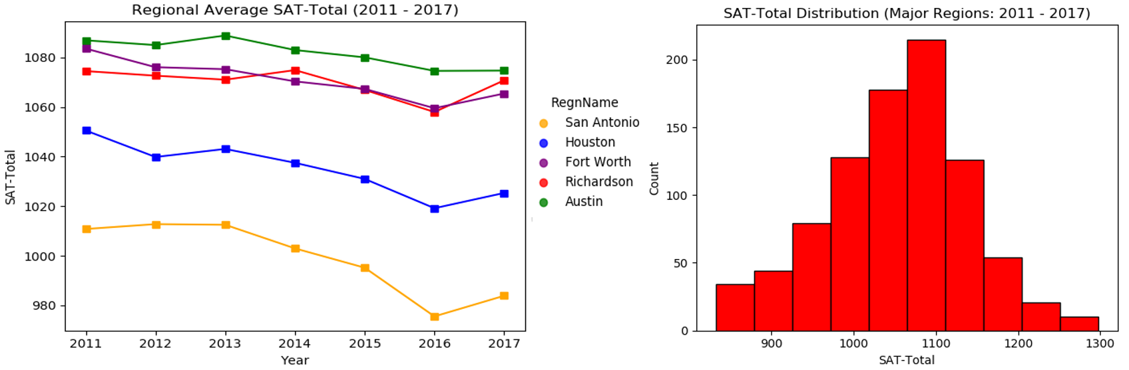
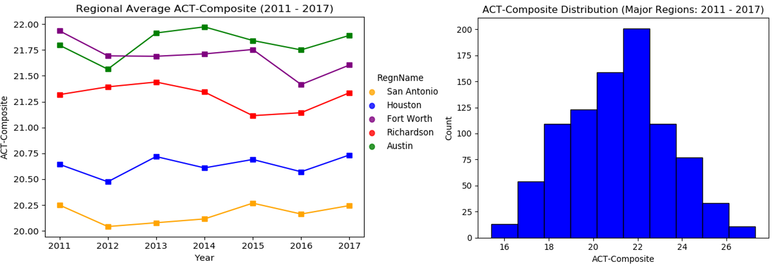
Data Analysis: (SAT & ACT)
District-Level Mean:
1052.8
District-Level Mean:
21.1

Slide 10
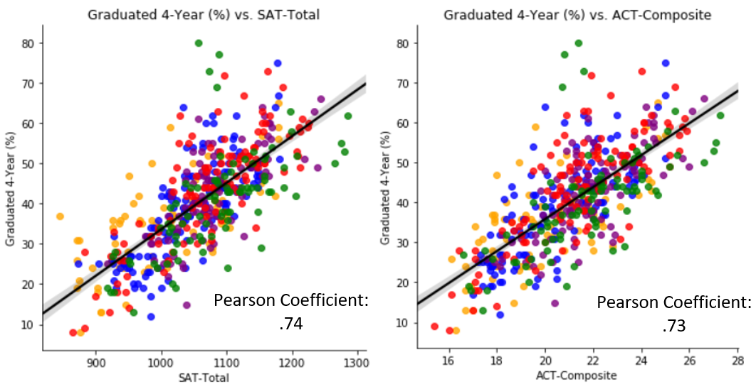

Slide 11

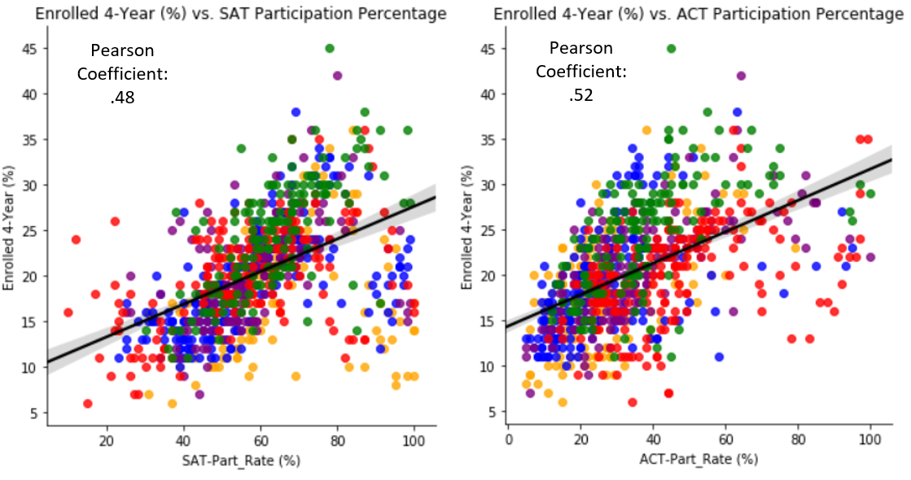
Data Analysis: (SAT/ACT Participation %)
It appears that the classes of 2011 – 2017 all appeared to favor taking the SAT. Why is this?
Participation % for both tests contained similar positive correlations with college enrollment %

Slide 12
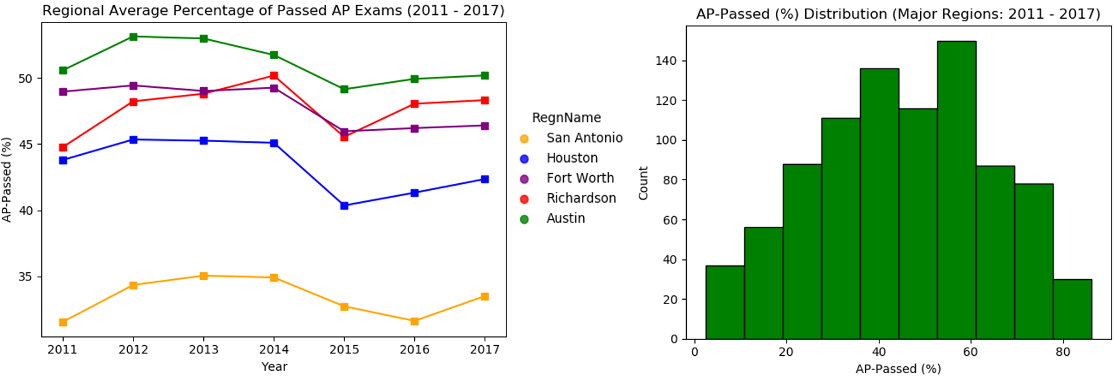
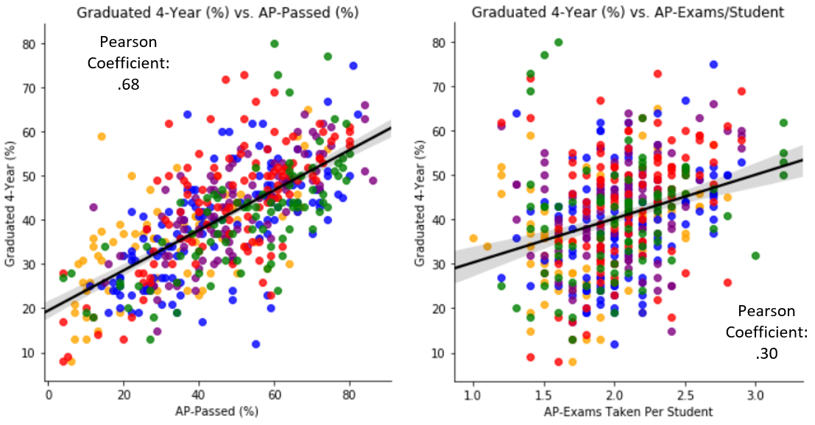
Data Analysis: (AP- Passing % and AP-Exams/Student)
District-Level Mean:
45.1%

Slide 13
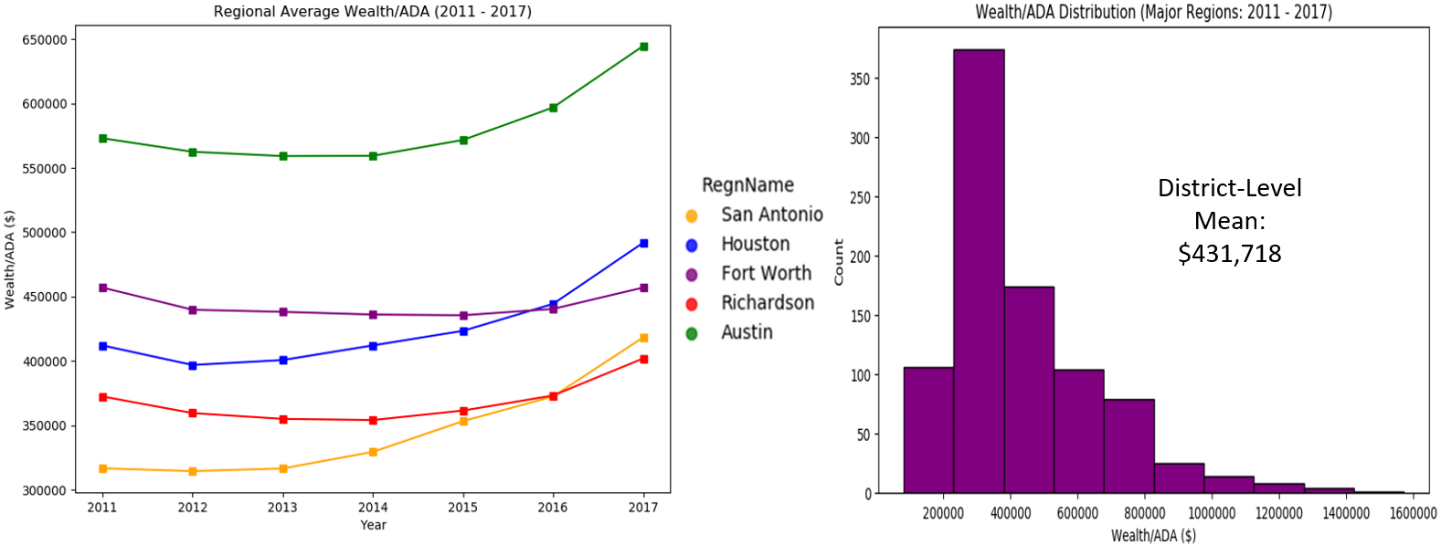
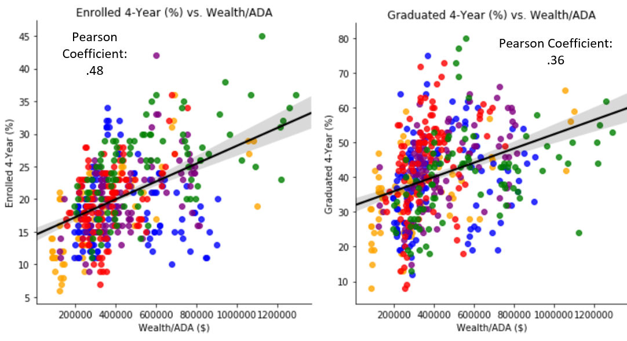
Data Analysis: (Wealth/ADA’s Influence on College Enrollment (%) Versus College Graduation (%))

Slide 14
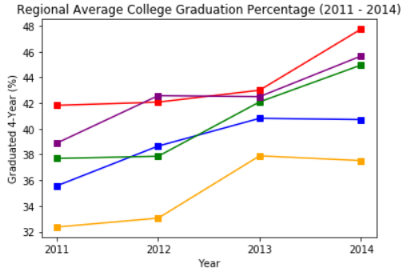
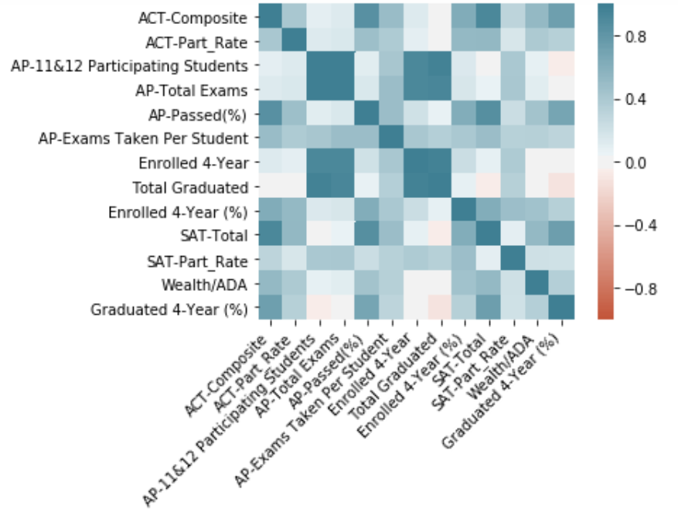
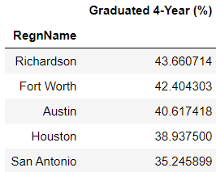
Data Analysis: Historical Percentage of Students Earning a College Degree Within Four Years
Correlation Heatmap:

Slide 15
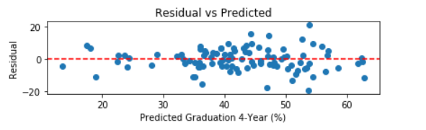

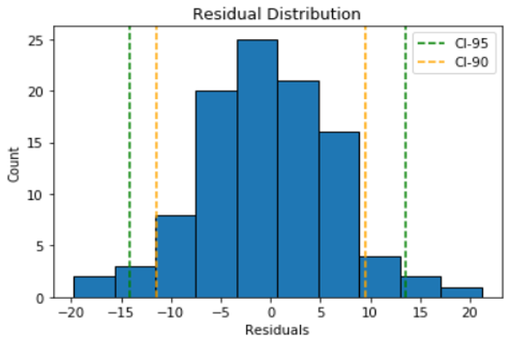

Model 1: Linear Regression

Slide 16
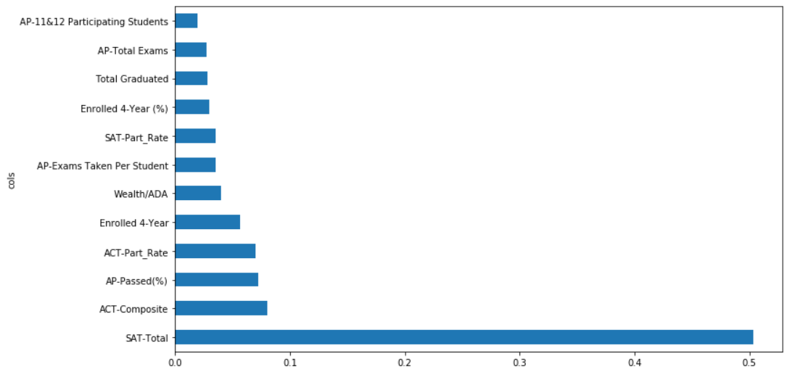
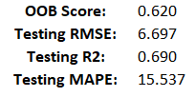
Model 2: Random Forest Regressor (No HyperParameter Tuning)
Feature Importance Plot:
Decided to drop bottom four features for Model 3. Features were redundant and/or used to engineer other features

Slide 17
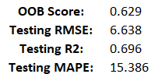
Model 3: Random Forest Regressor (HyperParameter Tuning & Feature Selection)
Best Parameters:
‘n_estimators’: 1000
‘max_features’: ‘log2’
‘min_samples_leaf’: 1
‘n_estimators’: [100, 200, 600, 1000]
‘max_features’: [‘sqrt’, ‘log2’, 0.5, None]
‘min_samples_leaf’: [5, 3, 2, 1]

Slide 18
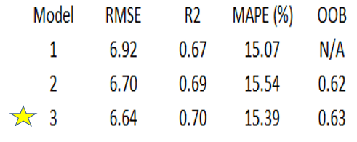
Model Selection – Performance Summary
Best Model: Model 3
While these performance results led me to favor Model 3, we’ll also compare its “Residual vs Predicted” and residual distribution with the base model (Model 1) in the next slide.

Slide 19
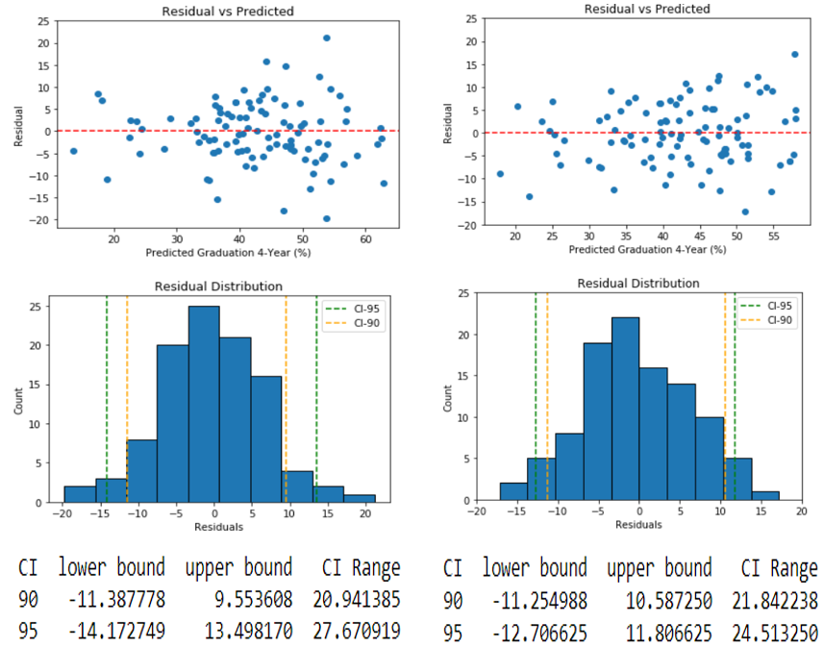
Model 1:
Model 3:

Slide 20
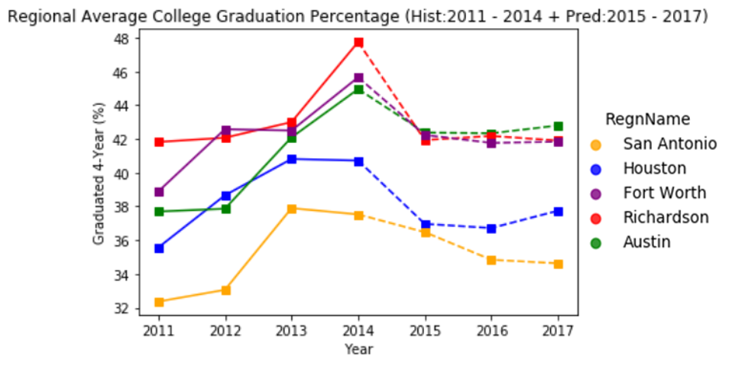
Predicting College Grad. % for High School Classes of 2015 - 2017

Slide 21
Future Work
When high school class of 2015 graduation percentage data come out, this will give me more historical data to train my model on, leading to better predicting power on unseen data.
Neural Network
Replicate project for other states (could lead to some interesting comparisons)
Should data come out for students who were able to graduate within four years from a specific Texas college (Ex: “University of Texas” / “Texas A&M”) after graduating high school from a particular Texas school district, I could build a model for clients that already have that certain Texas college in mind for their child.

Slide 22
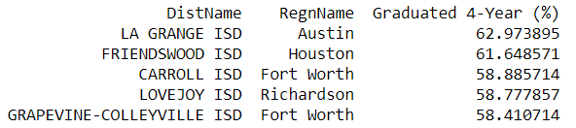
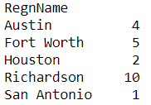
Recommendations to the Clients
Without any particular major region in mind, the client can simply take the approach of seeing who is predicted to average the best college grad. % for classes of 2011 – 2017.
One could also narrow the search to district counts by region for those predicted to average college grad. % above 50%. From this standpoint, client would be advised to consider Richardson (Dallas) due to the number of options

Slide 23
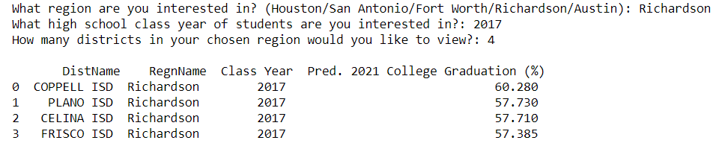
Recommendations to the Clients (continued)
Some clients may prefer taking a look at the class of 2017 to view the predicted college grad. % for 2021. Here clients are taking more of a “what have you done for me lately” approach.

Slide 24
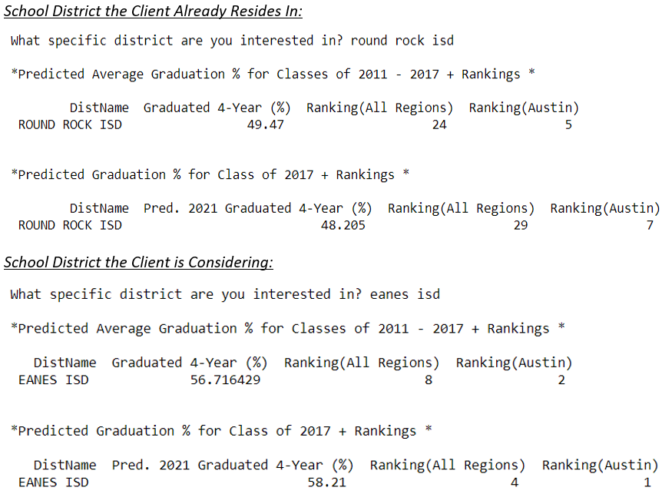
Recommendations to the Clients (continued)
Many clients already live within the major regions of Texas.
They could do a comparison between their current school district and the one they are now strongly considering
Moving can be a great hassle, so the client simply wants some data to convince them it may be worth it!
For the example on the right, I would say the client is justified in strongly considering the move from Round Rock ISD (Austin) to Eanes ISD (Austin).

Slide 25
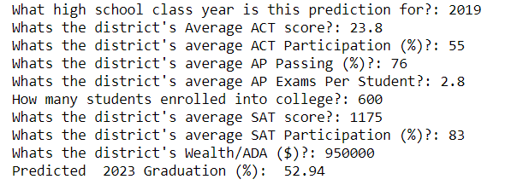
Recommendations to the Clients (continued)
Let’s say there’s a new school district (population growth is very apparent in the major regions of Texas) that’s been in operation for less than four years. If we have the school district’s test results/features from its first graduating class, we can use Model 3 to predict the percentage of those students who will earn a college degree within four years after enrolling into a Texas college. Based on the results, clients may consider a move to the new district.

