Slide 1
Texas Education: (Predicting Percentage of Students Who Will Graduate College Within 4-Years, Based on the Features of the School District They Attended High School in)
Capstone 1 Project

Slide 2
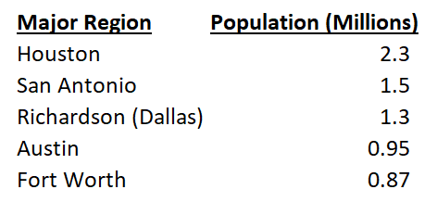
Data Collection: Texas’ Major Regions -The Focus of This Study
In this study, 2011 - 2017 data was collected from the following two resources:
-Texas Education Agency (“TEA”):
https://tea.texas.gov/
-Texas Education Reports (“TER”):
https://www.texaseducationinfo.org/
The data was then filtered to focus public school districts within the major regions of Texas.
The college enrollment and graduation data only considers Texas colleges.

Slide 3
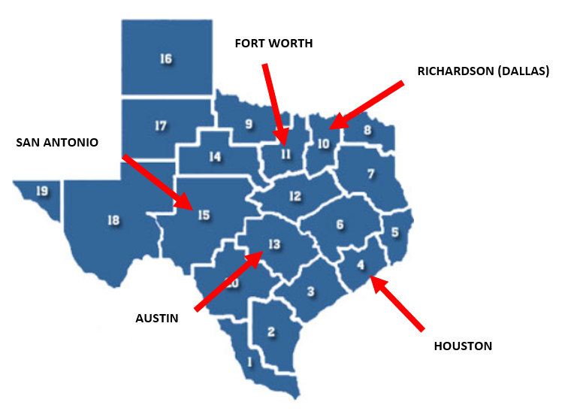
Texas’ Major Regions
Here’s how the Texas Education Agency splits up its educational regions for reporting data
The major regions represent areas with the most economic opportunity, making them prime locations for families and talented educators.

Slide 4

“We Would Like Our Child to Attend College. Do You Know Which School Districts Improve the Likelihood of this Happening?”
This is a very popular question among parents looking to provide their child with a quality education
With quality high school education, students can go to college prepared to earn their degree and live a more comfortable life.
This is what all concerned parents want for their child transitioning into adulthood.

Slide 5


Asking the Right Question
The better question for parents to ask is “which school districts are proven to contain a higher percentage of its graduates earn a college degree within four years?”
The honest truth is that there are many colleges willing to accept your child even if they had poor college admission test results.
Colleges will gladly collect expensive tuition checks until the student fails out (not prepared) or earns a degree (prepared student).

Slide 6
Aim of the Project/Product I Want to Provide:
Through this project, I aimed to study the relationship between the percentage of college students who graduate within four years and the features of the school district they attended high school in.
In order to achieve this goal, historical district features were collected for the high school classes of 2011 – 2017, along with the resulting percentage of students who were able to earn their college degree within four years.
With the historical data in place, I then utilized machine learning to build a predictive model to estimate the target variable (“Graduated 4-Year (%)”)

Slide 7

College Admissions Tests
SAT
Highest Possible Score is a 1600
SAT(Total) = Math (800) + Reading/Writing (800)
ACT
Highest Possible Score is a 36
ACT (Composite) =
(Math (36) + Reading (36) + English (36) + Science (36))
/ 4

Slide 8


AP Exams
At the end of the school year, students enrolled in AP classes have the chance to earn college credit through AP Exams!
Most colleges nationwide offer college credit for qualifying AP exam scores. College courses can cost thousands of dollars, but if you take and pass an AP test, you’re only spending roughly $93.
AP exams are scored from one to five, with five being the highest score. Colleges will accept a minimum exam score for it to transfer to college credit.
For the purpose of this data analysis, we will use the benchmark score of a 3 (most colleges accept this score) as an indicator of how well students in a district test.

Slide 9

Wealth Per Average Daily Attendance (“Wealth/ADA”)
Wealth:
Property values of the homes that are zoned to a specific district
Average Daily Attendance (“ADA”):
ADA = Sum of Attendance Counts / Days of Instruction

Slide 10
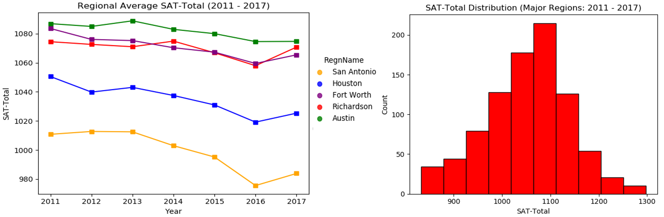
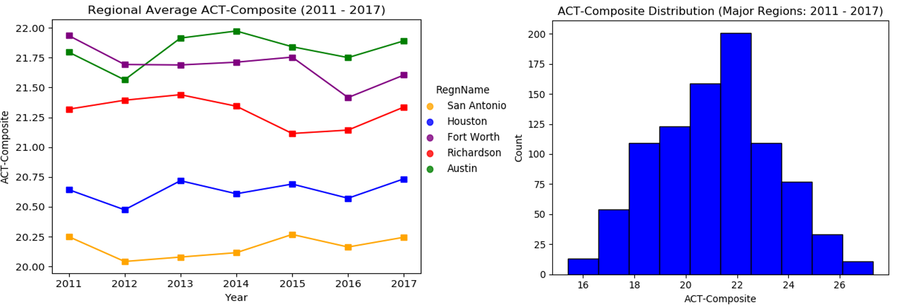
Data Analysis: (SAT & ACT)
District-Level Mean:
1052.8
District-Level Mean:
21.1

Slide 11
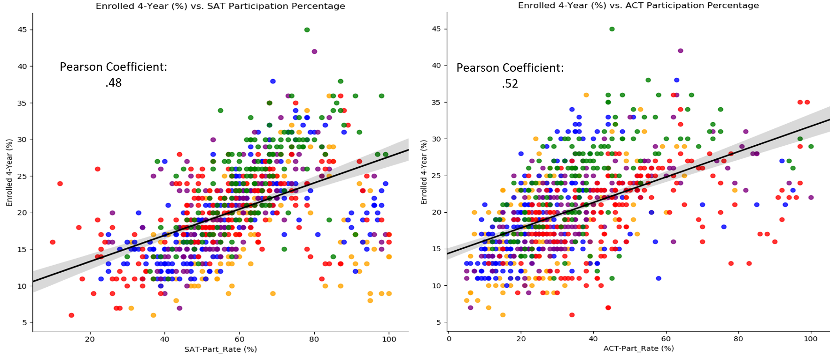
Data Analysis: (SAT/ACT Participation %)
It appears that the classes of 2011 – 2017 all appeared to favor taking the SAT. Why is this?
It’s extremely curious that this trend exists when you consider that all it takes is doing well on one of the two tests to gain college admission and receive scholarship

Slide 12
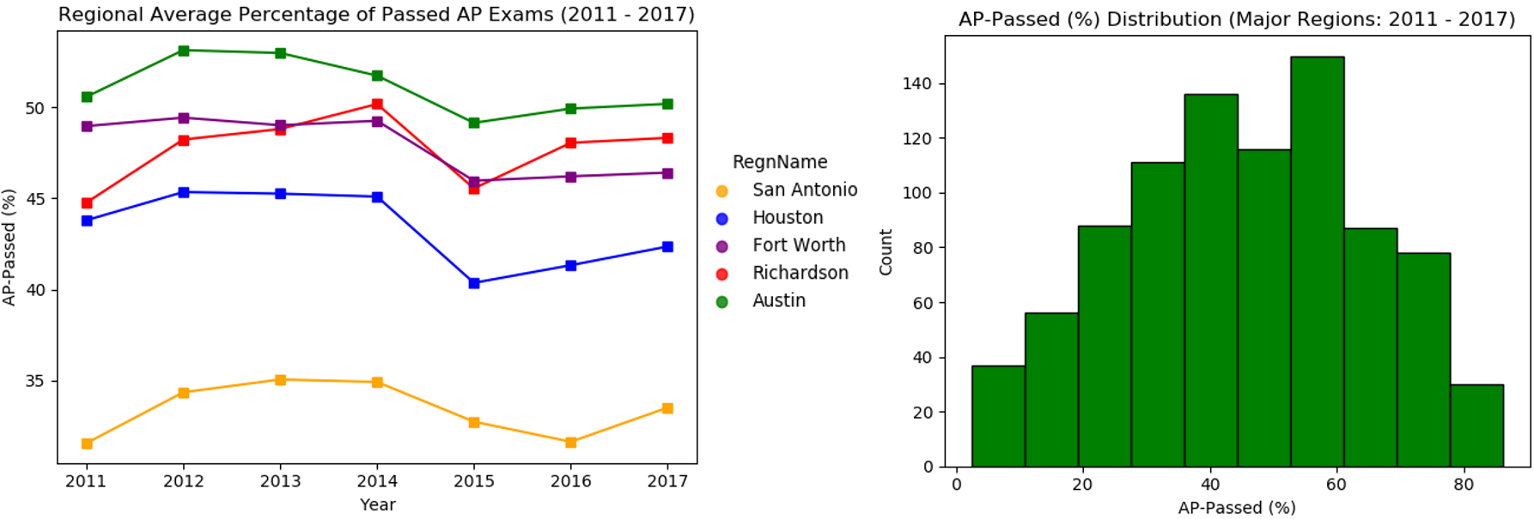
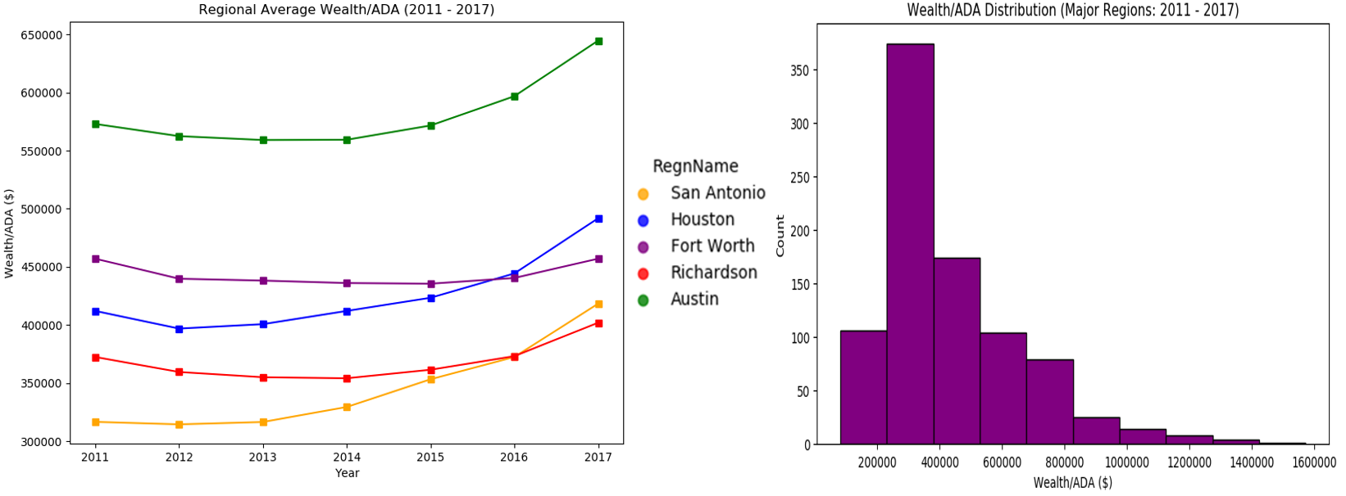
Data Analysis: (AP- Passing % and Wealth/ADA ($)
District-Level Mean:
45.1%
District-Level Mean:
$431,718

Slide 13
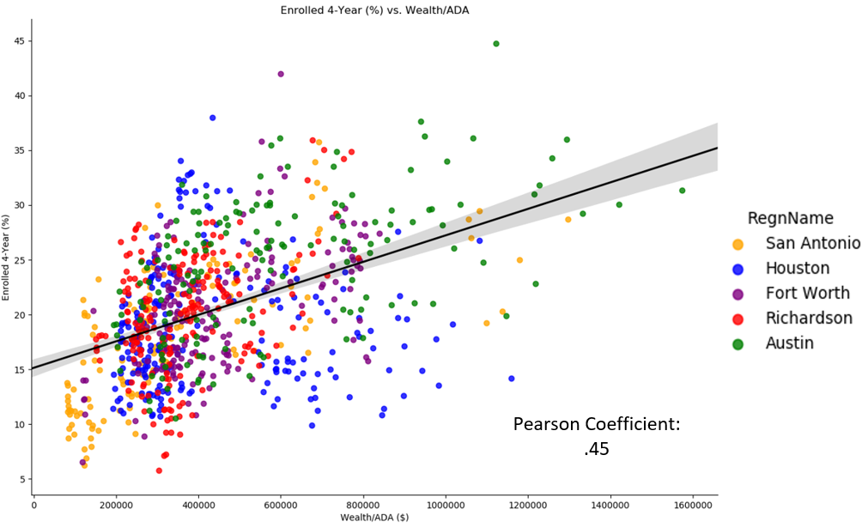
Data Analysis: (Wealth/ADA Effect on College Enrollment Percentage and College Graduation Percentage)
PART 1 of 2
Acknowledging that college is a business in the United States, one could hypothesize that we should see a decent correlation between Wealth/ADA and college enrollment percentage.
There does exist a positive correlation between the two, but its important to acknowledge that Wealth/ADA is not the sole factor in determining college enrollment percentage.
(SAT/ACT/AP etc.….)

Slide 14
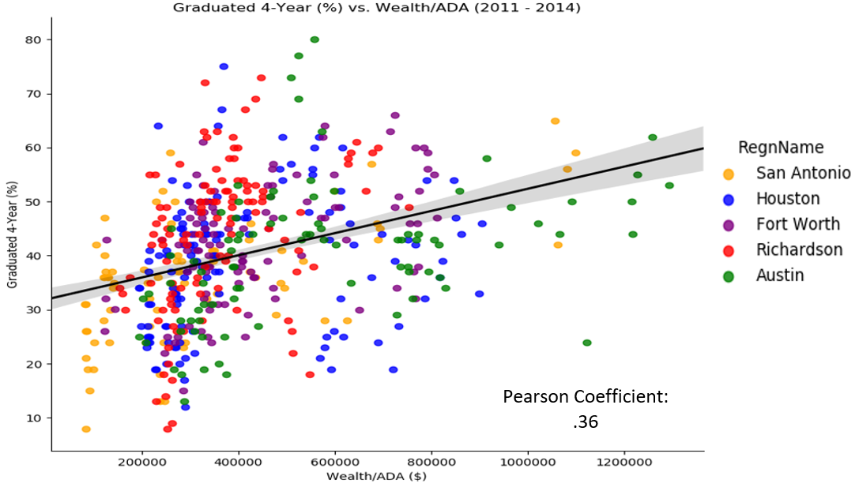
Data Analysis: (Wealth/ADA ($) Effect on College Enrollment Percentage vs. College Graduation Percentage)
PART 2 of 2
The correlation between Wealth/ADA and college graduation was a little bit weaker, but still positive.
Compared to college enrollment percentage, this is where the student’s actual education/performance has the upper hand in influencing the outcome.
In the middle-left part of the figure we see some of the highest college graduation percentages near the mean Wealth/ADA ($431,718)

