Slide 1
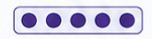
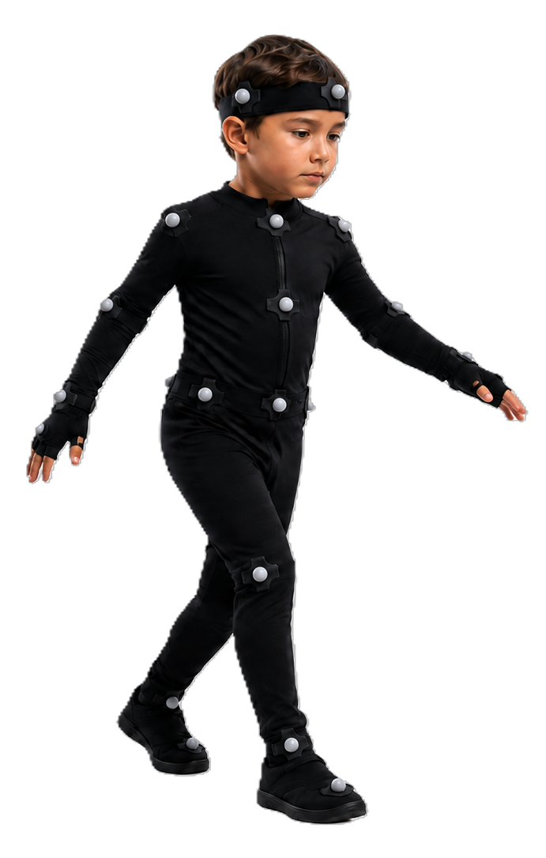
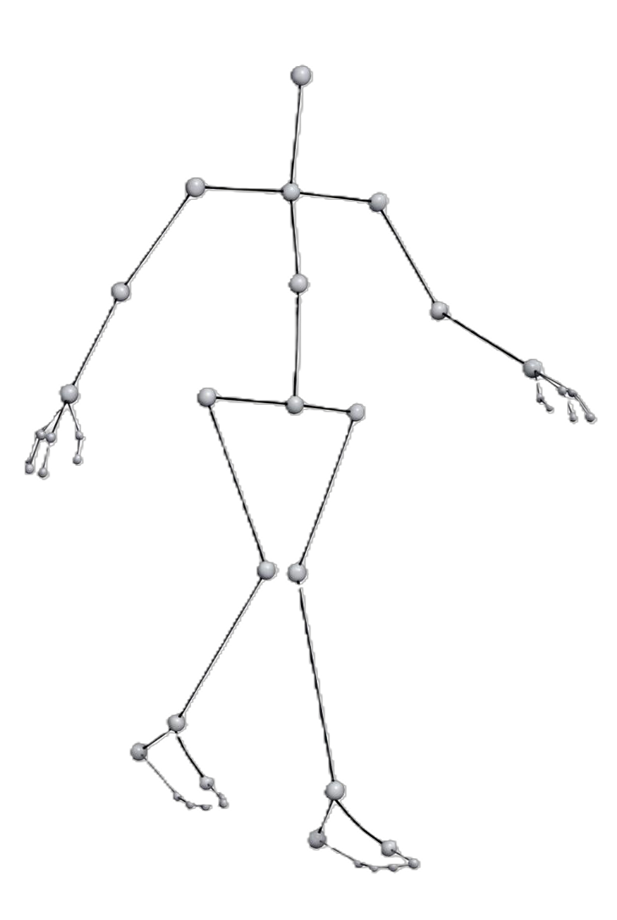
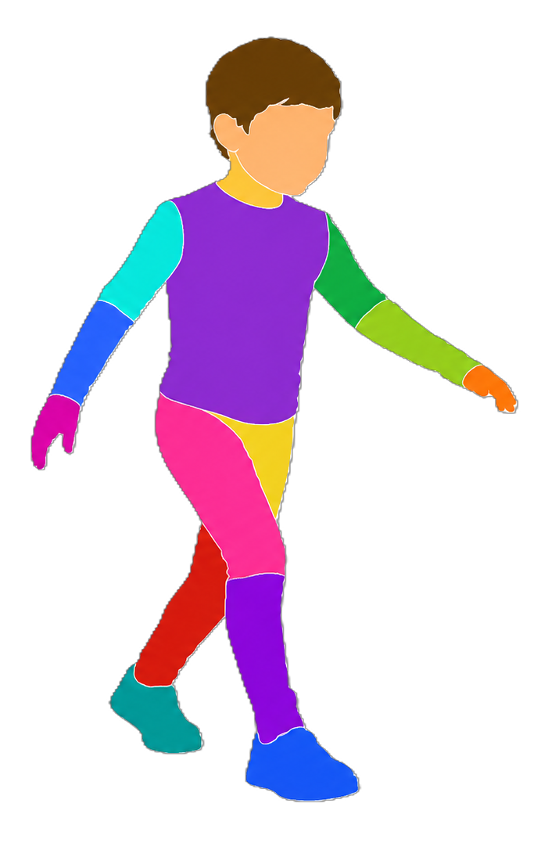
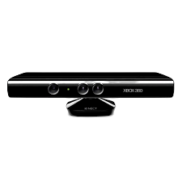

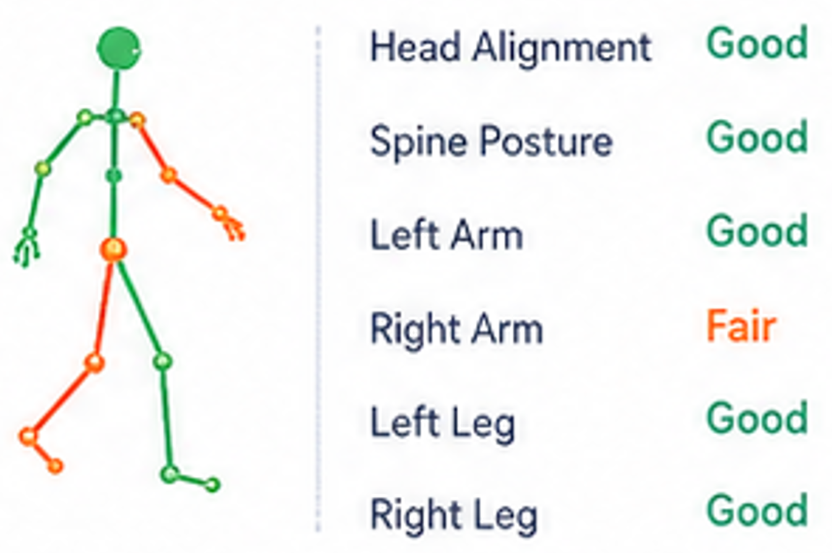



General Pipeline of AI-Based ASD Movement Analysis
1
2
3
4
5
6
Data
acquisition
Pre-
processing
Feature
extraction
AI model
ASD / TD
classification
or SMM
detection
Clinical
interpretation
• RGB video
• Kinect/Depth sensors
• Motion capture (VICON)
• Wearable IMU sensors
• Force plates
• segmentation
• denoising
• normalization
• pose estimation
• skeletal tracking
• kinematic features
• gait parameters
• skeletal features
• spatiotemporal features
• SVM
• RF
• ANN
• CNN
• LSTM
• GCN/GAT
• Transformer
• ASD classification
• gait analysis
• SMM recognition
• behavior assessment
• objective assessment
• severity assessment
• monitoring
• decision support

