Slide 1
CRISP-DM · STAGE 1
Business Understanding &
Problem Framing
Wind Power Forecasting & Turbine Underperformance Analytics
Governing principle: CRISP-DM drives the project. Dr. Mo’s Business Problem Framework defines the Stage-1 deliverables.
CRISP-DM = FRAMEWORK
DR. MO = STAGE-1 PROTOCOL
ACWA Power synthetic academic case · v6 · 16 Sep 2026

Slide 2
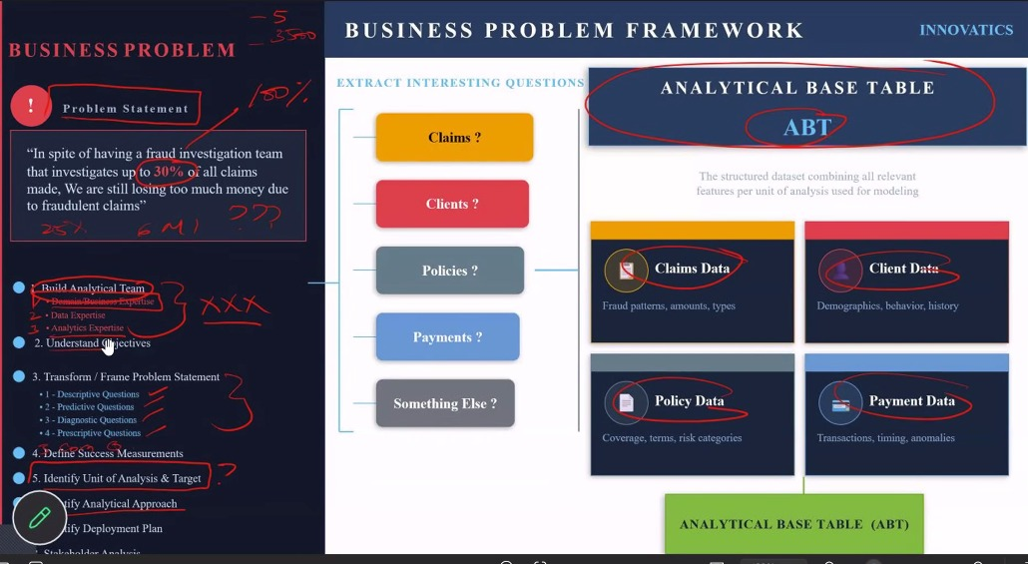
INSTRUCTOR FRAMEWORK
Dr. Mo’s Business Problem Framework is the Stage-1 checklist
We should be able to point to evidence for every box before moving into Data Understanding.
OUR INTERPRETATION
1. Build analytical team
2. Understand objectives
3. Transform / frame problem
4. Define success measurements
5. Identify unit of analysis & target
6. Identify analytical approach
7. Identify deployment plan
8. Stakeholder analysis
Output: required data + ABT specification
Source: Dr. Mo Business Problem Framework image supplied by the team.

Slide 3
STAGE 1 · BUSINESS PROBLEM
Start with what the capstone actually gives us
Separate context, symptom, impact and required outcome.
CONTEXT
SYMPTOM
BUSINESS IMPACT
TARGET OUTCOME
Wind generation varies with meteorology, turbine condition, curtailment and control settings.
Portfolio capacity factor ≈ 38%.
≈14% of turbine-hours generate at least 10% less power than expected under comparable wind conditions.
Those periods contribute to an estimated 5–8% annual generation gap.
Identify and explain underperformance; prioritize interventions supporting ≥2–3% annual energy recovery.
Important: 38% capacity factor is context , it is NOT evidence that the turbines are “62% underperforming.”
Source: ACWA Power capstone brief, Industry Background & Quantified Problem Statement; Key Baselines.

Slide 4
STAGE 1 · TRANSFORM / FRAME
The business problem in plain English
Do not presume the root cause before the evidence exists.
“Why are some turbine operating periods producing materially less power than expected under comparable conditions, what is driving the resulting generation gap, and which losses may be addressable?”
DO NOT ASSUME
ASK INSTEAD
THEN DECIDE
“The gearbox is failing.”
“Yaw is the cause.”
Where is the gap?
Why does it occur?
What is addressable?
What should we prioritize?
Source: EWA · InnovatiCS ACWA Power capstone brief; Dr. Mo Business Problem Framework.

Slide 5
STAGE 1 · BUILD ANALYTICAL TEAM
Team ≠ stakeholders
The project needs business/domain, data and analytics expertise before modeling begins.
TEAM LEAD · RASHID
SYSTEMS ENGINEERING· RAUL (STORY TELLING)
ENGINEERING · SANTOSH
SUPPORT · ANANYA
Direction, technical alignment, decision escalation, final team alignment.
Workflow, methodology alignment, integration, review cadence, blockers, deliverable completeness.
Data/engineering execution, analytical implementation, model development and testing.
Supporting engineering / analytics tasks when available.
Real-world expertise that must be represented or consulted
Wind Energy SME
SCADA / Operations SME
Data Engineering
Data Science / ML
Business / Finance
Instructor requirement: Domain Business Expertise + Data Expertise + Analytics Expertise.

Slide 6
STAGE 1 · UNDERSTAND OBJECTIVES
Translate the assignment into business objectives
Algorithms are not objectives; they are possible methods used later.
1 · QUANTIFY
2 · IDENTIFY
3 · EXPLAIN
Measure actual vs expected power and locate the generation gap.
Identify turbine-hours / turbines with material underperformance.
Separate weather, curtailment, availability and potentially technical drivers.
4 · EXPECT
5 · PRIORITIZE
6 · OPERATIONALIZE
Estimate what power should be produced under comparable valid conditions.
Rank potentially addressable losses by recoverable MWh / business value.
Define how monitoring and decision support could eventually use SCADA data.
Source: capstone brief, Project Objectives. Wording reframed at business level.

Slide 7
STAGE 1 · EXTRACT INTERESTING QUESTIONS
The required 5 × 5 question bank
Every question must trace back to the wind underperformance problem.
DESCRIPTIVE
DIAGNOSTIC
PREDICTIVE
PRESCRIPTIVE
COGNITIVE
What happened?
5 questions
Why did it happen?
5 questions
What is likely / expected?
5 questions
What should we do?
5 questions
How can the system learn/adapt?
5 questions
5 + 5 + 5 + 5 + 5 = 25 business/analytical questions — framed now, answered later with evidence.
Source: Dr. Mo requirement; Stage-1 question bank in team framing document.

Slide 8
STAGE 1 · 25-QUESTION BANK
Descriptive + Diagnostic
Descriptive = what happened. Diagnostic = why it happened.
DESCRIPTIVE · 5
DIAGNOSTIC · 5
1. How much actual power did each turbine produce versus expected?
2. What fraction of operating hours were >10% below expected?
3. Where are the largest generation gaps by farm, turbine and model?
4. When do the largest deficits occur?
5. Under what observed environmental/operating conditions do deficits occur most often?
6. What seasons of the month the turbine produce more power ?
7.What seasons of the month the turbine produce less power ?
8. Which geographical areas consume more power ?
9. Which geographical areas consume less power
1. How much apparent loss is associated with weather/resource conditions?
2. How much is associated with curtailment?
3. How much is associated with reduced availability?
4. Are yaw, rotor or condition signals associated with eligible underperformance?
5. Could missing, invalid or inconsistent data explain part of the apparent gap?
6. Is the preventive maintenance done regularly ?
7. Is the SCADA monitoring enough for preventive maintenance in real time?
8. Which sensors are the first to fail, do we have data to help diagnose ?
Questions refined from the team’s Stage-1 framing; final wording should be team-approved before analysis.

Slide 9
STAGE 1 · 25-QUESTION BANK
Predictive + Prescriptive + Cognitive
Keep Stage-1 questions ambitious, but distinguish what may require additional data.
PREDICTIVE · 5
PRESCRIPTIVE · 5
COGNITIVE · 5
1. What power should a turbine produce under comparable valid conditions?
2. Which turbine-hours are likely to become underperforming?
3. How large could the future energy deficit become if patterns persist?
4. Can SCADA condition signals predict emerging underperformance?
5. Can short-horizon generation be forecast reliably with available history?
6. Based on the season, winter, summer, etc or month could we quantify that we need more turbines ?
1. Which turbines should Operations investigate first?
2. Which potentially controllable loss categories offer the most recoverable MWh?
3. What alert threshold balances actionability and false alarms?
4. When should maintenance/intervention be scheduled to minimize generation loss?
5. What pilot actions should be tested before fleet-wide rollout?
6. Which sensors are most common to be replaced and how long it will take ?
7. What are the priority list components in a turbine to check when there is an operational issue?
1. How can new verified outcomes improve the benchmark over time?
2. How can field feedback distinguish normal variation from persistent degradation?
3. How can the system detect changing turbine behavior/drift?
4. How can new data sources refine root-cause hypotheses?
5. How can analytical findings be translated into explainable guidance for operators?
6. How can we achieve real time monitoring ?
7. How we can automate some configurations at the turbines to improve efficiency
Note: failure/RUL prediction requires maintenance/failure labels not currently established in the supplied dataset.

Slide 10
STAGE 1 · DEFINE SUCCESS MEASUREMENTS
Agree on success before modeling
SMART can support this CRISP-DM task; it does not replace CRISP-DM.
BUSINESS SUCCESS
ANALYTICAL SUCCESS
QUALITY / OPERABILITY
• Recover ≥2–3% of annual energy production
• Quantify potentially recoverable MWh
• Prioritize interventions with clear operational value
• Expected-power model target: R² ≥ 0.90
• Reliable identification of >10% underperformance under eligible conditions
• Clear separation of major loss categories
• Data-quality rules documented
• Leakage controlled
• Time/entity-aware validation
• Findings explainable and reproducible
SMART is used here to test whether objectives and measures are Specific · Measurable · Actionable · Relevant · Time-Bound.
Source: capstone brief, Key Baselines & Success Criteria + Model Governance Requirements.

Slide 11
STAGE 1 · UNIT OF ANALYSIS & TARGET
Define the grain before defining the model
The unit and target must match the business question.
PRIMARY UNIT OF ANALYSIS
REGRESSION TARGET
CLASSIFICATION TARGET
One turbine during one operating time interval
1 analytical observation = the performance and operating conditions of one specific turbine at one specific timestamp.
ABT grain: 1 row = 1 turbine × 1 SCADA time interval.
Validate the actual time/entity structure in Stage 2 before assuming continuous panel history.
Expected_Power_kW
Continuous target for expected-power / normal-behavior estimation.
Turbine_ID is an identifier — not the target.
Underperformance_Flag
Binary target for eligible >10% underperformance.
Power_Deviation_Pct and derived outcome fields require leakage controls.
Source: capstone brief, Project Objectives. Grain is a Stage-1 specification subject to Stage-2 validation.

Slide 12
STAGE 1 · REQUIRED DATA
Problem first → data requirement second
MECE is used here as a supporting structuring tool to avoid blind spots and double-counting.
A · EXTERNAL / NON-CONTROLLABLE
B · POTENTIALLY CONTROLLABLE
C · DATA / MEASUREMENT
Question: was output constrained for reasons that should not be labeled technical underperformance?
Need: meteorology, wind resource, curtailment, grid constraints, availability/downtime.
Question: was the turbine eligible to produce but still below expectation?
Need: SCADA controls, yaw/pitch/rotor, temperatures, vibration, alarms, maintenance/work orders, asset specs.
Question: is part of the apparent gap a data artifact?
Need: sensor metadata/calibration, missingness, invalid readings, timestamps, duplicates, units, data lineage.
MECE helps structure what evidence we need; Stage 2 determines what evidence we actually received.
McKinsey tool embedded within CRISP-DM Stage-1 framing / data-requirement definition.

Slide 13
STAGE 1 · ANALYTICAL BASE TABLE (ABT)
Dr. Mo’s concept: define the table we need before Stage 2 data analysis begins.
SOURCE DATA FAMILIES
TURBINE / ASSET
METEOROLOGY
SCADA / CONDITION
OPERATIONS
PERFORMANCE / TARGET
Farm_ID · Region · Site_Zone
Turbine_ID · Turbine_Model · Sensor_ID
Wind speed · Wind direction
Turbulence · Air temperature · Air density
Rotor speed · Yaw error
Gearbox oil temperature ·
Drivetrain vibration
Turbine availability
Curtailment status
Actual power · Expected power
Power deviation
· Underperformance flag
↓ COMBINE THE RELEVANT FEATURES AT ONE COMMON GRAIN: TURBINE + TIME ↓
WIND TURBINE ANALYTICAL BASE TABLE (ABT)
1 row = 1 turbine observed at 1 timestamped operating interval
Record_ID | Turbine_ID | Timestamp | Wind | Actual kW | Expected kW | Rotor | Yaw | Vibration | Availability | Curtailment | Target
EXAMPLE FROM THE SUPPLIED CSV
WTG-03561 | 2025-01-01 00:00 | Wind 10.10 m/s | Actual 2,469 kW | Expected 2,712 kW | Yaw −14.83° | Availability 96.72% | Curtailment 0 | Underperformance 0
STAGE 1 → Specify the ideal ABT:
what one row means + what data/features are required.
STAGE 2 → Inspect the supplied data:
what is available, missing, valid, usable, or limiting.

Slide 14
STAGE 1 · IDENTIFY ANALYTICAL APPROACH
Choose the analysis family — not the final algorithm
Specific algorithms are evaluated later after Data Understanding and Preparation.
DESCRIPTIVE
DIAGNOSTIC
PREDICTIVE
PRESCRIPTIVE
COGNITIVE
Actual vs expected; distribution; concentration
Loss attribution; associations; hypothesis tests
Expected-power regression; underperformance prediction
Priority ranking; intervention/pilot logic
Feedback, drift, learning and explainability
Candidate techniques such as regression, Random Forest, gradient boosting or anomaly detection are subordinate choices , they are not the business objective.
Source: EWA · InnovatiCS ACWA Power capstone brief; Dr. Mo Business Problem Framework.

Slide 15
STAGE 1 · DEPLOYMENT PLAN + STAKEHOLDERS
Define how evidence could become an operational decision
Stage 1 commits to the deployment shape; it does not claim production deployment exists.
DEPLOYMENT CONCEPT
STAKEHOLDERS
Historical data → ABT → offline validation → pilot / shadow mode → SCADA scoring → dashboard / alerts → human operational decision → verified outcome → feedback
Human operators/engineers remain responsible for field decisions and root-cause confirmation.
Operations / site engineers
Maintenance & Reliability
Asset Management
Data / Digital / SCADA
Finance
OEM / turbine supplier
IT / Cyber
Executive sponsor
Stakeholders are separate from the analytical project team.

Slide 16
STAGE-1 EXIT GATE
What must be agreed before Stage 2 begins
If these are not clear, we are not ready to analyze the dataset.
Problem statement
Team & stakeholders
Objectives
25 questions
Agreed and cause-neutral
Roles and evidence needs clear
Business outcomes defined
5×5 bank agreed
Success KPIs
Unit & targets
Required data / ABT
Approach & deployment
Business + analytical + quality
Grain and labels defined
Ideal evidence specified
High-level plan agreed
THEN → CRISP-DM STAGE 2: DATA UNDERSTANDING
Compare the ideal data requirement against the supplied dataset; assess quality, feasibility and gaps before preparation/modeling.
Source: capstone brief Required Analytical Workflow — Business Understanding precedes Data Understanding, Preparation and Modeling.

