Slide 1
SNAPDRAGON® AI LAB — BUILD & PRESENT CHALLENGE
Drishti
A fully offline visual assistant for blind and low-vision users — every model running on the Snapdragon Hexagon NPU.
No internet. No cloud inference. No recurring cost.
Rachit · Solo submission · github.com/Rachit0910
Notes:
Drishti means 'vision'. One sentence: it turns a Snapdragon HP PC into an assistive device that continuously tells a blind user what is around them, how far away, and which way - at 30fps, on battery, fully offline.

Slide 2
THE PROBLEM
A large population, served by the wrong tools.
1
Dedicated hardware
6.11%
Smart canes and handheld OCR readers are expensive, single-purpose, and usually imported.
2
Cloud phone apps
pooled prevalence of blindness among Indian adults aged 50 and over
Upload a photo, wait 2–3 seconds, hear a sentence. Fine for a tin in a kitchen. Useless on a street.
3
The gap
Nothing offers continuous, real-time awareness that keeps working with no signal.
Prevalence: systematic review and meta-analysis, National Medical Journal of India (n > 211,000).
Drishti is the third option: continuous, real-time awareness that keeps working with no signal.
Notes:
The structural flaw in both existing options is the same: neither gives you continuous awareness while moving, offline.

Slide 3
WHY THIS NEEDS THE NPU
The whole design is one number.
At 30 fps a frame must be handled in 33.3 ms. Detection and depth together cost 1.29 ms on the Hexagon NPU.
1.29 ms
3.9%
~90%
detection + depth,
every frame
of the 30 fps
frame budget
headroom left for
everything else
That headroom is the product. It is what lets a duty-cycled OCR pass, depth calibration, a salience engine and speech synthesis all share one frame without ever dropping it — on battery, for a full day.
Published Qualcomm AI Hub inference figures, Snapdragon X2 Elite (YOLOv8-Detection 0.67 ms, Midas-V2 0.62 ms, both w8a8).
Notes:
This is the slide that answers 'why not cloud, why not CPU'. A cloud round trip is 2-3 seconds - the difference between hearing about a kerb before or after you step off it.

Slide 4
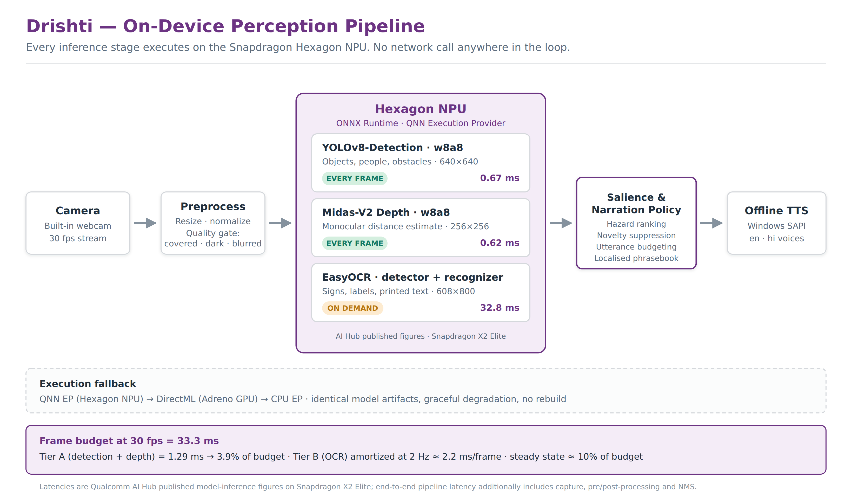
ARCHITECTURE
Three AI Hub models, one always-on pipeline.
Notes:
Detection and depth run every frame; OCR is user-triggered. Quality gate and narration policy run on CPU. No network call anywhere in the loop.

Slide 5
WHAT IS ACTUALLY NOVEL
Three off-the-shelf models is the easy part.
▲
◉
●
Relative depth is not distance
Speech is a serial channel
Silence is ambiguous
Midas-V2 predicts relative inverse depth. Announcing it as metres would give confident, wrong distances. We fit the map to metric units every frame, using detected objects of known size as anchors — a person is a reliable 1.68 m ruler.
Pipe every detection into a TTS engine and you get “chair chair person chair”. The policy scores hazard × proximity × centrality × confidence, lets imminent hazards interrupt, and stays silent when its budget is spent.
An empty corridor and a covered lens sound identical. A blind user cannot tell them apart — so degraded input is announced, not swallowed.
All three are implemented and unit-tested today — they run on any machine, with no camera and no NPU.
Notes:
The third one is the insight a sighted designer misses entirely, and it gets its own slide next.

Slide 6
THE PROBLEM A SIGHTED DESIGNER WOULD MISS
A covered lens and an empty room sound the same.
Drishti's correct behaviour in an empty corridor is silence. Its behaviour with a thumb over the lens is also silence. A sighted user glances at the camera. The only user this product has cannot.
Dark and featureless
“Camera is covered.”
→ move your hand
Dark but textured
“Too dark to see.”
→ turn on a light
No sharp edges
“Camera image is blurred.”
→ hold steadier
Recovered
“Camera clear.”
→ silence is meaningful again
Three conditions, not one, because the remedy differs. Debounced so a single dropped frame never cries wolf.
Notes:
This is the strongest accessibility argument in the submission. It is an insight, and it is already implemented and tested - 11 of the 37 tests.

Slide 7
EVIDENCE
This is not a plan. It runs today.
37
✓
Narration policy engine
17 tests
✓
Frame quality gate
11 tests
unit tests passing, on any laptop — no camera, no NPU, no account
✓
Metric depth calibration
9 tests
✓
Localisation — English + Hindi
tested
Three defects the tests caught — and changed the design
Depth jitter across a band boundary re-announced the same obstacle several times a second.
One frame mistaking a poster for a person shifted every announced distance by 73%.
Darkness and occlusion were being conflated — they need different tests and different advice.
Clone the repo and run all 37 in under a minute. Everything needing Snapdragon hardware is labelled as such.
Notes:
Documented bugs and their fixes are better evidence that testing is real than any coverage claim.

Slide 8
DEPLOYMENT & ACCESSIBILITY
Built for the user who cannot see the screen.
♪
Audio-first
ह
Speaks their language
No account, no login, no setup wizard. A flow that must be navigated visually is one this user cannot complete alone.
English and Hindi ship today. No user-facing string lives in the logic — adding a language is a data change plus a system voice.
⇄
Shares the channel
⊞
Institutional scale
Blind Windows users already run NVDA or JAWS. Short utterances, salience gating, instant yield on Escape.
One signed installer across Snapdragon HP models — practical for a school for the blind or an NGO.
Every one of these follows from a single fact: the user cannot see the screen.
Notes:
Accessibility here is not a compliance checklist on a finished UI - the audio channel IS the interface.

Slide 9
WHAT HAPPENS NEXT
From published figures to measured ones.
1
Export, quantize and profile all three models on real Snapdragon silicon through AI Hub device provisioning — no hardware needed to get true numbers.
2
Validate the full loop on a Snapdragon HP PC; finish the OCR decode; confirm the context cache removes the cold start.
3
End-to-end benchmarks with a CPU baseline; sustained thermal and power run for the all-day battery claim.
4
User testing with blind and low-vision participants; native review of the Hindi phrasing; NVDA coexistence check.
Every published figure in this deck gets replaced by a measured one.
Notes:
Close on the honesty point: the numbers here are Qualcomm's published figures, and the whole Phase 1 exists to replace them with our own measurements on real silicon.

