Slide 1
PRIVATE PSYCHIATRIC PRE-VISIT INTAKE
Built for real life.
A conversational intake tool that helps patients tell their story before the appointment and gives clinicians a concise, structured starting point.
It starts with a warm, non-judgmental conversation, then transitions to structured psychiatric intake—an app, not a person, therapist, or friend, and never a substitute for clinical care.

Slide 2





Extent of the problem
Trust gap: Patients fear intimate thoughts will be tracked, sold, or leaked.
Stigma: Shame and isolation can delay help-seeking.
Intake bottleneck: Weeks of psychological and physical symptoms must be compressed into a short appointment.
Access gap: Cloud-dependent tools fail when connectivity or mobile data runs out.
Built for psychiatric patients, psychiatrists, psychologists, intake nurses, care teams, clinics, university counseling centers, rural health programs, and community services.

Slide 3
Our solution and impact
A friendly, non-judgmental conversation leads into structured psychiatric intake—not a human, therapist, friend, or substitute for clinical care.
01
02
03
04
Chatbot session
Summary generation
Validated question flow
Impact
Friendly conversation transitions smoothly into health-related questions.
Patients arrive with their story organized. Clinicians start with context instead of reconstructing every symptom.
Self-reported psychological and physical symptoms become a clinician-ready summary.
DSM-5 Level 1 Cross-Cutting Symptom Measure, PHQ-9, and GAD-7 inform prompts from a curated question bank.
Patient-reported, not a diagnosis. For clinician review.

Slide 4
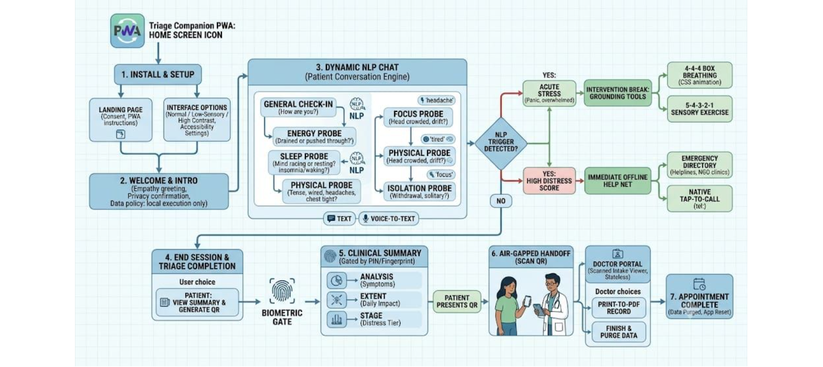
From welcome to clinician handoff
A friendly chat becomes a structured, privacy-first handoff.

Slide 5





Privacy and safety are built into the experience
Quick Exit
Auto-Purge
Consent & Delete
Corner button or two Esc presses wipes screen and redirects to a neutral page.
Visible 30–60 minute timer deletes transcripts and temporary variables; users can extend the session.
App explains storage and retention; “Delete everything” always available.
PIN + biometrics
QR privacy
Local 4-digit PIN with PBKDF2 and optional WebAuthn unlock.
Short-lived, one-time-use access token grants the handoff. QR does not contain patient data.

Slide 6





Interactive support and an offline emergency safety net
Supportive tools stay available when the connection does not.
Grounding
4-4-4-4 box breathing, 5-4-3-2-1 sensory grounding, and a tappable body-scan visualizer.
Crisis boundary
Self-harm or suicide signals pause the intake and open a supportive safety card.
Offline directory
Verified regional helplines, youth counseling services, and community clinics in static JSON.
Tap-to-call
Standard tel: links open the native dialer. Calls need cellular service, not data.
The bot never gives diagnoses, medication advice, or treatment instructions.

Slide 7

Clinician handoff and benefits
For patients: lower-friction conversation, privacy controls, accessible grounding tools, and English, Spanish, or Hindi support
For clinicians: structured symptom domains, physical-tension notes, daily distress trends, and a printable one-page intake form
Handoff: a one-time QR token gives the clinician access without putting patient data into the QR code itself
Boundary: the summary supports clinician judgment; it is not a diagnosis
A concise, structured starting point for clinician review.

Slide 8











Feasibility, scalability, and tech stack
Start local. Add regions and integrations without rebuilding the experience.
Progressive Web App
Local processing
Link-based access and offline operation.
Less dependence on backend infrastructure.
New regions
Future-ready handoff
Localized static JSON dictionaries add regional content.
Clinics can white-label the code. Future payloads can be shaped for HL7/FHIR-compatible EMR integration.
TECH STACK
HTML5
CSS3
Vanilla JS
PWA Service Workers
compromise.js
qrious.js
IndexedDB
AES-GCM
WebAuthn
Web Speech API
SVG

Slide 9
BEFORE REAL-PATIENT USE
Challenges and boundaries before launch
Clinical validity
Safety
Clinician review of question selection, domain mapping, and crisis responses.
Reliable escalation language without diagnosing or giving treatment instructions.
Privacy
Data governance
Threat modeling for shared devices, QR access, browser storage, and optional voice processing.
HIPAA/GDPR-level planning before server storage or real-patient deployment.
Next step
Validate the prototype with clinicians and patient advocates, then test the question bank and crisis flows.

