Slide 1

Digital Signature
13.<number>

Slide 2
concept of a signature.
A person signs a document to show that it originated from her or was approved by her.
The signature is proof to the recipient that the document comes from the correct entity.
When a customer signs a check, the bank needs to be sure that the check is issued by that customer and nobody else.
In other words, a signature on a document, when verified, is a sign of authentication- the document is authentic.
13.<number>

Slide 3
concept of a signature.
When Alice sends a message to Bob, Bob needs to check the authenticity of the sender;
he needs to be sure that the message comes from Alice and not Eve.
Bob can ask Alice to sign the message electronically.
In other words, an electronic signature can prove the authenticity of Alice as the sender of the message.
We refer to this type of signature as a digital signature.
13.<number>

Slide 4
13.1 COMPARISON
Differences between conventional signatures and digital signatures.
Inclusion
Verification Method
Relationship
Duplicity
13.<number>

Slide 5
13.1.1 Inclusion
A conventional signature is included in the document; it is part of the document.
But when we sign a document digitally, we send the signature as a separate document.
13.<number>

Slide 6
13.1.2 Verification Method
method of verifying the signature.
For a conventional signature, when the recipient receives a document, she compares the signature on the document with the signature on file.
The recipient needs to have a copy of this signature on file for comparison.
For a digital signature, the recipient receives the message and the signature.
A copy of the signature is not stored anywhere.
The recipient needs to apply a verification technique to the combination of the message and the signature to verify the authenticity.
13.<number>

Slide 7
13.1.3 Relationship
For a conventional signature, there is normally a one-to-many relationship between a signature and documents.
A person uses the same signature to sign many documents.
For a digital signature, there is a one-to-one relationship between a signature and a message.
Each message has its own signature. The signature of one message cannot be used in another message.
If Bob receives two messages, one after another, from Alice, he cannot use the signature of the first message to verify the second.
Each message needs a new signature.
13.<number>

Slide 8
13.1.4 Duplicity
In conventional signature, a copy of the signed document can be distinguished from the original one on file.
In digital signature, there is no such distinction unless there is a factor of time on the document.
Suppose Alice sends a document instructing Bob to pay Eve.
If Eve intercepts the document and the signature, she can replay it later to get money again from Bob.
13.<number>

Slide 9
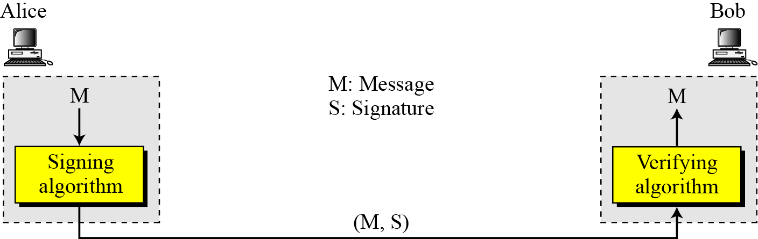
13-2 PROCESS
Figure 13.1 Digital signature process
Sender uses a signing algorithm to sign the message.
Receiver receives the message and the signature and applies the verifying algorithm to the combination.
13.<number>

Slide 10
13.2.1 Need for Keys
A conventional signature is like a private “key” belonging to the signer of the document.
The signer uses it to sign documents; no one else has this signature.
The copy of the signature is on file like a public key; anyone can use it to verify a document, to compare it to the original signature.
In a digital signature, the signer uses her private key, applied to a signing algorithm, to sign the document.
The verifier, on the other hand, uses the public key of the signer, applied to the verifying algorithm, to verify the document.
13.<number>

Slide 11
13.2.1 Need for Keys
When a document is signed, anyone, including Bob, can verify it because everyone has access to Alice’s public key.
Alice must not use her public key to sign the document because then anyone could forge her signature.
13.<number>

Slide 12
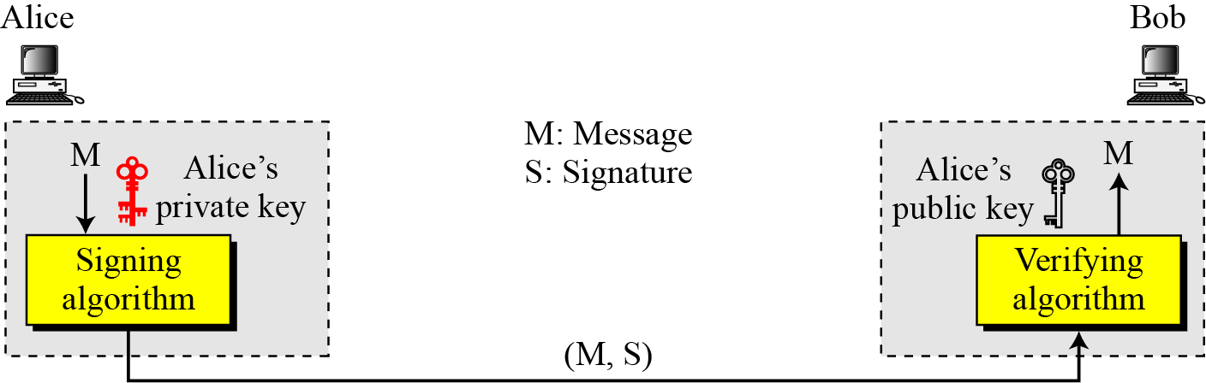
13.2.1 Need for Keys
Figure 13.2 Adding key to the digital signature process
A digital signature needs a public-key system.
The signer signs with her private key; the verifier verifies with the signer’s public key.
13.<number>

Slide 13
13.2.1 Continued
Can we use a secret (symmetric) key to both sign and verify a signature?
The answer is negative for several reasons.
First, a secret key is known by only two entities (Alice and Bob). So if Alice needs to sign another document and send it to Ted, she needs to use another secret key.
Second, creating a secret key for a session involves authentication, which uses a digital signature. We have a vicious cycle.
Third, Bob could use the secret key between himself and Alice, sign a document, send it to Ted, and pretend that it came from Alice.
13.<number>

Slide 14
13.2.1 Continued
Distinction between private and public keys as used in digital signatures and public and private keys as used in a cryptosystem for confidentiality.
In the latter, the private and public keys of the receiver are used in the process.
In a digital signature, the private and public keys of the sender are used.
13.<number>

Slide 15
13.2.1 Continued
A cryptosystem uses the private and public keys of the receiver.
Digital signature uses the private and public keys of the sender.
13.<number>

Slide 16
13.2.2 Signing the Digest
The asymmetric-key cryptosystems are very inefficient when dealing with long messages.
In a digital signature system, the messages are normally long, but we have to use asymmetric-key schemes.
The solution is to sign a digest of the message, which is much shorter than the message.
The sender can sign the message digest and the receiver can verify the message digest.
13.<number>

Slide 17
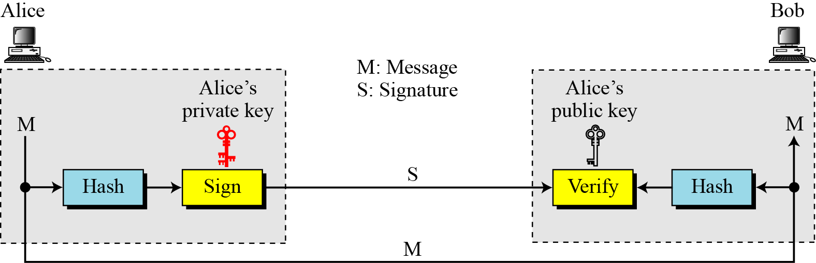
13.2.2 Signing the Digest
Figure 13.3 Signing the digest
Figure 13.3 shows signing a digest in a digital signature system.
13.<number>

Slide 18
13.2.2 Signing the Digest
Digest then goes through the signing process using Alice’s private key.
Alice then sends the message and the signature to Bob.
There are variations in the process that are dependent on the system. [study later]
For example, there might be additional calculations before the digest is made, or other secrets might be used.
In some systems, the signature is a set of values.
13.<number>

Slide 19
13.2.2 Signing the Digest
At Bob’s site, using the same public hash function, a digest is first created out of the received message.
Calculations are done on the signature and the digest.
The verifying process also applies criteria on the result of the calculation to determine the authenticity of the signature.
If authentic, the message is accepted; otherwise, it is rejected.
13.<number>

Slide 20
13-3 SERVICES
A digital signature can provide following services
Authentication
Integrity
Non Repudiation
13.<number>

Slide 21
13.3.1 Message Authentication
(Data origin Authentication)
A secure digital signature scheme, like a secure conventional signature can provide message authentication.
Bob can verify that the message is sent by Alice because Alice’s public key is used
in verification.
A digital signature provides message authentication.
13.<number>

Slide 22
13.3.2 Message Integrity
The integrity of the message is preserved even if we sign the whole message because we cannot get the same signature if the message is changed.
The digital signature schemes today use a hash function in the signing and verifying algorithms that preserve the integrity of the message.
A digital signature provides message integrity.
13.<number>

Slide 23
13.3.3 Nonrepudiation
If Alice signs a message and then denies it, can Bob later prove that Alice actually signed it?
For example, if Alice sends a message to a bank (Bob) and asks to transfer $10,000 from her account to Ted’s account, can Alice later deny that she sent this message?
With the scheme we have presented so far, Bob might have a problem.
Bob must keep the signature on file and later use Alice’s public key to create the original message to prove the message in the file and the newly created message are the same.
This is not feasible because Alice may have changed her private or public key during this time; she may also claim that the file containing the signature is not authentic.
13.<number>

Slide 24
13.3.3 Nonrepudiation
One solution is a trusted third party.
People can create an established trusted party among themselves.
Trusted party can solve many other problems concerning security services and key exchange.
Figure 13.4 shows how a trusted party can prevent Alice from denying that she sent the message.
13.<number>

Slide 25
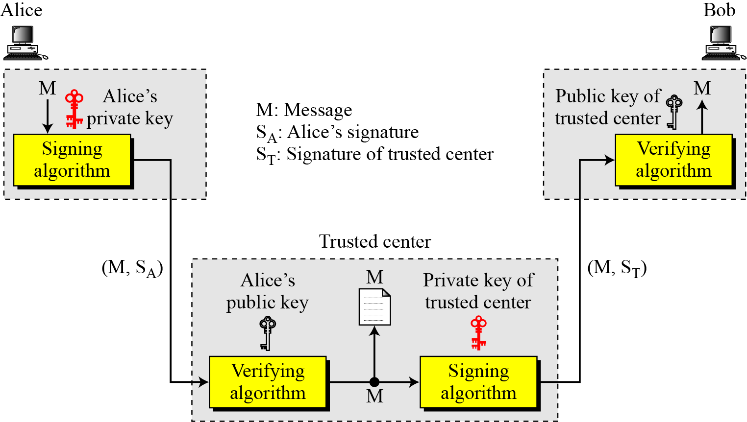
13.3.3 Nonrepudiation
Figure 13.4 Using a trusted center for nonrepudiation
Nonrepudiation can be provided using a trusted party.
13.<number>

Slide 26
13.3.3 Nonrepudiation
Alice creates a signature from her message (S_{A}) and sends the message, her identity, Bob’s identity, and the signature to the center.
The center, after checking that Alice’s public key is valid, verifies through Alice’s public key that the message came from Alice.
The center then saves a copy of the message with the sender identity, recipient identity, and a timestamp in its archive.
The center uses its private key to create another signature (ST) from the message.
The center then sends the message, the new signature, Alice’s identity, and Bob’s identity to Bob.
Bob verifies the message using the public key of the trusted center.
13.<number>

Slide 27
13.3.4 Confidentiality
A digital signature does not provide confidential communication.
If confidentiality is required, the message and the signature must be encrypted using either a secret-key or public-key cryptosystem.
Figure 13.5 shows how this extra level can be added to a simple
digital signature scheme.
13.<number>

Slide 28
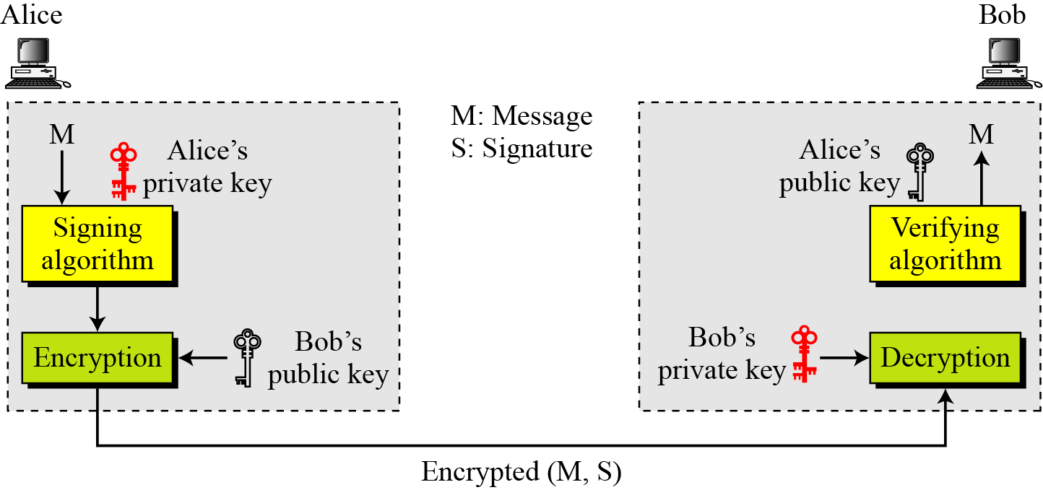
13.3.4 Confidentiality
Figure 13.5 Adding confidentiality to a digital signature scheme
A digital signature does not provide privacy.
If there is a need for privacy, another layer of encryption/decryption must be applied.
13.<number>

Slide 29
ATTACKS ON DIGITAL SIGNATURE
Key-Only Attack
The attacker has public verification key, and needs to convince that message came from intended source
Known-Message Attack
The attacker has one or more valid message-signature pairs (previous signed documents) , tries to create another message and forge sign on it.
Chosen-Message Attack
The attacker first gets signatures on arbitrary messages of the attacker's choice. Later forges sign.
13.<number>

Slide 30
13.4.2 Forgery Types
Forgery: Successful Attack
Existential Forgery
In Existential forgery, Eve may be able to create valid message signature pair, not the one she can really use (document is forged, content is randomly calculated)
-Message could be syntactically/semantically meaningless)
Selective Forgery
In Selective forgery, Eve may be able to forge signature on a message, with the content selectively chosen by eve.
-It is beneficial to eve and detrimental to signer the probability of such forgery is low, but not negligible
13.<number>

Slide 31
13-5 DIGITAL SIGNATURE SCHEMES
13.5.1 RSA Digital Signature Scheme
13.5.2 ElGamal Digital Signature Scheme
13.5.3 Schnorr Digital Signature Scheme
13.5.4 Digital Signature Standard (DSS)
13.<number>

Slide 32
RSA Digital Signature Scheme
The RSA idea can also be used for signing and verifying a message.
The digital signature scheme changes the roles of the private and public keys.
First, the private and public keys of the sender, not the receiver, are used.
Second, the sender uses her own private key to sign the document; the receiver uses the sender’s public key to verify it.
13.<number>

Slide 33
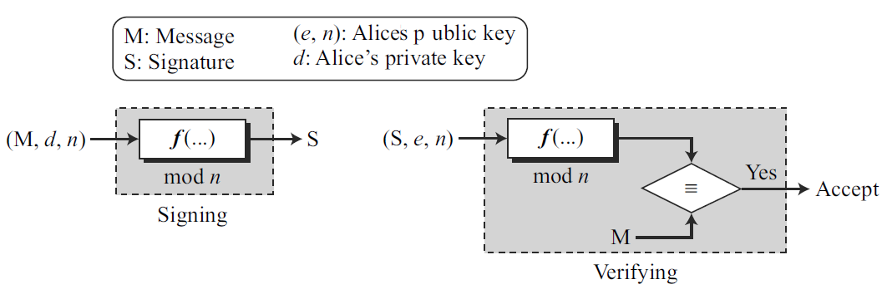
RSA Digital Signature Scheme
The signing and verifying sites use the same function, but with different parameters.
The verifier compares the message and the output of the function for congruence.
If the result is true, the message is accepted.
13.<number>

Slide 34
RSA Digital Signature Scheme
Key Generation
Key generation in the RSA digital signature scheme is exactly the same as key generation in the RSA cryptosystem.
Alice chooses two primes p and q and calculates n = p × q.
Alice calculates φ(n) = (p − 1) (q − 1).
She then chooses e, the public exponent, and calculates d, the private exponent such that e × d = 1 mod φ(n).
Alice keeps d; she publicly announces n and e.
13.<number>

Slide 35
RSA Digital Signature Scheme
Key Generation
In the RSA digital signature scheme, d is private;
e and n are public.
13.<number>

Slide 36
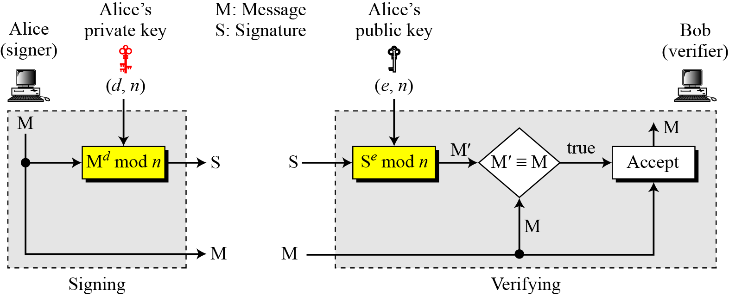
13.5.1 Continued
Signing and Verifying
Figure 13.7 RSA digital signature scheme
13.<number>

Slide 37
13.5.1 Continued
Signing and Verifying
Signing Alice creates a signature out of the message using her private exponent, S = M^{d} mod n and sends the message and the signature to Bob.
Verifying Bob receives M and S.
Bob applies Alice’s public exponent to the signature to create a copy of the message M′ = S^{e} mod n.
Bob compares the value of M′ with the value of M.
If the two values are congruent, Bob accepts the message.
13.<number>

Slide 38
13.5.1 Continued
Attacks on RSA Signature
There are some attacks that Eve can apply to the RSA digital signature scheme to forge Alice’s signature.
Key-Only Attack
Eve has access only to Alice’s public key.
Eve intercepts the pair (M, S) and tries to create another message M′ such that M′ ≡ S^{e}(mod n).
This problem is as difficult to solve as the discrete logarithm problem
This is an existential forgery and normally is useless to Eve.
13.<number>

Slide 39
13.5.1 Continued
Known-Message Attack
Here Eve uses the multiplicative property of RSA.
Assume that Eve has intercepted two message-signature pairs (M1, S1) and (M2, S2) that have been created using the same private key.
If M = (M1 × M2) mod n, then S = (S1 × S2) mod n. This is simple to prove because we have
Eve can create M = (M1 × M2) mod n, and she can create S = (S1 × S2) mod n, and fool Bob into believing that S is Alice’s signature on the message M.
This attack, which is sometimes referred to as multiplicative attack, is easy to launch.
This is an existential forgery as the message M is a multiplication of two previous messages created by Alice, not Eve; M is normally useless.
13.<number>

Slide 40
13.5.1 Continued
Chosen-Message Attack
This attack also uses the multiplicative property of RSA.
Eve can somehow ask Alice to sign two legitimate messages, M1 and M2, for her and later creates a new message M = M1 × M2.
Eve can later claim that Alice has signed M.
The attack is also referred to as multiplicative attack.
This is a very serious attack on the RSA digital signature scheme because it is a selective forgery (Eve can manipulate M1 and M2 to get a useful M).
13.<number>

Slide 41
13.5.1 Continued
RSA Signature on the Message Digest
Alice, the signer, first uses an agreed-upon hash function to create a digest from the message, D = h(M).
She then signs the digest, S = D^{d} mod n.
The message and the signature are sent to Bob.
Bob, the verifier, receives the message and the signature.
He first uses Alice’s public exponent to retrieve the digest, D′ = S^{e} mod n.
He then applies the hash algorithm to the message received to obtain D = h(M).
Bob now compares the two digests, D and D′. If they are congruent to modulo n, he accepts the message.
13.<number>

Slide 42
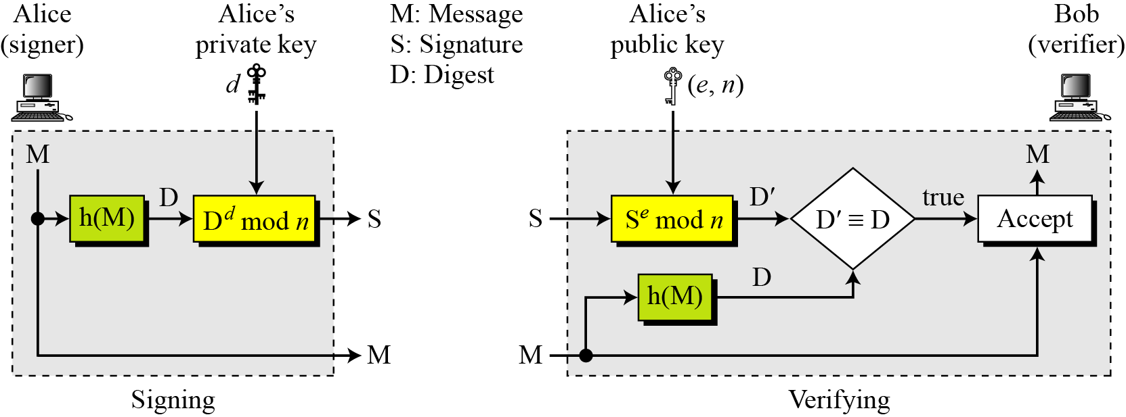
13.5.1 Continued
RSA Signature on the Message Digest
Figure 13.8 The RSA signature on the message digest
13.<number>

Slide 43
13.5.1 Continued
When the digest is signed instead of the message itself, the susceptibility of the RSA digital signature scheme depends on the strength of the hash algorithm.
13.<number>

Slide 44
13.5.1 Continued
Attacks on RSA Signed Digests
How susceptible to attack is the RSA digital signature scheme when the digest is signed?
Key-Only Attack three cases of this attack:
a. Eve intercepts the pair (S, M) and tries to find another message M′ that creates the
same digest, h(M) = h(M′). If the hash algorithm is second preimage resistant, this attack is very difficult.
b. Eve finds two messages M and M′ such that h(M) = h(M′). She lures Alice to sign h(M) to find S. Now Eve has a pair (M′, S) which passes the verifying test, but it is the forgery. If the hash algorithm is collision resistant, this attack is very difficult.
c. Eve may randomly find message digest D, which may match with a random signature S. She then finds a message M such that D = h(M). If the hash function is preimage resistant, this attack is very difficult to launch.
13.<number>

Slide 45
13.5.1 Continued
Known-Message Attack
Let us assume Eve has two message-signature pairs (M1, S1) and (M2, S2) which have been created using the same private key.
Eve calculates S ≡ S1 × S2. If she can find a message M such that h(M) ≡ h(M1) × h(M2), she has forged a new message.
Finding M given h(M) is very difficult if the hash algorithm is preimage resistant.
Chosen-Message Attack
Eve can ask Alice to sign two legitimate messages M1 and M2 for her. Eve then creates a new signature S ≡ S1 × S2.
Since Eve can calculate h(M) ≡ h(M1) × h(M2), if she can find a message M given h(M), the new message is a forgery.
Finding M given h(M) is very difficult if the hash algorithm is preimage resistant.
13.<number>

Slide 46
13.5.2 ElGamal Digital Signature Scheme
ElGamal digital signature scheme uses the same keys (as used in ElGamal cryptosystem) , but the algorithm is different.
13.<number>

Slide 47
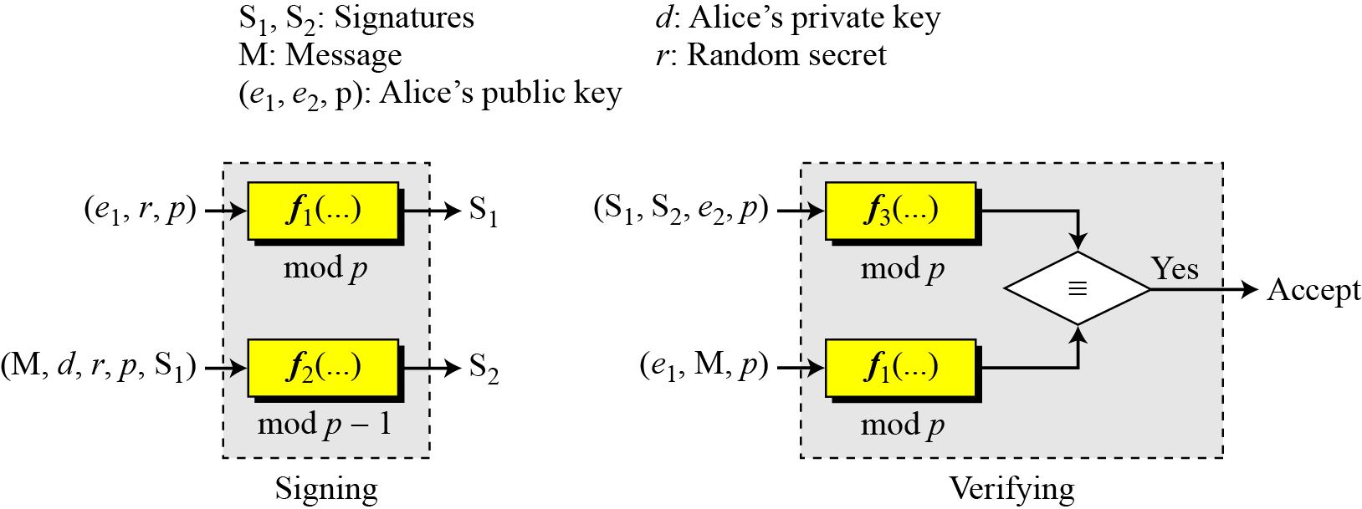
13.5.2 ElGamal Digital Signature Scheme
Figure 13.9 General idea behind the ElGamal digital signature scheme
In the signing process, two functions create two signatures;
In the verifying process the outputs of two functions are compared for verification.
One function is used both for signing and verifying but the function uses different inputs.
13.<number>

Slide 48
13.5.2 ElGamal Digital Signature Scheme
The message is part of the input to function when signing;
it is part of the input to function 1 when verifying.
Calculations in functions 1 and 3 are done modulo p;
it is done modulo p − 1 in function 2.
13.<number>

Slide 49
13.5.2 Continued
Key Generation
The key generation procedure here is exactly the same as the one used in the cryptosystem.
Let p be a large prime number .
Let e₁ be a primitive element.
Alice selects her private key d to be less than p − 1.
She calculates e₂ = e₁^{d} mod p.
Alice’s public key is the tuple (e₁, e₂, p);
Alice’s private key is d.
In ElGamal digital signature scheme, (e₁, e₂, p) is Alice’s public key; d is her private key.
13.<number>

Slide 50
13.5.2 Continued
Verifying and Signing
Signing Alice can sign the digest of a message to any entity :
Alice chooses a secret random number r. Note that although public and private keys can be used repeatedly, Alice needs a new r each time she signs a new message.
Alice calculates the first signature S₁ = e1^{r} mod p.
Alice calculates the second signature S₂ = (M − d × S₁) × r ⁻¹ mod (p − 1), where r⁻¹ is the multiplicative inverse of r modulo p.
Alice sends M, S₁, and S₂ to Bob.
13.<number>

Slide 51
13.5.2 Continued
Verifying and Signing
Verifying : Bob, receives M, S1, and S2, which can be verified as follows:
1. Bob checks to see if 0 < S1 < p
2. Bob checks to see if 0 < S2 < p − 1
3. Bob calculates V1 = e1^{M} mod p
4. Bob calculates V2 = e₂^{S1} × S₁^{S2} mod p
5. If V1 is congruent to V2, the message is accepted; otherwise, it is rejected.
13.<number>

Slide 52
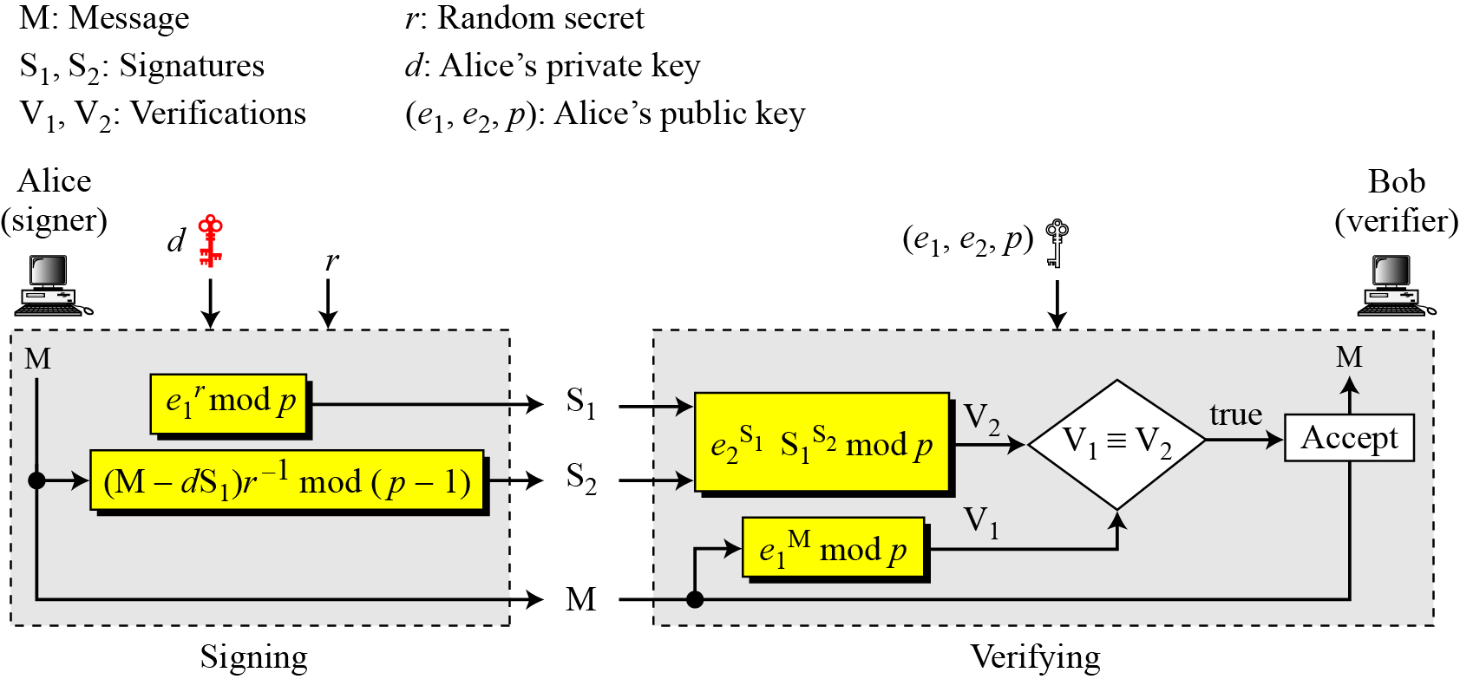
13.5.2 Continued
Verifying and Signing
Figure 13.10 ElGamal digital signature scheme
13.<number>

Slide 53
13.5.2 Continued
We can prove the verification criterion using e2 = e1^{d} and S1 = e1^{r}
Because e1 is a primitive root, it can be proved that the above congruence holds if
and only if M ≡ [d S1 + r S2] mod (p − 1) or S2 ≡ [(M − d × S1) × r ⁻¹] mod (p − 1),
which is the same S2 we started in the signing process
13.<number>

Slide 54
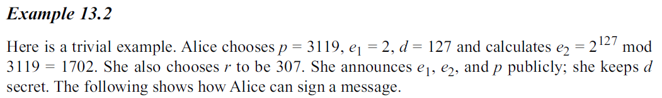
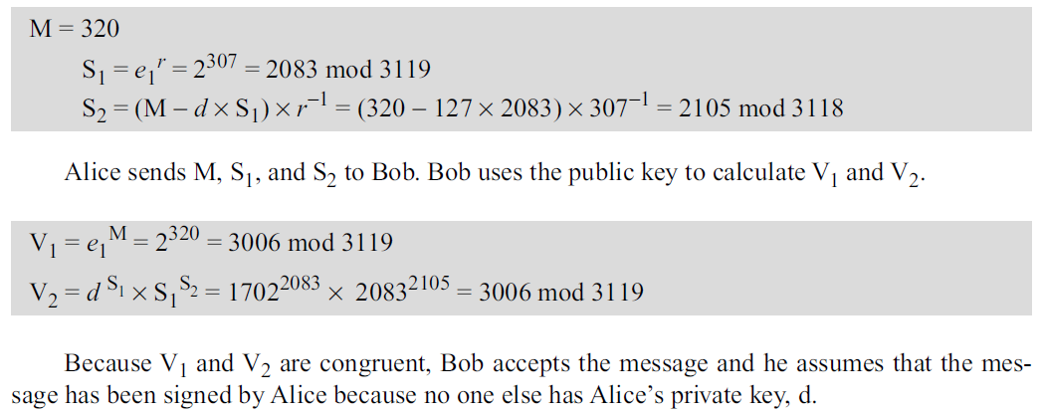
13.5.2 Continued
13.<number>

Slide 55
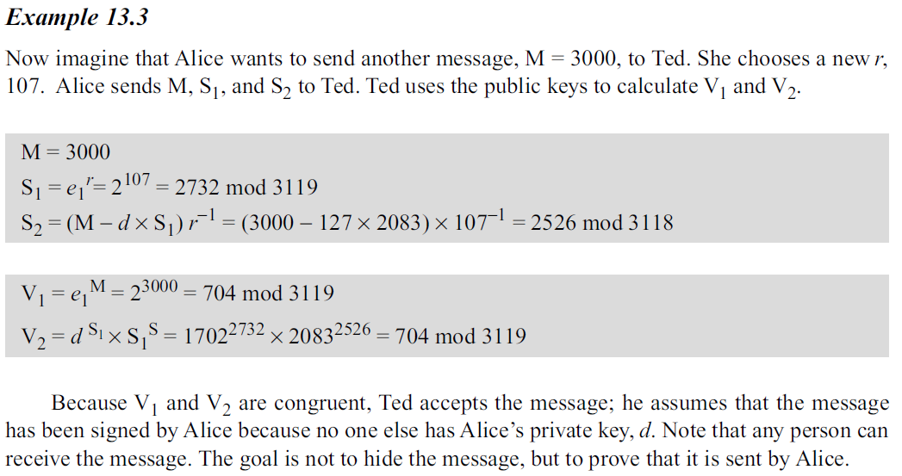
13.5.2 Continued
13.<number>

Slide 56
13.5.2 Continued
Forgery in the ElGamal Digital Signature Scheme
13.<number>

Slide 57
13.5.3 Schnorr Digital Signature Scheme
Problem with the ElGamal digital signature scheme is that p needs to be very large.
The recommendation is a p of at least 1024 bits.
This could make the signature as large as 2048 bits.
To reduce the size of the signature, Schnorr proposed a new scheme based on ElGamal, but with a reduced signature size.
13.<number>

Slide 58
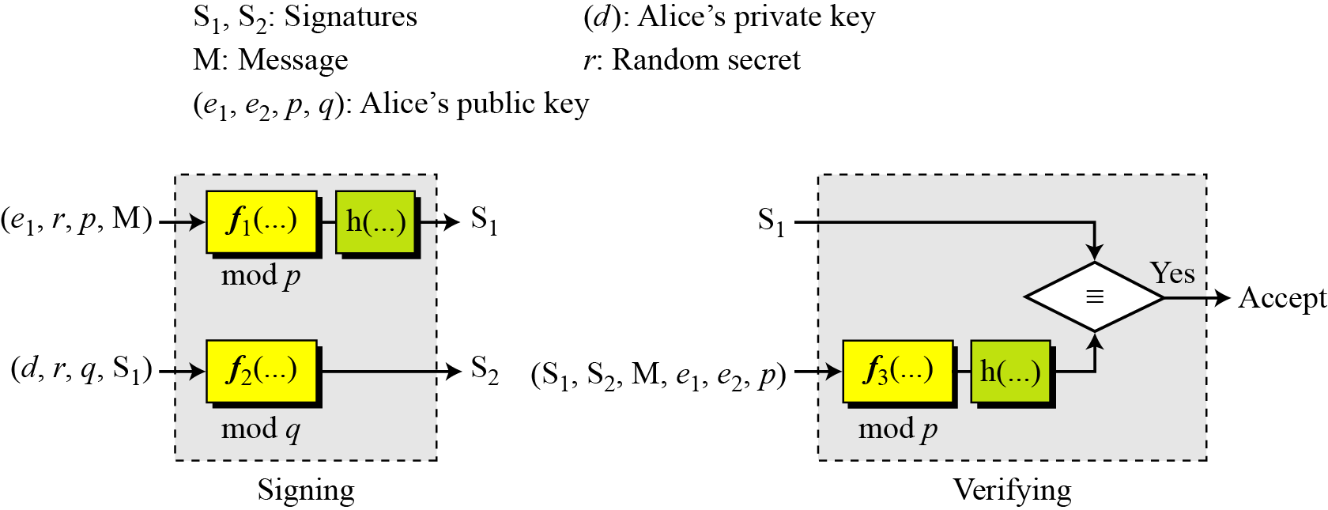
13.5.3 Schnorr Digital Signature Scheme
Figure 13.11 General idea behind the Schnorr digital signature scheme
In the signing process, two functions create two signatures;
In the verifying process, the output of one function is compared to the first signature for verification.
13.<number>

Slide 59
13.5.3 Schnorr Digital Signature Scheme
Figure 13.11 General idea behind the Schnorr digital signature scheme
Figure 13.11 also shows the inputs to each function.
The important point is that the scheme uses two moduli: p and q.
Functions 1 and 3 use p; function 2 uses q.
13.<number>

Slide 60
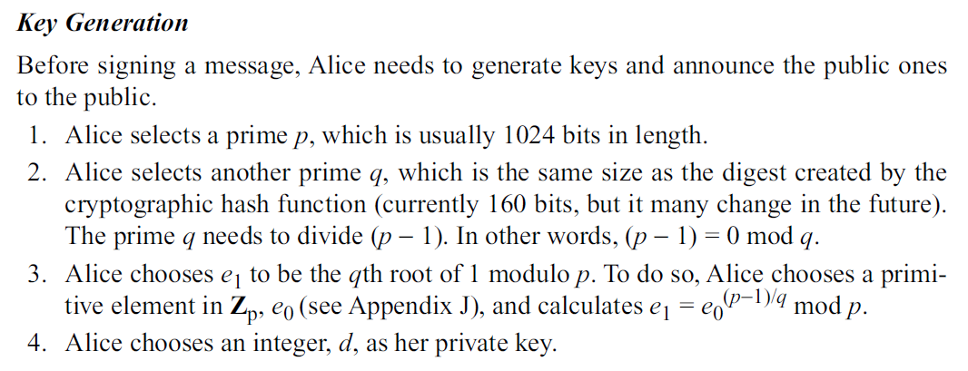
13.<number>

Slide 61
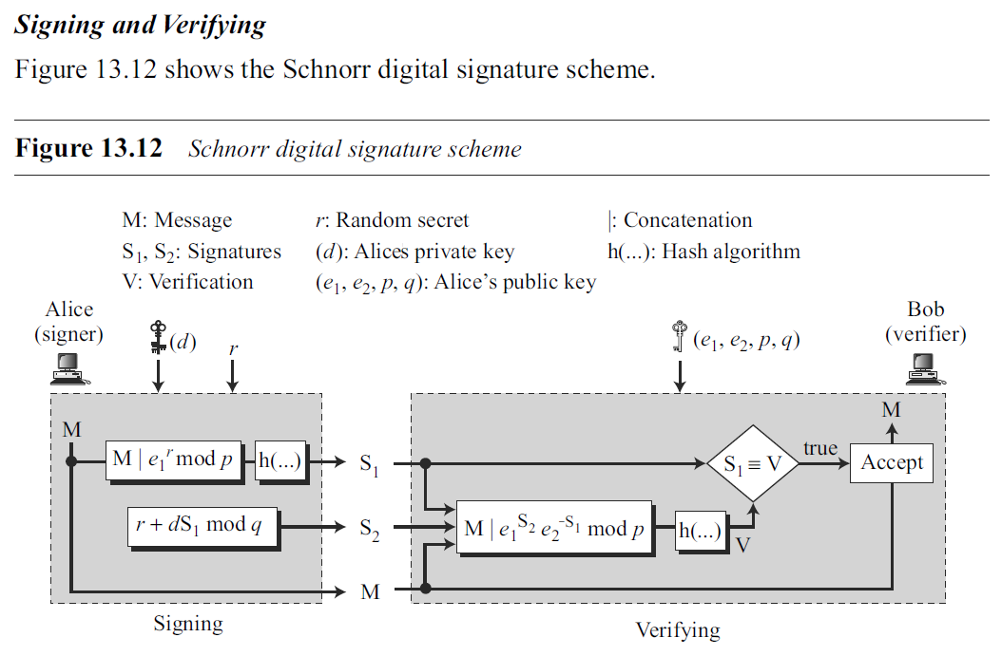
13.<number>

Slide 62
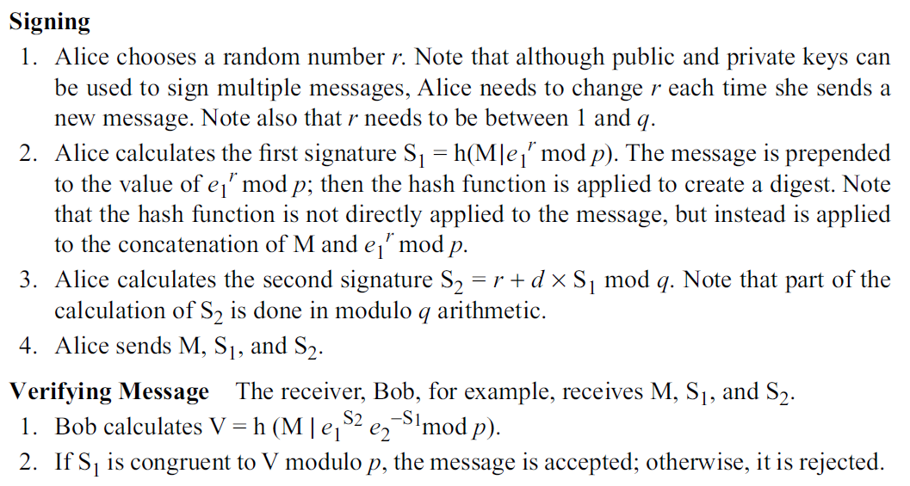
13.<number>

Slide 63
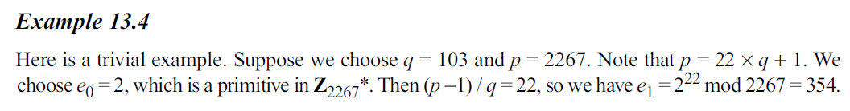
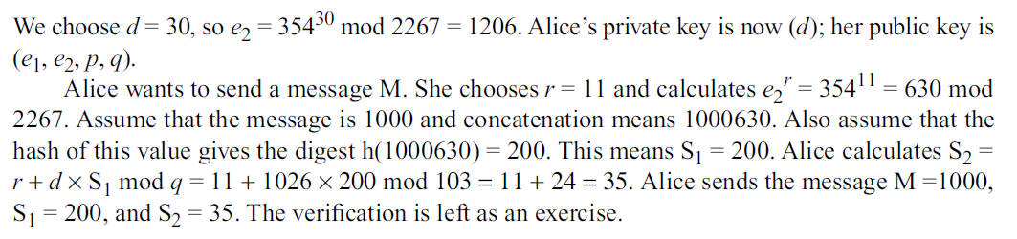
13.<number>

Slide 64
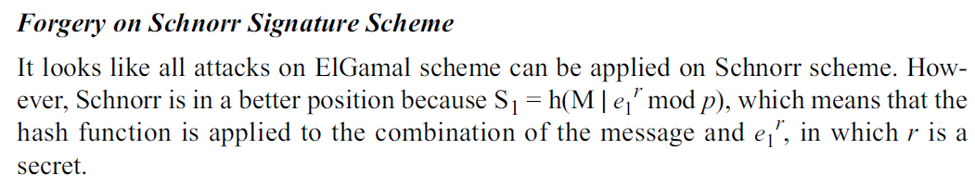
13.<number>

Slide 65
13.5.4 Digital Signature Standard (DSS)
The Digital Signature Standard (DSS) was adopted by the National Institute of Standards and Technology (NIST) in 1994.
DSS uses a digital signature algorithm (DSA) based on the ElGamal scheme with some ideas from the Schnorr scheme.
13.<number>

Slide 66
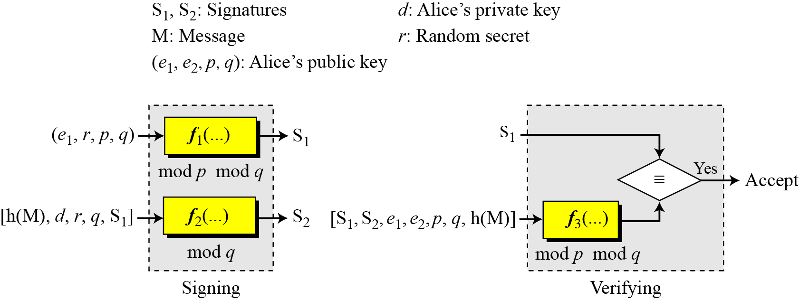
13.5.4 Digital Signature Standard (DSS)
Figure 13.13 General idea behind DSS scheme
In the signing process, two functions create two signatures;
In the verifying process, the output of one function is compared to the first signature for verification.
This is similar to Schnorr, but the inputs are different.
13.<number>

Slide 67
13.5.4 Digital Signature Standard (DSS)
Another difference is that this scheme uses the message digest (not the message) as part of inputs to functions 1 and 3.
The scheme uses two public moduli: p and q.
Functions 1 and 3 use both p and q; function 2 uses only q.
13.<number>

Slide 68
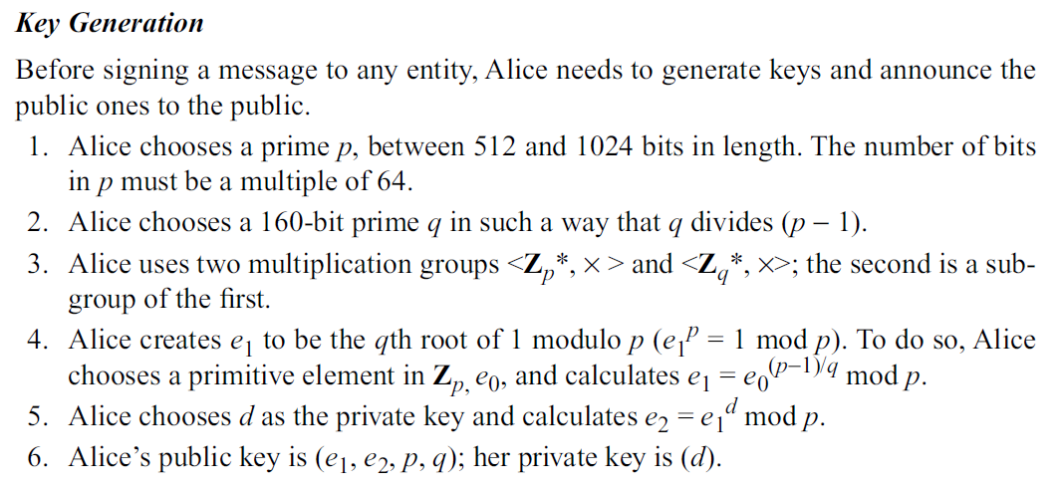
13.<number>

Slide 69
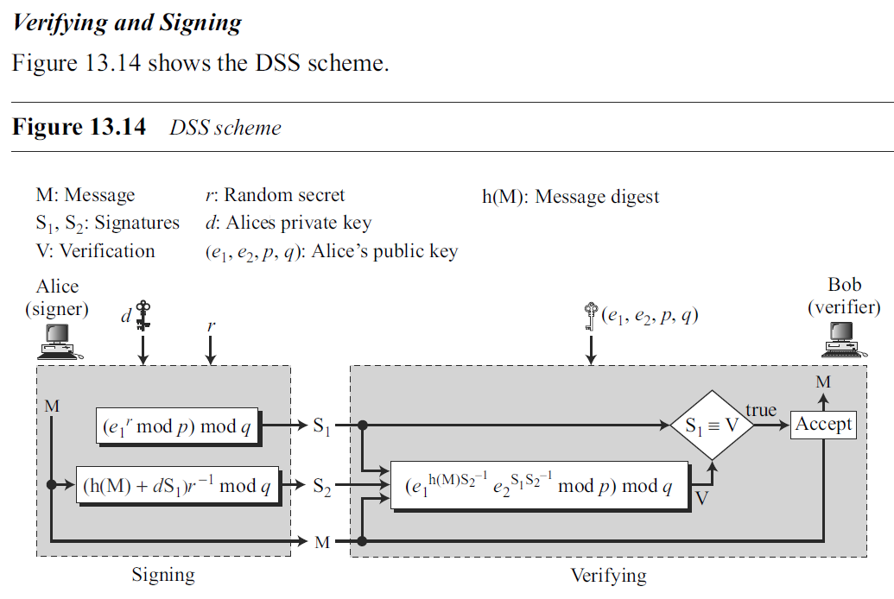
13.<number>

Slide 70
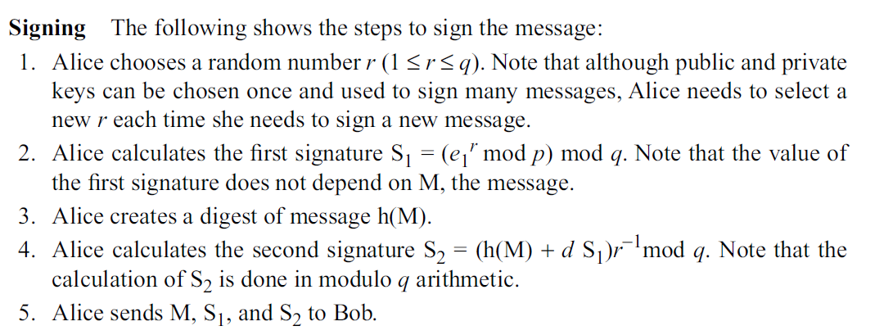
13.<number>

Slide 71
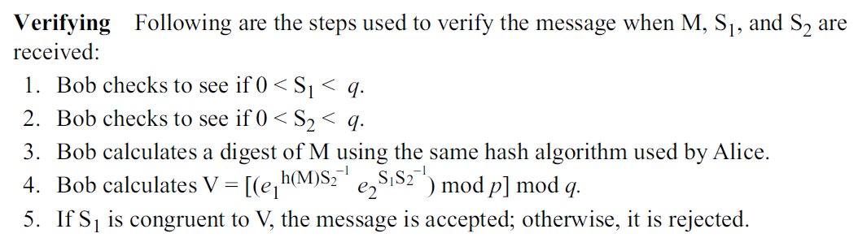
13.<number>

Slide 72
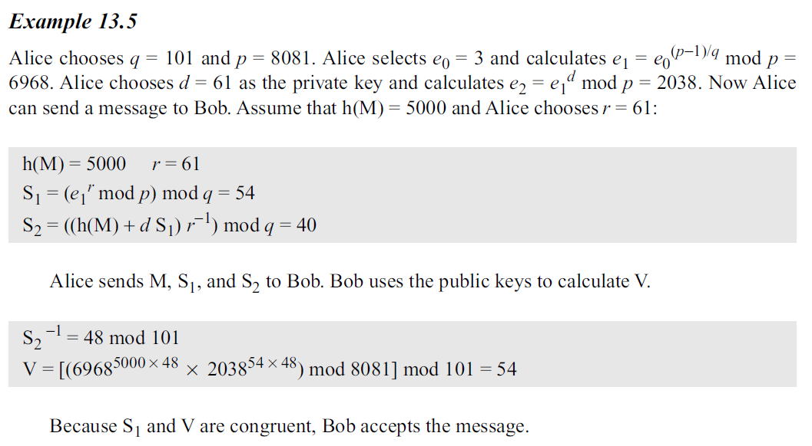
13.<number>

Slide 73
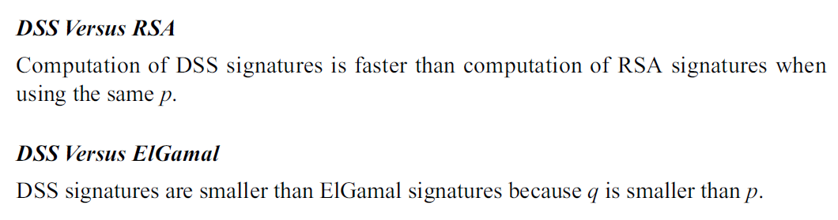
13.<number>

Slide 74
end
13.<number>

Slide 75
https://www.di-mgt.com.au/public-key-crypto-discrete-logs-4-dsa.html
13.<number>

