Slide 1
Searchable Symmetric Encryption:
Improved Definitions and Efficient Constructions
Reza Curtmola, Juan Garay, Seny Kamara, Rafail Ostrovsky
Work appeared in CCS’06
Presented by: Rachit Garg and Aravind Birudu

Slide 2
Motivation
Searching is the primarily way we access data. We google stuff for most things today.
We are outsourcing more and more of our data to third parties and we trust them less and less.
Examples: Industry: https://numer.ai/, for open source(data) machine learning Governments: Aadhaar Database Research Scientists: Genomic Data
Notes:
Industry: Talk about numerai, https://numer.ai/, industry is putting a lot of funding so that it can encrypt and output data so that it can be used for data analytics. Since the data is sensitive, encryption is needed.

Slide 3
The components
Ways to encrypt data
Model of the paper
Prior Work
Revisiting previous security definitions for SSE
Two new notions of security for SSE
“Non-adaptive” security
“Adaptive” security
New constructions
Further work

Slide 4
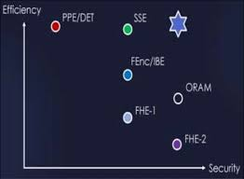
Ways to compute on encrypted data
We know of six different ways to search on encrypted data, each based on one of the following cryptographic primitives:
property-preserving encryption
functional encryption
fully-homomorphic encryption
searchable symmetric encryption
oblivious RAMs
secure two-party computation
Notes:
There are different types of PPE schemes that each leak different properties. The simplest form is deterministic encryption which always encrypts the same message to the same ciphertext

Slide 5
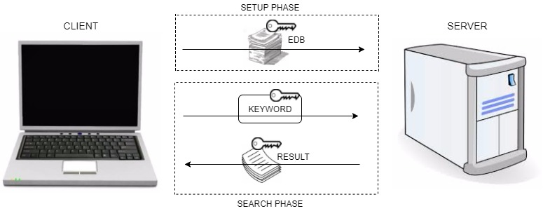
The Model
Client uploads documents and an additional data structure to the server. This additional structure helps in searching in the database. Goal: The leakage to the server should be minimum while the scheme being efficient

Slide 6
Security Definitions
History: History of the queries, includes the document collection and the word queried.
Access Pattern: Document indices returned by the queries.
Search Pattern: Indicates what are the keywords that are searched for.
Trace: Contains the length of the database, the access pattern and the search pattern.

Slide 7
ORAMs
SSE through oblivious RAMs.
ORAM’s can simulate data structures in a secure way, can support conjunctive queries.
Hides everything, even the access patterns.
Efficiency is logarithmic number of rounds for each read/write Lower bound shown by Goldreich and Ostrovsku.
Boneh-Kushilevitz-Ostrovsky-Skeith showed sqrt{DB} communication with constant rounds.

Slide 8
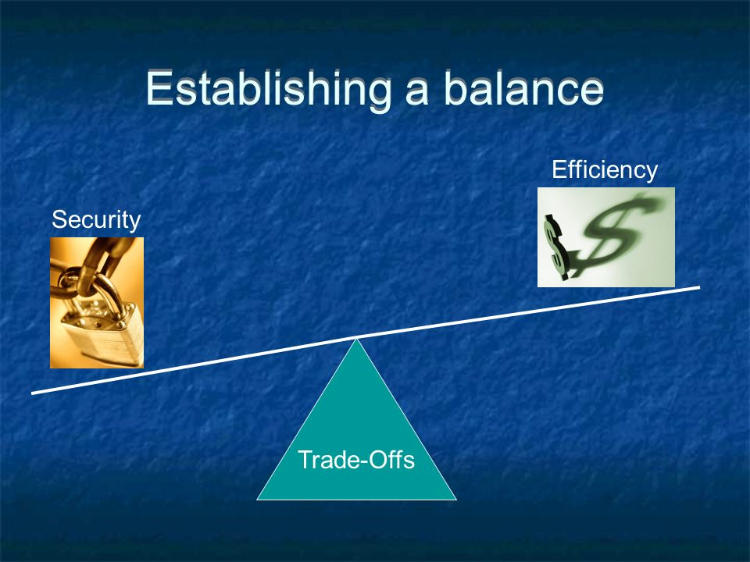
Get more efficiency! By leaking the access pattern but nothing else.

Slide 9
Prior Work
Previous Attempts
“Practical techniques for searches on encrypted data” [SWP00]
“Secure Indexes” [Goh03]
“Privacy-preserving keyword searches on remote encrypted data” [CM05]
[SWP00,Goh03,CM05]: “A secure SSE scheme should not leak anything beyond the outcome of a search”
[SWP00] : “any function of the plaintext that can be computed from the ciphertext can be computed from the length of the plaintext”
Issue: adversary gets to see search outcomes and search pattern

Slide 10
New Definition: “any function about the documents and the keywords that can be computed from the encrypted documents, the index and the trapdoors can be computed from the length of the documents, the search outcomes and the search pattern” (adaptive and non adaptive!)
IND2-CKA: indistinguishability against chosen-keyword attacks(used by [Goh03]) : “any function of the documents that can be computed from the encrypted documents and the index can be computed from the length of the documents and the search outcomes.
[CM05]: Any function that can be computed about the documents and keywords that can be computed from the encrypted documents, the index and the trapdoors can be computed from the length of the documents and the search outcomes. (non adaptive)
Question: Why not prove index secure in the sense of IND2-CKA and trapdoors “secure” using another definition?
They showed that there exists an SSE scheme that has IND2-CKA indexes and trapdoors that are “secure” but when taken together, adversary can recover keyword.

Slide 11
Algorithms
Keygen(1^{k}): outputs symmetric key K
BuildIndex(K, {D₁, ..., D_{n}}): outputs secure index I
Trapdoor(K, w): outputs a trapdoor T_{w}
Search(I, T_{w} ): outputs identifiers of documents containing w (id₁, ..., id_{m})

Slide 12
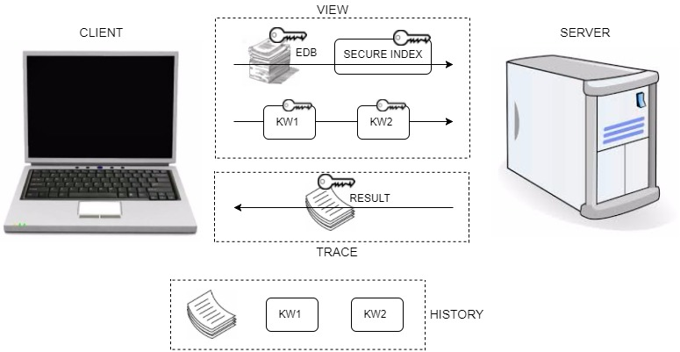
SSE Model

Slide 13
Adaptiveness
Non Adaptive: Non-adaptive adversaries make search queries without seeing the outcome of previous searches.
Adaptive: Adaptive adversaries can make search queries as a function of the outcome of previous searches.

Slide 14

NON ADAPTIVE

Slide 15
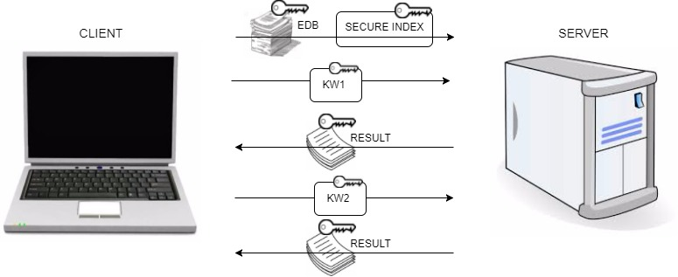
ADAPTIVE

Slide 16
Inverted Index Solution
For each distinct keyword w_i ∈ δ(D), a linked list L_i is created that points to all documents containing that keyword.
We then store all the nodes of all the lists in the array A permuted in a random order and encrypted with randomly generated keys.
Before encrypting the j th node of list L_i , it is augmented with a pointer (with respect to A) to the (j + 1)-th node of L_i , together with the key used to encrypt it.
Note that by storing the nodes of all lists L_i in a random order, the length of each individual L_i is hidden.
We then build a look-up table T that allows one to locate and decrypt the first node of each list L_i .
Notes:
In this way, given the location in A and the decryption key for the first node of a list L i , the server will be able to locate and decrypt all the nodes in L i .

Slide 17
Inverted Index Solution
The client generates both A and T based on the plaintext document collection D, and stores them on the server together with the encrypted documents.
When the user wants to retrieve the documents that contain keyword w i , it computes the decryption key and the address for the corresponding entry in T and sends them to the server.
The server locates and decrypts the given entry of T, and gets a pointer to and the decryption key for the first node of L i . Since each node of L i contains a pointer to the next node, the server can locate and decrypt all the nodes of L i , revealing the identifiers in D(w i ).

Slide 18

Construction:- The Inverted Index Solution
Building a Secure Index
Austin
Baltimore
Washington
Slide taken from web.cs.ucla.edu/~rafail/PUBLIC/SSE.ppt

Slide 19
Building a Secure Index
P: PRP
F: PRF
P(Austin)
F(Austin) = K_{A}
Austin
P(Baltimore)
F(Baltimore) = K_{B}
Baltimore
F(Washington) = K_{W}
Washington
P(Washington)
Slide taken from web.cs.ucla.edu/~rafail/PUBLIC/SSE.ppt

Slide 20

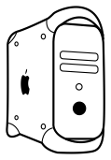
Searching
addr := P(Baltimore)
Trapdoor := (addr, key)
key := F(Baltimore)
Baltimore
D₈, D₁₀
Slide taken from web.cs.ucla.edu/~rafail/PUBLIC/SSE.ppt

Slide 21
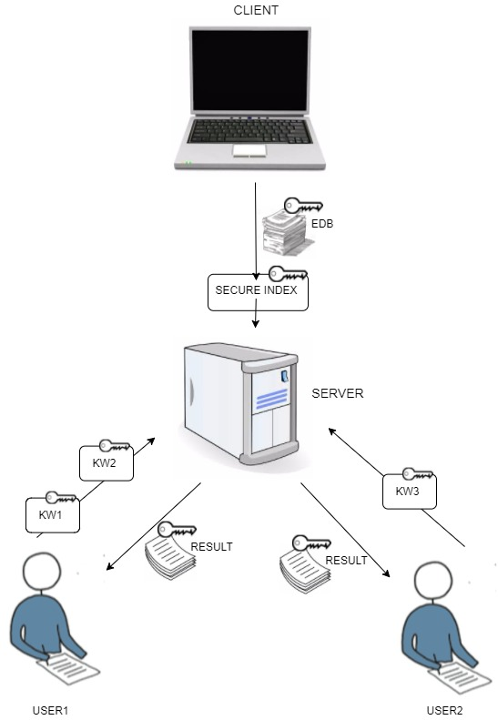
Multi - User SSE

Slide 22
Multi User SSE
Indexes and trapdoors require same security notions as single-user SSE
Revocation: owner can revoke searching privileges robust against user collusions
Anonymity: server should not know who initiated search
Simple construction that transforms single-user SSE schemes to multi-user SSE schemes.

Slide 23
Conclusion Table
Properties | ORAM | Other Solutions | This paper
Hides access patterns | yes | no | no
Server computation | O(log² n) | O(n) | O(1)
Server storage | O(n logn) | O(n) | O(n)
Number of rounds | log n | 1 | 1
communication | O(log² n) | O(1) | O(1)
Adaptive adversaties | yes | no | no

Slide 24
Further Work
This was a foundational work in SSE, it defined the necessary security definitions. There have been several improvements to the solution described in this paper.
The use of FKS dictionaries have been removed.
The inverted index solution is a static scheme, dynamic schemes have been proposed.
Cash, Jarecki, Jutla, Krawczyk, Rosu and Steiner have extended inverted index solution to handle boolean queries.

Slide 25
Thanks!

