Slide 1

lit
Sp
it’s lit.

Slide 2







?
?
?

Slide 3



Solution
A smart platform to split checks with people
Speed.
Simplicity.
Connectivity.

Slide 4

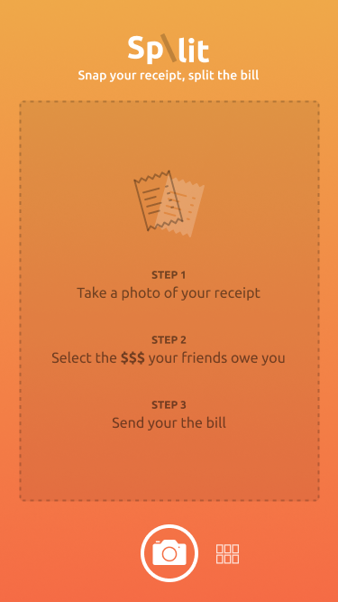
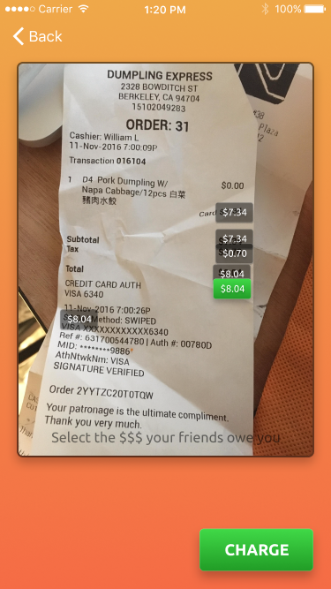
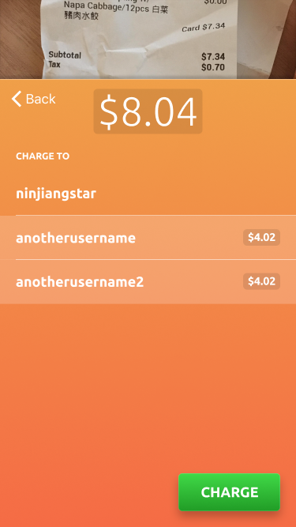

Slide 5



Target Audience

Slide 6
Future Implications

Slide 7
Rachit Kataria
Kelly Lampotang
Andrew Jiang
Samuel Breck
Catherine Chung

