Slide 1






?
?
?

Slide 2

lit
Sp
Receipt parsing done right.

Slide 3




Solution
A smart platform to split checks with people
Speed.
Simplicity.
Connectivity.

Slide 4

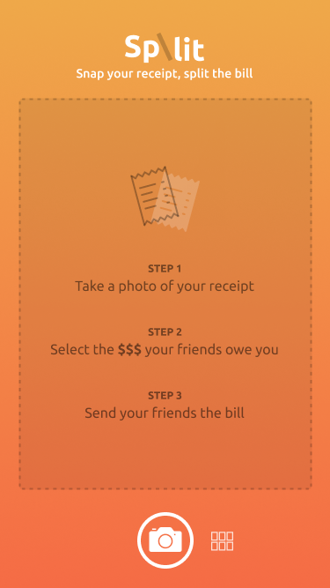
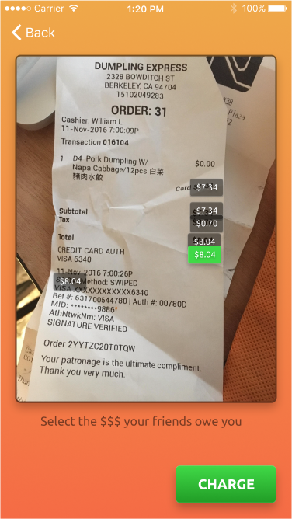
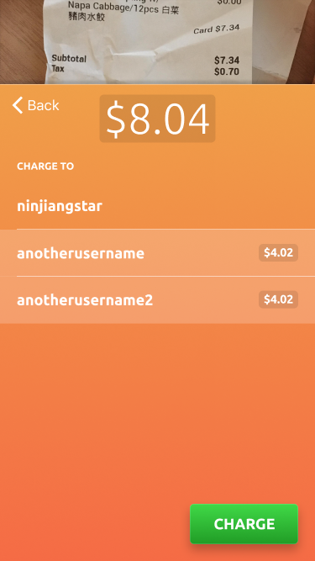

Slide 5



Target Audience

Slide 6
Less is More

Slide 7
Rachit Kataria
Kelly Lampotang
Andrew Jiang
Samuel Breck
Catherine Chung

