Slide 2
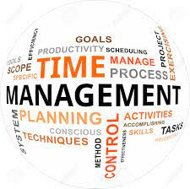
TIME MANAGEMENT

Slide 3
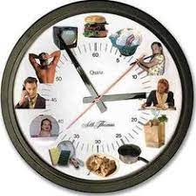
What Is Time Management
The Art of Arranging,
Organizing,
Scheduling one’s time
For the purpose of
generating more
effective work and
productivity is known
as time Management

Slide 4

Why Do We Need Time Management
To Save Time
To reduce Stress
To Work Effectively
To increase work output
To have More control over Study

Slide 5

Time Management Process
Cost your time
Goal setting
Planning
scheduling

Slide 6
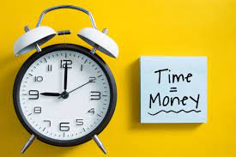
Cost Your Time
‘Time is money’ is a popular proverb that teaches us the importance and value of time in our life

Slide 7

Goal Setting
Setting lifeline goals help you to chart your life course and your career path
Breakup up your life time goals in smaller goals

Slide 8

Planning
Draw an action plan – A list of thing that need to be done to achieve goals

Slide 9

Scheduling
Instead of making time table make task table
Design your weakly or monthly schedule
At the end of the day check which task you did or not

Slide 10

Achieve your Goals
BE Your own judge or your own motivator, make Time Management your tools for success

Slide 11
