Slide 1
To Create A Simple Web Application With Spring Boot..!
We Will Follow MVC Pattern Using JSP As The View.
About This Application
We will develop a simple application with login functionality as well as the functionality to show a list of todo’s.

Slide 2
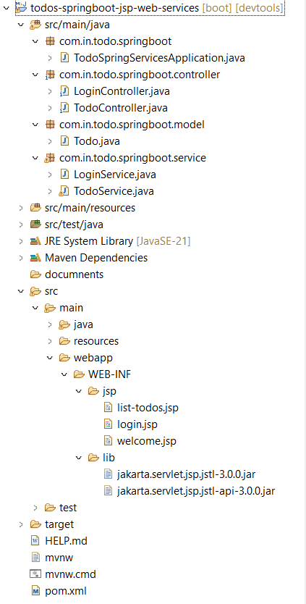

Files
Screenshot Shows Project Structure with All The Files We Would
Create.
.

Slide 3
A Brief Overview Of All Files
LoginService, TodoService - Contain the business logic. LoginService has simple hardcoded validation for userid and password. TodoService contains a service method to retrieve a list of todos.
login.jsp, welcome.jsp, list-todos.jsp - The name clearly explains what each of these views contain.
LoginController, TodoController - Act as Controllers in the MVC patter. LoginController has a little bit of flow. If user enters valid user id and password combination, he would be redirected to the welcome page. Otherwise, login page will be shown with the error message.
pom.xml - Important depedencies are Spring Boot Starter Web and tomcat-embed-jasper. We will talk about these later.
application.properties - This is typically used to configure frameworks in Spring Boot. In this example, we would configure our view resolver in application.properties.

Slide 4
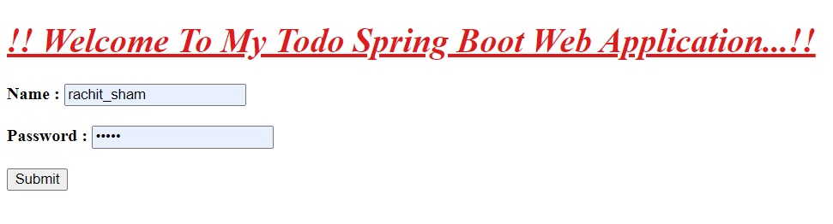
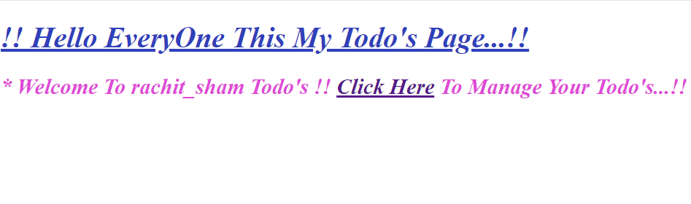
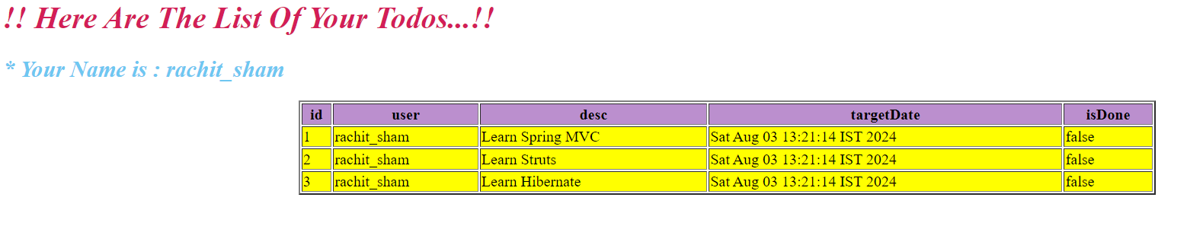
Screenshots Of The Application

Slide 5
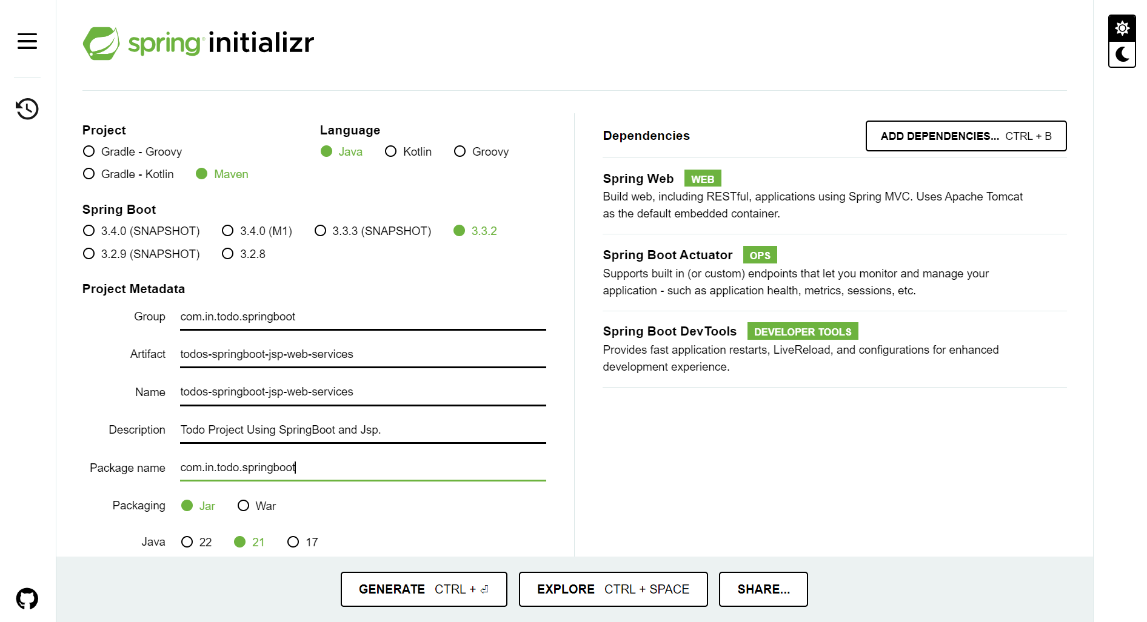
Bootstrapping Web Application With Spring Initializer
Creating a Web application with Spring Initializer is a cake walk. We will use Spring Web MVC as our web framework.
Spring Initializer http://start.spring.io/ is great tool to bootstrap your Spring Boot projects.

Slide 6
As Shown In The Image Above, Following Steps Have To Be Done
Launch Spring Initializer and choose the following
Choose com.in.todo.springboot as Group
Choose student-spring-services as Artifact
Choose following dependencies
Web
Actuator
DevTools
Click Generate Project.
Import the project into Eclipse.
If you want to understand all the files that are part of this project, you can go here.

Slide 7
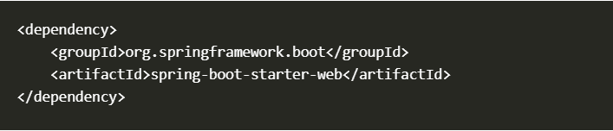
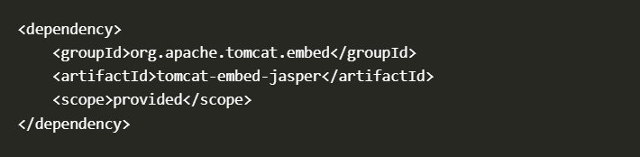
Project Dependencies
Spring Boot Starter Web provides all the dependencies, and the auto configuration need to develop web applications. It is the first dependency we would use.
We want to use JSP as the view. Default embedded servlet container for Spring Boot Starter Web is tomcat. To enable support for JSP’s, we would need to add a dependency on tomcat-embed-jasper.

Slide 8
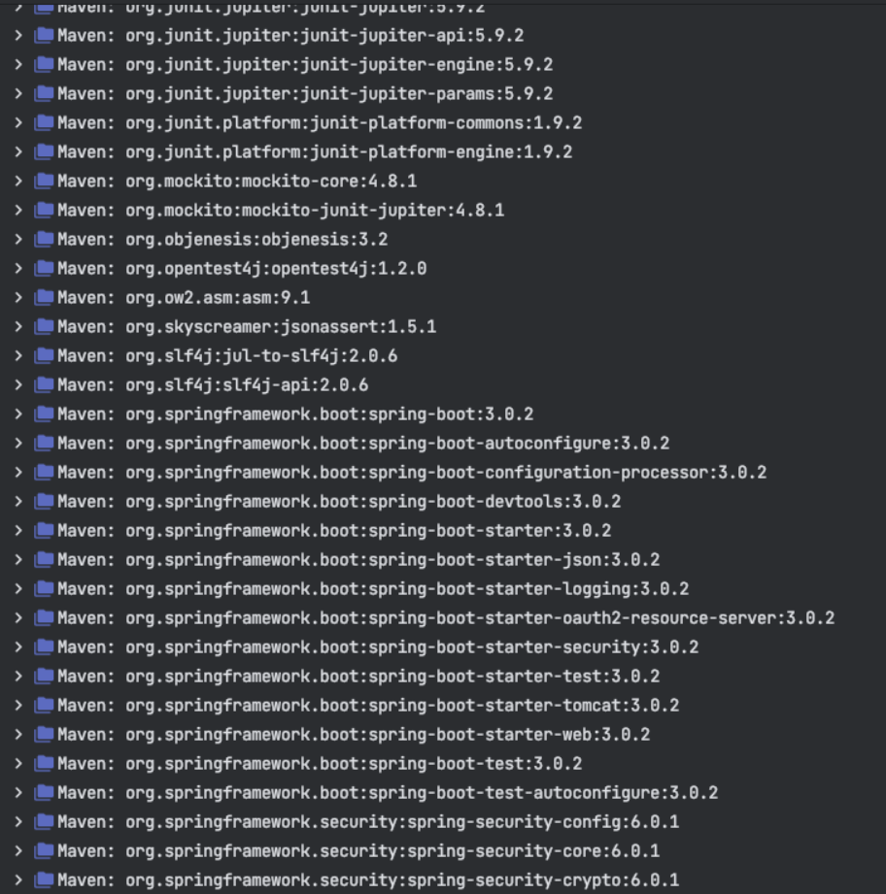
Spring Boot Starter Web Dependencies
Following screenshot shows the different dependencies that are added in to our application because of Spring Boot Starter Web.

Slide 9
Dependencies Can Be Classified Into
Spring - core, beans, context, aop
Web MVC - (Spring MVC)
Jackson - for JSON Binding
Validation - Hibernate Validator, Validation API
Embedded Servlet Container - Tomcat
Logging - logback, slf4j
Any typical web application would use all these dependencies. Spring Boot Starter Web comes prepackaged with these. As a developer, I would not need to worry about either these dependencies or their compatible versions.

Slide 10
Auto Configuration
Spring Boot Starter Web auto configures the basic things that are needed. To understand the features Spring Boot Starter Web brings in, lets run StudentServicesApplication.java as a Java Application and review the log.
Mapping servlet: 'dispatcherServlet' to [/]
Mapped "{[/error]}" onto publicorg.springframework.http.ResponseEntity<java.util.Map<java.lang.String, java.lang.Object>> org.springframework.boot.autoconfigure.web.BasicErrorController.error(javax.servlet.http.HttpServletRequest)
Mapped URL path [/webjars/**] onto handler of type [classorg.springframework.web.servlet.resource.ResourceHttpRequestHandler]
Spring Boot Starter Web auto-configures
Dispatcher Servlet
Error Page
Web Jars to manage your static dependencies
Embedded Servlet Container - Tomcat is the default

Slide 11

Configuring A View Resolver
We would have our jsp’s in /WEB-INF/jsp/. We would need to configure the view resolver with the prefix and suffix.

Slide 12
Login Controller
public String showLoginPage(ModelMap model): Mapped to the \login Get Method, this method shows the login page.
@Autowired LoginService service: LoginService has the validation logic
showWelcomePage(ModelMap model, @RequestParam String name, @RequestParam String password): Mapped to the \login Post Method, this method validates the userid and password. Redirects to welcome page if login is successful.

Slide 13
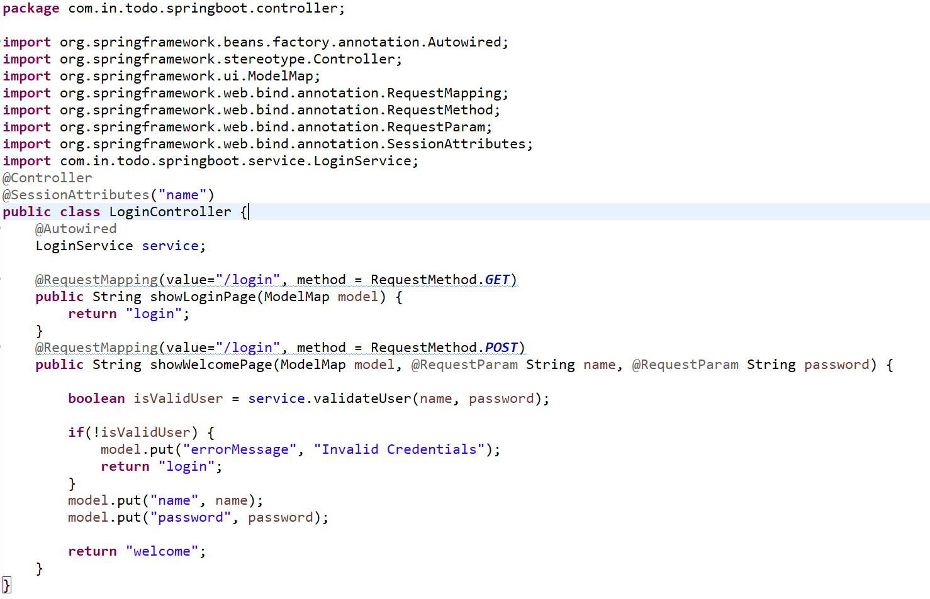

Slide 14
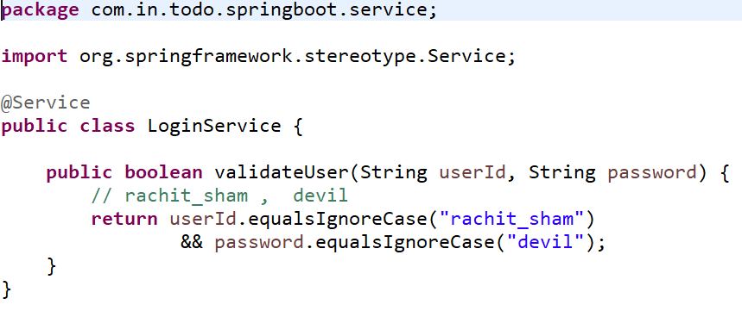
Login Service
Has the basic logic for authentication. Hardcoded business logic

Slide 15
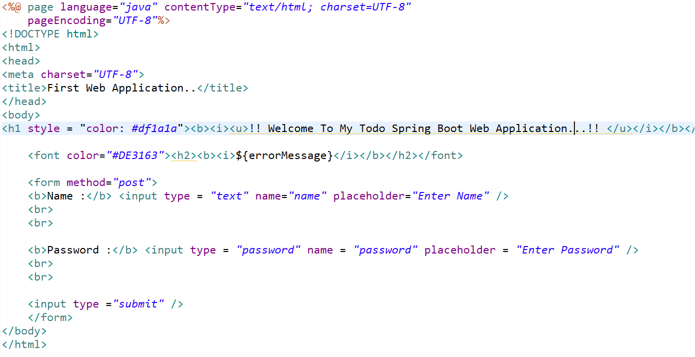
Login View – JSP
Simple login page with userid and password form fields. If error message is populated into model, ${errorMessage} will show the authentication failure error message.

Slide 16
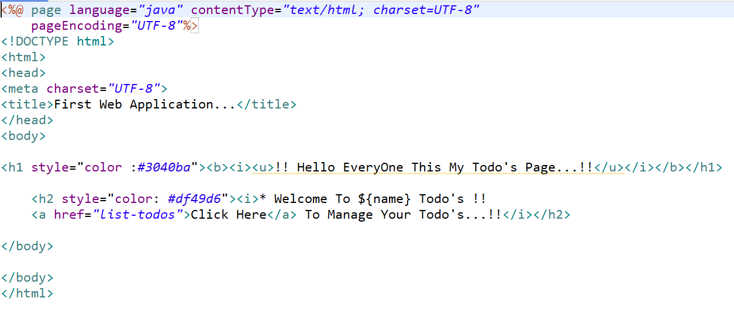
Welcome View - JSP
Welcome page is shown on successful authentication. Shows the name of the login user and a link to manage todo’s.

Slide 17
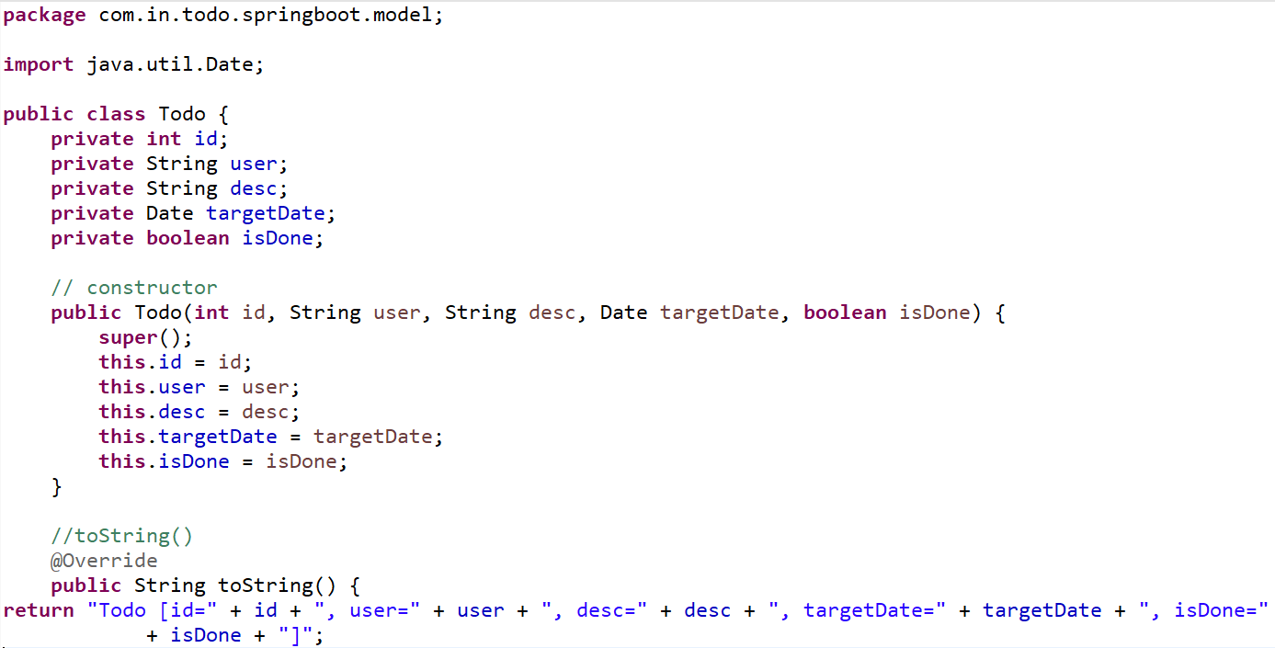
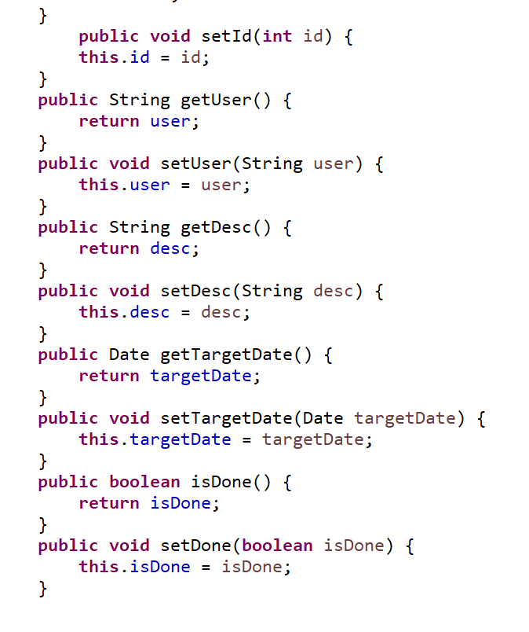
Todo Model
We are using a basic todo with id, user, description and a target date.

Slide 18
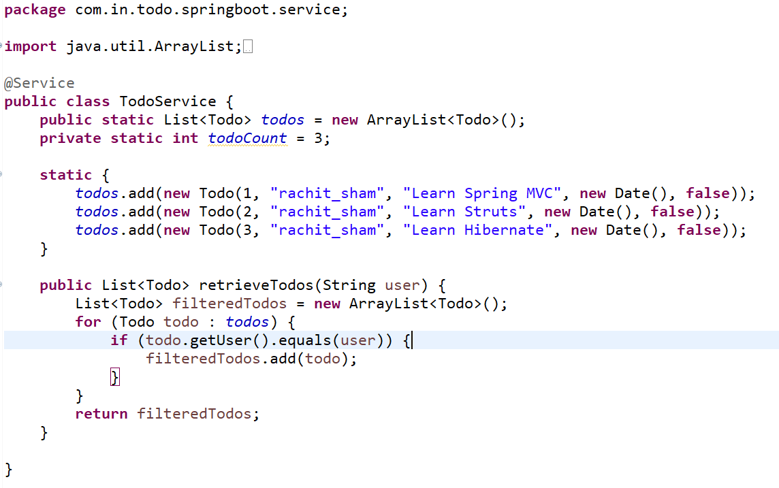
Business Service
Todoservice uses a simple ArrayList to store a list of todo’s in memory. It offers a method to retrieve the todo’s.

Slide 19
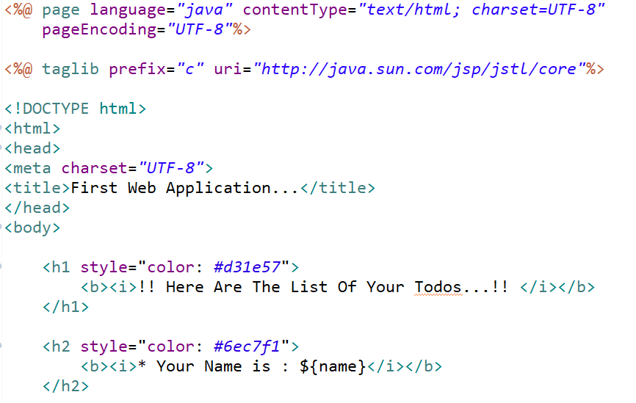
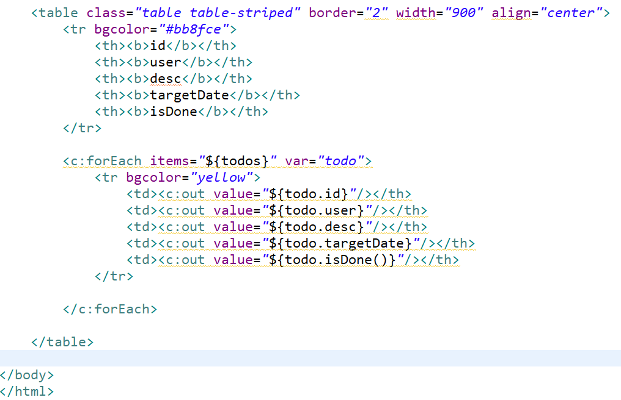
List Todo - JSP
List todos pages shows the list of todo’s. This is completely unformatted page. During the subsequest steps of our course, we beautify this page and add more functionality to add, delete and update todo’s.

Slide 20
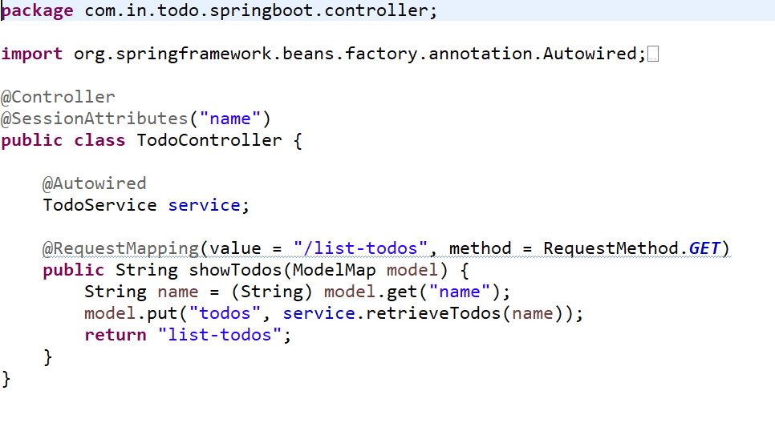
Todo Controller
Todo Controller has a simple method to retrieve the list of todos and populate it into model. It redirects to list-todos view.

Slide 21
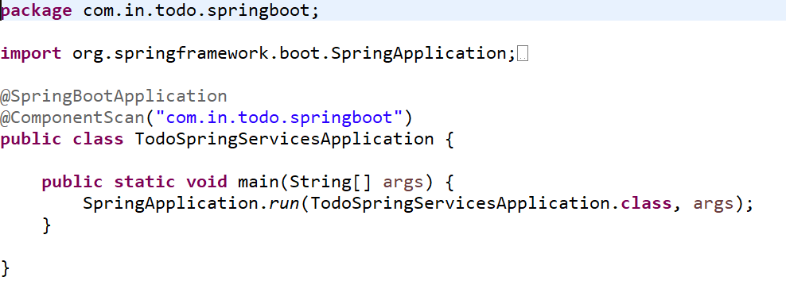
Running The Application
We use a Spring Boot Application class to launch our application.

Slide 22
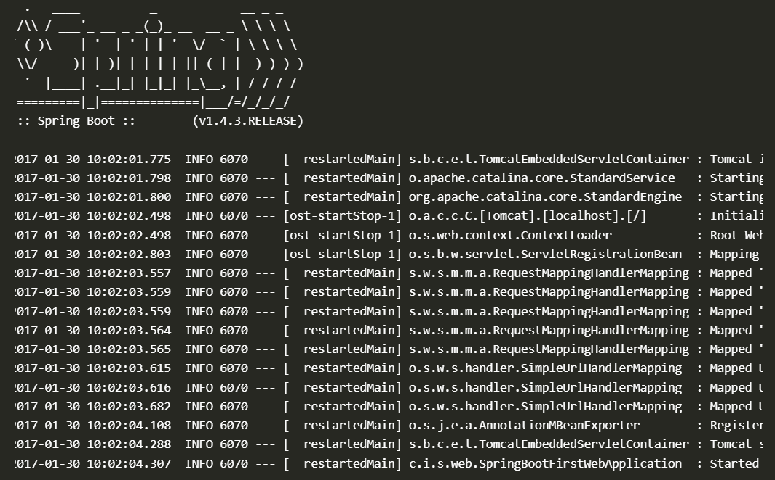
You can run this as a simple java application. When you run this, you would see the application starting up. Below is some of the extract from the log. You can see that all the request mappings are properly mapped.
You can launch the application at http://localhost:8080/login and enter [userid / password] combination of [rachit_sham / devil].
Complete code is on Github repository : https://github.com/RachitSham/todos-springboot-jsp-web-services step by step. You can download the zip and import as a maven project to be able to run it.

Slide 23

About Me
Name - Rachit Sharma
Qualification - Master of Computer Application
Technologies Known - Java, Servlet, JDBC, JSP, SQL, HTML, CSS, Springboot
Mobile No - 7459870198
Email - rachit222sharma@gmail.com
Github - https://github.com/RachitSham
LinkedIn - https://www.linkedin.com/in/rachit-sharma-techie/

