Slide 1
CT-based Patient Triage of COVID-19
Radiomics prediction of ICU admission, mechanical ventilation and death
UE24CS352A Machine Learning - Mini-Project
Faculty sample solution for students | synthetic data
Notes:
Introduce this as a worked example of a full submission: repo, write-up, slides, live demo. Stress that the data is synthetic and that the point is the method and the standards, not the numbers.

Slide 2
The problem: who needs intensive care?
At admission, predict three outcomes: ICU admission, mechanical ventilation (MV), in-hospital death
Inputs: CT radiomics, clinical features, lab results
Why it matters: allocate limited ICU resources to high-risk patients first
Why it is hard: outcomes are rare (about 2-8% of patients)
3
outcomes
5
data configurations
5
models
Notes:
Based on Zhan and Li, Stanford CS229 2020. Ask students why rare outcomes make accuracy a misleading metric.

Slide 3
Data: two cohorts, split by admission period
1,662
700
Cohort 1: development
ICU 93 | MV 47 | death 31
Cohort 2: external validation
ICU 57 | MV 45 | death 32
114 features: 100 radiomics, 7 clinical, 7 labs, plus a 0-4 radiologist score
The paper's hospital data is private, so this sample uses synthetic data with the same structure
Cohort 2 has a mild covariate shift, like a later admission period
Notes:
The generator lives in src/generate_synthetic_data.py. Be explicit that metrics on synthetic data are not clinically meaningful. A real submission would use a real public dataset and justify the choice.

Slide 4
Approach: select on training data only
1
2
3
4
Split
Engineer
Select
Validate
Cohort 1: 70% train / 30% test
Class weights, SMOTEENN, or SMOTEENN + LASSO
5 models; best by 3-fold CV AUROC on train
Refit on cohort 1; test on cohort 2
Bootstrap: 30 resamples of cohort 2, 95% intervals, paired one-sided t-tests. Deliberate improvement on the paper, which picked models on the 30% test split.
Notes:
Why SMOTEENN inside an imblearn Pipeline: resampling must happen only on training folds, otherwise synthetic points leak into validation and inflate scores. Ask students where leakage could creep in.

Slide 5
Implementation and how to run it
Python: scikit-learn, imbalanced-learn, LightGBM, SciPy
pipeline.py runs everything end to end, seeded (about 5 minutes)
demo.py scores individual patients live
README: setup, run commands, layout
pip install -r requirements.txt
python src/generate_synthetic_data.py
python src/pipeline.py
python demo.py
Notes:
Show the repo on screen. Point out the commit history, a clear README and no data or secrets committed beyond the synthetic CSV. Repository maintenance is graded.

Slide 6
Results: ClinLab wins on every task
The paper's headline (radiomics + clinical + labs best) did not replicate on synthetic data. Honest reporting is the lesson.
Notes:
Numbers are bootstrap means from results/table3_bootstrap_summary.csv. In the synthetic generator, labs are a cleaner readout of the latent severity than radiomics, and with few positives, 100 extra noisy features hurt. The RScore ventilation model scored 0.43, below chance: a flexible model overfitting 47 positives.

Slide 7
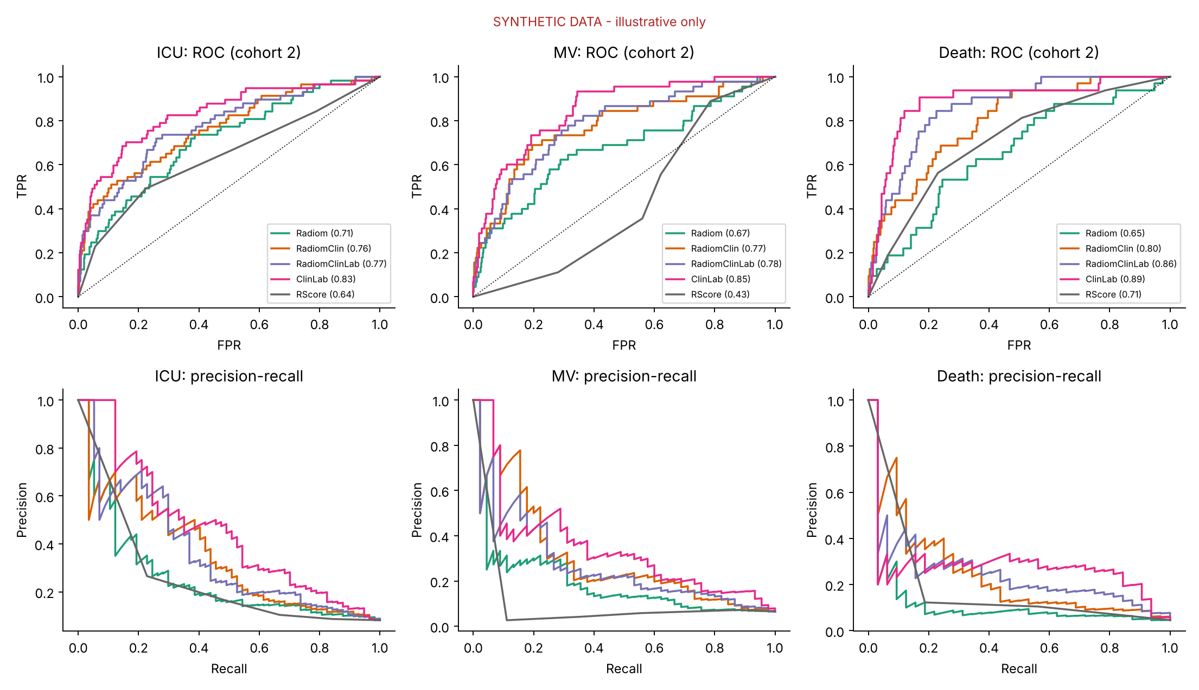
Discrimination on unseen patients (cohort 2)
Top: ROC. Bottom: precision-recall
Precision-recall matters with rare outcomes
Wide wobble = few positives (32-57 per task)
Notes:
Ask: why is the precision-recall plot more informative than ROC when only 2-8% of patients are positive?

Slide 8
What the statistics say
Comparison (AUROC) | ICU | MV | Death
Radiomics vs radiologist score | +0.076 | +0.254 | -0.047
Adding clinical to radiomics | +0.048 | +0.093 | +0.151
Paired one-sided t-tests over 30 bootstrap resamples: both comparisons significant (p<0.001) in every task, except radiomics vs radiologist score for death on AUROC
Top features: age, neutrophils, D-dimer, dyspnea, plus a few radiomics features
Caveat: bootstrap p-values on one fixed test cohort understate uncertainty
Notes:
Final bullet is a genuine limitation worth discussing: the bootstrap resamples the test patients but not the training process, so these p-values are optimistic.

Slide 9
Conclusions and takeaways
What held
What did not
Radiomics beat the radiologist score for ICU and MV
Clinical features add real value to radiomics
Radiomics + clinical + labs was not best; ClinLab was
Few positives punish high-dimensional inputs
For your own project: state data limits honestly, keep test data out of model selection, report intervals, and be ready to explain every line.
Notes:
Close by connecting to the grading criteria: individual contribution and Q&A reward understanding, not just working code.

Slide 10
Live demo
python demo.py
Trains the ICU model on cohort 1, then scores unseen cohort 2 patients and ranks them by predicted risk.
Questions?
Notes:
Run demo.py live. Expected: eight patients ranked by predicted ICU risk next to the true label. Then take questions.

