Slide 1
AegisAI Platform
Real-Time Border Threat Intelligence & Decision Support System
Integrated Computer Vision (YOLOv8), ML Threat Scoring (XGBoost) & GIS Analytics
Presenters: Rachith Bharadwaj T N (Lead Architect) & Ullas G M (Tactical Operations Lead)

Slide 2
AEGISAI DEFENSE INTELLIGENCE PLATFORM
Problem Statement & System Motivation
01. Sensor Saturation
Modern border monitoring generates massive multi-modal streams (CCTV, radar, IR) that cause severe cognitive overload during critical threat response windows.
02. System Silos
Legacy surveillance tools operate in isolation. Visual object detectors do not calculate spatial risk scores or communicate automatically with tactical GIS maps.
03. Ethical & Operational Risk
Automated kinetic systems risk severe false-positive actions. AegisAI enforces a strict 'Decision support, not decision making' advisory framework.

Slide 3
AEGISAI DEFENSE INTELLIGENCE PLATFORM
Decoupled Architecture & Technology Stack
Presentation Layer
Next.js 16 + React 19 + Tailwind CSS - Responsive Glassmorphism HUD - Turbopack Compilation - API Proxy Rewrites
Intelligence & REST API
Python Flask Microservice - Ultralytics YOLOv8 Computer Vision - XGBoost Quantile Threat Engine - ReportLab PDF Engine
Persistence & Security
MongoDB 8.2 + JWT Security - 42ms Query Connection Pool - Bcrypt 12-round Hashing - Cryptographic Audit Trail

Slide 4
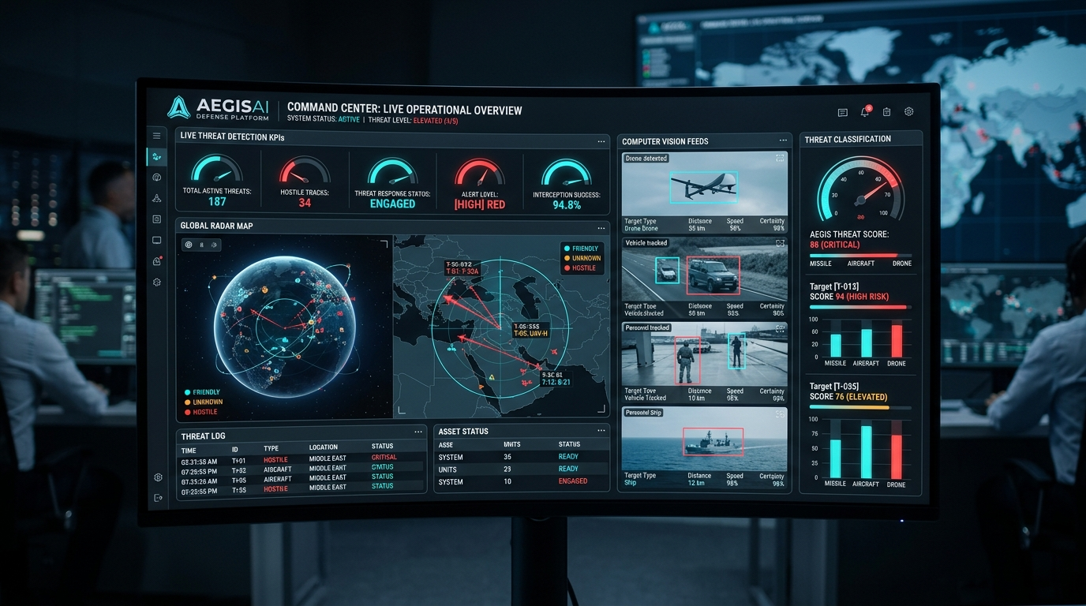
AEGISAI DEFENSE INTELLIGENCE PLATFORM
Feature 1: Command Center Tactical Dashboard
Unified Threat Operations Workspace
• Real-time threat status KPIs and active sector metrics.
• 24-hour threat outlook trend visualization.
• Live detection alerts fed directly from ML pipeline.
• Single-command execution via npm run dev (Concurrently).

Slide 5
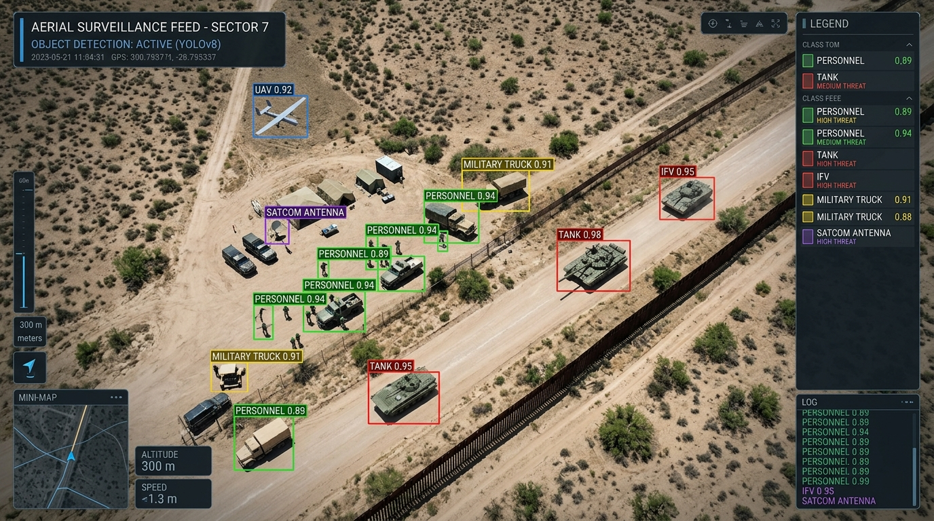
AEGISAI DEFENSE INTELLIGENCE PLATFORM
Feature 2: YOLOv8 Computer Vision Engine
Deep Learning Object Detection & Taxonomy
• Ultralytics YOLOv8 deep convolutional object detection.
• Real-time bounding box extraction and confidence scoring.
• Documented defense taxonomy proxy mapping.
• Translates generic classes (truck, boat) into military units.

Slide 6
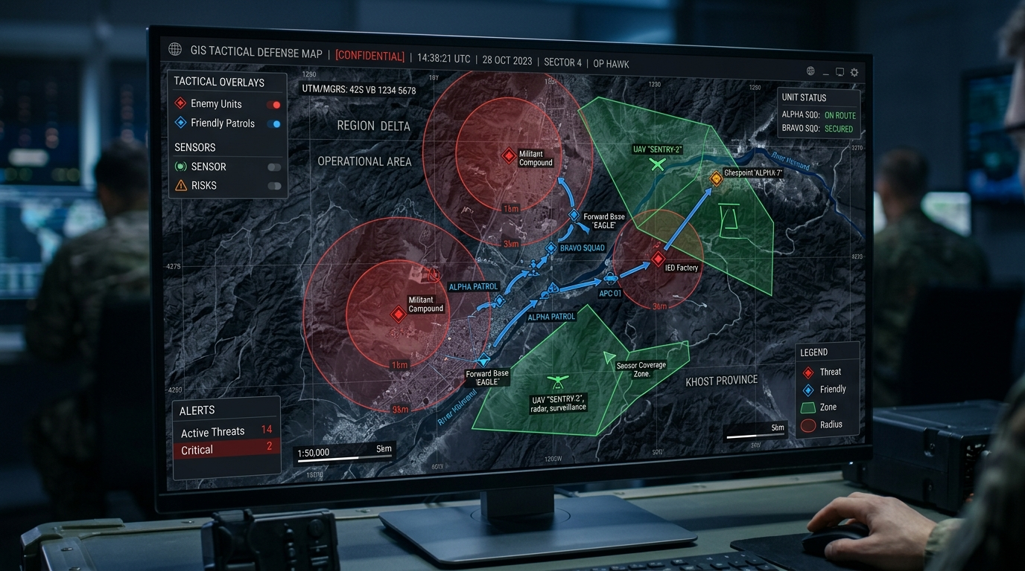
AEGISAI DEFENSE INTELLIGENCE PLATFORM
Feature 3: GIS Tactical Spatial Intelligence
Interactive Dark Satellite Spatial Analytics
• React Leaflet dark basemap spatial integration.
• Exponential severity radius calculation (R_severity).
• Real-time patrol unit markers and AO tracking.
• Interactive threat sector risk heatmaps.

Slide 7
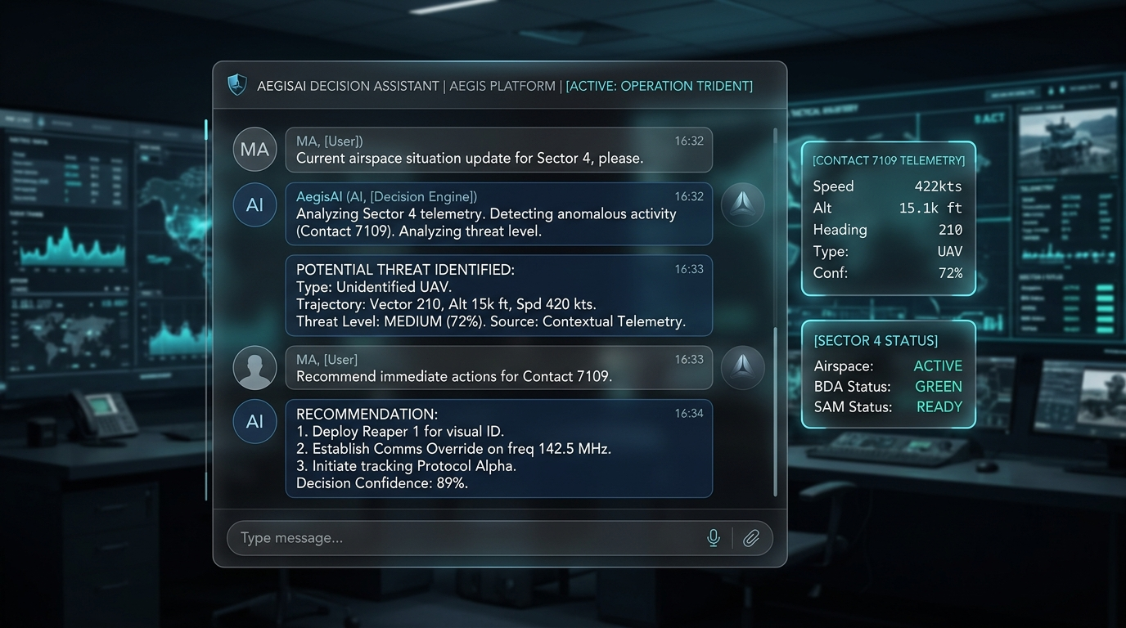
AEGISAI DEFENSE INTELLIGENCE PLATFORM
Feature 4: AegisAI Generative Decision Engine
Contextual Intelligence Assistant
• Active decision-support chat interface.
• Automatic injection of live telemetry & threat scores.
• Auditable response logging and query tracking.
• Graceful local fallback during network disconnects.

Slide 8
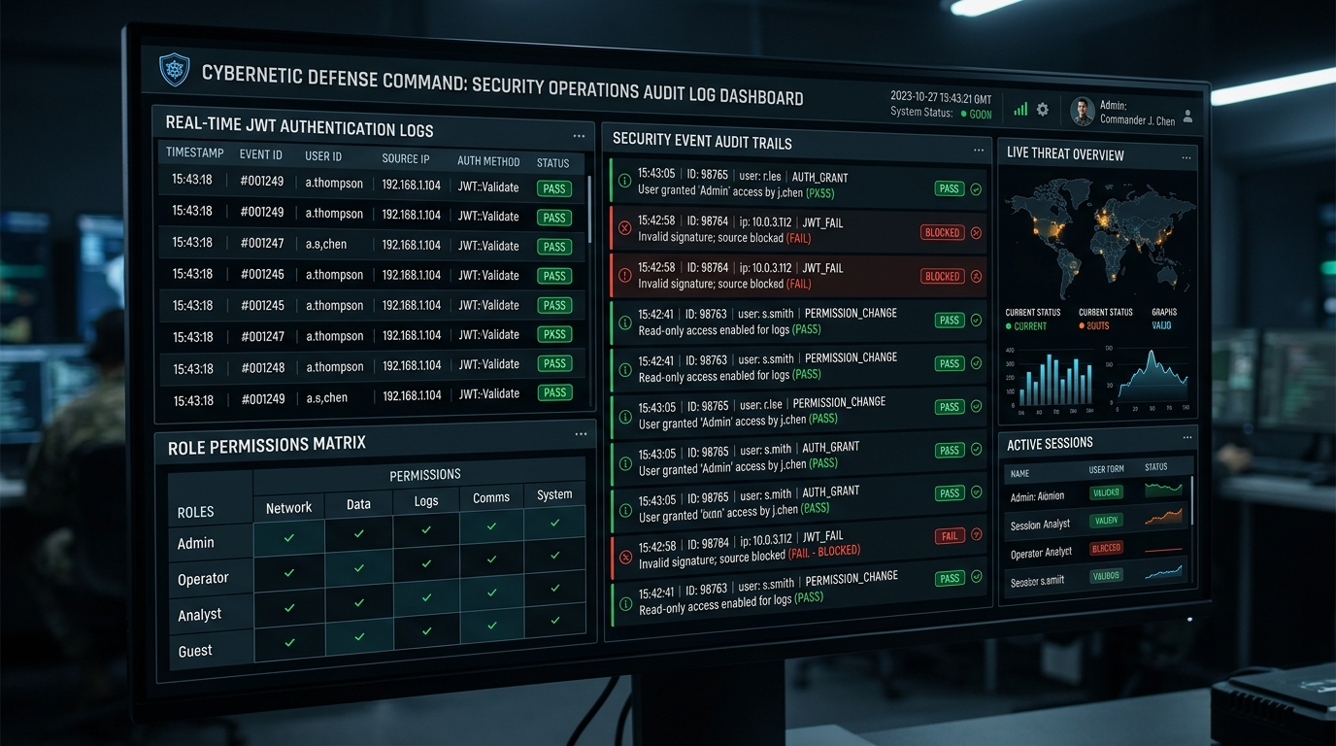
AEGISAI DEFENSE INTELLIGENCE PLATFORM
Feature 5: Role-Based Security & Audit Trail
Cryptographic Security Gateway
• HMAC-SHA256 JWT authentication & bcrypt hashing.
• RBAC Role Matrix: Admin (Rachith), Commander (Ullas), Analyst.
• Cryptographic audit log trail stored in MongoDB.
• Protection against JWT forgery & path traversal attacks.

Slide 9
AEGISAI DEFENSE INTELLIGENCE PLATFORM
Experimental Evaluation & Performance Benchmarks
132 / 132 E2E Tests Passed (100%)
✓ Health & Subsystems: 7/7 PASSED
✓ Registration Security: 13/13 PASSED
✓ RBAC Role Boundaries: 12/12 PASSED
✓ Auth Gateway Defense: 16/16 PASSED
✓ ML Threat Scoring: 30/30 PASSED
✓ Upload Security & Magic Bytes: 10/10 PASSED
✓ GIS Data Hub Analytics: 21/21 PASSED
✓ ReportLab PDF Stream: 9/9 PASSED
✓ Decision Assistant Engine: 4/4 PASSED
✓ Concurrency & Burst Load: 10/10 PASSED
Empirical Latency & Throughput Metrics
• MongoDB Query Latency: 42 ms (Target: < 100 ms)
• YOLOv8 Frame Inference: 38 ms (Target: < 100 ms)
• XGBoost Threat Scoring: 4.2 ms (Target: < 20 ms)
• Next.js Turbopack Build: 4.5 s (Target: < 15 s)
• 40-Request Burst Throughput: 0.20 s (Target: < 1.0 s)

Slide 10
AEGISAI DEFENSE INTELLIGENCE PLATFORM
Conclusion & Operational Impact
Summary of Platform Deliverables
✔ Fully Operational Defense Intelligence Workspace: Fuses vision, ML scoring, GIS, and AI assistant.
✔ Verified Security & Zero Defect Grade: 132/132 automated tests passed with 0 failures.
✔ Single-Command Deployment: npm run dev starts frontend and backend concurrently in one terminal.
✔ Advisory Paradigm: Empowers defense commanders with real-time situational awareness.
Thank You! Questions & Discussion.

