Slide 1
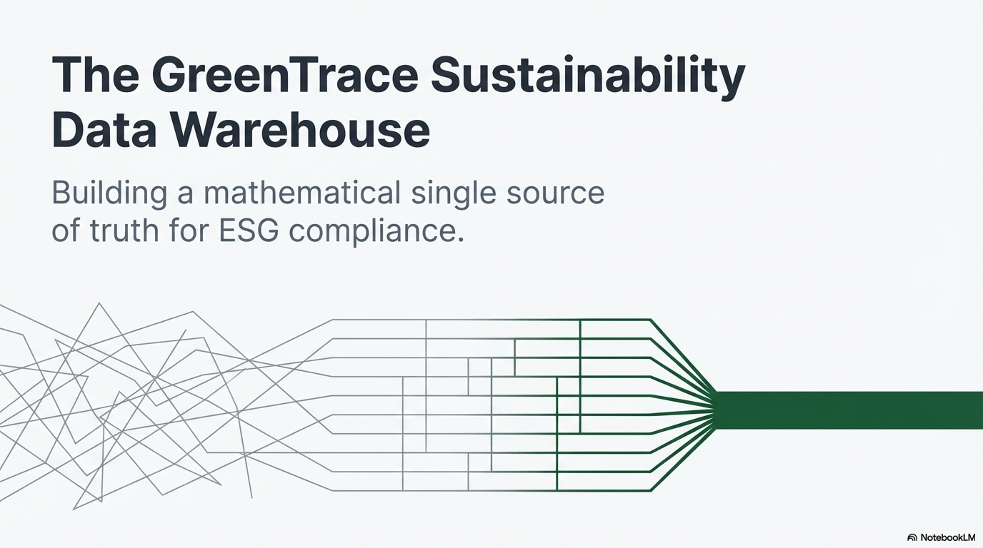

Slide 2
GreenTrace ESG Data Vault
Data Vault 2.0 warehousing, emissions analytics, secure service delivery, and interactive decision support
Current Snapshot
2026 Q1
25 facilities | 100 meters | 40 shipments
An ESG data platform engineered using Data Vault 2.0 as the core warehousing methodology.
Converts operational records into auditable warehouse structures, derived emission events, and analytical decision-support views.
Team focus: database design, ETL orchestration, service-layer engineering, visualization, integration, and security assurance.
Primary Insight
IN-NORTH
Highest modeled region at 9,638.22 kgCO2e
Peak Facility
Facility 00000015
2,006.05 kgCO2e total footprint
Warehouse Tables
22
Across vault, ledger, mart, metadata
Rows Processed
5,286
Validated ETL load count
Total Emissions
42.55 tCO2e
Scope 2 + Scope 3 modeled
GreenTrace | ESG Data Vault 2.0 | Slide 1

Slide 3
Problem Statement and Project Objectives
Why this system was designed and what it resolves
Research Problem
Enterprise ESG data is typically distributed across heterogeneous operational records, which weakens traceability, slows reconciliation, and reduces reporting confidence.
Technical Objective
Design a scalable warehouse using Data Vault 2.0, automate transformation and emission computation, and expose analytical access through a secure service layer.
Delivered Capability
Green Trace consolidates ESG entities, preserves historization and lineage, derives Scope 2 and Scope 3 metrics, and presents them through an interactive analytical interface.
Business goal: make sustainability reporting traceable, comparable, and analytically defensible.
System goal: separate warehousing, business logic, reporting, and user interaction into disciplined architectural layers.
Academic goal: demonstrate database management, warehousing, ETL engineering, visualization, and system integration within one coherent implementation.
GreenTrace | Project framing and expected value | Slide 2

Slide 4
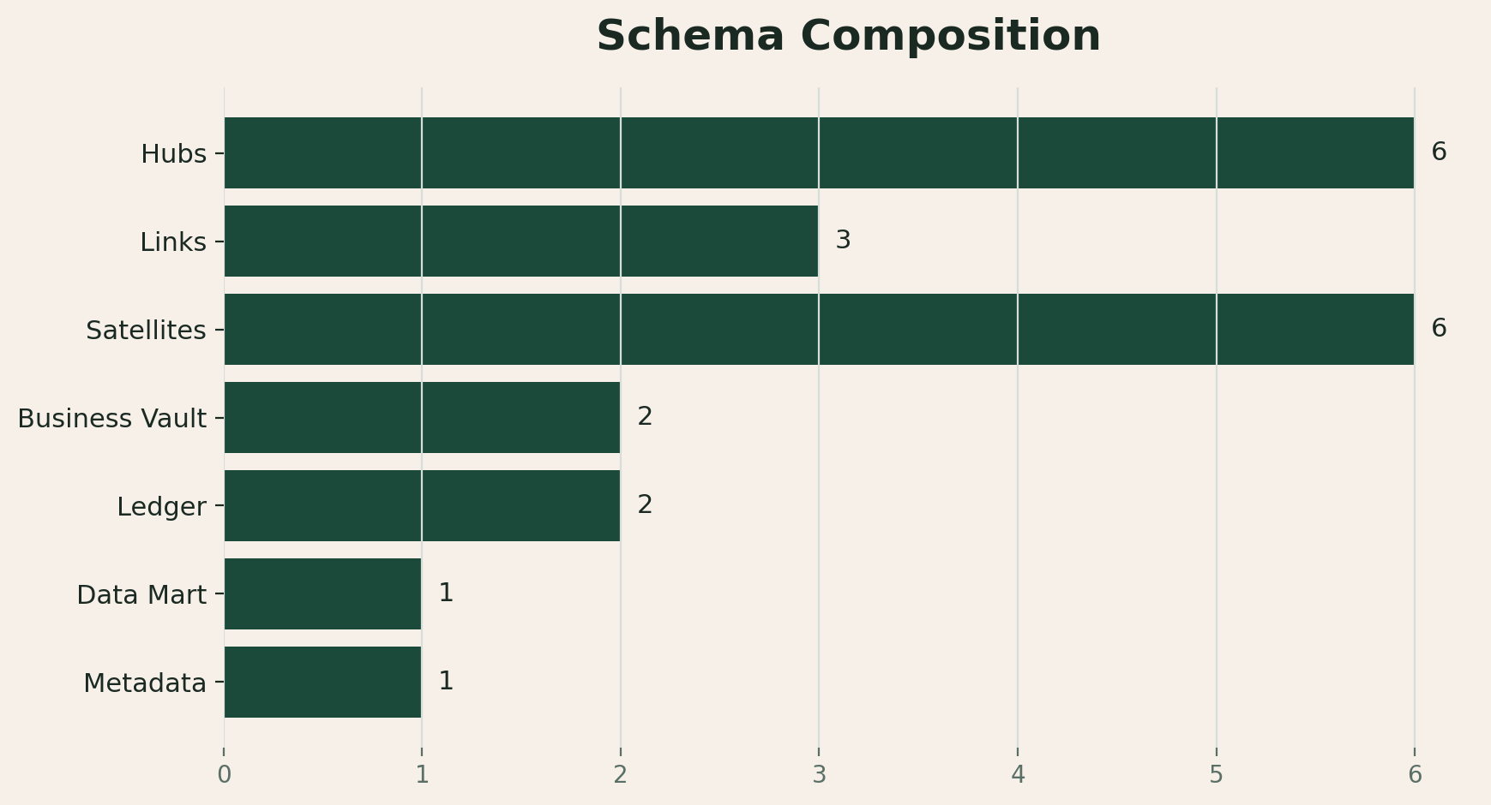
Warehouse Scope and Structural Profile
The implemented model at a glance
Warehouse Tables
22
Implemented across all logical layers
Facilities
25
Modeled organizational units
Meters
100
Granular energy capture points
Reporting Window
2026 Q1
Current analytical snapshot
Rows
5,286
Validated warehouse rows
Core business entities include facilities, suppliers, meters, shipments, carbon credits, and reporting periods.
The current model covers 25 facilities, 100 meters, 12 suppliers, 40 logistics records, and 10 carbon-credit assets.
The schema is distributed across hubs, links, satellites, Business Vault tables, ledger tables, a reporting mart, and lineage metadata.
This structure supports scalability, historization, referential clarity, and downstream analytical reproducibility.
GreenTrace | Dataset profiling and schema footprint | Slide 3

Slide 5
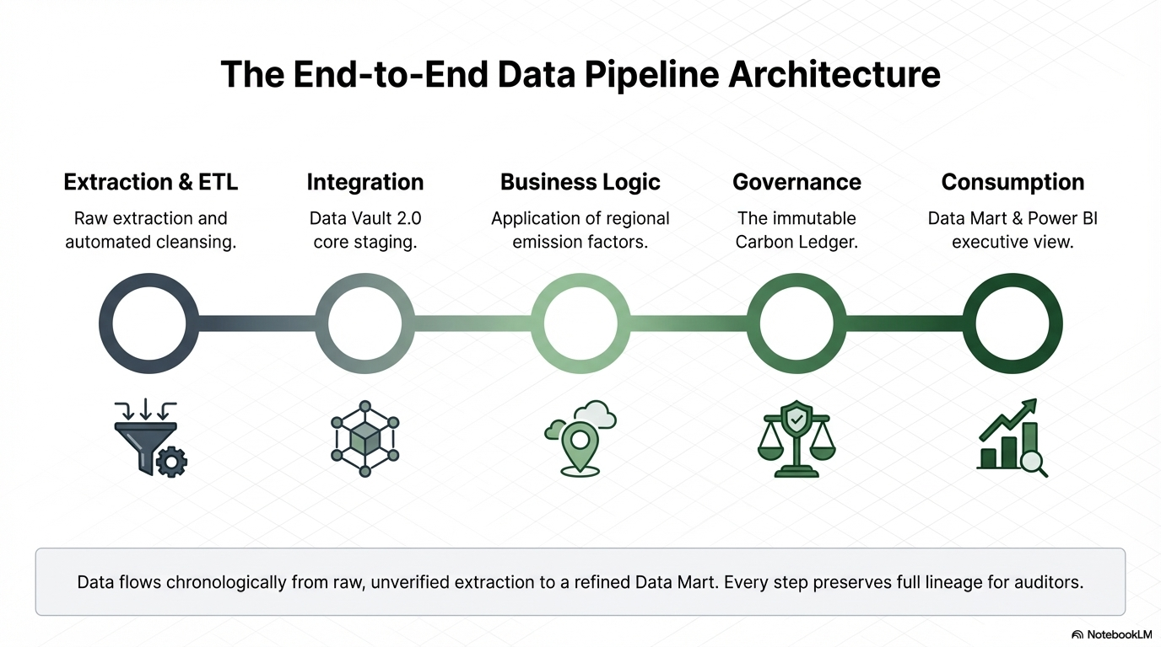

Slide 6
Database Management Design and Data Cleaning
Led by Harsha
Harsh's major contribution: schema discipline and data-quality assurance
The schema follows Data Vault 2.0 principles so each business concept is allocated to the correct structural layer.
Hubs preserve stable business identifiers such as facility, supplier, meter, shipment, carbon credit, and reporting period.
Links encode many-to-many business relationships such as facility-to-meter and shipment-to-supplier-to-facility.
Satellites retain descriptive context and temporal variation using load timestamp, record source, and hashdiff columns.
Data-quality work included duplicate elimination, null-handling, value normalization, and key-consistency validation before warehouse loading.
Hub Examples
Facility, Supplier, Meter, Shipment, Carbon Credit, Reporting Period
Link Examples
Facility-Meter, Facility-Period, Shipment-Supplier-Facility
Satellites
Attributes, readings, activity, manual ESG metrics
Design Strengths
Primary keys, foreign keys, indexes, and hashed identifiers make the schema scalable and auditable. The SQL schema script is idempotent, so the design can be recreated cleanly for repeated demonstrations.
Why this matters
Strong schema design reduced downstream ETL complexity and improved auditability, reporting clarity, and service-layer stability.
GreenTrace | Database design and cleaning ownership | Slide 5

Slide 7
Database Warehousing and ETL Processing
Led by Rachith
Rachit's major contribution: repeatable loading, validation, and warehouse orchestration
The ETL pipeline ingests tabular records, materializes them as Data Frames, and loads them into MySQL through SQL Alchemy.
A dependency-aware load order ensures that reference tables and hubs are loaded before links, satellites, and downstream analytical layers.
The execution flow supports clean reruns, which strengthens reproducibility during testing, validation, and presentation.
After each table load, row-count verification ensures that the warehouse state remains quantitatively consistent.
The current execution processed 5,286 rows across the implemented 22-table warehouse.
Extract
Acquire structured records for warehouse processing.
Transform
Normalize types, resolve anomalies, and align to schema.
Load
Insert into MySQL and verify quantitative integrity.
Warehousing Outcome
The warehouse now separates ingestion, persistence, and analytical consumption. This improves consistency, preserves structural integrity, and establishes a stable platform for downstream computation and APIs.
Validation Result
No row mismatches were accepted during ETL loading.
GreenTrace | ETL pipeline and warehousing discipline | Slide 6

Slide 8
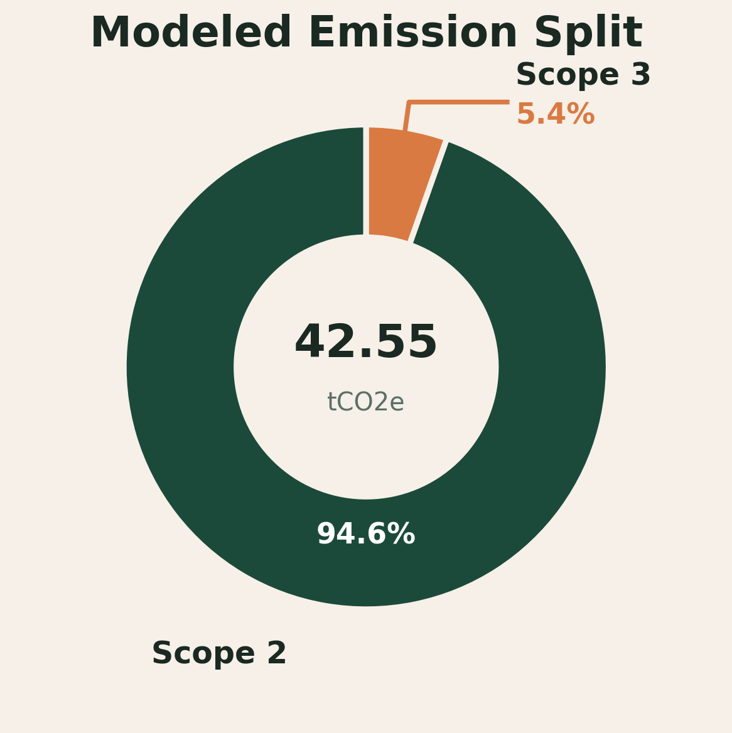
Business Vault, Carbon Ledger, Data Mart, and Lineage
Where raw warehouse data becomes analytical intelligence
Business Vault logic computes emissions as derived analytical facts rather than storing them as base warehouse entities.
Scope 2 formulation: CO2 = kWh x emission_factor using meter readings and region-specific coefficients.
Scope 3 formulation: CO2 = fuel_used_l x emission_factor using logistics activity and fuel-type coefficients.
Computed event volume: 2,400 Scope 2 rows and 40 Scope 3 rows.
The carbon ledger is designed around ISSUE and RETIRE transactions so credit balances can prevent double counting.
The data mart aggregates facility-period emissions, while lineage metadata is designed to preserve transformation traceability across the analytical stack.
Scope 2
40.27 tCO2e 94.6% share
Scope 3
2.28 tCO2e 5.4% share
Peak Interval
03:00 with 1,785.31 kgCO2e
GreenTrace | Business computation and audit layers | Slide 7

Slide 9
Backend Services and Security Hardening
Backend + Security
Service-layer delivery with explicit control, validation, and operational safeguards
Backend capabilities
Security checks implemented in code
Strict response headers: Content Security Policy, X-Frame-Options, X-Content-Type-Options, Referrer-Policy, and Permissions-Policy.
Per-session write token is required for any modifying request.
Origin and Referer checks block cross-origin write operations.
SQL console is limited to one statement and only allows SELECT, INSERT, UPDATE, and DELETE.
Disallowed keywords such as DROP, ALTER, TRUNCATE, CREATE, GRANT, and REVOKE are blocked.
Facility edit inputs are validated for hash IDs, country format, field length, and grid-region characters.
Flask delivers the presentation interface and exposes APIs for health checks, analytical retrieval, facility updates, and controlled SQL execution.
SQLAlchemy manages the transactional connection layer to MySQL.
The service layer can read from the live warehouse or fall back to a static analytical snapshot when connectivity is unavailable.
Server-Sent Events support lightweight state refresh without requiring a full-page reload cycle.
Backend APIs
/api/health | /api/live-data | /api/live-events | /api/editor/facilities | /api/sql/execute
Security outcome
The system does not treat visualization as sufficient; it also constrains write operations, validates user input, and reduces unsafe interaction paths.
GreenTrace | Backend integration and security review | Slide 8

Slide 10
Frontend Design and Visualization Layer
Led by Ullas
Ullas's major contribution: translating warehouse metrics into a coherent analytical interface
Overview Page
A cinematic landing page introduces the project, key metrics, architecture layers, and story flow for presentation-ready explanation.
The frontend is implemented using HTML, CSS, and JavaScript rather than relying on an external dashboard framework.
Animated counters, reveal transitions, charts, and card-based summaries make the analytical narrative easier to communicate during a technical presentation.
Facility leaders, regional totals, and operational composition views are grounded in warehouse-derived metrics rather than illustrative placeholders.
A live studio overlay enables controlled interaction for refresh, attribute update, and analytical query execution.
Dashboard Page
Displays KPIs, regional comparisons, facility rankings, emission pulse over time, vehicle mix, and supplier sectors in one analytical cockpit.
Architecture Page
Explains the system narrative, phase timeline, schema density, and example analyst queries.
Design Goal
Increase interpretability without abstracting away the genuine warehouse and service-layer complexity.
Visualization Goal
Present emissions, regional distribution, facility ranking, and system architecture in a format suitable for viva defense and live demonstration.
GreenTrace | Frontend ownership and user experience layer | Slide 9

Slide 11
Frontend-Backend Integration Flow
How the interface remains synchronized with the analytical core
Frontend
Dashboard pages, live studio controls, charts, and visual storytelling.
Flask API
Routes return JSON for health, live data, editor rows, and controlled SQL execution.
Warehouse Access
SQLAlchemy reads from MySQL and writes new satellite versions when permitted.
Live Refresh
EventSource and refresh controls trigger UI updates without full application reloads.
User Feedback
Status badges, query feedback, and refreshed visuals confirm each action.
A facility update writes a new satellite version to sat_facility_attr, thereby preserving historization semantics.
The SQL console is deliberately constrained, so the integration supports demonstration-oriented interaction while still respecting security controls.
This integration is academically important because the project is implemented as a connected analytical system rather than as disconnected warehouse and dashboard components.
GreenTrace | Integration between UI, API, and warehouse | Slide 10

Slide 12
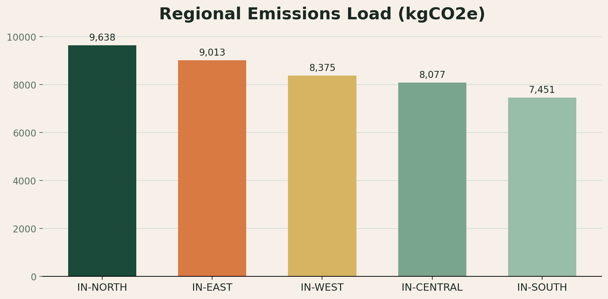
Key Results and Analytical Insights
What the current GreenTrace snapshot reveals
Total Emissions
42.55 tCO2e
Combined Scope 2 and Scope 3
Scope Split
94.6% / 5.4%
Scope 2 dominates the snapshot
Top Region
IN-NORTH
9,638.22 kgCO2e
Peak Interval
03:00
1,785.31 kgCO2e
Rank | Facility | Region | kgCO2e
1 | F-00000015 | IN-NORTH | 2,006
2 | F-00000005 | IN-NORTH | 1,997
3 | F-00000025 | IN-NORTH | 1,934
4 | F-00000003 | IN-EAST | 1,895
5 | F-00000008 | IN-EAST | 1,891
GreenTrace | Snapshot metrics and top performers | Slide 11

Slide 13
Team Contributions
Role allocation across the project lifecycle
Harsh
Database management design, schema structuring, and pre-load data-quality refinement.
Rachit
Warehouse implementation, ETL orchestration, MySQL integration, backend APIs, and system integration.
Ullas
Frontend design, visualization composition, interaction flow, and presentation-oriented interface structure.
Rahul
Documentation review, presentation formatting support, and introducing the project for us.
Integration and security hardening were consolidated during the final stage to connect the warehouse, service layer, and frontend into one controlled analytical workflow.
This division of work allowed the project to progress in clearly separated phases without destabilizing the overall architecture.
GreenTrace | Ownership and collaboration summary | Slide 12

Slide 14
Conclusion and Future Scope
What this project demonstrates and where it can go next
GreenTrace demonstrates that a Data Vault 2.0 warehouse can be used not only for storage, but also for computation, auditing, and user-facing analytics.
The project combines database management, warehousing, ETL engineering, backend services, visualization, system integration, and security assurance in one coherent delivery.
The current implementation already models real ESG entities and emissions; future work can extend it into a broader enterprise sustainability platform.
Suggested future enhancements:
Populate manual ESG metrics and add Scope 1 calculations.
Expand the carbon ledger into full credit retirement workflows tied to facilities and reporting periods.
Strengthen lineage playback, deployment automation, and role-based authentication.
Add automated testing for ETL, API validation, and dashboard behavior.
Final Takeaway
GreenTrace is not just a report. It is a connected data product that turns raw ESG data into structured, explainable, and secure carbon intelligence.
Facilities
25
Tracked in the model
Meters
100
Energy capture points
Shipments
40
Scope 3 activity rows
Credits
10
Carbon-credit assets
GreenTrace | Closing slide | Slide 13

Slide 15


