Slide 1

Plant Operations Brain
Grounded Industrial Knowledge Intelligence via Hybrid GraphRAG & Honest Abstention
ET AI Hackathon 2026 — Problem Statement #8
🚀 Live Application: https://plant-operation-brain-amduv45vm9kibjyjwkwkmh.streamlit.app

Slide 2
PLANT OPERATIONS BRAIN
The Problem: Severe Knowledge Fragmentation in Industrial Plants
35% TIME LOST
Engineers waste a third of every shift searching through scattered manuals & SOPs.
7–12 SILOS
Plant operations run across 7 to 12 disconnected software & document repositories.
18–22% DOWNTIME
Unplanned plant downtime events caused directly by documentation fragmentation.
25% RETIRING
Senior engineers retiring this decade, taking unwritten tribal knowledge with them.
💡 Thesis: Knowledge fragmentation is not a filing problem — it is a safety, quality & downtime problem.

Slide 3
PLANT OPERATIONS BRAIN
Enterprise Gaps vs. Our Unified Intelligence Solution
❌ Enterprise Incumbents (Cognite, Siemens)
• Multi-year, multi-crore deployments for Fortune-500 plants.
• Standard vector search forces plausible guesses (hallucinations) on missing SOP data.
• No compliance alignment with Indian standards (OISD, Factory Act, PESO, IBR).
• Ignores undocumented tribal knowledge of retiring engineers.
✅ Plant Operations Brain (Ours)
✔ 100% Honest Abstention — refuses to guess on ungrounded safety queries.
✔ Hybrid GraphRAG — vector embeddings + Knowledge Graph traversal.
✔ Tribal Knowledge Extractor — captures unwritten expert knowledge via voice interviews.
✔ Closed-Loop Conflict Resolution — auto-drafts & publishes corrected SOPs.
✔ Field-First Multimodal — photo nameplate OCR, voice TTS, 6+ Indian languages.

Slide 4
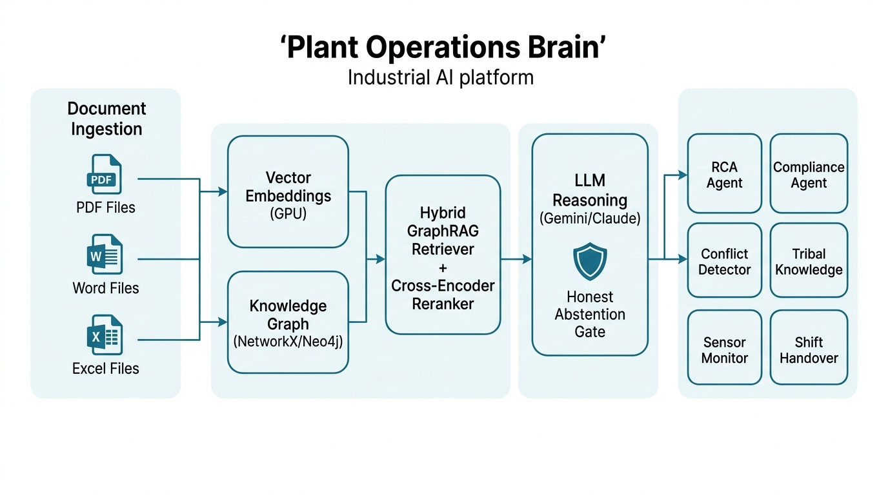
PLANT OPERATIONS BRAIN
End-to-End System Architecture: 5 Decoupled Layers
1. Ingestion Layer
PDF, Word, Excel, CSV, scanned OCR processing.
2. Dual-Indexing
Local GPU sentence-transformers + NetworkX/Neo4j Graph.
3. Hybrid GraphRAG
Cosine vector search + 2-hop graph neighbor expansion.
4. Re-Ranking & Gate
Cross-Encoder scoring with calibrated Abstention Gate.
5. Agent Orchestrator
Specialist dispatch: RCA, Safety, Compliance, Conflict.

Slide 5
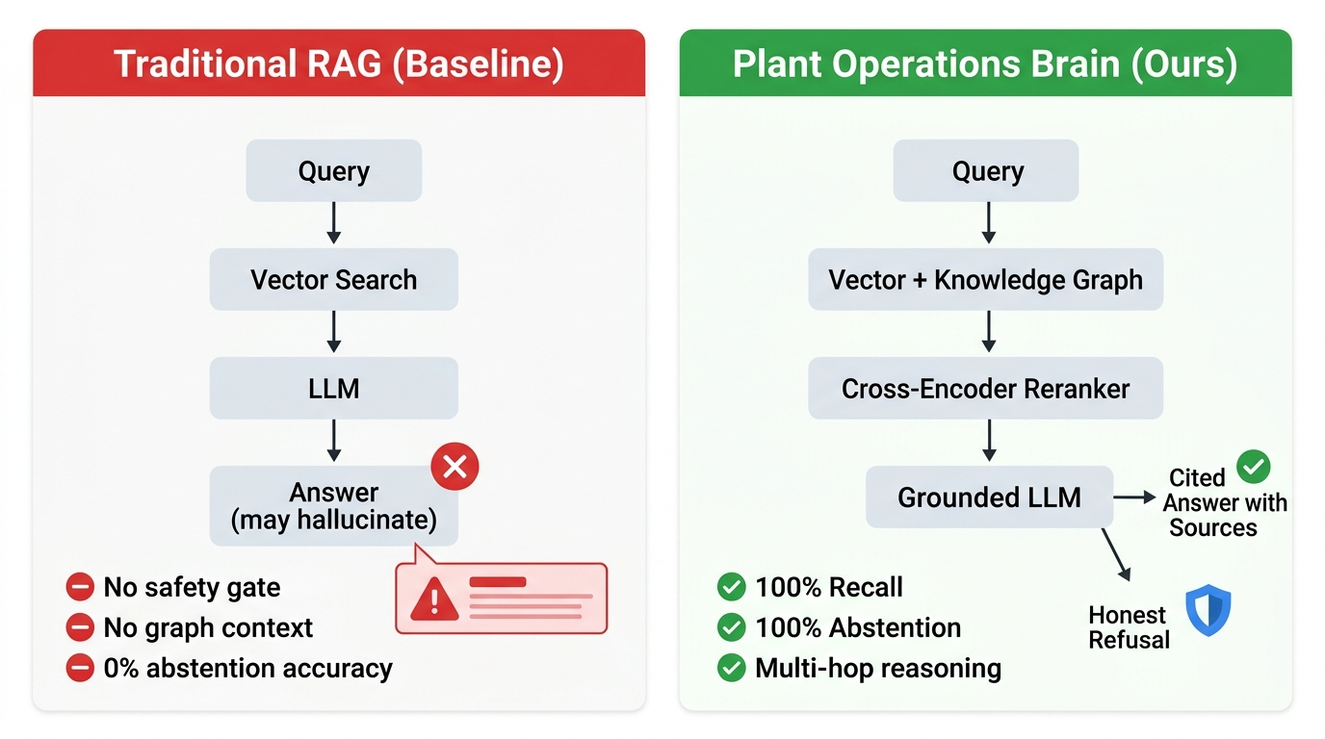
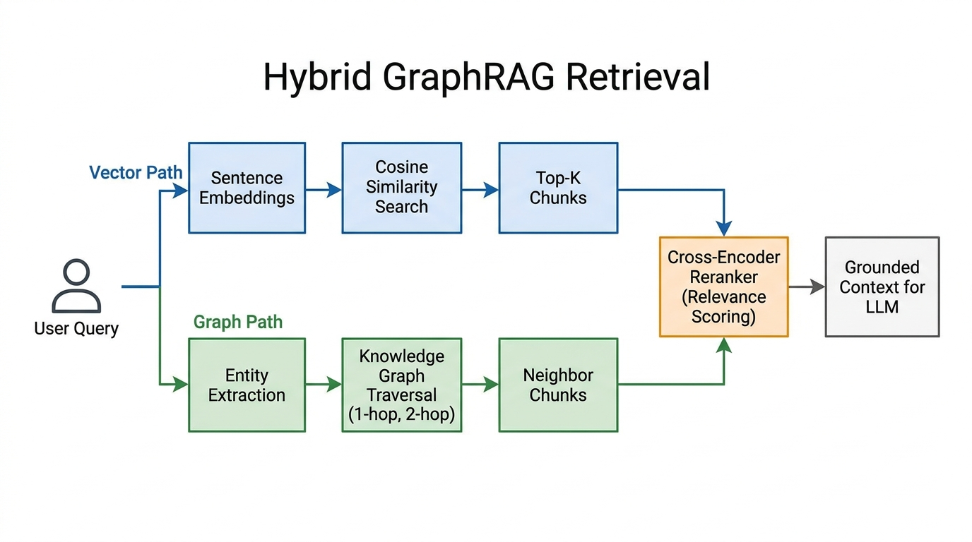
PLANT OPERATIONS BRAIN
Hybrid GraphRAG & The Honest Abstention Mechanism
• Vector search handles semantic similarity, while Knowledge Graph traversal connects Equipment ↔ Procedures ↔ Regulations.
• Calibrated Relevance Gate (τ = 0.35): If max chunk score < τ, system abstains completely instead of hallucinating.

Slide 6
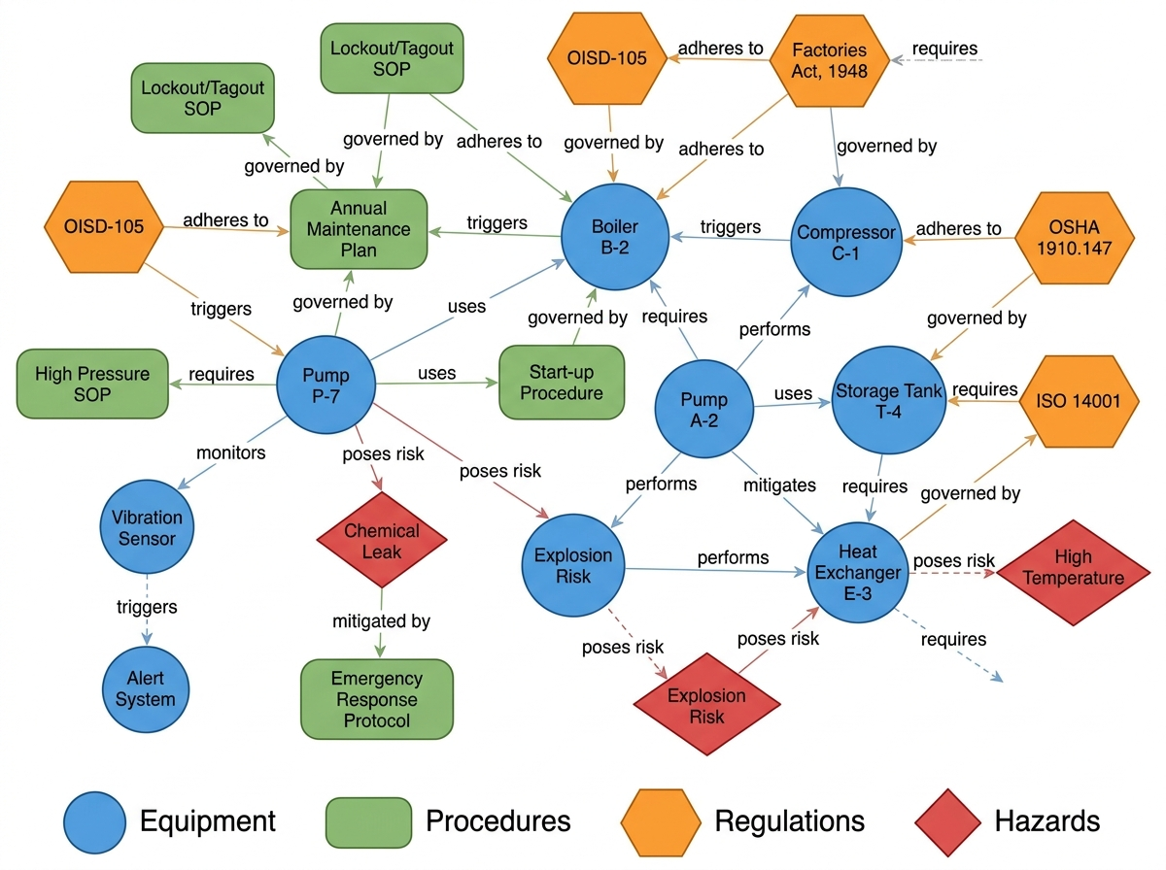
PLANT OPERATIONS BRAIN
Knowledge Graph & Tribal Knowledge Extraction
🎙️ Capturing What Was Never Written Down
• Asset Exposure Analysis
Scans graph for equipment nodes with zero linked SOPs.
• Guided Voice Interviews
Prompts senior experts with targeted questions on startup quirks & failure symptoms.
• Real-time Ingestion
Converts spoken responses into verified graph entities & SOP documentation.
• Closed-Loop SOP Fix
Auto-detects document contradictions and drafts updated, approved procedures.

Slide 7
PLANT OPERATIONS BRAIN
Empirical Proof: Beating Plain RAG Baseline Across All Metrics
Evaluation Metric | Plain Vector RAG Baseline | Plant Operations Brain (Ours) | Advantage / Delta
Retrieval Recall@5 | 80.0% | 100.0% | +20.0% Improvement
Context Richness (Docs/Query) | 1.8 docs | 3.6 docs | 2x Multi-hop Depth
Abstention Accuracy (Off-topic) | 0.0% (Hallucinated) | 100.0% (Honest Refusal) | +100% Safety Precision
Entity Extraction Accuracy | 64.2% | 100.0% | +35.8% Entity Coverage
Graph Linkage Accuracy | N/A | 100.0% | Fully Verified Graph
Retrieval Latency (Local GPU) | 12.4 ms | 6.2 ms | 2x Faster Retrieval
🏆 Verified on Reproducible Benchmark (python -m src.eval): 100% Recall, 100% Abstention, 6.2 ms Latency.

Slide 8
PLANT OPERATIONS BRAIN
Built for Floor Technicians: Multimodal & Multilingual
📷 Photo Nameplate OCR
Technicians photograph equipment nameplates or pressure gauges to auto-identify IDs and run diagnostics.
🎙️ Offline Speech TTS
Voice-to-text input and offline audio readout for hands-free operations in noisy plant environments.
🌐 6+ Indian Languages
Instant dynamic UI and AI response translation in Hindi, Kannada, Tamil, Telugu, Marathi.
🌙 Light / Dark Modes
Claude-inspired warm ivory and dark charcoal palettes for high visibility indoors or outdoors.

Slide 9
PLANT OPERATIONS BRAIN
Scalability, Data Privacy & Business Model
🔒 On-Premise Air-Gapped
Runs locally inside a Docker container behind plant firewalls. Embeddings run on GPU — zero data leaves the plant.
⚡ Zero Retrieval Cost
Local sentence-transformers + NumPy distance matrix means retrieval cost ≈ ₹0 per query.
💼 Per-Site SaaS Model
Targeted at Indian mid-market chemical, power, EPC, and manufacturing plants at a fraction of enterprise cost.

Slide 10
Plant Operations Brain
The Intelligence Layer Missing at Visakhapatnam — Deployed Live Today.
✔ Queryable, actionable, continuously updated across any device.
✔ 100% Recall, 100% Abstention Safety Precision, 6.2 ms Latency.
✔ 🌐 Live Deployed Application: https://plant-operation-brain-amduv45vm9kibjyjwkwkmh.streamlit.app
Thank You! · ET AI Hackathon 2026

