Slide 1
Unit-2
The Computer System

Slide 2
Computer Organization and Architecture
A computer system is a combination of numbers of physical parts which are arranged and related in a manner so as to achieve the objective for which the instructions or programs are written.
In other word, it is the logical structure for designing the fundamental operation of computer system.
Computer architecture is the backbone for creating successful computer system.
Computer architecture is the design, arrangement and construction of the different parts of a computer system together.
It deals with functional behavior of a computer system. It comes before computer organization while designing a computer.
The computer system is divided into subsystems which include input unit, processing unit, output unit and storage unit.
Combination of all these subsystem forms a complete computer system.
Computer organization is the way the hardware components operate and the way they are connected together to form computer system.
Computer organization deals with structural relationship.

Slide 3
Computer Architecture
Computer architecture refers to those attributes of a system that have direct impact on logical execution of program like instruction set, addressing mode, I/O mechanisms, etc
Computer organization refers to the operational units and their interconnections that realize the architectural specification like control signals, interface between computer and peripherals.
For example, multiply instruction is computer architecture and how that multiply is implemented is computer organization.

Slide 4
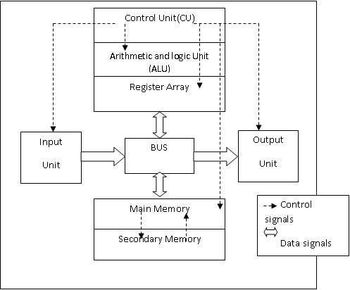
Computer Architecture

Slide 5
Computer Architecture
Computer architecture refers to those attributes of a system that have direct impact on logical execution of program like instruction set, addressing mode, I/O mechanisms, etc
Computer organization refers to the operational units and their interco Input Unit
Input means accumulation of raw data and sequential set of instructions given to the computer to produce meaningful and useful output. The input may be in various forms like text, numbers, symbols, sound, picture, etc. The unit used to give input to computer is input unit. Different devices are used for input purpose such as keyboard, mouse, joystick, microphone, camera, scanner, etc. An input unit accepts data and instructions from the user through input devices, then converts them into the computer understandable form and supplies the converted data and instruction to the control unit for further processing through BUS. Input devices are controlled by control unit.

Slide 6
Computer Architecture
Processing Unit
Processing unit is also known as Central processing Unit (CPU). Processing unit controls and directs all the operation and components of computer system. It is the heart of computer system. It is linked with various peripheral devices like input/output devices, storage devices and so on. It performs computation, executes instruction and transfer information from one part of the computer system to another with the help of BUS. Processing unit performs logical comparison, mathematical computation, executes statements and transfer information to different parts of computer. Processing unit consists of three parts:
(i) ALU(Arithmetic and logical Unit)
It is the place where actual execution of instructions takes place during the processing of data. All data and instructions stored in primary memory before or after processing send to ALU for arithmetic or logical operation. ALU perform arithmetic calculations such as addition, subtraction, multiplication, division on integer and real number. It can also perform logical operation (AND, OR, NOT) and comparison (such as greater than, less than, equal to, not equal to, etc) between two operand.

Slide 7
Computer Architecture
(ii) CU (Control Unit)
It directs all hardware components to operate and flow necessary signals to the components. It is also responsible for execution of instruction. It manages and coordinates the entire computer system. It obtains instructions from the program stored in main memory, interprets the instructions and directs other unit of the system to execute them. It is the central nervous system of other components of computer system since it controls all other units in the system.
(iii)Register Array
Register array is the memory in the CPU which holds or stored data to be processed in sequential order one after another and stored the result of operation temporarily.

Slide 8
Computer Architecture
Memory Unit
Memory is a large array of words or bytes, each with its own address. In other word, memory is the storage location of data and information in the computer system before or after processing the data. It is also called the backing storage in which data and information can be stored and retrieved through input device and imprinted on the output device. All data and information are stored in binary form. Memory Unit can be categorized into two major types. They are:
(i) Primary Memory
Primary memory is a semiconductor memory and called as main memory. It holds data and information that is currently processed by CPU, intermediate results produced during the time of computation and recently processed data. It is the only memory that is directly connected with CPU and able to send and receive data and information directly from the processor. RAM, ROM, cache memory, etc are the examples of primary memory.

Slide 9
Computer Architecture
RAM (Random Access Memory)
RAM stands for ‘Random Access Memory’ and is the primary memory of computer which is made up of semiconductor chips. It is the main work space used by the computer to load any program that is to be executed. This is a temporary storage because data and instruction stored in RAM remain as long as power is on. So this is also called as volatile memory. RAM is a read/write memory where data and information can be replaced at any time and its contents can be accessed randomly from any location in any order. RAM is expensive and it can access data very fast due to the use of semiconductor technology. There are two types of RAM on the basis of semiconductor chips, they are:
(i) SRAM
It stands for Static Random Access Memory and is made up of transistors. The data stored in SRAM can be remember and retains without refreshing or recharged. Static RAM has low bit density, low power consumption and is more expensive. SRAM are fast since data access time is around 10-30 nanosecond. Examples: Cache memory

Slide 10
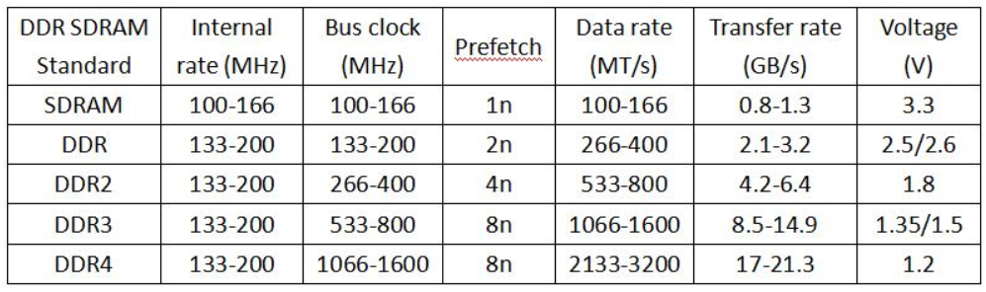
Computer Architecture
RAM (Random Access Memory)
(ii) DRAM:
It stands for Dynamic Random Access Memory and is made of capacitors. The capacitors discharge gradually and memory cells lose their contents so it is necessary to refresh or recharge periodically to retain its memory contents. DRAM has high density and high power consumption. DRAM is slower than SRAM and data access time is around 40-50 nanosecond. Examples: DDR(Dual Data Rate), DDR-2, DDR3, DDR4.

Slide 11
Computer Architecture
(b) ROM:
ROM stands for ‘Read Only Memory’ and is the primary memory of computer where data and instructions are permanently written. It is a non-volatile memory chip in which data is stored permanently and cannot be changed by usual programs. ROM is mainly used to store the programs that do not change and frequently used. The programs stored in ROM are called firmware. Firmware is written by manufacturers at manufacturing time. BIOS (Basic Input Output System) is an example of program which is stored in ROM. BIOS is used to activates hardware such as keyboard, mouse, monitor, harddisk, etc.

Slide 12
Computer Architecture
Types of ROM:
(i) PROM: It stands for Programmable Read Only Memory. PROM is a once programmable i.e. user can write his information in PROM only once. The information written in PROM is permanent and cannot be erased or deleted. A special equipment called PROM programmer is used to write information in PROM.
(ii) EPROM: EPROM stands for ‘Erasable Programmable Read Only Memory’. Information can be re-programmed in EPROM. The stored information in EPROM can be erased by exposing it to high intensity short wave ultraviolet light for about 20 minutes. The technique of erasing content is not easy because EPROM IC has to be removed from the computer for the exposure to UV light. EPROM is used in product development and experimental project.
(iii) EEPROM: EEPROM stands for ‘Electrically Erasable Programmable Read Only Memory’ and similar to EPROM. It can be modified and reprogrammed by the user using electrical charge. EEPROM is also called as Electrically Alterable PROM (EAPROM). Information can be erased in few millisecond from EEPROM.

Slide 13
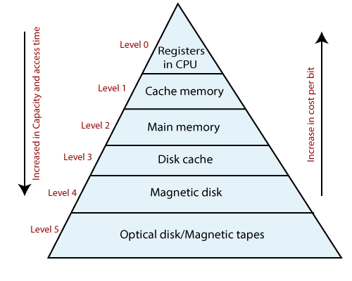
Computer Architecture
(ii) Secondary memory:
Secondary memory is the storage area of the computer system. It is also called as permanent memory because once we stored data in secondary memory it remains even if the computer is turned off. So, it is a non-volatile memory. It can store massive data i.e. its storage capacity is huge. Magnetic and optical technology is used in secondary memory. Hard disk, floppy disk, CD, DVD, pendrive, etc are examples of secondary memory.
Memory hierarchy

Slide 14
Computer Architecture
Cache memory
Cache memory is a semiconductor high speed buffer place between main memory and CPU. It is extremely fast and small. Its access time is closer to the processing speed of CPU. Cache memory is used to store instructions code and data, which are to be currently executed by the CPU.
The access time of main memory is slow in comparison to the processing speed of CPU. So, CPU has to wait for a long period to obtain data and instructions from main memory for execution which slowdown the performance. To overcome this problem there is necessary of another storage location where data can be accessed in the speed CPU processed them. So, use of cache memory let the processor work in its actual speed by ignoring the access time and processing speed of main memory.

Slide 15
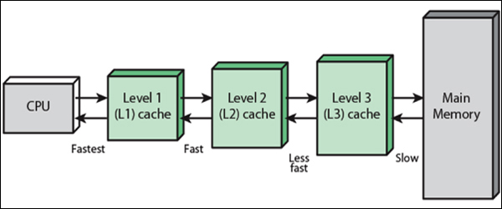
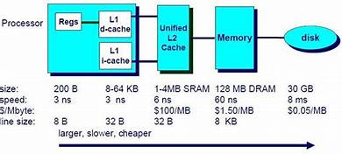
Computer Architecture
Cache memory

Slide 16
Computer Architecture
Output Unit
After processing data and information stored in the memory we have to provide the results to the user in human understandable form. The unit which is used to deliver data and information after processing it to the user in human understandable form is known as output unit. Output unit converts the data and information that are in binary format to human understandable form before giving output. Monitor, printer, speaker, plotter, etc are the examples of output devices.

Slide 17
Computer Architecture
BUS
Data and information have to electrically flow from one device to another device to fulfill the requirements of the user such as from input unit to control unit, control unit to memory unit, memory unit to control unit or control unit to output unit. Bus is a collection of wires, chips and slots inside the computer through which data is transmitted from one part of computer to another. This also can be compared with highway on which data travels. BUS is used for interconnection between different units of computer system to transfer data and information. There are three types of BUS:
(i) Address bus
(ii) Data bus
(iii) Control bus

Slide 18
Computer Architecture
BUS
(i) Address bus
Address bus is the pathway to transmit addresses of memory or I/O devices. The address bus is unidirectional that is bits flow in one direction from the microprocessor to peripheral devices. Whenever processor needs data from memory, it places the address of data on address bus
(ii) Data bus
Data bus is the pathway to transmit data from one device to another device. Data bus is bidirectional i.e. bits flow in both directions from microprocessor to memory and peripheral devices and vice versa. It is an electrical path that connects CPU, memory, I/O devices and secondary storage devices. The bus contain parallel group of lines, and number of lines in bus affects the speed at which the data travels between different components.
(iii) Control bus
Control bus is the pathway for all timing and controlling function sent by the control unit to the other unit of the system. Control bus are used to identify a device type, with which microprocessor have to communicate.

Slide 19
Computer Architecture
BUS
(iii) Control bus
Control bus is the pathway for all timing and controlling function sent by the control unit to the other unit of the system. Control bus are used to identify a device type, with which microprocessor have to communicate. In other word, we can say control bus carries control information from control unit to other units. Control information is used for directing the activities of all units. It controls the functioning of other units.

Slide 20
Computer Architecture
BUS
(iii) Control bus
Control bus is the pathway for all timing and controlling function sent by the control unit to the other unit of the system. Control bus are used to identify a device type, with which microprocessor have to communicate. In other word, we can say control bus carries control information from control unit to other units. Control information is used for directing the activities of all units. It controls the functioning of other units.

Slide 21
Use and working of typical peripheral devices
A computer peripheral device is an external object that provides input and output for the computers.
Peripherals are commonly divided into three kinds: input devices, output devices, and storage devices.
An input devices converts incoming data and instructions into a pattern of electrical signals in binary code that are comprehensible to a digital computer. Some common input devices are: keyboard, mouse, touchscreen, pen tablet, joystick, MIDI keyboard, Scanner, digital camera, microphone, video camera, MICR, BCR, etc.
An output devices reverses the process, translating the digitized signals into a form intelligible to the user. Some common output devices are: monitor, projector, TV screen, printer, plotter, speakers, etc.

Slide 22
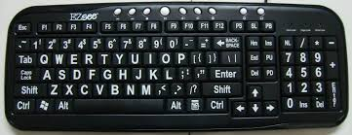
Use and working of typical peripheral devices
Input devices
Keyboard: The keyboard is a basic input device that is used to enter data into a computer or any other electronic device by pressing keys. It has different sets of keys for letters, numbers, characters, and functions. Keyboards are connected to a computer through USB or a Bluetooth device for wireless communication.
There can be different types of keyboards based on the region and language used. Some of the common types of keyboards are as follows:
i) QWERTY Keyboard:
It is the most commonly used keyboard with computers in modern times. It is named after the first six letters of the top row of buttons and is even popular in countries that do not use Latin-based alphabet. It is so popular that some people think that it is the only type of keyboard to use with computers as an input device.

Slide 23
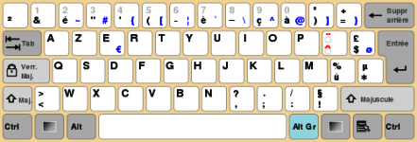
Use and working of typical peripheral devices
Input devices
Keyboard: Some of the common types of keyboards are as follows:
ii) AZERTY Keyboard:
It is considered the standard French keyboard. It is developed in France as an alternative layout to the QWERTY layout and is mainly used in France and other European countries. Some countries have manufactured their own versions of AZERTY.
Its name is derived from the first six letters that appear on the top left row of the keyboard. The Q and W keys in AZERTY keyboard are interchanged with A and Z keys in QWERTY keyboard. Furthermore, in AZERTY keyboard M key is located to the left of the L key.
AZERTY keyboard differs from QWERTY keyboard not only in the placement of letters but also in many other ways, e.g., it gives emphasis on accents, which is required for writing European languages like French.

Slide 24
Use and working of typical peripheral devices
Input devices
Mouse: The mouse is a hand-held input device which is used to move cursor or pointer across the screen.
It is designed to be used on a flat surface and generally has left and right button and a scroll wheel between them.
Laptop computers come with a touchpad that works as a mouse.
It lets you control the movement of cursor or pointer by moving your finger over the touchpad.
Some mouse comes with integrated features such as extra buttons to perform different buttons.
The mouse was invented by Douglas C. Engelbart in 1963.
Early mouse had a roller ball integrated as a movement sensor underneath the device.
Modern mouse devices come with optical technology that controls cursor movements by a visible or invisible light beam.
A mouse is connected to a computer through different ports depending on the type of computer and type of a mouse.

Slide 25
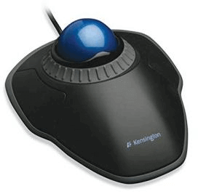
Use and working of typical peripheral devices
Input devices
Mouse: Common types of mouse are:
i) Trackball Mouse:
It is a stationary input device that has ball mechanism to move the pointer or cursor on the screen. The ball is half inserted in the device and can be easily rolled with finger, thumb or the palm to move the pointer on the screen. The device has sensor to detect the rotation of ball. It remains stationary; you don't need to move it on the operating surface. So, it is an ideal device if you have limited desk space as you don't need to move it like a mouse.

Slide 26
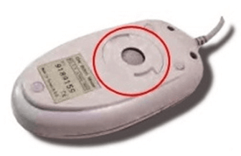
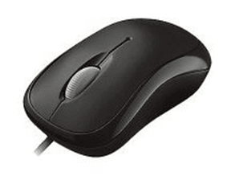
Use and working of typical peripheral devices
Input devices
Mouse: Common types of mouse are:
ii) Mechanical Mouse:
It has a system of a ball and several rollers to track its movement. It is a corded type of mouse. A mechanical mouse can be used for high performance. The drawback is that they tend to get dust into the mechanics and thus require regular cleaning.
iii) Optical Mouse:
An optical mouse uses optical electronics to track its movement. It is more reliable than a mechanical mouse and also requires less maintenance. However, its performance is affected by the surface on which it is operated. Plain non-glossy mouse mat should be used for best results. The rough surface may cause problems for the optical recognition system, and the glossy surface may reflect the light wrongly and thus may cause tracking issues.

Slide 27
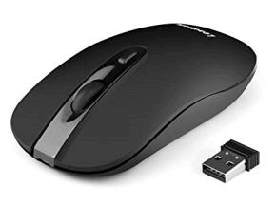
Use and working of typical peripheral devices
Input devices
Mouse: Common types of mouse are:
iv) Cordless or Wireless Mouse:
As the name suggests, this type of mouse lacks cable and uses wireless technology such as IrDA (infrared) or radio (Bluetooth or Wi-Fi) to control the movement of the cursor. It is used to improve the experience of using a mouse. It uses batteries for its power supply.

Slide 28
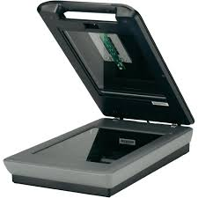
Use and working of typical peripheral devices
Input devices
Scanner: The scanner uses the pictures and pages of text as input.
It scans the picture or a document.
The scanned picture or document then converted into a digital format or file and is displayed on the screen as an output.
It uses optical character recognition techniques to convert images into digital ones.
Some of the common types of scanners are as follows:
i) Flatbed Scanner:
It has a glass pane and a moving optical CIS or CCD array. The light illuminates the pane, and then the image is placed on the glass pane. The light moves across the glass pane and scans the document and thus produces its digital copy. You will need a transparency adapter while scanning transparent slides.

Slide 29
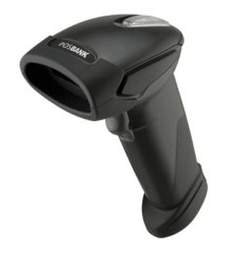
Use and working of typical peripheral devices
Input devices
Scanner:
ii) Handheld Scanner:
It is a small manual scanning device which is held by hand and is rolled over a flat image that is to be scanned. The drawback in using this device is that the hand should be steady while scanning; otherwise, it may distort the image. One of the commonly used handheld scanners is the barcode scanner which you would have seen in shopping stores.

Slide 30
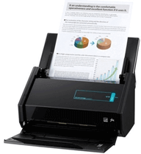
Use and working of typical peripheral devices
Input devices
Scanner:
iii) Sheetfed Scanner:
In this scanner, the document is inserted into the slot provided in the scanner. The main components of this scanner include the sheet-feeder, scanning module, and calibration sheet. The light does not move in this scanner. Instead, the document moves through the scanner. It is suitable for scanning single page documents, not for thick objects like books, magazines, etc.

Slide 31
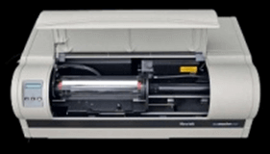
Use and working of typical peripheral devices
Input devices
Scanner:
iv) Drum Scanner:
Drum scanner has a photomultiplier tube (PMT) to scan images. It does not have a charge-coupled device like a flatbed scanner. The photomultiplier tube is extremely sensitive to light. The image is placed on a glass tube, and the light moves across the image, which produces a reflection of the image which is captured by the PMT and processed. These scanners have high resolution and are suitable for detailed scans.

Slide 32
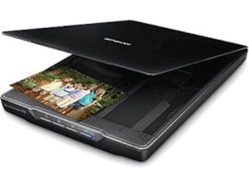
Use and working of typical peripheral devices
Input devices
Scanner:
v) Photo Scanner:
It is designed to scan photographs. It has high resolution and color depth, which are required for scanning photographs. Some photo scanners come with in-built software for cleaning and restoring old photographs.

Slide 33
Use and working of typical peripheral devices
Printer is an output device through which we can convert softcopy to hardcopy output. Printer is a peripheral device for producing text or images on the paper. Printers provide information in a permanent readable form. The printer can be classified into two categories on the basis of technology. They are impact printer and non-impact printer.
Types of printer
Impact printers are those which work by striking a head or needle against an ink ribbon to make a mark on the paper. Impact printer uses the electromechanical mechanism. Impact printers can print multiple copies of output at a time by using carbon between the papers. Dot-matrix printer, daisy wheel printer, line printer are the example of impact printer.

Slide 34
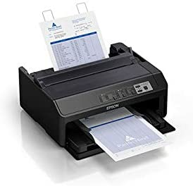
Use and working of typical peripheral devices
Types of printer
Dot matrix printer: Dot matrix printers are character printers that print one character at a time. They form characters and all kinds of images as a pattern. Dot-matrix printer has a print head that moves horizontally across the paper. Print head contains array of pins that strike against an ink ribbon to form patterns of dots on the paper. To print a character, the printer activates the appropriate set of pins and print head move horizontally from left to right and right to left. Such a method of printing is called bidirectional printing. The more pins, the clearer the letters on the paper will be printed. Dot matrix printers are impact printers because they print by hammering the pins on the inked ribbon to leave ink impressions on a paper. They use carbon paper to produce multiple copies. Normally dot-matrix printers have slow printing speed range from 30 to 600 characters per second.

Slide 35
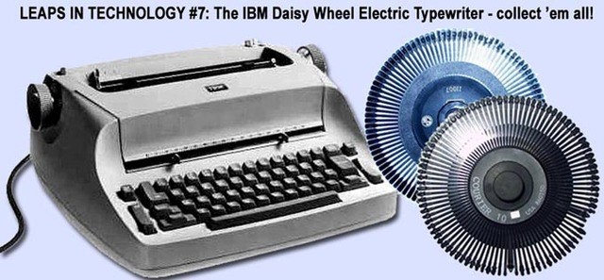
Use and working of typical peripheral devices
Types of printer
Daisy wheel printer: Daisy wheel printer is a circular wheel or disk with "petals". Each petal has the form of a letter (in capital and lower-case), number, or punctuation mark on it. In order to print each character, the wheel/disk rotates until the desired letter (petal) is facing the paper and a hammer strikes the petal against the ribbon and the page. They cannot print graphics, and cannot change fonts unless the print wheel is physically replaced.

Slide 36
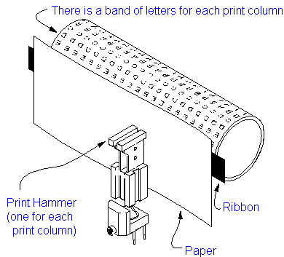
Use and working of typical peripheral devices
Types of printer
Drum printers: Drum printers are line printers that print an entire line at a time. It consists of a solid cylindrical drum with raised characters on its surface in the form of circular bands. Each band consists of all printing characters supported by the printer in its characters set. Total number of bands is equal to the maximum number of characters that can be printed on a line. A drum printer with 132 characters per line can support 96 characters embossed (raised) on its surface. The drum rotates at a high speed. A character is printed at a desired position by activating the appropriate hammer when the character at the print position passes below it. The drum printers have predefined set of characters in predefined style and cannot be changed. Drum printers cannot be used to print graphics such as charts and graph. Printing speed of drum printers ranges from 300 to 2000 lines per minute.

Slide 37
Use and working of typical peripheral devices
Types of printer
Non-Impact printer
Non-impact printers are those in which printing is done ink-jet, electrostatic, chemical, laser beam and thermal technology. Non-impact printer can produce a single copy at a time. Inkjet printers, laser printers, thermal printers are the examples of non-impact printer.
Types of non-impact printer:
Inkjet printer
It is a non-impact printer which works by spraying ionized ink from a nozzle onto the paper by heating the ink near the nozzle to a temperature of 900 degree Fahrenheit. When the resistor heats up the ink near it vaporizes and is ejected through nozzle making a dot on the paper placed in front of the print head. While printing a character, printer selectively heats the appropriate nozzle as the print head move horizontally.

Slide 38
Use and working of typical peripheral devices
Types of non-impact printer:
Laser printer
Laser printer is a non-impact high resolution printer that uses a laser beam technology to produce an image on a drum. The light of laser alters the electrical charge on the drum whenever it hits. The drum is then rolled through a reservoir of toner, which is picked up by the charged portions of the drum. Laser printers are page printers that print one page at a time. To print a page of output, laser beam is focused on the electro statically charged drum by spinning multi-sided mirror. The mirror focuses on the laser beam on the surface of drum to create the patterns of characters/images to be printed on the page. Photoconductive difference in electric charge is created on drum that is exposed to laser beam. Then toner composed oppositely charged ink particles and sticks to the drum where laser beam are charged. The toner then fused permanently on the paper with heat and pressure to produce the output.

Slide 39
Use and working of typical peripheral devices
Types of non-impact printer:
Thermal Printer
Thermal printer is a type of printer which produces images by pushing electrically heated pins against special heat sensitive paper. Thermal printer uses dot-matrix approach to print characters. Color thermal printers are also available.

Slide 40
Use and working of typical peripheral devices
Standalone and network printer
Standalone printer:
A local printer or standalone printer or independent printers is a printer that is directly connected to a specific computer via USB cable. This printer is only accessible from that particular workstation, allowing it to only service one computer at a time.
Network Printer:
A network printer is a part of a workgroup or network computers that all can access the same printers at the same time. A network printer doesnot have to have that physical connection to a network as it can be connected wirelessly and assigned to a workgroup.

