Slide 1
Unit-3
Operating System

Slide 2
Introduction
An operating system is a collection of programs that controls the overall operations of a computer.
In other word, the system which instruct and directs computer to operate properly within its defined parameters is known as operating system.
Operating system helps to controls the execution of computer program which may provide scheduling debugging, input/output, compiling, storing, supervising and management of data. This is an interface between user and the hardware.

Slide 3
Introduction: Role of OS
We can mainly categorize the role of operating system into two. They are:
OS as an resource manager:
The concept of an operating system as primarily providing abstractions to application programs is a top-down view. An alternative, bottom-up, view holds that the operating system is there to manage all the pieces of a complex system. Modern computers consist of processors, memories, timers, disks, mice, network interfaces, printers, and a wide variety of other devices. In the bottom-up view, the job of the operating system is to provide for an orderly and controlled allocation of the processors, memories, and I/O devices among the various programs wanting them.
Modern operating systems allow multiple programs to be in memory and run at the same time.

Slide 4
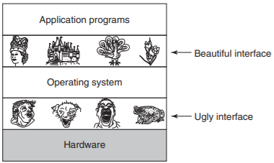
Introduction: Role of OS
We can mainly categorize the role of operating system into two. They are:
OS as a extended machine:
The architecture (instruction set, memory organization, I/O, and bus structure) of most computers at the machine-language level is primitive and awkward to program, especially for input/output. All operating systems provide yet another layer of abstraction for using disks: files. Using this abstraction, programs can create, write, and read files, without having to deal with the messy details of how the hardware actually works. So, OS hides the hardware complexity from users and manages hardware on behalf of one or more application according to some predefined policies so it is an extended machine.

Slide 5
Function of OS
Process management
Memory management
File input/output management
Device management
CPU management
Security
Network management
Backup and recovery
Virtual memory

Slide 6


Process
program
process
Code is loaded from secondary to primary memory
Secondary memory
Main memory
A program contains a set of instructions which perform some specific task for the users. A program is stored in secondary memory.
When we execute the program, the program converts into the process and competes with other processes to access CPU. Thus when a program is loaded into memory it becomes process

Slide 7
Difference between program and process
SN | Program | SN | Process
1. | It consist of a set of instructions in a programming language. | 1 | It is an executing part of a program.
2 | The program only needs memory for storage. | 2 | The resource requirement is quite high in case of a process(I/O, CPU,…)
3 | It is loaded into the secondary storage device. | 3 | It is loaded into the main memory.
4 | The time span of program is unlimited | 4 | The time span of process is limited.
5 | It is passive entity. | 5 | It is an active entity.

Slide 8
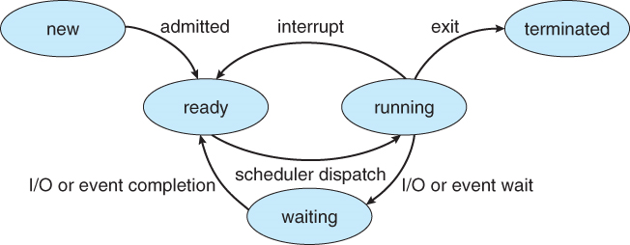
2.4 Process States
Diagram of process state
As a process executes, it change state.

Slide 9
2.4 Process States
New: The process has been created but not yet admitted to the pool of executable processes.
Ready state:
- Process that is not allowed to CPU but is ready to run.
- All ready processes are kept in a queue and they keep waiting for CPU time to be allocated by the OS in order to run.
- A list of processes ordered based on priority.

Slide 10
Process States
Running state:
- Process executing on CPU.
- The instructions with in a process are executing.
- When a process gets a control from a CPU plus other resources, it starts executing.
- Only one process at a time(assuming a single processor machine)
.

Slide 11
Process States
Blocked/waiting state:-
Process that is waiting for some event to happen. A waiting process lacks some resources other than CPU. (e. g. I/O completion events).
Blocked state processes are normally not considered for execution until the related suspending conditions is fulfilled.

Slide 12
Process States
Terminate: -
A process terminates when it finishes executing its last statement.
At this point of time, the process may return some data to its parent process.

Slide 13
Function of Operating System
Process management:
When more than one process runs on the systme the OS decides how and when a proess will use the CPU. For this CPU scheduling algorithm is used. The OS can allocates and deallocates process to the process and keeps record of CPU status. Some of the CPU scheduling algorithm are: First Come First Serve (FCFS), Shortest Job First (SJF), Round-Robin Scheduling, Priority based scheduling, etc.
Purpose of CPU scheduling:
- Proper utilization of CPU. OS makes sure that CPU should be busy as much as possible.
- Since every device should get a chance to use the processor, OS makes sure that the devices get fair processor time
- Increasing the performance of the system.

Slide 14
Function of Operating System
2. Memory management
Memory is the storage location of data and information in the computer system before or after processing the data. It is also called the backing storage in which data and information can be stored and retrieved through input device and imprinted on the output device.
The fundamental duty of operating system is to
manage memory available, allocates and deallocates the memory,
keep records of which part of primary memory is used by whom and how much.
Distributes the memory while multiprocessing.

Slide 15
Function of Operating System
File management: File system is the most important components of operating systems. Operating system is responsible for managing files or folders stored on hard disk and other storage device. An operating system helps in creation or deletion of files or folders, open files or folders for reading and writing, transfer data to or from one files to another and manages the files or folders. An OS also keeps records of the status and locations of files as well as allocates and deallocates the resources.

Slide 16
Function of Operating System
4. Input/output management
File system is the most important components of operating systems.
Operating system is responsible for managing files or folders stored on hard disk and other storage device.
An operating system helps in creation or deletion of files or folders, open files or folders for reading and writing, transfer data to or from one files to another and manages the files or folders.
5. Device management:
A system is a collection of different devices and peripherals. To make these devices work operating system is required. A device is a piece of hardware like keyboard, mouse, monitor, etc.
Every operating system has an I/O subsystem for managing I/O devices.
The operating system serves as an interpreter for several devices and language. Most of operating system use device driver to translate input and output signals into commands to specific hardware devices.

Slide 17
Function of Operating System
6. CPU management:
Operating system handles the problem of assigning various task for processing. It help CPU to schedule its activities so as to meet the demands of various parts of CPU and the computer itself. CPU get the commands from keyboard or storage medium, put it into memory process the command and transfer result into the predetermined place and get ready for another task.
7. Security:
While we stored the data in the memory we must be assure that our data is secured from access of unauthorized user that may be a group of hackers or software like viruses. They may delete or update or change information which may harm the user. Security is the mechanism for controlling access of program or data by the authorized user to gain resources. Operating system helps to provide security for the data and programs stored in the memory.

Slide 18
Function of Operating System
8. Network management:
Collection of autonomous computer system is computer network. We have to work on different computers to share files, folders and resources or to communicate from one system to another. The files sharing mechanism, security and resource management are managed by operating system. Network operating system is used to manage networking facilities which uses protocols for to communicate on the network.
9. Backup and recovery:
Storing data in secondary storage device like hard disk is known as backup. Backup of data is done to protect data and information from loss. Generating data and information from storage device is data recovery. Backup and recovery assures from loss of data and facilitates to gain previous recovery point.

Slide 19
Function of Operating System
10. Virtual memory:
When there are programs larger than main memory operating system uses the free space from secondary device to create a workable space, which is virtual memory. This memory is no longer exists after the computer system is turn off. Virtual memory is created by using two methods: paging and segmentation techniques. The whole program is divided into pages. Only those pages required at a particular time are stored in main memory and remaining pages are stored in secondary memory and loaded immediately when required in main memory.

Slide 20
Types of Operating System
Based on user:
Single User Operating system: The operating system designed for only one user at a time to operate the system (computer) is known as single user operating system. It provides an environment where a single user can carry out his/her work at a time. These operating system are used for computer having a single terminal i.e. stand alone pcs. Examples of single user operating system are Windows-XP, Vista, Windows-7, etc.
Multiuser operating system: The operating system designed for more than one user at a time to operate the system (computer) is known as multiuser operating system. This system divides the total time into a number of time and schedules the task one after another in a given priority. These operating system are used for computer having multiple terminals. Examples of multiuser operating system are UNIX, Windows NT, Xenix, etc.

Slide 21
Types of Operating System
Based on processing method:
Batch system: In this mode, user can instruct the operating system to execute a number of program one after the other. The list of program is given in a file. The user instruct the operating system either to perform the command without further user interruption or to request certain data as each task is started. Most of the operating system allow for operating in batch mode. Batch mode simplifies the execution of complex lists of programs especially if the same list is run repeatedly.
Multitasking/Multiprogramming: A multitasking operating system is one that allows a PC to perform more than one task at a time. There are several types of multitasking operating system which include:
Context switching: Only the foreground applications utilizes the processor.
Cooperative multitasking: Background tasks utilize the processor during idle times.
Time slice multitasking: Each task utilizes the processor for a fraction of a second.

Slide 22
Types of Operating System
Based on processing method:
Multiprocessing system: A multiprocessing system is one in which more than one processor are linked together in a coordinated way. They share main memory and input/output devices. There processors can execute different independent programs simultaneously. They can also execute portions of the same programs.
Real time system: This is a online systems that respond to input immediately. This operating system is designed for the purpose of controlling and monitoring external activities with timing constraints. They are used for navigation where the computer must react to a steady flow of new information without interruption.
Time sharing: This is a kind of multiprogramming operating system which operates in an interactive mode with quick response time. A time sharing system allows multiple user to share resources simultaneously. It takes a small fraction of time for each command, only need a little CPU time for each user.

Slide 23
Types of Operating System
On the basis of user interface:
GUI: GUI stands for Graphic User Interface. It provides the facility to represents programs, files, options with graphical images such as menu, icons, dialog boxes, windows on the screen. User can select and activate the options pointing and clicking with mouse or keyboard. User can identify the type of file or command with the help of icons or graphical images. So, it is simple and easy to handle and is user friendly. Since GUI is a pictorical representation of programs, files and option, it needs a strong compability of a computer. Examples of GUI based operating system are Ms-Windows 2003 XP, server, vista, mac, etc.
CUI: CUI stands for Character User Interface and it is earlier form of operating system where user have to carry out their tasks on the basis of commands. There are tremendous number of command based on nature of task. The user has to learn a large set of commands to perform a specific task. User have to input commands on text mode and as a result output is displayed in text form. The user cannot view any graphics, pointing, icons or menus. It is very difficult to operate the computer on CUI based operating system. Examples of CUI based operating systems are: DOS, UNIX, LINUX, etc

Slide 24
Windows 9x
It is the series of Microsoft Windows operating system in between 1995 to 2000.
It is based on windows 95 kernel and its foundation of MS-DOS.
The first version of windows 9x is windows 95 which was succeed by windows 98 Second Edition(SE) and then windows Millenimum Edition(Me).
Windows me was the last version of windows 9x.
Windows 9x is used for home desktops.
The internal versions of windows 9x are 4.x. The internal versions for windows 95, 98 and me are 4.0, 4.1, 4.9 respectivley.
After the release of windows XP’s in 2001 microsoft marked the end of the windows 9x era.

Slide 25
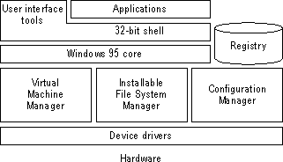
Windows 9x: Architecture
Its architecture is monolithic.
A monolithic kernel is an operating system architecture where the entire operating system is working in kernel space. The monolithic model differs from other operating system architectures

Slide 26
Windows NT/2000
Window NT is a multithreaded, microkernel based OS.
Micro kernel means kernel component is very small, and provides only basic functions such as thread dispatching and hardware exception handling. Hardware-specific code is kept in a separate layer called the Hardware Abstraction Layer (HAL). The HAL simplifies porting of the operating system to new processor architectures like the IA-64 (Intel itanium Architecture).
The core operating system code runs in privileged processor mode. This mode is also known as protected mode (when referring to the CPU), or kernel mode (when referring to a process or thread). Protected mode provides direct access to system memory and other hardware. Applications run in a nonprivileged processor mode known as user mode and have no direct hardware access. Applications have to use the system calls — the API (Application Programming Interface) — in the underlying operating system to perform tasks such as reading or writing to memory or to the screen.

Slide 27
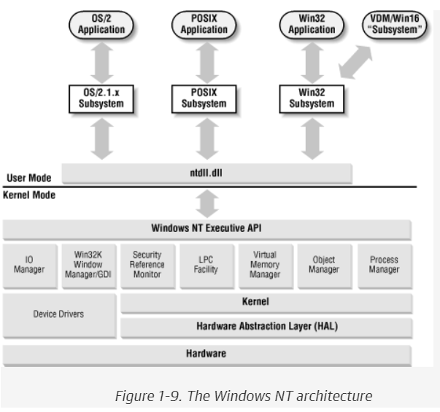
Windows NT/2000

Slide 28
Windows NT/2000 subsystems and services
Operating system services are kept in discrete subsystems, some running in user mode and others in kernel mode. There are several kernel mode subsystems in Windows NT. They provide NT’s native functionality for user mode subsystems through ntdll.dll (running in user mode). The kernel mode subsystems make up the Windows NT Executive, and consist of the following:
Object Manager: The Windows NT architecture is not strictly object-oriented, but internal structures such as shared memory segments, processes, and threads are represented as objects to provide a uniform method for handling things like access control. The Object Manager creates, manages, and deletes Windows NT Executive objects (Executive objects encapsulate one or more kernel objects and expose not only the kernel and kernel-mediated resources, but also an expanded set of services that the kernel does). Objects are represented in a hierarchical namespace much like a filesystem.
Process Manager: Responsible for creating and terminating processes and threads using underlying kernel functions.
Virtual Memory ManagerImplements the virtual memory used to allocate a private address space to each process.
I/O ManagerProvides a device-independent I/O system to processes. It dispatches I/O requests to the appropriate device driver.
Local Procedure Call (LPC) FacilityImplements a fast, lightweight version of Remote Procedure Call (RPC) for communication between components within a computer.
Security Reference Monitor (SRM)Enforces the access and audit policies in the system. The Security Reference Monitor provides access validation, privilege checking, and audit message generation at runtime for both user and kernel mode processes.^{[12]}
Window Manager and Graphical Device Interface (GDI)These components make up the kernel mode part of the Win32 subsystem. They handle user input and screen output. All of the Win32 subsystem originally ran in user mode; however, for performance reasons, a part of it was moved to kernel mode as of NT 4.0.
The subsystems running in user mode are called the environment subsystems. There are three environment subsystems:
Win32 subsystemThe part of the Win32 subsystem running in user mode. The Win32 subsystem is a required part of the operating system and is loaded as a part of the boot sequence. The subsystem consists of the Win32 API DLLs (kernel32.dll, user32.dll, gdi32.dll ) and the Win32 subsystem process (csrss.exe).
POSIX subsystemProvides support for POSIX.1 applications. It’s an optional component that is loaded on demand.
OS/2 1.x subsystemProvides support for OS/2 1.x console applications. It’s an optional component that is loaded on demand.

Slide 29
Windows NT/2000 subsystems and services
Process Manager: Responsible for creating and terminating processes and threads using underlying kernel functions.
Virtual Memory Manager: Implements the virtual memory used to allocate a private address space to each process.
I/O Manager: Provides a device-independent I/O system to processes. It dispatches I/O requests to the appropriate device driver.
Local Procedure Call (LPC) Facility: Implements a fast, lightweight version of Remote Procedure Call (RPC) for communication between components within a computer.
Security Reference Monitor (SRM):Enforces the access and audit policies in the system. The Security Reference Monitor provides access validation, privilege checking, and audit message generation at runtime for both user and kernel mode processes.^{[12]}
Window Manager and Graphical Device Interface (GDI):These components make up the kernel mode part of the Win32 subsystem. They handle user input and screen output. All of the Win32 subsystem originally ran in user mode; however, for performance reasons, a part of it was moved to kernel mode as of NT 4.0.

Slide 30
Windows NT/2000 subsystems and services
The subsystems running in user mode are called the environment subsystems. There are three environment subsystems:
Win32 subsystem: The part of the Win32 subsystem running in user mode. The Win32 subsystem is a required part of the operating system and is loaded as a part of the boot sequence. The subsystem consists of the Win32 API DLLs (kernel32.dll, user32.dll, gdi32.dll ) and the Win32 subsystem process (csrss.exe).
POSIX subsystem: Provides support for POSIX.1 applications. It’s an optional component that is loaded on demand.
OS/2 1.x subsystem: Provides support for OS/2 1.x console applications. It’s an optional component that is loaded on demand.

Slide 31
Windows NT Networking
The first version of Windows NT (Windows NT 3.1) was released in 1993. It was positioned as a successor to the LAN Manager products from Microsoft and IBM. To interoperate and provide backward compatibility with these products, it had to support some established networking standards, such as NetBIOS and SMB. They still provide the foundation for most Windows NT network communication in both Windows NT 4.0 and Windows 2000.
NetBIOS
NetBIOS (Network Basic Input/Output System) is a standard for transmitting data between computers over the network. The NetBIOS specification was developed for IBM back in 1983 to allow network communication between applications. NetBIOS provides three key services:
Name service Locates NetBIOS names on the network.
Session service Provides a connection between two computers.
Datagram service Provides a connectionless communication channel between computers.

Slide 32
Windows NT Networking
NetBIOS
The first implementations of NetBIOS didn’t separate the software interface from the network protocol. Later on, the network-level part of the standard was named NetBEUI (NetBIOS Extended User Interface). The Windows NT version of NetBEUI is also referred to as NBF (NetBIOS Frame). Nowadays, NetBIOS can use transports other than the nonroutable NetBEUI protocol, such as TCP/IP ( NetBIOS over TCP/IP—NetBT) or IPX/SPX.
Server Message Block (SMB)
Remember that NetBIOS is merely a standard for finding resources and transmitting bits. A higher-level protocol is required on top of NetBIOS for it to be of any real use. Here’s where SMB comes in. Server Message Block (SMB)^{[15]} is a standard for sending commands and data. SMB is mostly used for file and print sharing, but it can also be used for Inter-Process Communication (IPC) to communicate with processes on other systems.

Slide 33
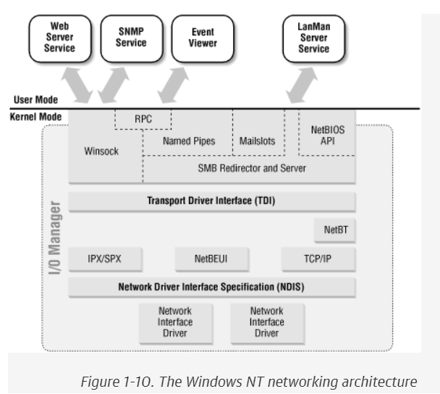
Windows NT Networking
Server Message Block (SMB)
SMB over NetBIOS uses ports udp/137 (NetBIOS name service) and udp/138 (NetBIOS datagram service) or tcp/139 (NetBIOS session service). Windows 2000 includes support for running SMB without NetBIOS over tcp/445. This support is referred to as Direct Host .

Slide 34
Windows NT Networking
NT networking architecture
The I/O Manager in the NT Executive is responsible for most I/O processing, including disk and network I/O. Some of the networking components in the I/O Manager and shows how user mode services interact with these components can be understand by the NT networking architecture

Slide 35
Windows Server 2003
Windows Server 2003 is the second version of Windows Server operating system produced by Microsoft. It is also part of the Windows NT family of operating systems and was released on April 24, 2003.^{[9]} Derived from the Windows XP operating system, Windows Server 2003 is the successor to Windows 2000 and the predecessor to Windows Server 2008. An updated version, Windows Server 2003 R2, was released to manufacturing on December 6, 2005. Windows Server 2003's kernel was later adopted in the development of Windows Vista.
Windows server 2003 comes in a number of edition each targeted towards a particular size and type of business. Although all types of windows servers 2003 have the ability to share files and printers, act as an application server, host message queues, provide email services, authenticate users.

Slide 36
Windows Server 2003
Windows Server 2003 Types:
Windows server 2003 Web meant for building and hosting web applications, web pages, XML web services. It is designed to be used as an IIS web server. Windows server 2003 web supports maximum of 2 physical processors and maximum of 2 GB RAM. It is the only edition of windows server 2003 that doesnot require any client access license.
Windows server 2003 Standard is aimed for small to medium sized businesses. Standard edition supports file and printer sharing, offers secure internet connectivity and allows centralized desktop application deployment. A specialized variant for X64 architecture was released in April 2005.The IA-32 variants supports upto 4 physical processors and upto 4 GB RAM where as X64 variant is capable of addressing upto 32 GB of RAM.

Slide 37
Windows Server 2003
Windows Server 2003 Types:
Windows Server 2003 Enterprise is aimed towards medium to large businesses. It is a full function server operating system that supports upto 8 physical processors and Windows Server 2003 Enterprise is aimed towards medium to large businesses. It is a full-function server operating system that supports up to 8 physical processors and provides enterprise-class features such as eight-node clustering using Microsoft Cluster Server (MSCS) software and support for up to 64 GB of RAM through PAE. Enterprise Edition also comes in specialized variants for the x64 and Itanium architectures. With Service Pack 2 installed, the x64 and Itanium variants are capable of addressing up to 1 TB and 2 TB of RAM, respectively. This edition also supports Non-Uniform Memory Access (NUMA). It also provides the ability to hot-add supported hardware. Windows Server 2003 Enterprise is also the required edition to issue custom certificate templates.
Datacenter
Windows Server 2003 Datacenter is designed^{[20]} for infrastructures demanding high security and reliability. Windows Server 2003 is available for IA-32, Itanium, and x64 processors. It supports a maximum of 32 physical processors on IA-32 platform or 64 physical processors on x64 and IA-64 hardware. IA-32 variants of this edition support up to 64 GB of RAM.^{[17]} With Service Pack 2 installed, the x64 variants support up to 1 TB while the IA-64 variants support up to 2 TB of RAM.^{[17]} Windows Server 2003 Datacenter also allows limiting processor and memory usage on a per-application basis.
This edition has better support for storage area networks (SANs): It features a service which uses Windows sockets to emulate TCP/IP communication over native SAN service providers, thereby allowing a SAN to be accessed over any TCP/IP channel. With this, any application that can communicate over TCP/IP can use a SAN, without any modification to the application.
The Datacenter edition, like the Enterprise edition, supports 8-node clustering. Clustering increases availability and fault tolerance of server installations by distributing and replicating the service among many servers. This edition supports clustering with each cluster having its own dedicated storage, or with all cluster nodes connected to a common SAN.

Slide 38
Windows Server 2003
Windows Server 2003 Types:
Windows Server 2003 Datacenter is designed^{[20]} for infrastructures demanding high security and reliability. Windows Server 2003 is available for IA-32, Itanium, and x64 processors. It supports a maximum of 32 physical processors on IA-32 platform or 64 physical processors on x64 and IA-64 hardware. IA-32 variants of this edition support up to 64 GB of RAM.^{[17]} With Service Pack 2 installed, the x64 variants support up to 1 TB while the IA-64 variants support up to 2 TB of RAM.^{[17]} Windows Server 2003 Datacenter also allows limiting processor and memory usage on a per-application basis.
This edition has better support for storage area networks (SANs): It features a service which uses Windows sockets to emulate TCP/IP communication over native SAN service providers, thereby allowing a SAN to be accessed over any TCP/IP channel. With this, any application that can communicate over TCP/IP can use a SAN, without any modification to the application.

Slide 39
Windows Server 2003
Windows Server 2003 Types:
Windows Server 2003 Datacenter is designed^{[20]} for infrastructures demanding high security and reliability. Windows Server 2003 is available for IA-32, Itanium, and x64 processors. It supports a maximum of 32 physical processors on IA-32 platform or 64 physical processors on x64 and IA-64 hardware. IA-32 variants of this edition support up to 64 GB of RAM.^{[17]} With Service Pack 2 installed, the x64 variants support up to 1 TB while the IA-64 variants support up to 2 TB of RAM.^{[17]} Windows Server 2003 Datacenter also allows limiting processor and memory usage on a per-application basis.
This edition has better support for storage area networks (SANs): It features a service which uses Windows sockets to emulate TCP/IP communication over native SAN service providers, thereby allowing a SAN to be accessed over any TCP/IP channel. With this, any application that can communicate over TCP/IP can use a SAN, without any modification to the application.

Slide 40
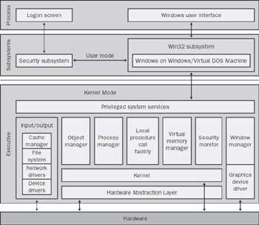
Windows Server 2003
Windows Server 2003

Slide 41
Windows Server 2003
Windows Server 2003 Executive mode
It is also known as kernel or privileged executive mode. Windows server 2003 breaks it operationsinto five segments that run in kernel or privileged mode: Hardware Abstraction Layer (HAL), microkernel Device drivers, executive managers, executive services buffer.
These elements handle system responsibilities that are hidden from the user.
Windows server 2003 protected user mode system can be viewed as a buffer between user applications and kernel mode services structure.
Windows server 2003 supports two protected subsystems:
The integral subsystem performs underlying operating system tasks for example security management.
The environmental subsystem establishes foundation for applications and user interfaces.

Slide 42
Windows Server 2003
Windows Server 2003 Registry
The windows server 2003 Registry is a database that contains operating system, hardware and software information for the local computer system. Other items stored in Registry include: hardware configuration data, program group and desktop settings for each user, user profile data, local language and time settings, network configuration data, security information for users and groups, activeX and OLE server data.

Slide 43
Scheduling
A Process Scheduler schedules different processes to be assigned to the CPU based on particular scheduling algorithms. There are six popular process scheduling algorithms-
First Come First Served (FCFS) scheduling
Shortest-Job-Next (SJN) Scheduling
Priority Scheduling
Shortest Remaining Time
Round Robin(RR) Scheduling
Multiple-Level Queues Scheduling
These algorithms are either non-preemptive or preemptive. Non-preemptive algorithms are designed so that once a process enters the running state, it cannot be preempted until it completes its allotted time, where as in preemptive scheduling scheduler may preempt a low priority process enters into a ready state.

Slide 44
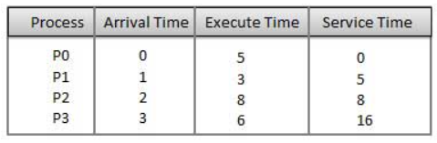
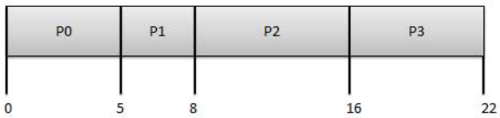
Scheduling: First Come First Serve (FCFS)
First Come First Serve (FCFS)
Jobs are executed on first come, first serve basis.
It is a non-preemptive, pre-emptive scheduling algorithm.
Easy to understand and implement.
Its implementation is based on FIFO queue.
Poor in performance as average wait time is high.
Representing the above processes in Gantt chart

Slide 45
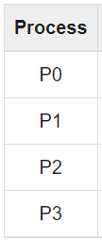
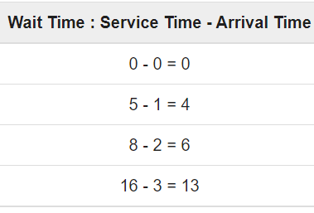
Scheduling: First Come First Serve (FCFS)
Jobs are executed on first come, first serve basis.
It is a non-preemptive, pre-emptive scheduling algorithm.
Easy to understand and implement.
Its implementation is based on FIFO queue.
Poor in performance as average wait time is high.
Representing the above processes in Gantt chart
Average wait time =(0+4+6+13)/4
=5.75

Slide 46
Scheduling: Shortest Job First (SJF)
This is also known as shortest job first, or SJF
This is a non-preemptive, pre-emptive scheduling algorithm.
Best approach to minimize waiting time.
Easy to implement in Batch systems where required CPU time is known in advance.
Impossible to implement in interactive systems where required CPU time is not known.
The processer should know in advance how much time process will take.

Slide 47
Scheduling:Priority Based Scheduling
Priority scheduling is a non-preemptive algorithm and one of the most common scheduling algorithms in batch systems.
Each process is assigned a priority. Process with highest priority is to be executed first and so on.
Processes with same priority are executed on first come first served basis.
Priority can be decided based on memory requirements, time requirements or any other resource requirement.
Given: Table of processes, and their Arrival time, Execution time, and priority. Here we are considering 1 is the lowest priority.

Slide 48
Scheduling:Shortest Remaining Time
Shortest remaining time (SRT) is the preemptive version of the SJN algorithm.
The processor is allocated to the job closest to completion but it can be preempted by a newer ready job with shorter time to completion.
Impossible to implement in interactive systems where required CPU time is not known.
It is often used in batch environments where short jobs need to give preference.
Round Robin Scheduling
Round Robin is the preemptive process scheduling algorithm.
Each process is provided a fix time to execute, it is called a quantum.
Once a process is executed for a given time period, it is preempted and other process executes for a given time period.
Context switching is used to save states of preempted processes.

Slide 49
Scheduling:Round Robin Scheduling
Round Robin is the preemptive process scheduling algorithm.
Each process is provided a fix time to execute, it is called a quantum time.
Once a process is executed for a given time period, it is preempted and other process executes for a given time period.
Context switching is used to save states of preempted processes.

