Slide 1
Industrial Equipment Overview
Generated Presentation

Slide 2
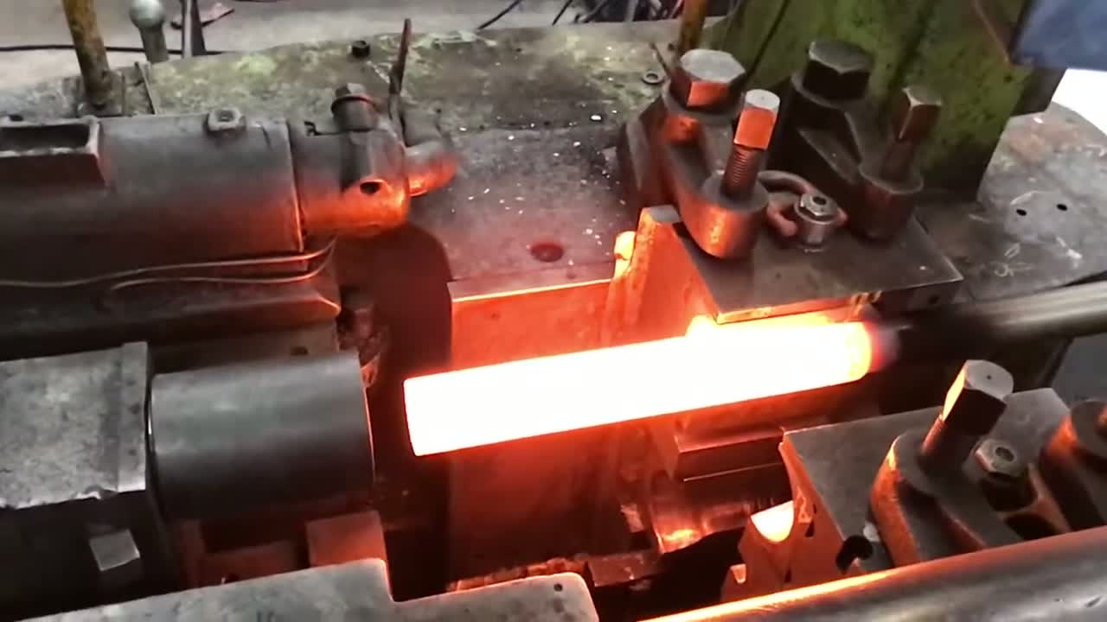
Slide 1
3B 4B 3B 6B 6B 6B 6B 7B 7B 7B

