Slide 1
Industrial Equipment Overview
Generated Presentation

Slide 2
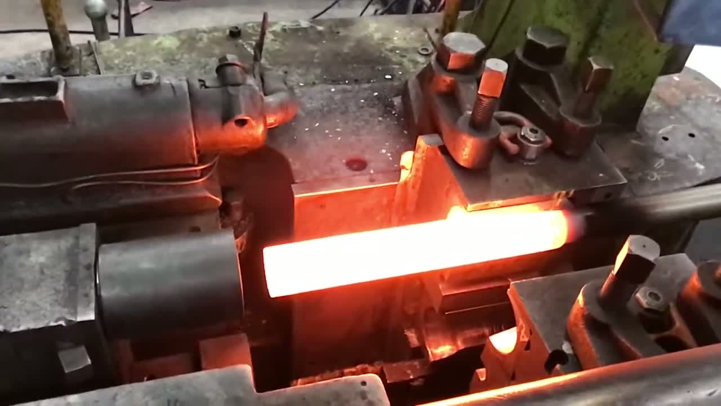
Slide 1
frame_0001

Slide 3
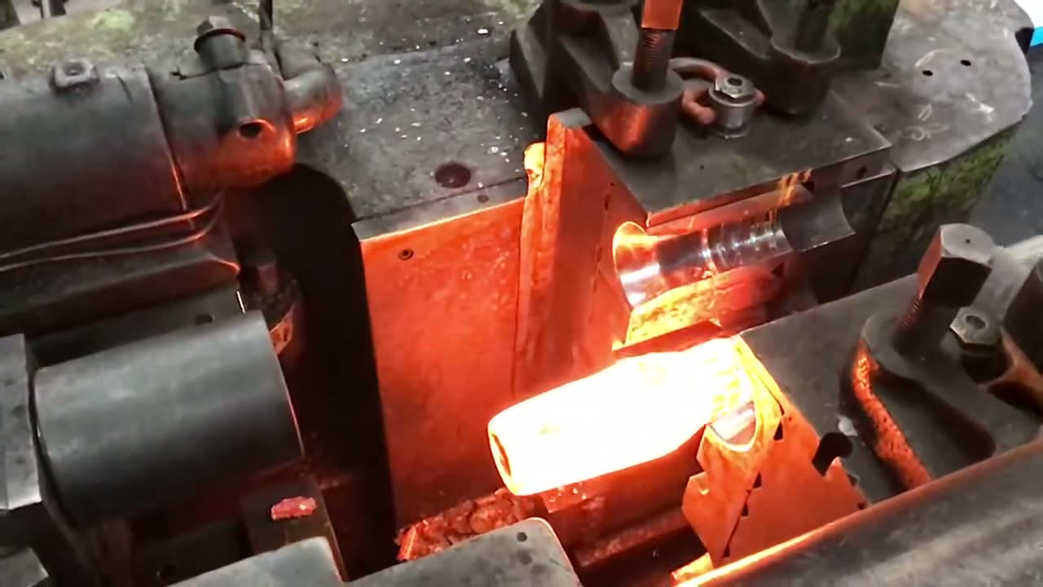
Slide 2
jpg: a metal object with a red and black flame
frame_0002

Slide 4
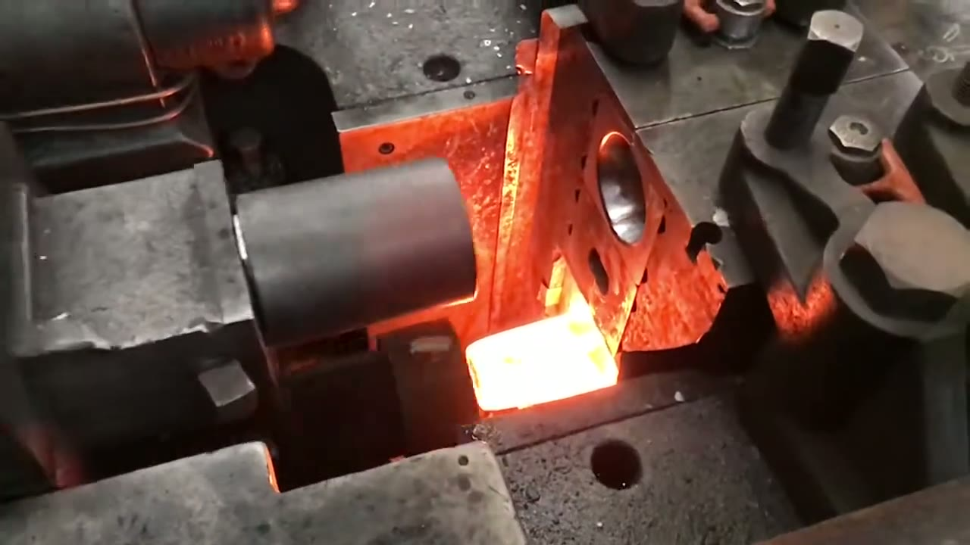
Slide 3
jpg: a fire hydrant with a lot of smoke coming out of it
frame_0003

Slide 5
Slide 4
jpg: a fire pit with a lot of food inside of it

