Slide 1
LearnEd
Cloud-Native Learning Platform
Using Kubernetes and Prometheus Monitoring
Submitted By: Rachna Devi
Roll No.: 53 | Section: 4OM05 | Reg. No.: 12215283
Submitted To: Ms. Arshiya | Assistant Professor |
Course: INT-334 – Enterprise Application Automation | LPU, Session 2025-26

Slide 2
Table of Contents
01
Introduction
Project Snapshot
Background, motivation and project overview
Platform:
LearnEd – E-Learning Website
02
Problem Statement
Challenges with traditional deployment approaches
GitHub:
Rachna0612/E-LEARNING
03
System Architecture
Containerization:
Docker (nginx:alpine)
Kubernetes cluster design and component layout
Orchestration:
Kubernetes v1.29 (kubeadm)
04
Technology Stack
Tools and technologies used in the project
Infrastructure:
AWS EC2 (Ubuntu 22.04)
05
Key Results
Monitoring:
Prometheus + Grafana (Helm)
Outcomes, metrics and observations
Auto-Scaling:
Horizontal Pod Autoscaler
06
Conclusion
Course:
INT-334, LPU, 2025-26
Summary and future scope
2

Slide 3
Introduction
What is LearnEd?
Key Objectives
LearnEd is a cloud-native educational platform designed to deliver structured course content and learning resources to students through a responsive web interface.
The project was developed to demonstrate real-world Kubernetes orchestration and Prometheus-based monitoring on a practical application — an online learning system — rather than a synthetic demo.
Containerize the frontend using Docker for portability and consistency
1
2
Deploy on a multi-node Kubernetes cluster via kubeadm on AWS EC2
3
Implement Horizontal Pod Autoscaling (HPA) for dynamic scaling
4
Achieve zero-downtime deployments using RollingUpdate strategy
Background & Motivation
5
Set up Prometheus + Grafana monitoring with real-time dashboards
Educational platforms face unpredictable traffic — especially during examinations. Traditional server-based deployments fail under these spikes. This project applies cloud-native principles to solve that.
6
Document the full implementation for reproducibility
3

Slide 4
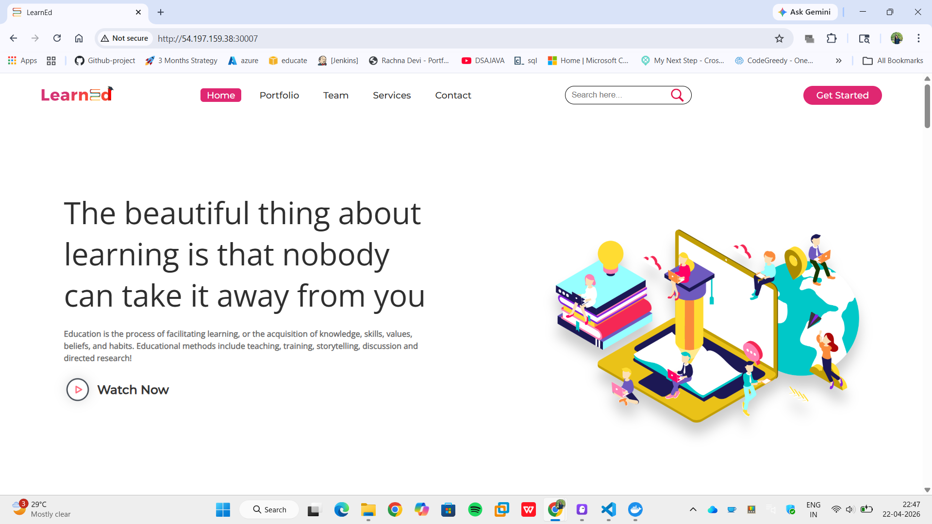
Learn-Ed Website Port (30007)
The Learn-Ed application is deployed in Kubernetes
Runs inside container on:
Container Port: 80
Exposed externally using NodePort:
NodePort: 30007
Access via:
http://<Public-IP>:30007

Slide 5
Problem Statement
Traditional web application deployments suffer from critical operational limitations when handling dynamic workloads such as those experienced by educational platforms during examination seasons.
Static Infrastructure
Single Point of Failure
Fixed resource allocation cannot dynamically scale up during examination peaks or scale down during off-peak hours, leading to resource waste or system overload.
Monolithic server deployments mean any instance crash brings the entire platform offline. There is no redundancy or automatic recovery mechanism.
No Real-Time Monitoring
Manual Operations
Without centralised metrics collection and alerting, administrators discover failures only after students report them — by which time, reputational damage is already done.
Scaling, updates, and failover all require manual SSH access, increasing human error and making it impossible to respond fast enough during sudden traffic spikes.
Solution: LearnEd uses Kubernetes for automated scaling and self-healing, Prometheus for real-time monitoring, and Docker for portable, reproducible deployments.
4

Slide 6
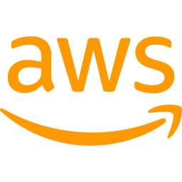

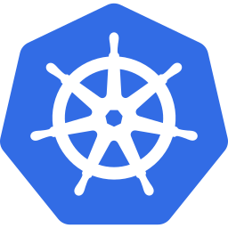



Tools & Technologies Used
AWS EC2
Docker
Kubernetes
Cloud infrastructure
Ubuntu 22.04 LTS
Container image
Nginx Alpine base
Orchestration
kubeadm v1.29
Prometheus
Grafana
Helm
Metrics collection
Time-series DB
Dashboards &
Visualization
Package manager
Monitoring stack
All tools are Open Source • Industry Standard • Production Grade

Slide 7

Security Group Configuration
Inbound Rules — AWS EC2 Security Group
Port | Protocol | Purpose | Why Needed
22 | TCP | SSH Access | Connect to EC2 instance via terminal
80 | TCP | HTTP Traffic | Serve web app over standard HTTP
30000-32767 | TCP | Kubernetes NodePort | Expose K8s services externally
6443 | TCP | K8s API Server | kubectl commands from local machine
9090 | TCP | Prometheus Web UI | Access Prometheus metrics interface
30310 | TCP | Prometheus NodePort | External access to Prometheus
31949 | TCP | Grafana NodePort | Access Grafana dashboard externally
3007 | TCP | Custom App Port | Additional application endpoint

Slide 8
The Dockerfile
Dockerfile
Line-by-Line Explanation
1
# -- Base image: Nginx Alpine (~5MB)
2
FROM nginx:alpine
FROM nginx:alpine
3
Lightweight 10MB base image with Nginx web server built-in
4
# -- Remove default nginx welcome page
5
RUN rm -rf /usr/share/nginx/html/*
RUN rm -rf ...
6
Clean out the default Nginx welcome page
7
# -- Copy project files into nginx web root
8
COPY . /usr/share/nginx/html
COPY . /usr/share/...
9
Copy all HTML/CSS/JS files into Nginx's web root directory
10
# -- Expose port 80
11
EXPOSE 80
12
EXPOSE 80
13
# -- Start nginx in foreground
Tells Docker the container listens on port 80 (HTTP)
14
CMD ["nginx", "-g", "daemon off;"]
CMD ["nginx"...]
Start Nginx server in foreground mode (required for Docker)

Slide 9




KUBERNETES
Namespace: elearning
Namespace
▶
▶
▶
Deployment
Service
HPA
elearning
elearning-deployment
2 Replicas
NodePort :30007
Port 80 → 80
2–6 Pods
CPU 70%
Container Details
Image:
rachna06/e-learning:latest
CPU Request:
100m │ Limit: 300m
Container Port:
80
Mem Request:
64Mi │ Limit: 128Mi

Slide 10
NAMESPACE & DEPLOYMENT
📄 namespace.yaml
📄 deployment.yaml
apiVersion: v1
kind: Namespace
metadata:
name: elearning
name: elearning-deployment
namespace: elearning
replicas: 2
image: rachna06/e-learning:latest
containerPort: 80
resources:
requests:
cpu: "100m" memory: "64Mi"
limits:
cpu: "300m" memory: "128Mi"
Key Points:
Creates isolated environment 'elearning'
Logical boundary for all K8s resources
Prevents conflicts with other namespaces
Key Points:
2 replicas ensure high availability
CPU & memory limits prevent resource abuse
Label selector: app=elearning

Slide 11
SERVICE CONFIGURATION
📄 service.yaml
Traffic Flow
apiVersion: v1
kind: Service
metadata:
name: elearning-service
namespace: elearning
spec:
type: NodePort
selector:
app: elearning
ports:
- protocol: TCP
port: 80
targetPort: 80
nodePort: 30007
External User
Browser / Client
▼
NodePort 30007
Node external port
▼
ClusterIP :80
Internal service
▼
Pod Port 80
elearning-container

Slide 12
HORIZONTAL POD AUTOSCALER (HPA)
📄 hpa.yaml
How HPA Works:
apiVersion: autoscaling/v2
kind: HorizontalPodAutoscaler
metadata:
name: elearning-hpa
namespace: elearning
spec:
scaleTargetRef:
apiVersion: apps/v1
kind: Deployment
name: elearning-deployment
minReplicas: 2
maxReplicas: 6
metrics:
- type: Resource
resource:
name: cpu
target:
type: Utilization
averageUtilization: 70
Metrics server monitors CPU every 15 seconds
Scales up when avg CPU > 70% across pods
Never drops below 2 pods for reliability

Slide 13
Application Deployment Steps
1
Apply Namespace
$ kubectl apply -f namespace.yaml
→ namespace/elearning created
2
Apply ConfigMap
$ kubectl apply -f configmap.yaml
→ configmap/elearning-config created
3
Deploy Application
$ kubectl apply -f deployment.yaml
→ deployment.apps/elearning-deployment created
4
Expose Service
$ kubectl apply -f service.yaml
→ service/elearning-service created
5
Enable Auto-Scale
$ kubectl apply -f hpa.yaml
→ horizontalpodautoscaler.autoscaling/elearning-hpa created
6
Verify Pods
$ kubectl get pods -n elearning
→ All pods: STATUS=Running ✓

Slide 14
System Architecture
Architecture Overview
Component Breakdown
LearnEd runs on a two-node Kubernetes cluster provisioned using kubeadm on AWS EC2 instances. The architecture follows a layered model:
• Presentation Layer: HTML/CSS/JS frontend served by Nginx
• Orchestration Layer: Kubernetes manages pods, scaling, and networking
• Monitoring Layer: Prometheus scrapes metrics; Grafana visualises them
User requests arrive at the EC2 public IP on NodePort 30007, are routed by the Kubernetes Service to a healthy pod, which returns content. Prometheus simultaneously scrapes metrics from every component every 15 seconds.
Component
Role
Master Node (EC2)
Runs control plane: API Server, Scheduler, etcd
Worker Node (EC2)
Runs application pods (Nginx containers)
Docker / Docker Hub
Builds & distributes the nginx:alpine image
Deployment
Maintains 2 replicas; rolling update strategy
Service (NodePort)
Exposes app on port 30007; load-balances pods
HPA
Scales pods 2 → 8 when CPU exceeds 70%
Prometheus (Helm)
Collects metrics (accessible on 30310)
Grafana (Helm)
Visualizes metrics (accessible on 31949)
5

Slide 15
Technology Stack
Category
Tool / Technology
Version / Detail
Purpose
Frontend
HTML + CSS + JavaScript
Latest
Application UI served to the student's browser
Source Control
GitHub
—
Version control for application source code
Containerization
Docker
nginx:alpine
Packages app into a portable 10MB container image
Image Registry
Docker Hub
Cloud registry
Stores and distributes the Docker image globally
Orchestration
Kubernetes (kubeadm)
v1.29
Manages pods, scaling, networking, and self-healing
Networking
Flannel CNI
Latest
Pod-to-pod overlay network across cluster nodes
Infrastructure
AWS EC2
Ubuntu 22.04 LTS
Cloud VMs hosting Master and Worker nodes
Auto-Scaling
Horizontal Pod Autoscaler
K8s built-in
Scales pods 2 → 8 based on CPU utilisation > 70%
Monitoring
Prometheus
kube-prometheus-stack
Scrapes and stores time-series metrics every 15s
Dashboards
Grafana
Bundled with above
Visualises metrics via imported community dashboards
Alerting
AlertManager
Bundled with above
Routes notifications when thresholds are breached
Package Mgr.
Helm v3
Latest
Installs entire monitoring stack in one command
6

Slide 16
Conclusion
Summary
Future Scope
LearnEd demonstrates that production-grade cloud-native engineering is achievable at university level using entirely open-source tools.
CI/CD Pipeline:
GitHub Actions auto build + deploy on every commit
Kubernetes self-healing + HPA auto-scaling + RollingUpdate together eliminate manual operations and unplanned downtime.
AWS EKS Migration:
Managed control plane, auto etcd backups
Grafana Loki:
Prometheus and Grafana provide complete real-time visibility — from container CPU to cluster health — without custom instrumentation.
Centralised log aggregation alongside metrics
OpenTelemetry:
The entire stack is reproducible from scratch on fresh AWS EC2 instances by following the documented step-by-step procedure.
Distributed tracing and custom business metrics
Multi-Region Deploy:
The project maps directly to INT-334 Course Outcomes CO1–CO6: containerization, cluster management, networking, scaling, and monitoring.
Mumbai + Singapore AZs for national coverage
HTTPS / TLS:
Let's Encrypt certificate + Ingress controller
8

Slide 17
Thank You

