Slide 1
Version Control with Git
Kaushal Sahu

Slide 2
Agenda
  What is Version Control? (and why use it?)
  What is Git? (And why Git?)
  How Git Works (in theory)
  Setting up Git (surviving the CLI)
  The basics of Git (Just make it work!)
  Working together (without killing each other)

Slide 3
Getting Started with Version Control
What is version control?

Slide 4
Getting Started with Version Control
Version Control - A system for managing changes made to documents and other computer files
What kinds of files can we use it with?
  Source code
  Documentation
  Short stories
  Binary files (music and pictures)
What should we use it for?
  Text files
  Projects that have lots of revisions (changes)
  Collaborating

Slide 5
VCS Systems and their Operation
Lots of different choices available:
  CVS
  SVN
  Perforce
  Git
  Mercurial (Hg)
  Bazaar
  And more!
Most follow a repository model (though differ in how the repositories work)

Slide 6
So why Git (and still, why VCS)?
Our goals
  Share code (or something else) easily
  Keep track of any changes we make (and undo them with ease)
  Maintain multiple versions of the same project/code base
  Clearly communicate what changes have been made

Slide 7
What is a VCS?
  One central repository
  Must be capable of connecting to repo
  Need to solve issues with group members making different changes on the same files

Slide 8
How Git stores data
Let's quickly talk about what goes into a repository (and what a repo is)
Commit - A snapshot of the trees and blobs [ Binary Large Object] at a point in time
It's easier to think of things in terms of changes in files
(but that's not really how Git does it--we'll ignore that for now)
Git (and other VCSes) get their power from working on files where changes can be easily seen (i.e. not binary files)

Slide 9
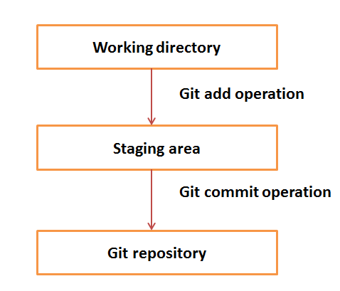
How Git stores data

Slide 10
Let's Get Started (Setting up Git)
Install git for your platform of choice (git-scm.org)
  Graphical installer for Windows
  DMGs for Mac
  Your favorite Linux package manager
  Or compile from source!
And let's get set up: (green = command, blue = variable)
git config --global user.name “Kaushal Sahu"
git config --global user.email “xyz@xxxx.coms"
Quick thing about line endings:
Windows: git config --global core.autocrlf true
Mac/Linux: git config --global core.autocrlf input

Slide 11
Creating our first repository
Establish our first repository:
mkdir git-test
cd git-test
git init
What do we have here?
git status
Let's take a quick look around
  .git directory
  Add a file, make some changes, and run git status

Slide 12
Using our first repository
Let's commit a file into the repo:
git add test.py
git commit -m "My very first commit"
git status
Let's add a file we don't want to actually save
git add test.pyc
git commit -m "Something I didn't want to commit"
git rm test.pyc
git commit -m "Removing derivable data"
And stay out: .gitignore file

Slide 13
Looking deeper at the repository
What did we just do (at a glance)?
git hist
And what about in detail?
git log
git diff test.py
But why add and then commit
  Staging area -- Where we set up a commit between file changes on the system and the commit to the repo

Slide 14
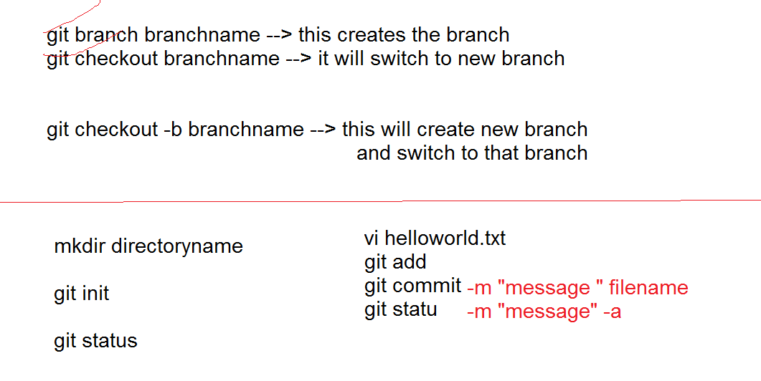
Create branch and switching to new branch

Slide 15
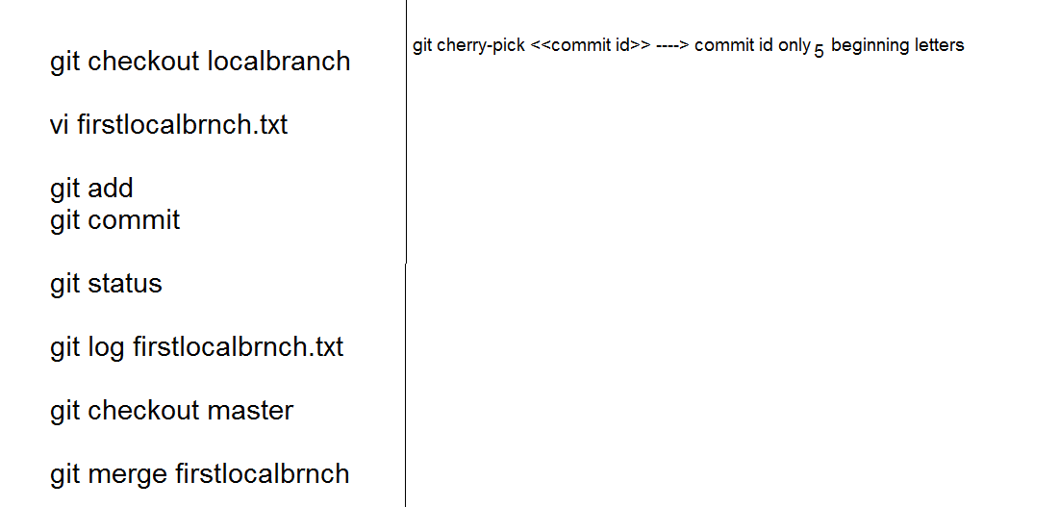

Slide 16
Sharing -- Using a remote origin
Let's say our friend has set up a repository somewhere:
git clone git@github.com:Dylnuge/davesdots.git
Make changes and commit like normal, then:
git push
If they make any changes, we can get them:
git pull
We can also tell an active repo where the remote origin is:
git remote add origin nugent5@yt:~/davesdots.git

Slide 17
Resolving commit conflicts
My friend and I both made changes. What happens when I try to:
git push
Usually: automatic merging
Manual merging might be needed though--git will tell you to edit, and then commit.
Getting the original version of a file:
git checkout -- test.py # "--" means local repo head
A quick look at the stash
git stash # Put my staging area on the stack
git stash pop # Pop it back off (after resolving)

Slide 18
Advanced Versioning: Branches
So what is a branch?
  Exactly what it sounds like!
  By default, everything is on the ﻿master branch
  We can make changes on another branch
Simple usage of branches:
git checkout -b testing # Make a new branch "testing"
make some changes and commit them
git checkout master # Switch to "master" branch
git merge testing # Merge the "testing" branch
Let's talk about use cases--versions, experimental branches, major change branches, etc

Slide 19
Advanced Versioning: Reverting changes
Revert ALL THE THINGS we changed:
git checkout -f
Ut oh, we already commited it:
git revert HEAD # Revert last commit (HEAD)
We can also use both of these commands to specify a revision (by it's SHA hash tag, visible in git log)
Revert is a very complex and nuanced command. Look stuff up as you need it

