Slide 1

Projet
https://getbootstrap.com/ pour les éléments
Iframe Google pour le calendrier
De nezali rachid

Slide 2
CONFIG
<?php
$status = session_status();
if($status == PHP_SESSION_NONE){
//Si non active
session_start();
}else
if($status == PHP_SESSION_DISABLED){
//Si session non valide
}else
if($status == PHP_SESSION_ACTIVE){
//Destruction et redémarrage d'une nouvelle
session_destroy();
session_start();
}
//Donnée serveur
$servername = "localhost";
$username = "root";
$password = "";
$dbname = "ecole";
//Connection DB
try {
$conn = new PDO("mysql:host=$servername;dbname=$dbname", $username, $password);
$conn->setAttribute(PDO::ATTR_ERRMODE, PDO::ERRMODE_EXCEPTION);
} catch (PDOException $e) {
echo "<br>" . $e->getMessage();
}

Slide 3

LOG IN/OUT
<?php
//récuperation de email et mot de passe et comparaison
session_start();
require('config.php');
$query= $conn->prepare("SELECT*FROM personn WHERE email = ?");
$query->execute([$_POST['email']]);
$users=$query->fetch();
$mdp=$_POST['mdp'];
if ($users&&($mdp==$users['mdp'])){
echo 'AUTH OK';
header("location: dashboard\index.php");
}
else{
echo "<script>alert(AUTH NOK)</script>";
}
{session_start();
$_SESSION['email']=$user['email'];
$_SESSION['mdp']=$user['mdp'];}
?>
<?php
//Destruction de la session
require 'config.php';
session_destroy();
header('location:index.html');
?>

Slide 4
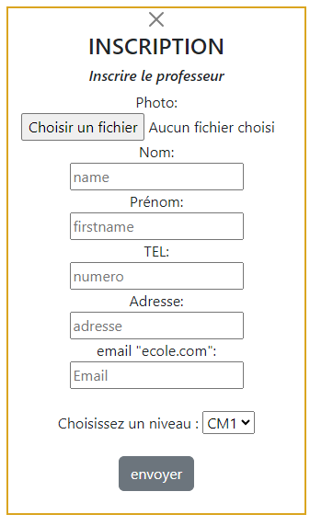
INSCRIPTION
<?php
require('config.php');
// récupère donnée formulaire
$name = $_POST['name'];
$firstname = $_POST['firstname'];
$numero = $_POST['numero'];
$email = $_POST['email'];
$adresse = $_POST['adresse'];
$niveau = $_POST['niveau'];
$fonction = $_POST['fonction'];
$mdp = $_POST['mdp'];
$photo = $_POST['photo'];
//insertionDB
try {
$sql="INSERT INTO personn (`name`,`firstname`,`numero`,
`email`,`adresse`,`niveau`,`fonction`,
`mdp`,`photo`) VALUES
('$name','$firstname','$numero','$email','$adresse','$niveau','$fonction','$mdp','$photo')";
$conn->exec($sql);
//fermeture auto
echo '<script>self.close();</script>';
} catch (PDOException $e) {
echo "<br>" . $e->getMessage();
}
?>
<!--Input auto-->
<input name="fonction" type="hidden" value="prof">
<input name="mdp" type="hidden" value="00000000"> <div>
<button type="submit" value="submit" class="btn btn-secondary">envoyer</button></div></br>
</form>
</div>
<!--fonction pour fermeture bouton-->
<script>
function closeinscription() {
var url = '../inscriptionprof.html';
var windowFeatures = 'height=532px,width=250px,toolbar=no,location=no,status=no,menubar=no,scrollbars=no,resizable=no';
window.close(url, '_blank', windowFeatures);
}
</script>

Slide 5
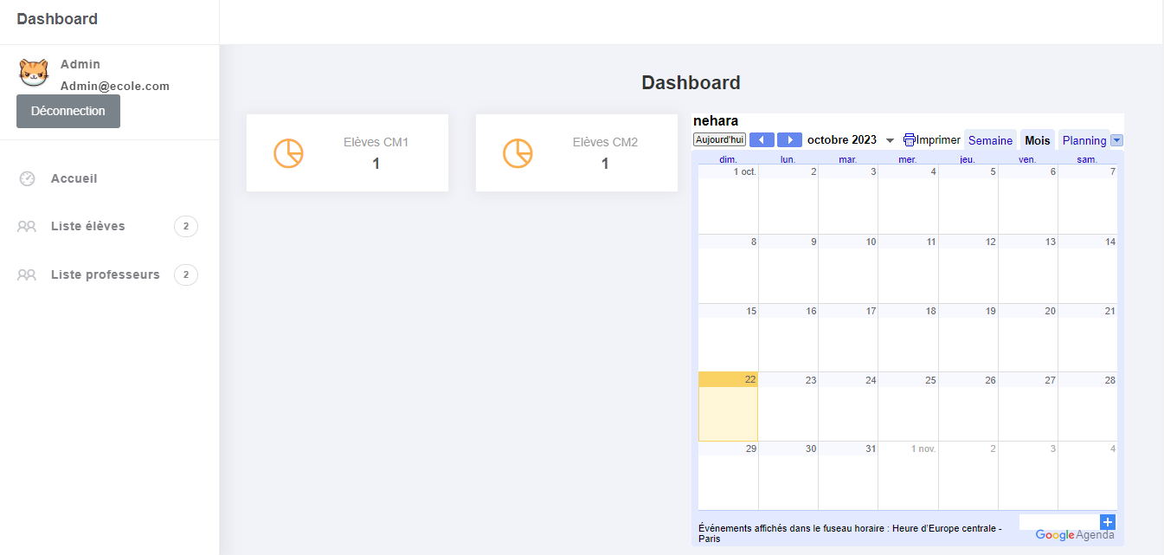
PAGE PRINCIPALE

Slide 6
PAGE PRINCIPALE
CALENDRIER
BADGE
COMPTE CM
IFRAME DE GOOGLE AGENDA
<!-- Lien page élève-->
<li class="nav-item">
<a href="le.php">
<i class="la la-group"></i>
<p>Liste élèves</p>
<span class="badge badge-count">
<!-- Badge Nombre d'élève-->
<?php function nbreleve()
{ require('../config.php');
$nombreeleve = 0;
$query = $conn->prepare("SELECT COUNT(*) FROM personn WHERE fonction = 'eleve'");
$query->execute();
$nombreeleve = $query->fetchColumn();
echo $nombreeleve;}
nbreleve();?></span></a>
</li>
<!-- Compte nombre élève CM1-->
<div class="col-7 d-flex align-items-center">
<div class="numbers"> <p class="card-category">Elèves CM1</p>
<h4 class="card_title">
<?php
function nbrcm1()
{require('../config.php');
$nombreElevesCM1 = 0;
$query = $conn->prepare("SELECT COUNT(*) FROM personn WHERE fonction = 'eleve'AND niveau = 'cm1'"); $query->execute();
$nombreElevesCM1 = $query->fetchColumn();
echo $nombreElevesCM1;}
nbrcm1();
?>
/h4></div>
</div>

Slide 7
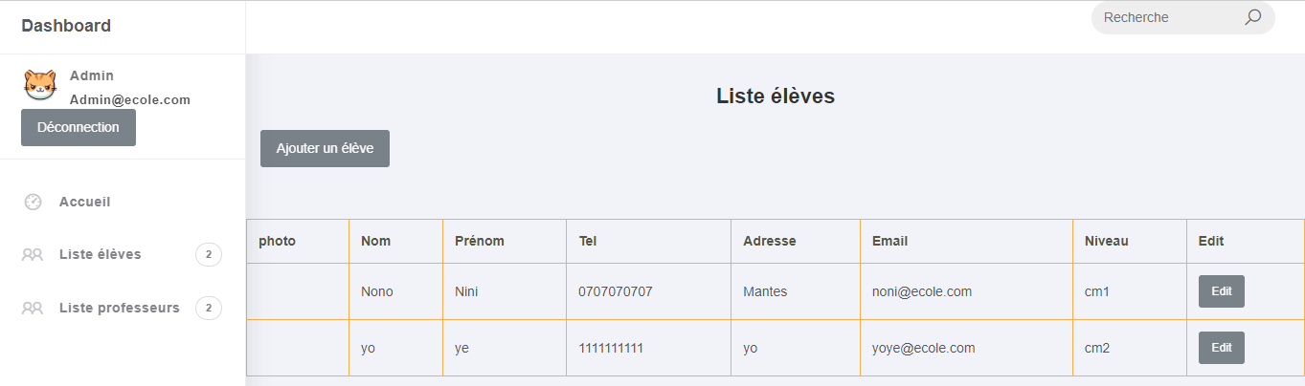
LES LISTES ELEVE ET PROF

Slide 8
LA LISTE
RECHERCHE
FUNCTION AVEC FORMULAIRE
<table class="table table-bordered table-bordered-bd-warning mt-4">
<thead>
<!--Structure tableau-->
<tr>
<th scope="col">photo</th>
<th scope="col">Nom</th>
<th scope="col">Prénom</th>
<th scope="col">Tel</th>
<th scope="col">Adresse</th>
<th scope="col">Email</th>
<th scope="col">Niveau</th>
<th scope="col">Edit</th>
</tr>
</thead>
<!-- Recherche élève dans DB -->
<?php
require('../config.php');
$query = $conn ->prepare(" SELECT * FROM personn WHERE fonction = 'eleve' ");
$query-> execute() ;
while($rows=$query->fetch(PDO::FETCH_ASSOC))
{?>
<!-- Envoie des données rechercher dans le tableau--><tr>
<td><?php echo $rows['photo'];?></td>
<td><?php echo $rows['name'];?></td>
<td><?php echo $rows['firstname'];?></td>
<td><?php echo $rows['numero'];?></td>
<td><?php echo $rows['adresse'];?></td>
<td><?php echo $rows['email'];?></td>
<td><?php echo $rows['niveau'];?></td>
<td><button onclick="openinscription()" type="file" class="btn btn-secondary btn-sm">Edit</button></td>
</tr> <?php } ?></tr></tbody></table>

Slide 9
Problématique
La responsivité mais en amélioration grâce a Bootstrap
Gestion de temps
Clean code en amelioration
Bouton Edit
Bouton Recherche
Base de donnée

