Slide 1

MOOV
IT

Slide 2
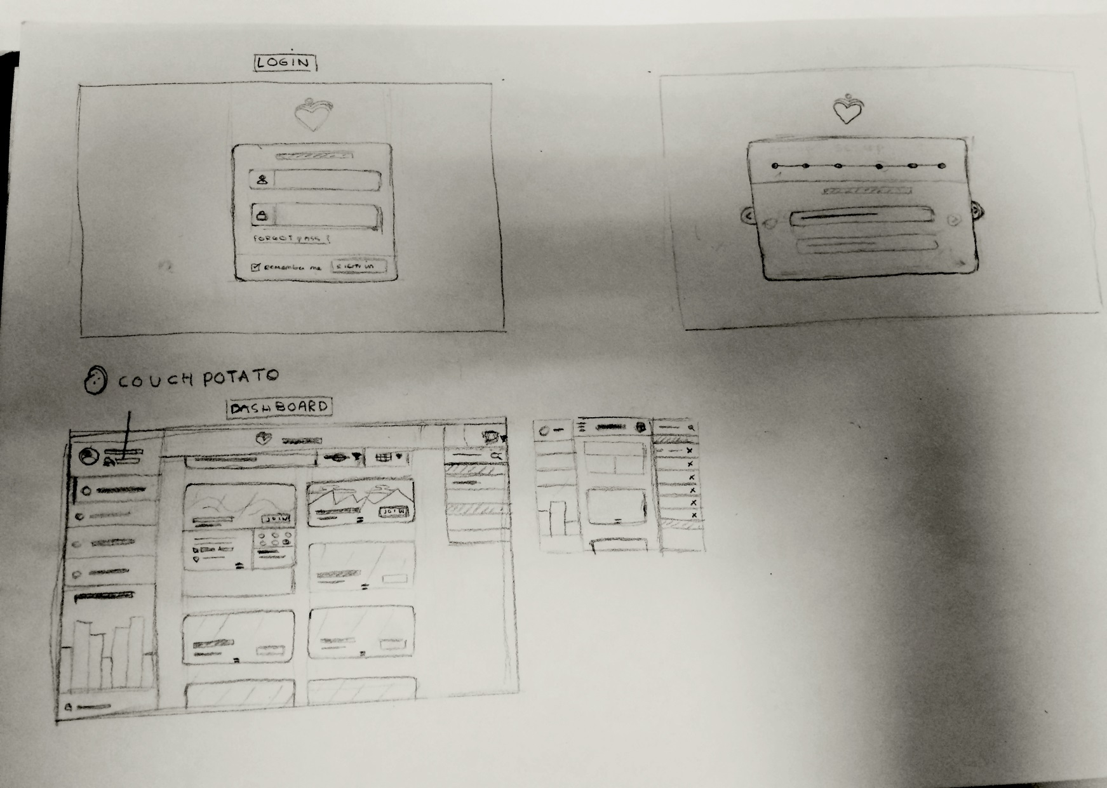
Wireframe

Slide 3
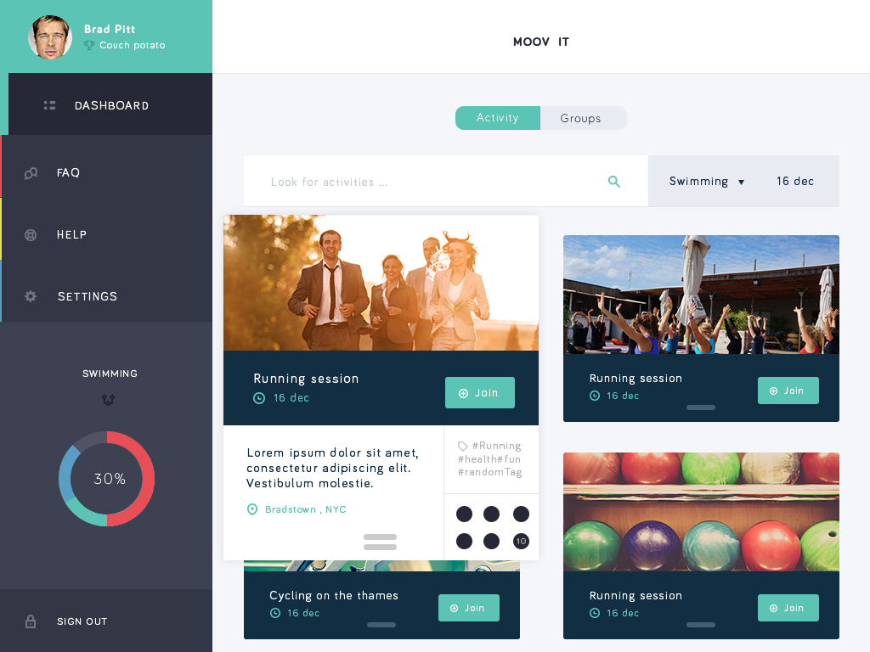
ontwerp

Slide 4
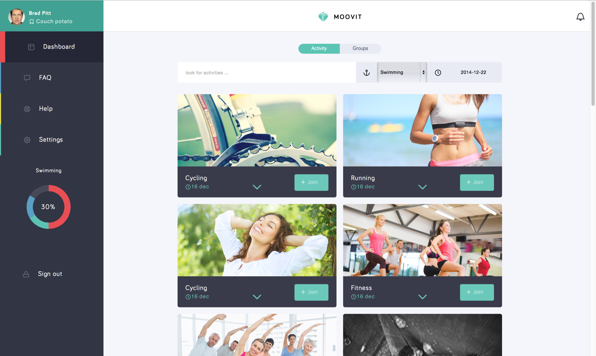
website

Slide 5
Site
Dashboard
Profiel
FAQ
Help
Settings

Slide 6
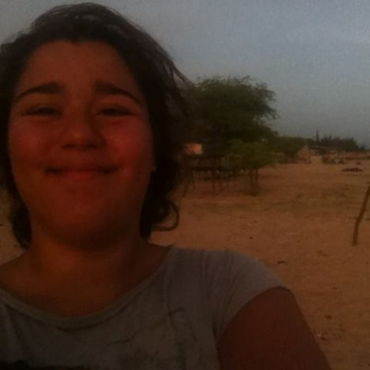
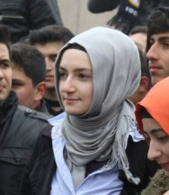
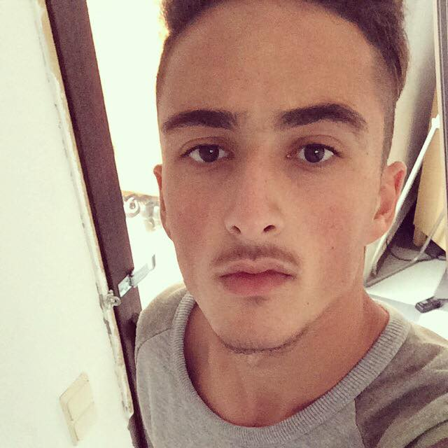
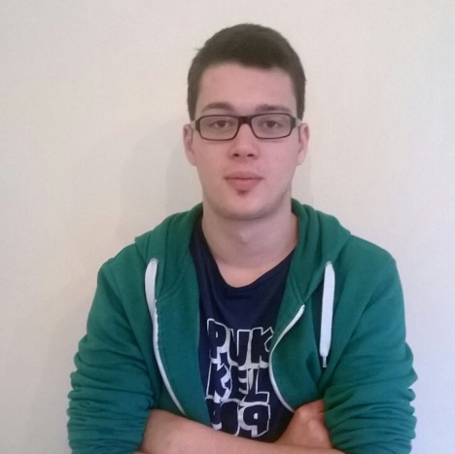
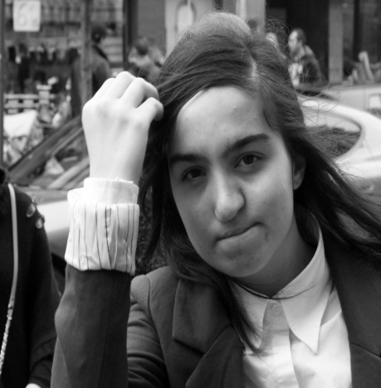
Team C
Maëlys Sobieraj
Rachouan Rejeb
Hatice Akarca
Jonas Pardon
H. Ahsen Gözen

