Slide 1

Build a Personalized Online Course Recommender System with Machine Learning
Rachana S
08-12-2024

Slide 2

Outline
Introduction and Background
Exploratory Data Analysis
Content-based Recommender System using Unsupervised Learning
Collaborative-filtering based Recommender System using Supervised learning
Conclusion
Appendix

Slide 3

Introduction
Project background and context
This project aims at building a recommendation system. Due to the company's rapid growth, the number of courses and learners has significantly increased. This expansion has made it more challenging for learners to find new, interesting courses and to create personalized learning paths. Therefore, this project aims to develop a recommender system that assists learners in discovering courses that align with their interests and helps them to better navigate their educational journeys.
The project involves in analysing online course enrolment data through EDA, extracting text features (BoW), and calculating course similarities. Content-based and collaborative filtering recommendation systems were developed using unsupervised and supervised learning techniques like K-means, PCA, NMF, and Neural Networks.
Problem states and hypotheses
The primary challenge this project addresses is the difficulty learners face in discovering new courses that match their interests and in creating personalized learning paths, due to the growing number of courses and learners.
Our hypothesis is that developing a personalized recommender system, which leverages course content and learners' past interactions with courses, can help learners find new courses of interest and enhance their learning journeys.
We will investigate and compare various unsupervised and supervised machine learning models to identify the best-performing model for this task.
The main obstacle that based here is we have multiple options and each has its own assumptions to it. Hence picking the appropriate model is crucial to yield the expected outcomes.

Slide 4

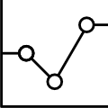
Exploratory Data Analysis

Slide 5
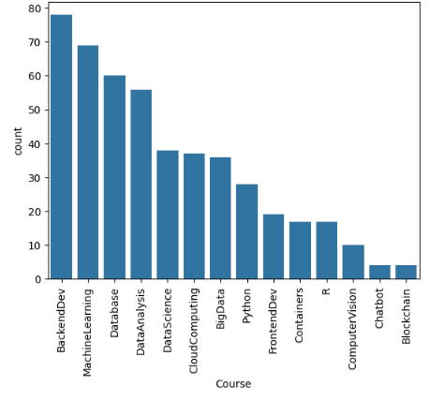
Course counts per genre
In the process of analysing course genres, the dataset was examined to identify the popularity of various online course topics.
By calculating course counts for each genre and visualizing the results through a bar chart and table, insights into the most sought-after subjects were revealed.
The analysis revealed that Backend Development, Machine Learning, and Database courses are among the most prevalent, while Blockchain and Chatbot courses are less common.
This exploration provides valuable insights for learners and educators seeking to understand current trends in online education.
The x-axis represents the course genre and the y-axis presents the course count per genre.
the barchart of course counts per genre

Slide 6
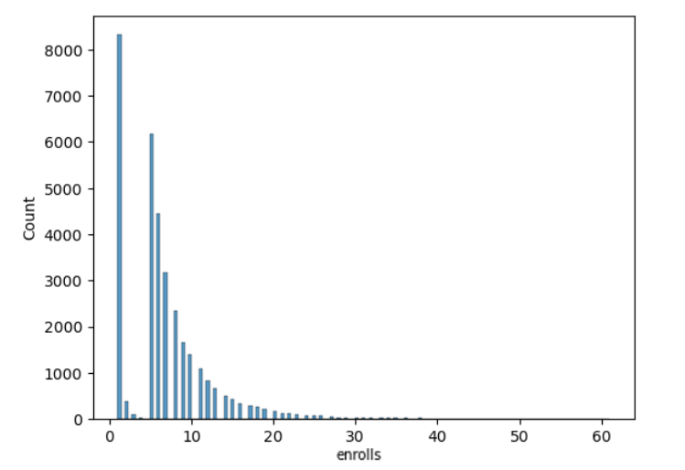
Course enrollment distribution
The analysis of course enrolment data aimed to uncover patterns in user engagement and interactions with online courses. The dataset contains 233,306 enrolment records from 5,000 unique users. Upon aggregating the rating counts, it was observed that most users provide only a few ratings, while a smaller group rates more frequently. The distribution of these ratings highlights differences in user engagement, offering valuable insights that can help refine course offerings and improve the overall user experience.

Slide 7
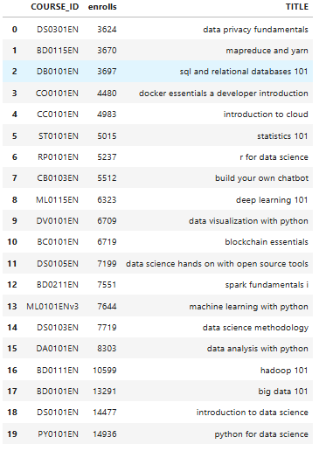
20 most popular courses
The goal of this task was to identify the top 20 most popular courses based on enrolment counts. By aggregating the data using the groupby() and size() methods in Pandas on the item column, the courses were ranked by their enrolment counts. The sort_values() method was then applied to order the courses, and the slice() method was used to extract the top 20 courses. Finally, the merge() method in Pandas was utilized to join the resulting list with the course details, providing insights into the most popular courses and learner preferences on the platform.

Slide 8
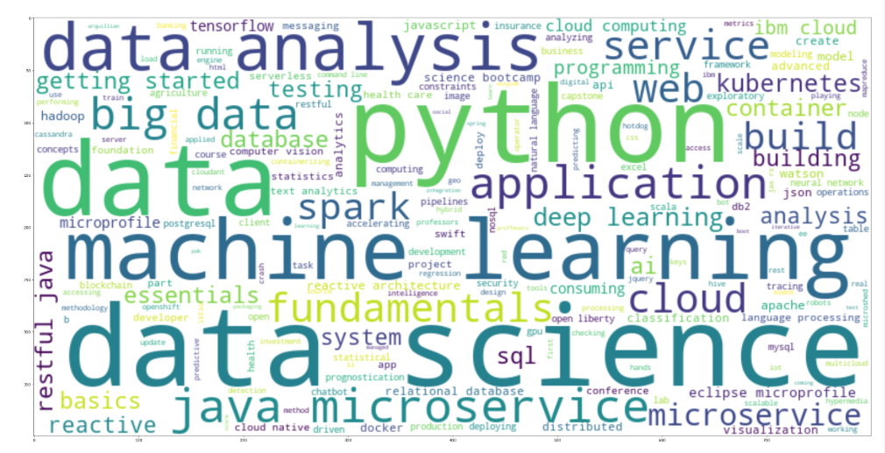
Word cloud of course titles
A word cloud is a visual representation of text data where the frequency of each word is depicted by its size, with more frequent words appearing larger.
From the obtained word cloud we can infer an general understanding that the courses in the dataset are focused on demanding IT skills.
The libraries used to generate the word cloud are NLTK, WordCloud, Matplotlib.
The Key Steps involved are:
Install and import required libraries.
Define text and split into words.
Remove standard and custom stopwords.
Reconstruct filtered text.
Generate and plot the word cloud.
Word Cloud created based on course title

Slide 9

Content-based Recommender System using Unsupervised Learning
Cluster2
Cluster1

Slide 10
Flowchart of content-based recommender system using user profile and course genres
YES
These courses are enrolled by the user. Hence add these course to the recommendation
User profile
Check
Score > Threshold ?
Dot Product
Course Genres
No
These courses are unavailable or has no match with the user. Hence don’t recommend these courses

Slide 11
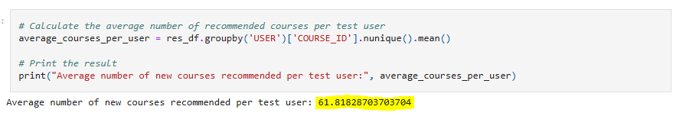
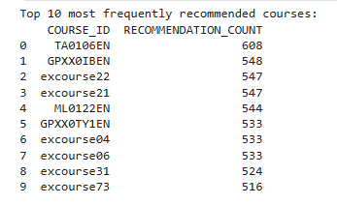
Evaluation results of user profile-based recommender system
Place your hyper-parameter settings, such as recommendation score or course similarity thresholds, etc
During our discussion, we decided on a recommendation score threshold of 10.0 to exclude low-scoring recommendations. This threshold helps us identify which courses are relevant enough to suggest to users. Additionally, we might have tweaked other hyper parameters, such as feature representation methods or similarity metrics, while implementing the recommender system.
On average, how many new/unseen courses have been recommended per user (in the test user dataset)
We calculated the average number of new courses recommended per user in the test dataset, which measures the coverage and diversity of the recommender system. The average was found to be around 61.82 courses per user.
What are the most frequently recommended courses? Return the top-10 commonly recommended courses across all users
The table lists the top 10 most recommended courses, with each row showing the COURSE_ID and its RECOMMENDATION_COUNT. Recommendations are based on user profiles and course genre relevance, with more relevant courses being recommended more often.

Slide 12
Flowchart of content-based recommender system using course similarity
YES
Recommend the course 1 if user had course 2 in his recommendation list and vice-versa.
Check
result > Threshold ?
Course 1
Similarity matrix calculation using cosine, Euclidean,etc
Course 2
No
Don’t Recommend the course 1 if user had course 2 in his recommendation list and vice-versa.

Slide 13
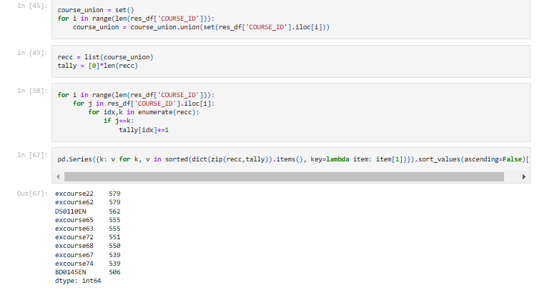
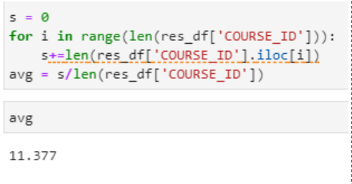
Evaluation results of course similarity based recommender system
Your hyper-parameter settings, such as a score or similarity threshold
The hyper-parameter setting for generating recommendations in the course similarity based recommender system was a similarity threshold of 0.6. This threshold determined the level of similarity required between courses for them to be recommended to users.
What are the most frequently recommended courses? Return the top-10 commonly recommended courses
On average, how many new/unseen courses have been recommended per user (in the test user dataset)

Slide 14
Flowchart of clustering-based recommender system
normalized user profile features
Clustering Model
Get all courses belonging to cluster
Grouped Users
For each user get cluster label
Find unseen courses
Make recommendation

Slide 15
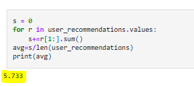
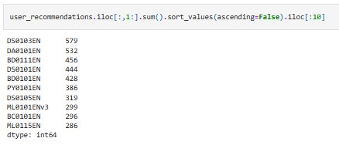
Evaluation results of clustering-based recommender system
Your hyper-parameter settings, such as a score or similarity threshold
We optimized hyperparameters by using the elbow method to determine the ideal K-means clusters and selecting PCA components that explained over 90% of the variance, ensuring effective user grouping and minimal information loss.
On average, how many new/unseen courses have been recommended per user (in the test user dataset)
What are the most frequently recommended courses? Return the top-10 commonly recommended courses

Slide 16

Collaborative-filtering Recommender System using Supervised Learning

Slide 17
Flowchart of KNN based recommender system
User Interaction Matrix
Similarity Matrix
Split train and test data
Train model
Sciket Surprise
Make prediction

Slide 18
Flowchart of NMF based recommender system
Use NMF
Similarity by matrix product
User interaction matrix
Splitting of data into 2 dense matrix U,I
Prediction making

Slide 19
Flowchart of Neural Network Embedding based recommender system
User one hot encoded vector
Embedding
Neural network
score
Item one hot encoded vector

Slide 20
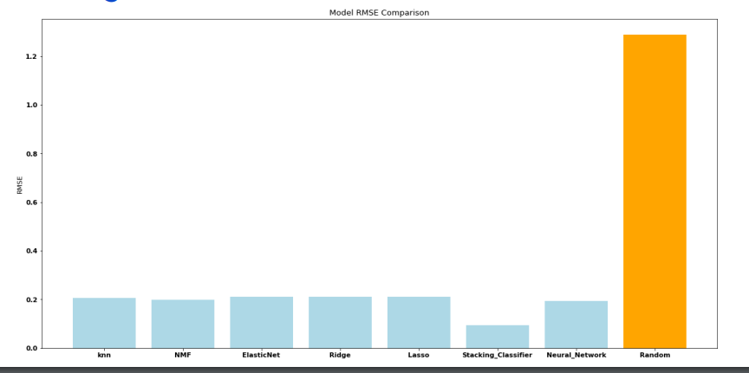
Compare the performance of collaborative-filtering models

Slide 21

Recommender System Development:
Developed a recommender system combining collaborative filtering and supervised learning techniques.
Aims to facilitate the discovery of new courses and optimize personalized learning paths for users.
Impact on Student Engagement:
The system is designed to attract more students and enhance their learning experience by recommending relevant courses.
Key Insights from Data Analysis:
Course Genres: Explored a wide variety of course genres, with backend development, machine learning, and databases emerging as the most popular based on enrolment counts.
User Behaviour: Analysis of course enrolments revealed that many users completed courses, rather than just auditing them, indicating higher engagement.
Top Courses: Data-related courses like Python for Data Science, Introduction to Data Science, and Big Data 101 were among the most popular, reflecting the growing demand for skills in data analysis and machine learning.
Optimizing Course Offerings:
The findings stress the importance of offering diverse courses to cater to varying learner interests.
Data-driven insights help in optimizing course offerings, leading to enhanced user engagement.
Business Impact:
Increased usage of the recommender system is expected to encourage students to explore a broader range of courses, resulting in higher platform revenue for Coursera.

