Slide 1



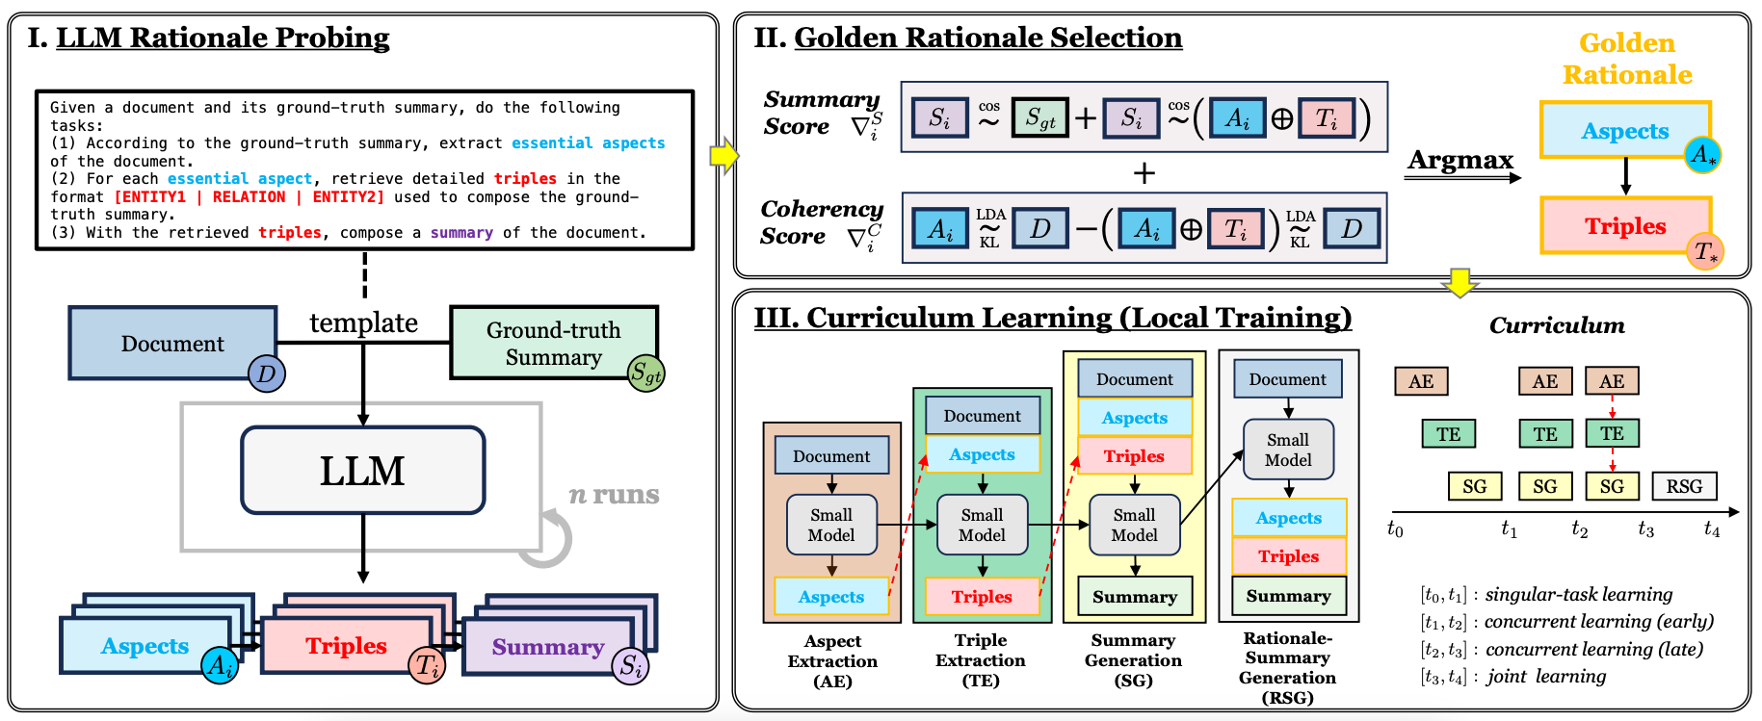
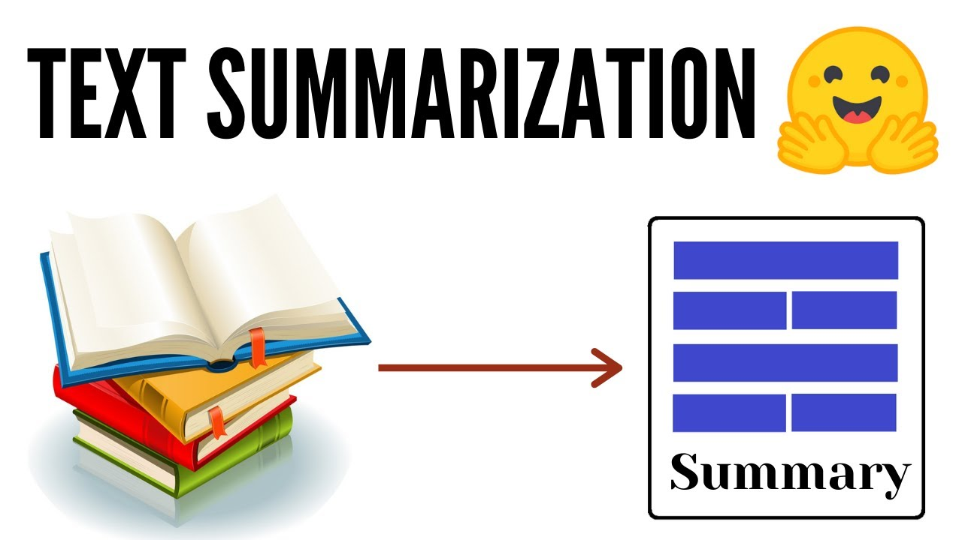
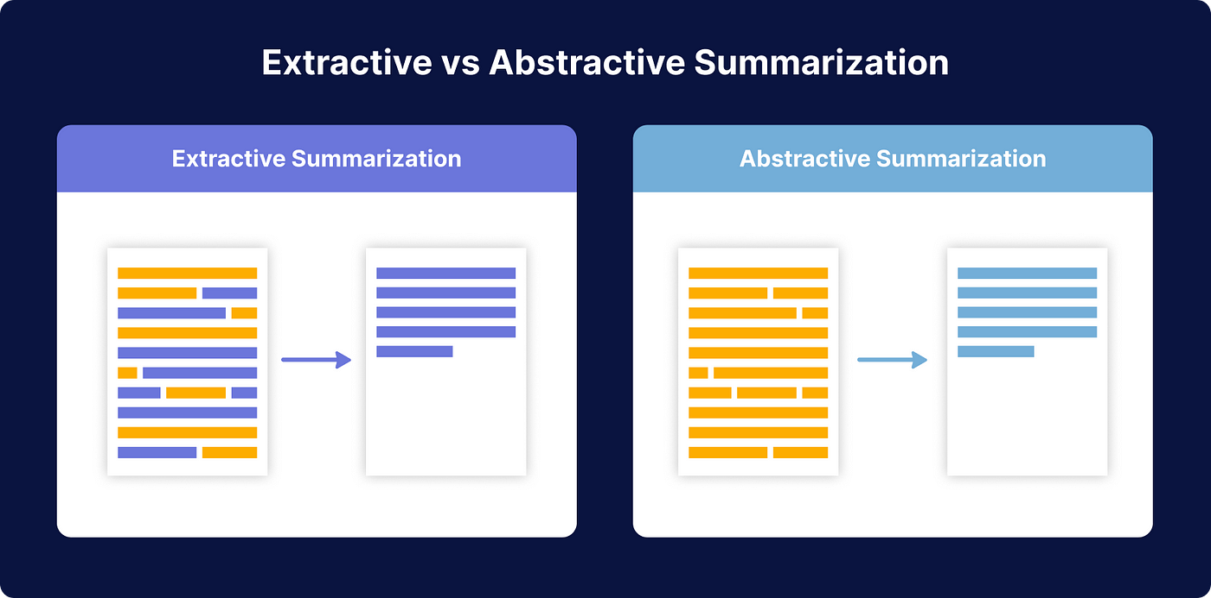



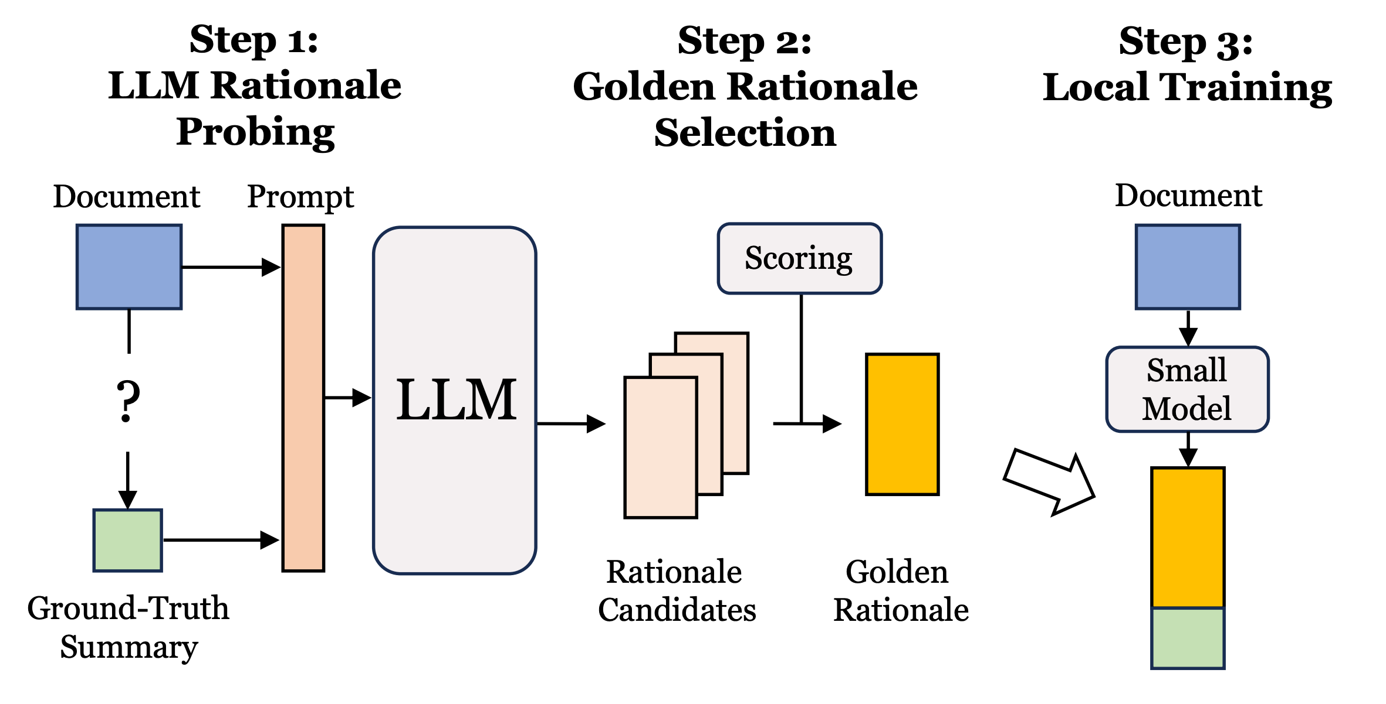
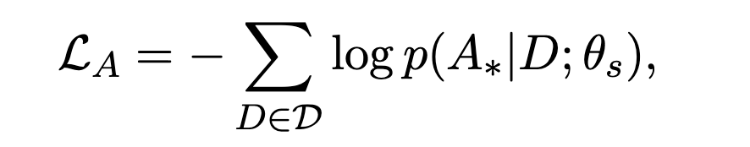
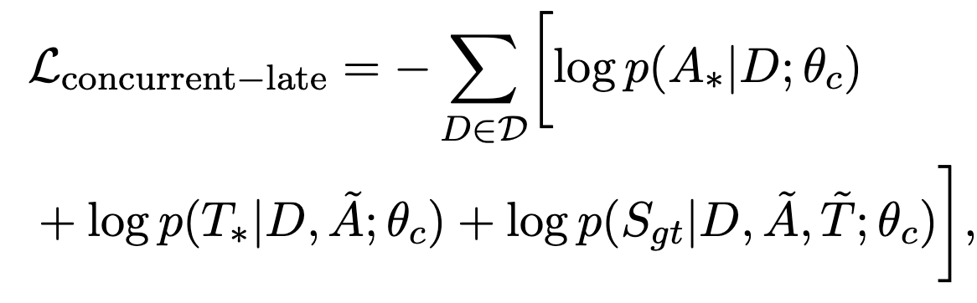
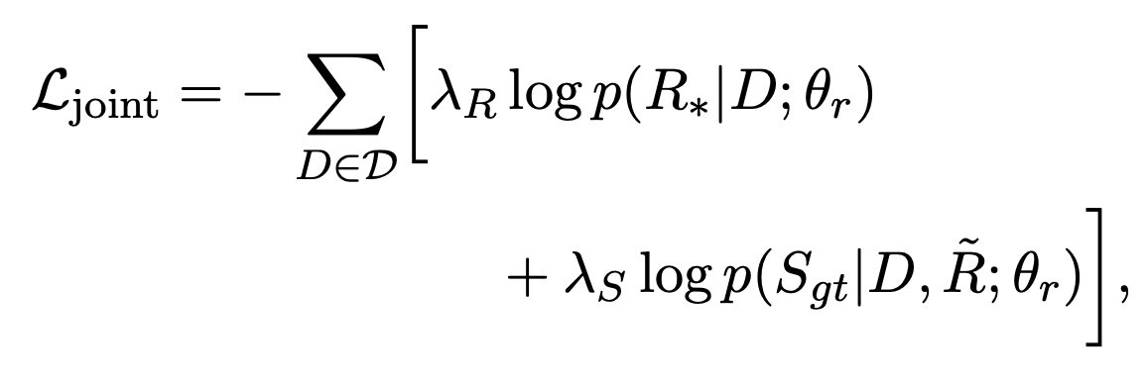
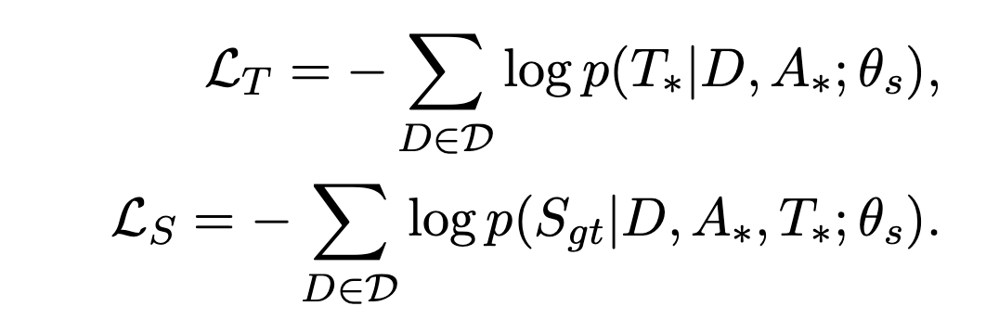
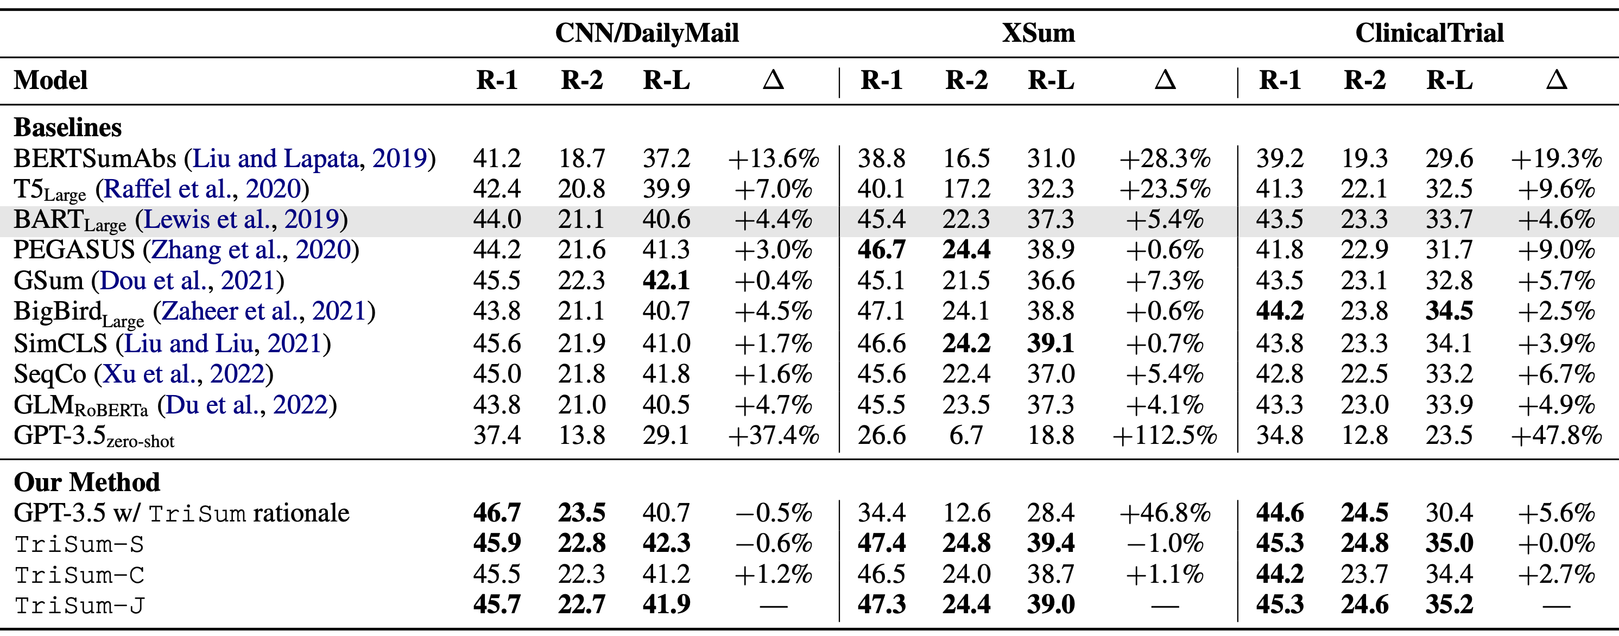
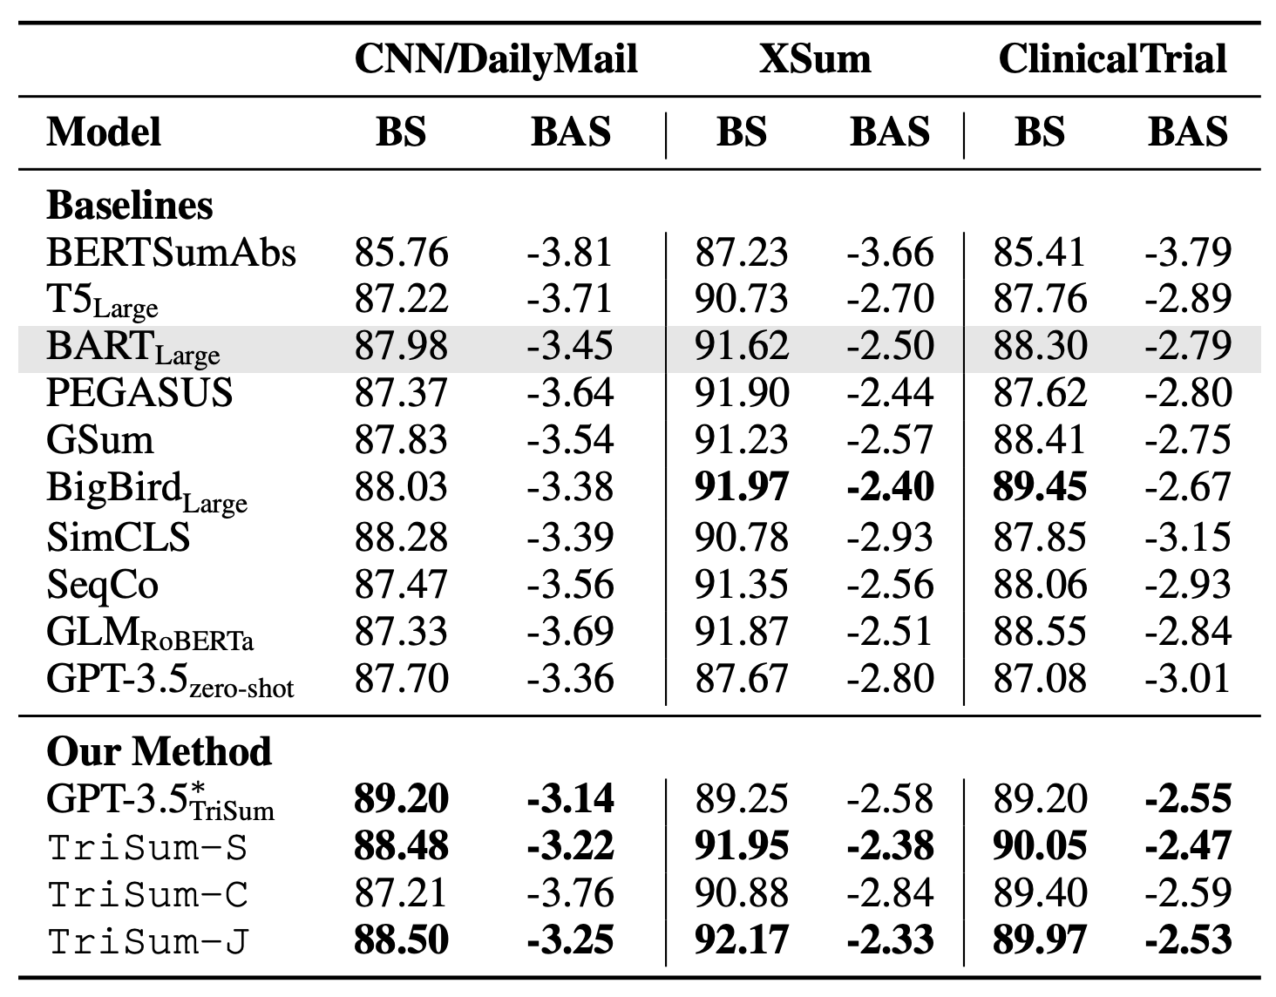
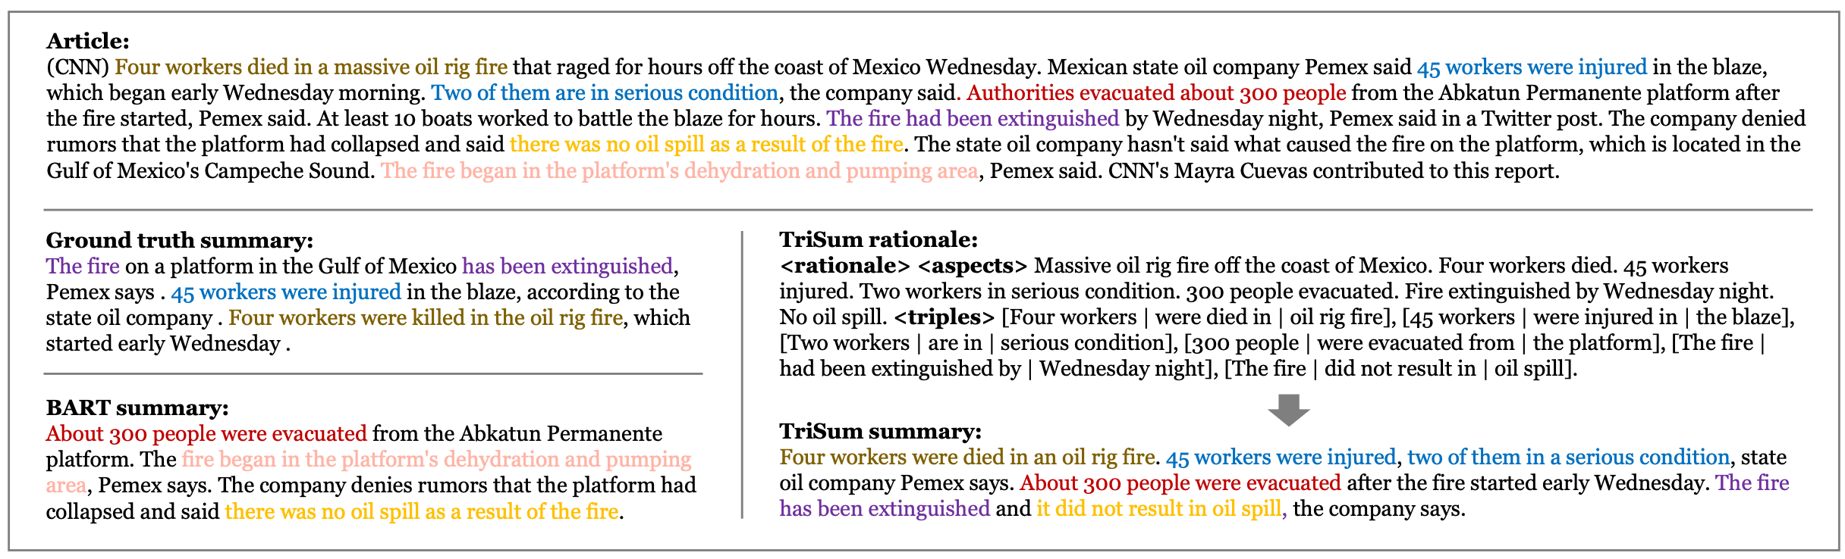
TriSum: Learning Summarization Ability from Large Language Models with Structured Rationale
NAACL’24
Pengcheng Jiang^{[1]}, Cao Xiao^{[2]}, Zifeng Wang^{[1]}, Parminder Bhatia^{[2]}, Jimeng Sun^{[1]}, Jiawei Han^{[1]}
[1] University of Illinois Urbana-Champaign [2] GE HealthCare
Introduction
Methodology – TriSum
In the era of information overload, text summarization has become a crucial tool for quickly grasping the essence of lengthy documents.
Our focus: Abstractive Summarization
Pros: Cost-effective for fine-tuning;
Cons: Low factualness and interpretability
Small PLMs (BERT/BART/T5)
TriSum Framework
Pros: High interpretability with rationale;
High NLU capabilities.
Cons: Costly for fine-tuning
Step 1 – LLM Rationale Probing:
For each pair of <document, ground-truth summary>, we let the LLM generate essential aspects, relationship triples, and a summary, as a structured rationale.
Step 2 – Golden Rationale Selection:
Summary Score: evaluates the semantic similarity between the generated summary and the ground truth. Coherence Score: measures how well the aspects and triples align with the document's latent topics.
Step 3 – Local Training:
We employ a curriculum learning strategy, starting with simpler tasks to the more complex task of a rationale-summary generation.
LLMs
(e.g., GPT, LLaMA)
Can we train a small model to learn the interpretable summarization ability from LLMs?
Experiments & Results
ROUGE score performance
BERTScore/BARTScore performance
Findings:
On average, TriSum-J consistently outperformed state-of-the-art baselines, achieving improvements of 4.5%, 8.5%, and 7.4% in ROUGE scores, respectively.
TriSum-generated rationales also enhanced the performance of LLMs themselves (GPT-3.5 w/ TriSum’s rationale), showcasing the value of interpretable rationales.
Future Works
Adapting TriSum to other NLP tasks (e.g., QA, machine translation)
Generating richer rationales with graph representations or knowledge bases
Developing interactive, user-centric summarization systemsuser-centric experiences.
…
Thank you for your interest!
Please email pj20@illinois.edu for any questions.
An example of abstractive summarization of an article in CNN/DailyMail dataset. We use different colors to show the distinct topics in the article and summary.
The rationale provides a structured breakdown of the essential information, enhancing the interpretability of the summarization process.

