Slide 1
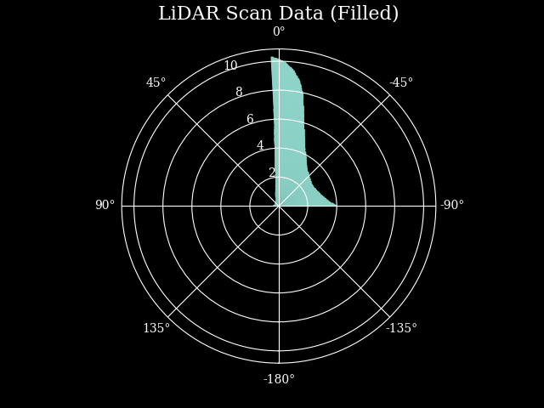
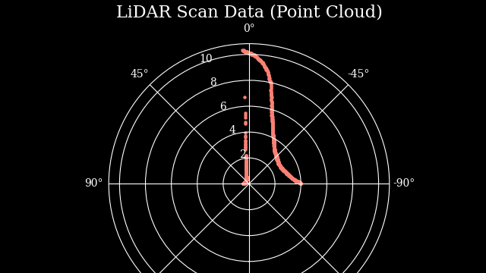
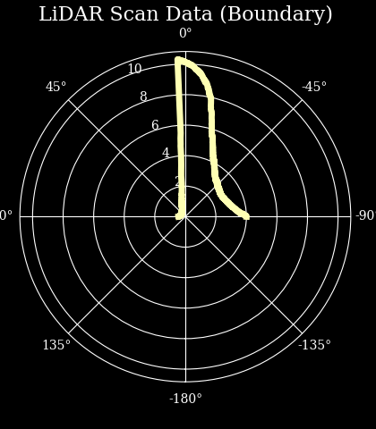

Reactive Methods
w/ RacingAI

Slide 2
Pull This Repo !!!
https://github.com/RacingAI/Reactive-Methods-Workshop

Slide 3
What is it?
Reactive
Consists of 2 main steps:
Find the longest safely traversable distance
Follow that line
Notes:
Explain what a reactive method is
Mention the two main steps of this algorithm
Onto next slide

Slide 4

What is it?
$$f(x)$$
Notes:
Explain what a reactive method is
Mention the two main steps of this algorithm
Onto next slide

Slide 5


What is it?
$$L$$
$$f(x)$$
$$\{θ, s\}$$
Notes:
Explain what a reactive method is
Mention the two main steps of this algorithm
Onto next slide

Slide 6
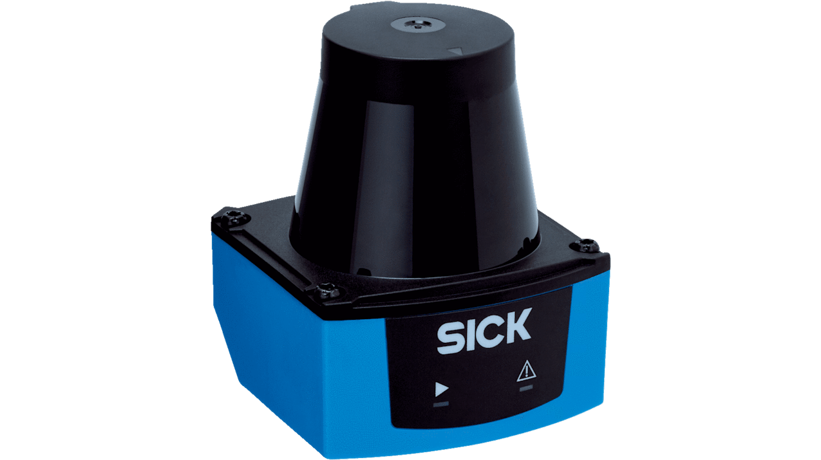
Longest Safely Traversable Distance
Get the LiDAR scans
from the sensors
Notes:
- This is pretty self explanatory………..

Slide 7
Longest Safely Traversable Distance
Get the LiDAR scans from the sensors
Notes:
- Mention that this is an example dataset of LiDAR scans that we have plotted. Negative angles are to the right of the car and positive angles are left of the car

Slide 8
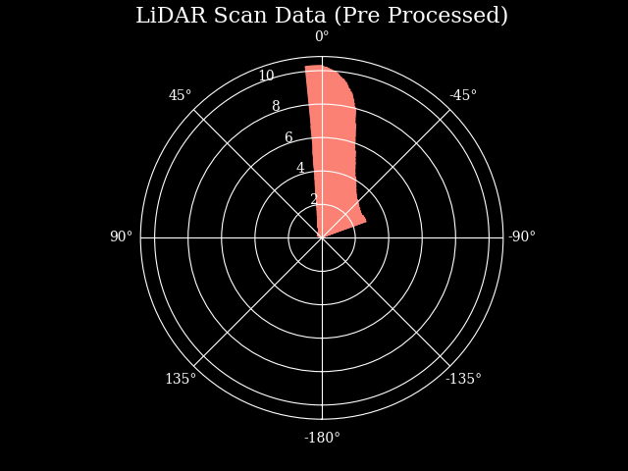
Longest Safely Traversable Distance
Remove the LiDAR scans from behind you and limit your FOV
Notes:
This is officially the first step of the algorithm, They don’t need to worry about removing LiDAR scans from behind the car as the gym environment only gives scans from -90->+90deg
They do need to worry about limiting the FOV. Talk about why this is needed and the issues that may arise from limiting it too much
Onto next slide

Slide 9
Longest Safely Traversable Distance
What happens if we only travel the longest distance?
Notes:
Slides 9->10 deal with the reason of why we need this algorithm after all and why we can’t just choose the longest LiDAR point and drive.
Onto next slide

Slide 10
Longest Safely Traversable Distance
What happens if we only travel the longest distance?
Notes:
Notice the collision with the wall
Onto next slide

Slide 11
Longest Safely Traversable Distance
What happens if we only travel the longest distance?
Width
Length
Notes:
Mention that our car has physical dimensions and hence just choosing the longest scan doesn’t work
Mention this algorithm only depends on the width of the car
Onto next slide

Slide 12
Longest Safely Traversable Distance
Judging the safe distance by finding disparities
Notes:
This is the beginning of an example for finding a disparity
Mention what a disparity is: “A disparity occurs when the difference between two successive LiDAR scans is greater than some threshold we set
Onto next slide

Slide 13
Longest Safely Traversable Distance
Judging the safe distance by finding disparities
Notes:
Here is two example LiDAR scans
Onto next slide

Slide 14
Longest Safely Traversable Distance
Judging the safe distance by finding disparities
Notes:
Just showing the scans side by side
Onto next slide

Slide 15
Longest Safely Traversable Distance
Judging the safe distance by finding disparities
Notes:
Orange line shows the difference between the two lines
Onto next slide

Slide 16
Longest Safely Traversable Distance
Judging the safe distance by finding disparities
3
5
2
Notes:
Take the example numbers of 2 and 5, difference of 3
Threshold for this example is 2
So, LiDAR scan “5” is a disparity
Onto next slide

Slide 17
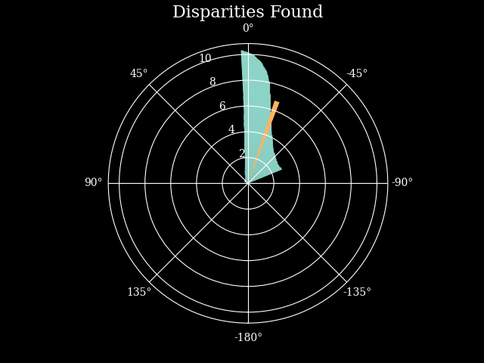
Longest Safely Traversable Distance
Judging the safe distance by finding disparities
Notes:
- Going back to the LiDAR scans we started with at the beginning of the workshop
- Just remind them that negative angles are turning right, and positive angles are turning left.
- Maybe ask the audience to interpret this disparity. Ie in this case it would mean that there is a wall/obstacle to the left of the car, so we need to turn right

Slide 18
Longest Safely Traversable Distance
Can we just choose any disparity we find?
Notes:
Explain using this example why we cant just choose a disparity and drive in that direction

Slide 19
Longest Safely Traversable Distance
Can we just choose any disparity we find?

Slide 20
Longest Safely Traversable Distance
Can we just choose any disparity we find?
2.34
3.51
1.17

Slide 21
Longest Safely Traversable Distance
Can we just choose any disparity we find?
Notes:
Explain using this example why we cant just choose a disparity and drive in that direction

Slide 22
Longest Safely Traversable Distance
Can we just choose any disparity we find?
Notes:
Explain using this example why we cant just choose a disparity and drive in that direction

Slide 23
Longest Safely Traversable Distance
Extending the disparity
Notes:
For a pair of points (green, orange) around a disparity (red), we find the closer one
Cover enough LiDAR points with the closer distance to half the width of the car
Cover further distances with closer ones. Never overwrite closer distances with further ones
If the closer distance is to the left of the disparity cover left to right and vice versa. Here we cover left to right

Slide 24
Longest Safely Traversable Distance
Extending the disparity
Notes:
This is just explaining the covering
Ask the audience how they would find the angle, if they knew the red and green lengths
Specify that the red is HALF the width of the car

Slide 25



Longest Safely Traversable Distance
Extending the disparity
$$w$$
$$a$$
$$θ$$
Notes:
This is just explaining the covering
Ask the audience how they would find the angle, if they knew the red and green lengths
Specify that the red is HALF the width of the car

Slide 26



Longest Safely Traversable Distance
Extending the disparity
$$w$$
$$φ$$
$$a$$
$$x$$
$$θ$$
$$φ$$
Notes:
This is just explaining the covering
Ask the audience how they would find the angle, if they knew the red and green lengths
Specify that the red is HALF the width of the car

Slide 27










Longest Safely Traversable Distance
Extending the disparity
$$w$$
$$φ$$
$$x^{2}=a^{2}+w^{2}−2aw\cos{φ}$$
$$x$$
$$a$$
$$x=\sqrt{a^{2}+w^{2}−2aw\cos{φ}}$$
$$θ$$
$$φ$$
$$\frac{\sin{φ}}{x}=\frac{\sin{θ}}{w}$$
$$\frac{w\sin{φ}}{x}=\sin{θ}$$
Notes:
This is just explaining the covering
Ask the audience how they would find the angle, if they knew the red and green lengths
Specify that the red is HALF the width of the car

Slide 28




Longest Safely Traversable Distance
Extending the disparity
$$w$$
$$φ$$
$$\frac{w\sin{φ}}{x}=\sin{θ}$$
$$x$$
$$a$$
$$θ$$
$$\sin^{−1}{\frac{w\sin{φ}}{x}=θ}$$
$$φ$$
$$\sin^{−1}{\frac{w\sin{φ}}{\sqrt{a^{2}+w^{2}−2aw\cos{φ}} }=θ}$$
Notes:
This is just explaining the covering
Ask the audience how they would find the angle, if they knew the red and green lengths
Specify that the red is HALF the width of the car

Slide 29
Longest Safely Traversable Distance
Extending the disparity
Notes:
Start of example for extending disparities
Red is the disparity. Orange is the further of the two distances around the disparity. Green is the closer one
Red dashed line shows the covering arc and the points needed to cover half the width of the car plus some safety percentage
Onto next slide

Slide 30
Longest Safely Traversable Distance
Extending the disparity
Notes:
Since the short distance is to the left of the disparity, we cover from left to right as shown.
Onto next slide

Slide 31
Longest Safely Traversable Distance
Extending the disparity
Notes:
Here we perform the same steps as before with the new disparity on the right.
We cover from right to left
Onto next slide

Slide 32
Longest Safely Traversable Distance
Extending the disparity
Notes:
- Now we can find the longest distance from these scans (one of the yellow lines) and be certain we won't hit any of the walls. Ie. We have found the Longest Safely Traversable Distance

Slide 33
Longest Safely Traversable Distance
Now what?
Notes:
- Now we can find the longest distance from these scans (one of the yellow lines) and be certain we won't hit any of the walls. Ie. We have found the Longest Safely Traversable Distance

Slide 34
Longest Safely Traversable Distance
Now what?
β
Notes:
Calculate the angle
Limit the angle to -+90deg

Slide 35
Longest Safely Traversable Distance
Then drive!!
Notes:
Calculate the angle
Limit the angle to -+90deg

Slide 36
What about speed?
Longest Safely Traversable Distance
Notes:
- This is pretty self explanatory………..

Slide 37

Where to go from here?
Virtual Competition
- November 2022
Physical Competition
- March 2023
Notes:
Virtual comp in November ()
Physical Comp in March
Make teams with your friends

Slide 38

Thank You
Follow us on our Instagram
@racing.ai
Contact us with any questions
racingai.contact@gmail.com

