Slide 1
OpenStack Identity Federation

Slide 2





Many thanks to:

Slide 3
Who are we?
Joe Savak – Rackspace Product Manager (°⍸°)
Brad Topol – IBM Distinguished Engineer ¯\_(ツ)_/¯
Jorge Williams – Rackspace Principal Architect ●~*
Steve Martinelli – IBM Software Developer, Keystone Core (╯°□°)╯ ┻━┻

Slide 4
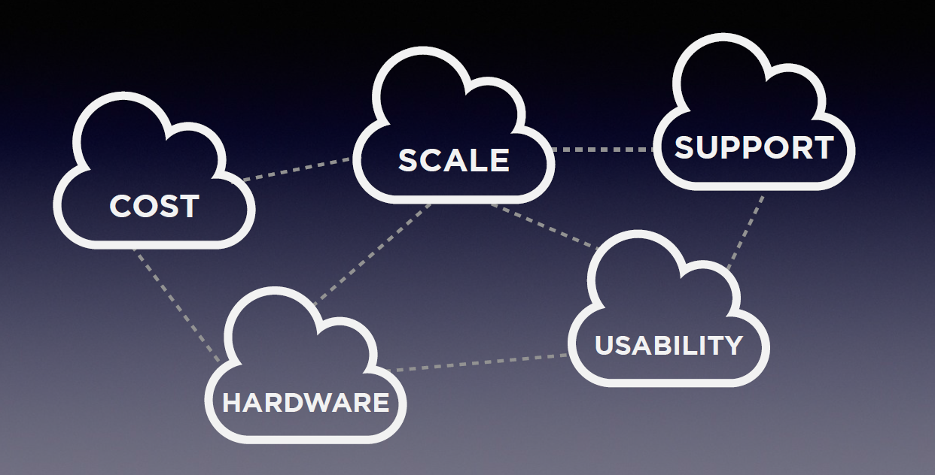

Slide 5
Federwhation?
The mechanisms to establish trusts between identity providers and OpenStack clouds enabling a user to:
    Securely access resources (servers, files, volumes, dbs. unicorns, etc)
    Across multiple endpoints provided in multiple authorized clouds
    With their single credential
    Maintained in a trusted identity provider
    Without having to provision additional identities or re-login all the time
    (ADFS, Tivoli Federated IdM, Shibboleth are other federated identity implementations)

Slide 6
Federwhytion?
1. Any time a new identity is provisioned, it is a security risk.
2. It is a burden on clients to deal with multiple tokens across multiple cloud service providers.
3. We spend too much time logging in or going through forget password workflows.
4. We spend too much time administrating identities in various service providers. (Imagine administration of a full university or enterprise with identities always in flux)
5. The best test of interoperability in the cloud is to enable one identity access across multiple clouds.
6. Removes a blocker to cloud brokering and multi-cloud workload management.

Slide 7
SAML, OpenID Connect, AbFab?
There are many federation protocols out there.
Each with their own pros & cons.
So keystone federation was made to be extensible to allow various protocol support.
SAML2 ← supported in icehouse, determined at HK summit to support this first. As part of icehouse, we use Shibboleth to avoid re-inventing the wheel for the SAML authentication handshake.
OpenID connect (based on OAuth2)← in the works, Juno
AbFab ← accepting pull requests.

Slide 8

The big picture – Icehouse – federation with identity providers
Via access
manager
Pre-reqs:
Keystone deployed as part of apache
and mod_shib enabled for SAML 2 handshake
  Many implementors use Apache already.
  Per Keystone core: Keystone is focusing on
  being a proxy instead of a provider
(3) SAML response
(4) Unscoped Token
(2) SAML
Response
(1) SAML
Request
(5) Scope token: Get
projects/domains
and request scoped token
Keystone 1
Acme identity
provider
Nova 1
Swift 1
  With your company credentials, you can access resources and execute APIs in an OpenStack
  cloud without having to provision a new identity for that cloud.
  Just keep using your company-issued identity!
  R2D2 could be:
              an access manager like OneLogin or NetIQ Access Manager
              A federation-enabled openstack client (using Enhanced Client or Proxy, possibly)
              both would need to speak the supported federation protocol for the cloud.

Slide 9
Let's talk Juno & beyond
Feedback wanted!
Detailed use cases are always welcome :)
Contribute back to the community!
  Review the API spec
  Propose an API spec
  Review the code
  Review the docs
  Create a guide
  Play with the code
  Test the code with your development environment
  Etc...
Federated Identity is easily one of the most visible blueprints the Keystone team has done in a while, as a community, let's make sure it's awesome!
https://blueprints.launchpad.net/keystone/+spec/keystone-to-keystone-federation

Slide 10
The big picture – Juno & beyond -
Federation with service providers
(8) decode
token origin
(6) Create server using
Token from keystone1
Keystone 2
(3) SAML response
(4) Unscoped Token
(11) Token
Valid
(10) Federation Response
(9) Federation
Request
(via SAML or
other protocol)
(5) Scope token: Get projects/domains
and request scoped token
(2) SAML
Response
(1) SAML
Request
(7) Validate
token
Nova 2
Acme identity
provider
Keystone 1
  With your company credentials, you can access
  resources and execute APIs in many OpenStack
  clouds without having to provision a new
  identity for each cloud
  And – without having to know about the different
  Federation protocols that each cloud supports
Nova 1
Swift 1

Slide 11
Juno & beyond
Wait... decode token??
decode
token origin
Keystone 2
A federated token needs to include information about where the originating authentication occurred. This is needed for keystone to validate the asserted identity and understand what access the identity should have.
1 potential solution building off of what is supported in icehouse:
Token metadata includes: {originating-identity-provider aka issuer}/{protocol}/{subject}
Need to see how this works with PKI.
Allows auditing support across multiple clouds!
Potentially visible by emitting CADF events

Slide 12
Juno & beyond
Wait – how do clouds trust each other?
I trust cloud1 as an identity provider
So when they say that the user was
authenticated, I verify it was them saying
that and then believe them.
I support nova.
It's here:
https://nova2.cloud2.com/
CLOUD 2
Keystone 2
Nova 2
I trust cloud2 as a service provider
So any identities authenticating
through me should be given
Cloud 2 endpoints
I support nova and swift.
They are here:
https://nova1.cloud1.com/
https://swift1.cloud1.com/
CLOUD 1
Keystone 1
Nova 1
Swift 1
Trusts are setup out of band, during a provisioning process where public keys are exchanged between two (or more) parties.
One service catalog is returned containing all accessible endpoints across clouds when a user authenticates

Slide 13




Juno & beyond
The big picture – Putting it all together
Federation with identity providers & service providers
Keystone 2
OpenID-connect
IBM TFIM
Nova 2
Acme identity
provider
Keystone 1
SAML
Keystone 3
Microsoft
AD
AbFab
Nova 1
Swift 1
Swift 2
Keystone 4
No client changes
needed to
get federated access
Trove 1

Slide 14

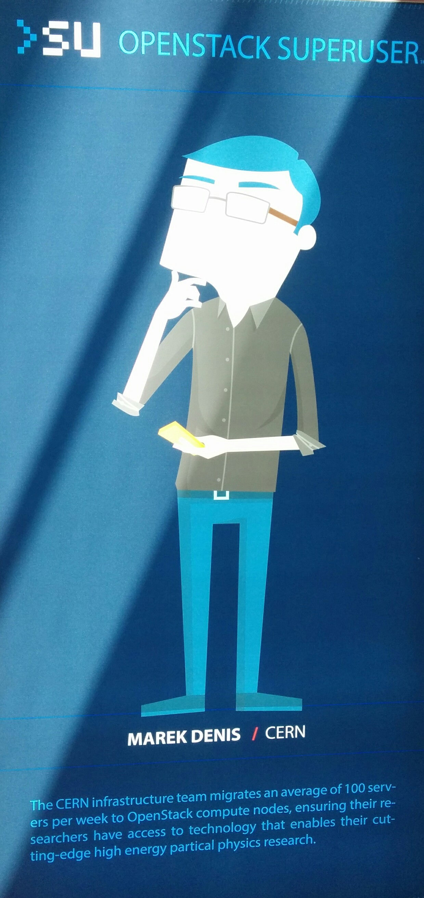
What was delivered in Icehouse?
Officially, from the Icehouse release notes:
  “The OS-FEDERATION extension allows Keystone to consume federated authentication via an Apache module for multiple Identity Providers, and mapping federated attributes into OpenStack group-based role assignments” – Dolph Mathews (Keystone PTL)
Outline:
  New Keystone OS-FEDERATION APIs
    Identity Providers
    Protocols
    Mappings
  Motivation for Mappings
    Setting up OpenStack Groups
    SAML Assertions
    Creating a Mapping
  Getting In!
    Requesting an unscoped token
    Listing available resources
    Requesting a scoped token
~=

Slide 15
New Keystone OS-FEDERATION APIs
Identity Providers: /OS-FEDERATION/identity_providers/{idp_id}
  An Identity Provider is a third party service that is trusted by the Identity API to authenticate identities.
  Register SAML Identity Providers such as ADFS or Tivoli Federated Identity Manager.
  {
  "identity_provider": {
  "description": "Stores ACME identities",
  "enabled": true,
  "id": "ACME",
  }
  }
  description (string) - Describes the identity provider.
  enabled (boolean) - Indicates whether this identity provider should accept federated authentication requests.
  id (string) - User-defined unique id to identify the identity provider.

Slide 16
New Keystone OS-FEDERATION APIs
Protocols:
/OS-FEDERATION/identity_providers/{idp_id}/protocols/{protocol_id}
  A Protocol entry contains information that dictates which mapping rules to use for a given incoming request. An IdP may have multiple supported protocols.
  Currently, only the SAML 2.0 federation protocol is supported. However, the framework is extensible to support other federation protocols, i.e.: OpenID, WS-Federation, SAML 1.0.
  Identity Providers can communicate in many protocols, so associate an Identity Provider with a Mapping, based on a protocol.
  {
  "protocol": {
  "id": "saml2",
  "mapping_id": "xyz234",
  }
  }
  mapping_id (string) - Indicates which mapping should be used to process federated authentication requests.
  id (string) - User-defined unique id to identify the protocol.

Slide 17
New Keystone OS-FEDERATION APIs
Mappings: /OS-FEDERATION/mappings/{mapping_id}
    A mapping is a set of rules to map federation protocol attributes to Identity API objects. An Identity Provider can have a single mapping specified per Protocol. A Mapping is simply a list of rules.
    A mapping is a method to translate remote attributes (from an Identity Provider) to local attributes (Keystone entities).
    Mappings are created as a top level resource so as to enable re-use between Identity Providers.
{
"mapping": {
"id": "ACME_MAP",
"rules": [...],
}
}
    rules (list) - Each object contains a rule for mapping attributes to Identity API concepts. A rule contains a remote attribute description and the destination local attribute.
    id (string) - User-defined unique id to identify the mapping.
More on this soon!

Slide 18
Motivation for Mapping
Setting the scene:
  Classic Keystone, does user stevemar, have role developer, on project services?
    Or does the requesting user belong to group that has role developer, on project services?
  Admin means something different to CNN than it does to Coca Cola Co.
    Neither mean anything in Keystone for federated users.
Identifying the problem:
  Federated users do not exist in Keystone, they exist on an Identity Provider.
  An Identity Provider will only return attributes related to an identity.
  We don't have a solution for mapping what an IdP sees to what Keystone knows.
Finding a solution:
  Create a mapping to handle the translation and establish relationships between Keystone attributes and Identity Provider attributes.
  Initially, a mapping would be a 1:1 relationship between Identity Provider attributes and Keystone groups.
  A federated user can authenticate with an Identity Provider, and be mapped to a Keystone group, and will inherit the roles from the group.

Slide 19
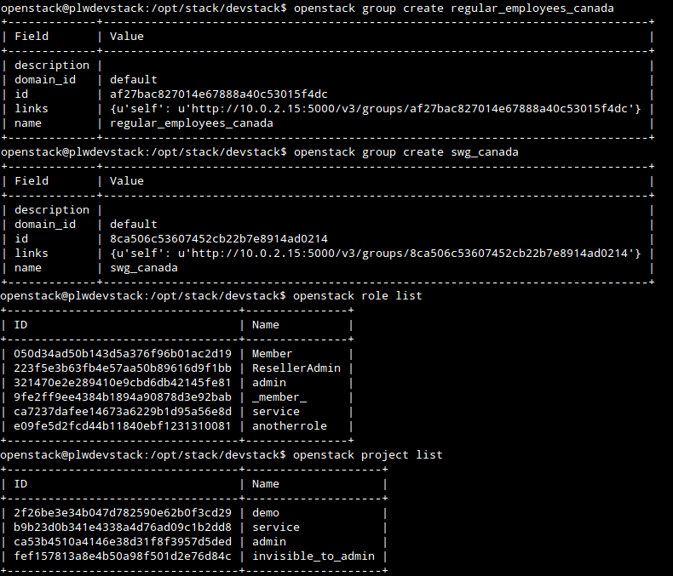

Setting up OpenStack for Groups
  Create groups, that have a role(s) on a project or domain.
  Can be done via CLI for convenience.
Keystone Group IDs:
regular_employees_canada
  (af27ba … 15f4dc)
swg_canada
  (8ca506 … ad0214)
Keystone groups have a globally unique id
Associate groups with a role on a project.
(Roles and projects listed on left side)

Slide 20
SAML Assertions
  An assertion from a valid Identity Provider, is an indication that the user has been authenticated.
  A snippet from a SAML assertion is seen below, containing user and group information (from an IdP perspective).
  The 'idp_group' in the SAML attributes are the IdPs method of assigning groups, these need to be mapped back to the groups that were created in the previous step.
<saml:AttributeStatement>
<saml:Attribute Name="subject">
<saml:AttributeValue xmlns:xs="http://www.w3.org/2001/XMLSchema"
xmlns:xsi="http://www.w3.org/2001/XMLSchema-instance"
xsi:type="xs:string"
>stevemar</saml:AttributeValue>
</saml:Attribute>
<saml:Attribute Name="idp_group">
<saml:AttributeValue xmlns:xs="http://www.w3.org/2001/XMLSchema"
xmlns:xsi="http://www.w3.org/2001/XMLSchema-instance"
xsi:type="xs:string"
>IBM Regular Employees Canada</saml:AttributeValue>
</saml:Attribute>
<saml:Attribute Name="idp_group">
<saml:AttributeValue xmlns:xs="http://www.w3.org/2001/XMLSchema"
xmlns:xsi="http://www.w3.org/2001/XMLSchema-instance"
xsi:type="xs:string"
>SWG Canada</saml:AttributeValue>
</saml:Attribute>
</saml:AttributeStatement>
Keystone Group IDs:
regular_employees_canada
  (af27ba … 15f4dc)
swg_canada
  (8ca506 … ad0214)
IdP Group attributes:
IBM Regular Employees Canada
SWG Canada

Slide 21
Adding the Mapping
  Create a mapping to map the IdP attributes to Keystone attributes.
  Example request body sent to OS-FEDERATION/mappings/BP_MAP
{
"mapping": {
"rules": [
{
"local": [
{
"group": {
"id": "af27bac827014e67888a40c53015f4dc"
}
}
],
"remote": [
{
"type": "idp_group",
"any_one_of": [
"IBM Regular Employees Canada"
]
}
]
}
]
}
}
"rules": [
{
"local": [{
"user": {
"name": "{0}"
}}],
"remote": [{
"type": "subject"
}]
},
{
"local": [{
"group": {
"id": "8ca506c53607452cb22b7e8914ad0214"
}}],
"remote": [{
"type": "idp_group",
"any_one_of": [
"SWG Canada"
]}]
}
]
A mapping can have many rules!
In this case 'IBM Regular Employees Canada' maps to ID 'af27ba … 15f4dc'
IdP Group attributes:
IBM Regular Employees Canada
SWG Canada
Keystone Group IDs:
regular_employees_canada
  (af27ba … 15f4dc)
swg_canada
  (8ca506 … ad0214)
Mapped!

Slide 22
Getting In!
Setting the scene:
  The user is already authenticated through their own Identity Provider.
  Keystone is acting as a proxy, for them to have access to the cloud.
  In classic Keystone authentication, scope is defined as a project or domain the user wishes to access.
    That doesn't change with federation.
Identifying the problem:
  The federated user doesn't know anything about the resources (projects/domains) available.
Finding a solution:
  Create new APIs to allow a look-up
  How to get in.
    Initially retrieve an unscoped token.
    Look up which resources (projects/domains) are available.
    Retrieve a scoped token.
  Success!
Notes:
Thanks Brad,
Brad just finished talking about the mapping portion, and now I'll quickly talk about actually Getting in!
So let's level set a bit
the objective here is to actually get in, and start using keystone tokens
- what do we actually know -
we know the the user has already been authenticated by their IDP
we also know that in keystone, scope is defined as a project or domain
- problems with this -
how can a user initiate the authentication process with their IDP
and how can a federated user find out what projects or domains we have access to, if the user doesn't actually exist in the backend
- how did we solve this -
we created a couple new APIs to allow look-up
- initially, let's get an unscoped token
- look up what resources we can access
- get a scoped token

Slide 23
Getting In! - Part 1
Request an unscoped token:
/OS-FEDERATION/identity_providers/{idp_id}/protocols/{protocol}/auth
  Initiate the SAML handshake.
  A protected URL, as such a request made to the URL would be redirected to the Identity Provider, to start the SAML authentication procedure.
    Really controlled by Apache through mod_shib, for now.
  The returned token would look like a normal unscoped Keystone token, but with extra Federation content.
Response Header: `X-Auth-Token: wJalrXUtnFEMI/K7MDENG/bPxRfiCYEXAMPLEKEY`
Response Body:
{
"token": {
"methods": [
"saml2"
],
"user": {
"id": "stevemar",
"name": "stevemar",
"OS-FEDERATION": {
"identity_provider": "BP",
"protocol": "SAML",
"groups": [
{"id": "af27ba … 15f4dc"},
{"id": "8ca506 … ad0214"}
]
}
}
}
}
Standard Keystone token ID (PKI, UUID … )
Data from mapping output
Data about the IdP and protocol.
Data from mapping output
Notes:
So requesting an unscoped token
To kick off the SAML handshake process with their IDP, a user can simply perform a GET on the URL you see at the top.
The URL would have to be protected by the IDP using mod_shib and apache.
When the SAML handshake is finished, keystone actually determines which mapping to use against the SAML values.
The returned token should actually look like a regular unscoped keystone token, with a few minor differences
such as:
- the methods portion should say `saml2`
- and more importantly the group IDs that came back from the mapping are in the token.
this is important because we will use these values in the next step

Slide 24
Getting In! - Part 2
By using group memberships, a federated user can have access to a resource (project or domain).
Use the unscoped token returned from the previous step and call either:
List projects a federated user can access:
  GET /OS-FEDERATION/projects
OR
List domains a federated user can access:
  GET /OS-FEDERATION/domains
Output will be in the same format as GET /v3/projects or GET /v3/domains
Notes:
So now that we have an unscoped token, we want to actually scope it to a project or domain.
We can take advantage of a few new APIs
By making a call with the unscoped token to either of the URLs seen on the slide, we can get back a list of projects or domains that the user (and by default the group) can access.
The output will look just like the output from /projects or /domains

Slide 25
Getting In! - Part 3
Request a scoped token: /auth/tokens
Once a federated user knows the project or domain id, a request can be made to retrieve a token that has access to that specific project or domain.
The returned token should look like a regular Keystone token!
Response Body:
{
"token": {
"methods": ["saml2"],
"roles": [
{ "id": "050d34ad50b143d5a376f96b01ac2d19",
"name": "Member" },
{ "id": "ca7237dafee14673a6229b1d95a56e8d",
"name": "service" }
],
"expires_at": "2014-03-28T03:07:42.027427Z",
"project": {
"domain": {
"id": "default",
"name": "Default"
},
"id": "b9b23d0b341e4338a4d76ad09c1b2dd8",
"name": "service"
},
"user": {
"id": "joeuser%40ca.ibm.com",
"name": "joeuser@ca.ibm.com"
},
"issued_at": "2014-03-28T02:07:42.027492Z"
}
}
Request Body:
{
"auth": {
"identity": {
"methods": [
"saml2"
],
"saml2": {
"id": "wJalrXUtnFEMI/K7MDENG/bPxRfiCYEXAMPLEKEY"
}
}
},
"scope": {
"project": {
"id": "263fd9"
}
}
}
Our roles on the project, inherited from groups
Unscoped Token ID taken from Step 1
Taken from Step 2
SUCCESS!!!!
Notes:
Alright, so we have an unscoped token, and now know which project we want to access,
the last step would be to get a scoped token.
This call, is very similar to the regular Keystone calls to rescope a token,
Simply change the method to saml2, and add a scope value.
The resulting token will include the roles that the user (and group) has, and can be used just like a regular token!

Slide 26
Federation Design Sessions
Additional design sessions related to Federation:
Federation – TODAY! - 1:30 pm – 2:10 pm - B306
Locally managed identities – TODAY! • 2:20 pm – 3:00 pm - B306
User & Group IDs – TOMORROW! • 11:40 am – 12:20 pm - B306
Notes:
Thanks for coming to the presentation, we will have a few other talks about Federation in the Keystone design sessions today and tomorrow, please try to drop by! Any questions?

