Slide 1

REBOS

Slide 2
Overview
The application that we are proposing is a web-based application that will be used to shortlist the cream level candidates that will be apt for the company. This application takes into consideration, how sound-minded and what as a person he or she is capable of. The application mainly has 3 main stages, once a candidate goes through all 3 stages he or she is enlisted as one of the best candidates, in between the process candidates are sifted out depending on many criteria. The application is designed considering many criteria and scenarios, it is developed with an intention to provide a faster and efficient recruitment system.

Slide 3
Purpose
52% of talent acquisition leaders say that the most difficult part of their job is to shortlist the right candidate and 3% of candidates never hear back from a company after one touchpoint. On the flip side, it’s a challenge for employers to communicate well with all their candidates. For high volume recruiting, this would require communicating with thousands of candidates, in addition to a recruiter’s normal screening functions and other duties. Artificial Intelligence enabled software bots can definitely provide a solution for this problem.

Slide 4
Proposed solution
An Artificial Intelligence enabled software bot that would oversee the whole recruitment process, where the bot would communicate with each individual candidate, take in all required information, provide the candidate with a technical and personality based question to determine if he or she is the right cacndidate for the companey. Once decided the candidates shortlisted are proposed to the companey as the best candidates.

Slide 5
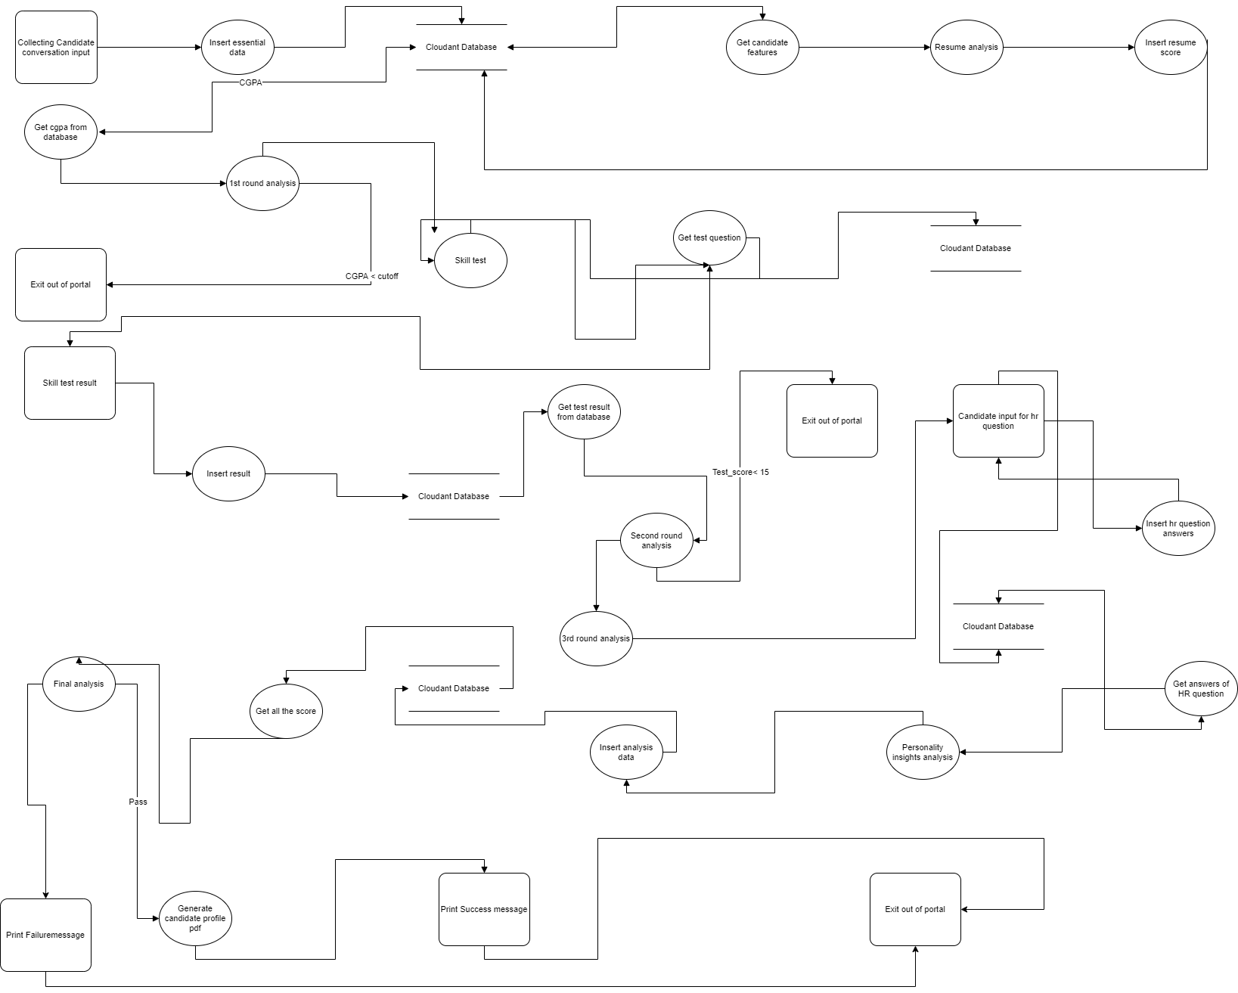
Block diagram

Slide 6
EXPERIMENTAL INVESTIGATIONS
The application has 3 stages where candidates are rejected. For every stage an extensive investigation was done to determine the right criteria to accept the students.
In the 1 st stage the application accepts candidates who’s cgpa in their graduation is more than a threshold fixed by the company.
In the 2 nd stage the candidates are provided with a technical test which he or she has to clear within 15 mins. A minimum score of 15 is required to pass the test.
In the 3 rd stage the candidates is required to answer some personality based questions, based on which his or her personality is evaluated using IBM Watson personality insight feature. On extensive investigation a range for all the personality traits are fixed.

Slide 7
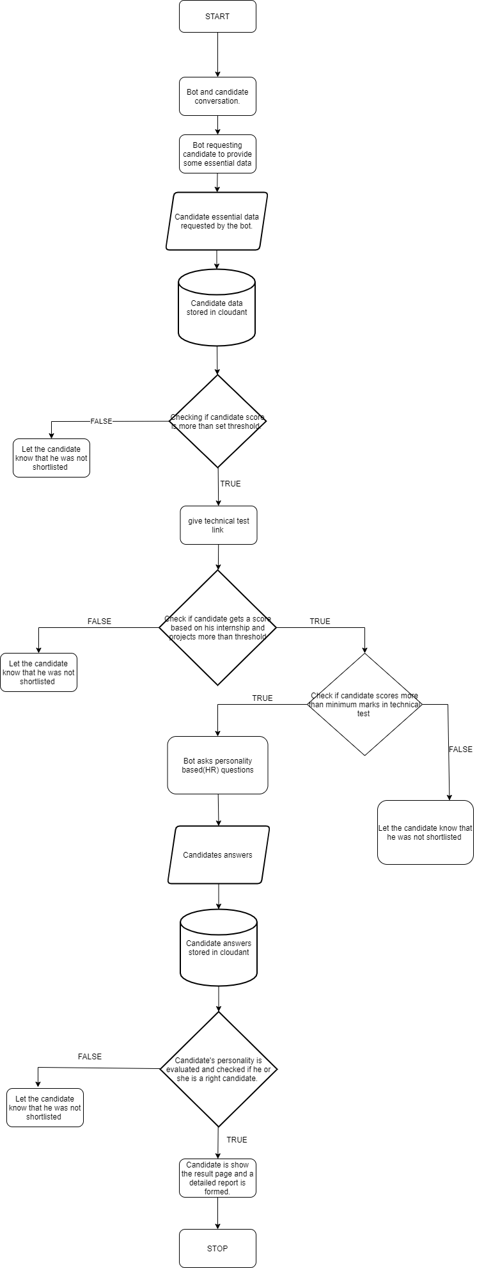
FLOWCHART

Slide 8
ADVANTAGES
● Increases the profitability of the companey.
● Saves time and resources for candidates and the companies.
● Reduce the time required for the whole process.
● Contactless and safe recruitment process.
● Gives a preoverview of the personality of the candidate.

Slide 9
Disadvantages
The personality insight feature of IBM Watson requires a minimum of 100 words to evaluate, despite having 100 words it sometimes does not give a good enough score.

Slide 10
CONCLUSION
There is a huge impact on the business as it provides a comprehensive analysis on the candidates coding skills and personality, it also checks if the candidate is a right fit for the company based on the criteria given by them. This system linearizes the wide pool of talented candidates and brings them to a single platform which saves a substantial amount of resources and time during the recruitment season, in these times of crisis this platform gives a contactless and safe environment to conduct the recruitment process with minimal human interactions , which will change the way recruitment process is conducted in the coming future.

Slide 11
BIBILOGRAPHY
https://www.youtube.com/watch?v=C8jxInLM9nM
https://cloud.ibm.com/docs/assistant?topic=assistant-api-client-get-context
https://cloud.ibm.com/apidocs/assistant/assistant-v2?code=python
https://cloud.ibm.com/apidocs/personality-insights
https://python-cloudant.readthedocs.io/en/stable/
https://blog.miguelgrinberg.com/post/the-flask-mega-tutorial-part-i-hello-world
https://www.youtube.com/watch?v=BUmUV8YOzgM&list=PLF2JzgCW6-YY_TZCmBrbO pgx5pSNBD0_L&index=1

