Slide 1
Episode01
Patterns&Practices Unity
(dependency injection container)
Konstantinos Bakopanos
http://www.DeadDevsSociety.com

Slide 2
E01: p&p Unity
Source code under:
http://bakopanos.googlecode.com/svn/trunk/blog/videos/
Requirements for this episode:
  VS2008 SP1
  Tortoise

Slide 3
E01: p&p Unity
A short introduction to Unity
Real world data entry application
Many simplifications in order to keep the demo simple

Slide 4
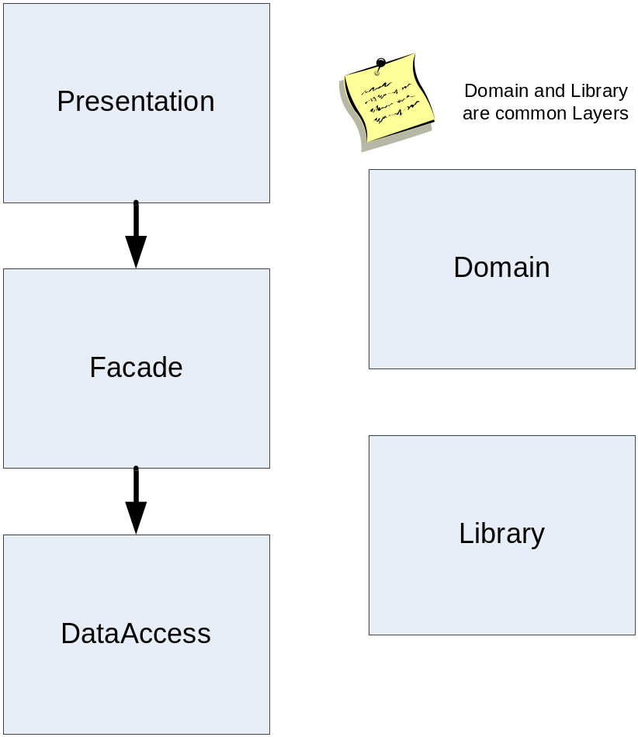
Layers Diagram

